Slide 1
ST03: viability and micronucleus follow-up
OT-15-S0064 | Selverant Therapeutics Inc | 07/14/2015
Dr N. Takamori | Osterquill Toxicology Inc

Slide 2
Repeat at lower exposure before attribution
40 test articles in the HepG2 viability screen.
Selverant Therapeutics Inc requested a lower-exposure repeat before attributing the micronucleus signal to genotoxicity.
The supplied aggregate table does not demonstrate a consistent concentration-related micronucleus increase.
Osterquill Toxicology Inc | Confidential 2

Slide 3
Investigation summary
Metric | Value
Project | OT-15-S0064
Client | Selverant Therapeutics Inc
Compounds tested | 40
Series / chemotype | Selverant aminoquinazoline series 03 (Aminoquinazoline)
Assays | In vitro cytotoxicity (HepG2), In vitro micronucleus
Turnaround (calendar days) | 40
Price | USD 42,300
Osterquill Toxicology Inc | Confidential 3

Slide 4
Exposure context and control-validity limits
Started 06/04/2015; interim discussion 06/24/2015; completed 07/14/2015.
HepG2 ATP-content endpoints at 24 h and 48 h provide viability context, not TK6 exposure measurements.
TK6 exposures: 3 h with and without S9; 24 h without S9.
Positive-control values and formal acceptance determinations are absent from this summary; consult original observation sheets before regulatory use.
No live-animal procedures are described in this package.
Osterquill Toxicology Inc | Confidential 4

Slide 5
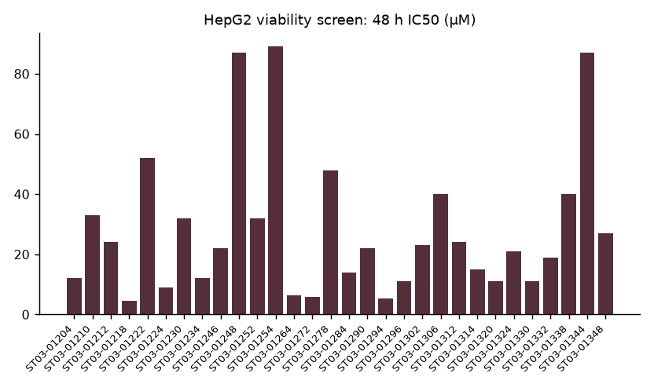
HepG2 viability screen: 48 h IC50 (µM)
Osterquill Toxicology Inc | Confidential 5

Slide 6
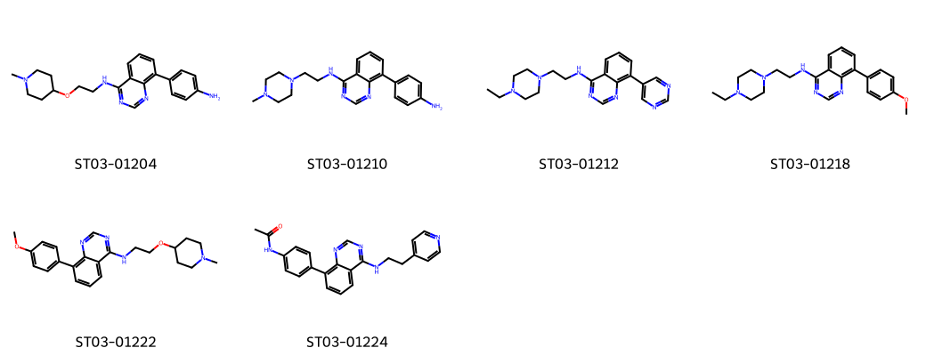
Representative test article structures
Osterquill Toxicology Inc | Confidential 6

Slide 7
Mammalian-cell micronucleus assessment: exposure and RPD
Treatment | Conc (µg/mL) | % MN cells | RPD (%)
3 h +S9 | vehicle | 1.09 | 100
3 h +S9 | 50 | 1.13 | 95
3 h +S9 | 100 | 0.81 | 89
3 h +S9 | 200 | 0.61 | 67
3 h -S9 | vehicle | 0.94 | 100
3 h -S9 | 50 | 0.85 | 92
3 h -S9 | 100 | 0.39 | 94
3 h -S9 | 200 | 0.70 | 88
24 h -S9 | vehicle | 0.73 | 100
24 h -S9 | 50 | 1.27 | 90
24 h -S9 | 100 | 0.27 | 87
24 h -S9 | 200 | 0.44 | 81
Osterquill Toxicology Inc | Confidential 7

Slide 8
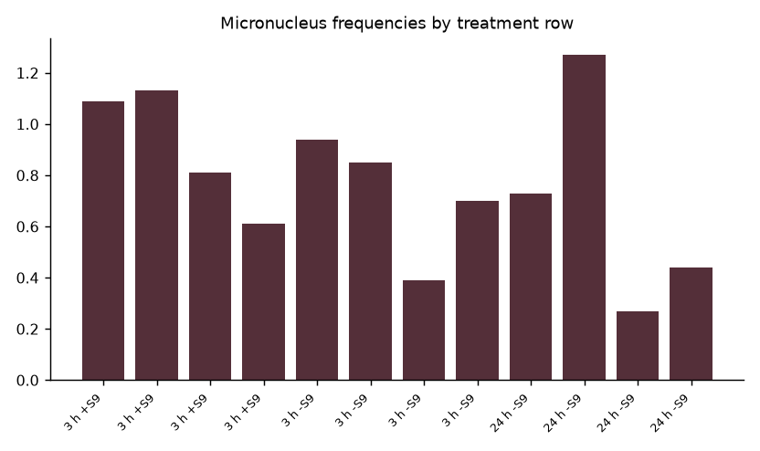
Micronucleus frequencies by treatment row
Osterquill Toxicology Inc | Confidential 8

Slide 9
Interpretation at the client discussion
RPD declines at the highest concentration in the S9-activated short exposure, qualifying the exposure interpretation.
Micronucleus frequencies vary around corresponding vehicles without a consistent dose-related increase.
The investigation narrative associates the concern with cytotoxic exposure; these aggregate rows alone do not establish that association.
Do not infer a definitive genotoxicity conclusion from this subset.
Osterquill Toxicology Inc | Confidential 9
Notes:
Kenji Morita should reconcile individual scoring and control-validity observations before the repeat is interpreted. HepG2 and TK6 responses are not interchangeable.

Slide 10
Lower-exposure repeat: decision and deliverables
Retain matched vehicle and positive controls under each exposure schedule.
Use closer concentration spacing below the cytotoxic region; report proliferation alongside micronucleus scoring.
Link test article identity, S9 status, exposure and scoring observations under OQ/2015/001043.
Dr N. Takamori will interpret the repeat with Kenji Morita; Lucia Moretti will review traceability and compliance scope.
The repeat is the next decision point, not an established resolution of the concern.
Osterquill Toxicology Inc | Confidential 10

