Slide 1
1. CVL tablet lot 3: stability review
Corvenlea Pharmaceuticals plc | WA/2020/313 | 03 Dec 2021
Notes:
Final readout. Protocol opened 30 Nov 2020; approved results completed 30 Nov 2021. LIMS accession WST-20-009708. The tablet lot remained within the agreed assay and impurity limits. Corvenlea used the report in its formulation transfer package.

Slide 2
2. Approved numerical evidence
Condition | Timepoint (months) | Assay (% LC) | Total impurities (%) | Result
25 °C/60% RH | 0 | 100.6 | 0.19 | Complies
25 °C/60% RH | 1 | 100.5 | 0.20 | Complies
25 °C/60% RH | 3 | 100.1 | 0.18 | Complies
25 °C/60% RH | 6 | 99.9 | 0.22 | Complies
25 °C/60% RH | 9 | 99.5 | 0.35 | Complies
25 °C/60% RH | 12 | 99.8 | 0.33 | Complies
30 °C/65% RH | 0 | 99.8 | 0.19 | Complies
30 °C/65% RH | 1 | 100.3 | 0.21 | Complies
30 °C/65% RH | 3 | 100.6 | 0.23 | Complies
30 °C/65% RH | 6 | 100.3 | 0.32 | Complies
30 °C/65% RH | 9 | 100.3 | 0.36 | Complies
30 °C/65% RH | 12 | 99.6 | 0.45 | Complies
40 °C/75% RH | 0 | 100.3 | 0.25 | Complies
40 °C/75% RH | 1 | 99.8 | 0.20 | Complies
40 °C/75% RH | 3 | 99.6 | 0.39 | Complies
40 °C/75% RH | 6 | 98.4 | 0.69 | Complies
Westravelle Analytical Ltd, a Tarnovell company | Confidential 2
Notes:
Source: E-001 / CVL_PULLS_AND_SUITABILITY_RESULTS_Rev03.xlsx, approved 30 Nov 2021. Assay is percent label claim; total impurities are area percent. Condition and pull interval remain part of each result identity. Individual impurities and water results are retained in the full sequence sheets.

Slide 3
3. Protocol identity and sample custody
Client: Corvenlea Pharmaceuticals plc
Protocol: WA/2020/313 | LIMS: WST-20-009708
Opened 30 Nov 2020; completed 30 Nov 2021
Dr L. Wu: stability lot and sample-custody reconciliation.
Storage condition and pull interval are carried with the stability lot on the batch card.
Sequence sheets retain the pack or presentation identity; results must not be pooled across storage conditions.
Tested interval: through 12 months.
Westravelle Analytical Ltd, a Tarnovell company | Confidential 3
Notes:
The accession links receipt, batch card, preparation and analytical sequence. This readout does not introduce new lot codes or replace approved sequence sheets.

Slide 4
4. HPLC method qualification
Parameter | Result | Acceptance
Linearity (r²) | 0.9994 | ≥0.999
Range (% nominal) | 50-150 | 80-120 minimum
Accuracy 80% (% recovery) | 100.0 | 98.0-102.0
Accuracy 100% (% recovery) | 100.2 | 98.0-102.0
Accuracy 120% (% recovery) | 100.7 | 98.0-102.0
Repeatability (%RSD, n=6) | 0.46 | ≤2.0
Intermediate precision (%RSD) | 0.86 | ≤2.0
LOQ (% of nominal) | 0.02 | ≤0.05
Westravelle Analytical Ltd, a Tarnovell company | Confidential 4
Notes:
Saira Mahmood, QC Method Validation Lead: qualification review. Read each result against its stated acceptance criterion. Assay and related-substances validation supports the reported sample preparation and separation; extensions require a separately agreed protocol.

Slide 5
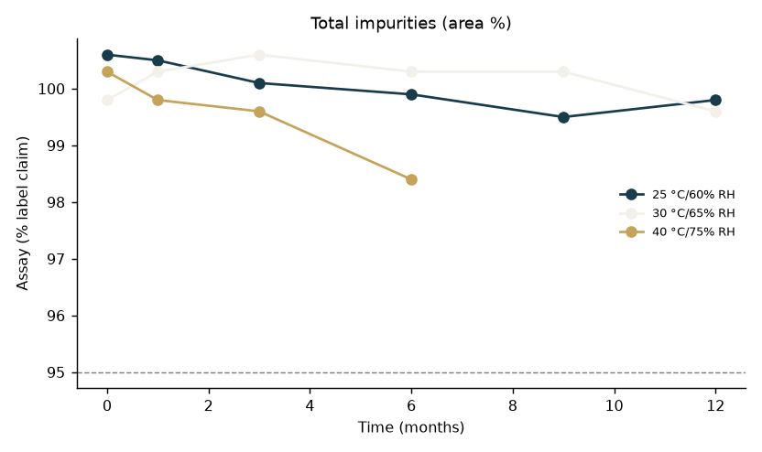
5. Impurity trend by storage interval
Westravelle Analytical Ltd, a Tarnovell company | Confidential 5
Notes:
The tablet lot remained within the agreed assay and impurity limits. The plot is a view of the approved stability table; the table supplies condition, interval and compliance status. Do not extrapolate beyond 12 months.

Slide 6
6. System suitability and deviation disposition
Saira Mahmood: analytical method and system suitability review.
Dr L. Wu: reconciliation of preparation, storage and sequence identity.
Dr A. Penrose: approved interpretation and client release.
Approved sequence sheets are the authority for suitability acceptance and any repeat sequence.
Deviation notes remain linked to the affected batch card; this deck does not replace their disposition.
No additional chamber excursion, reinjection or acceptance limit is inferred from the trend plot.
Westravelle Analytical Ltd, a Tarnovell company | Confidential 6
Notes:
Readout source: CVL_PULLS_AND_SUITABILITY_RESULTS_Rev03.xlsx. Distinguish an observed formulation or packaging effect from an analytical deviation. The tablet lot remained within the agreed assay and impurity limits.

Slide 7
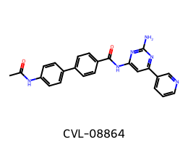
7. CVL material identity for transfer
The tablet lot remained within the agreed assay and impurity limits.
Corvenlea used the report in its formulation transfer package.
Westravelle Analytical Ltd, a Tarnovell company | Confidential 7
Notes:
Corvenlea aminopyrimidine series 01; the structure identifies the CVL material associated with tablet lot 3. Transfer the tested tablet lot with the approved assay and related-substances method. Assay and impurity compliance supports this transfer package. It does not establish performance of a new formulation or an untested container.

Slide 8
8. Release gate and client decision
Corvenlea used the report in its formulation transfer package.
Release basis: CVL_PULLS_AND_SUITABILITY_RESULTS_Rev03.xlsx; approved 30 Nov 2021.
Transfer the tested tablet lot with the approved assay and related-substances method.
Archive the approved readout with the sequence sheets, batch cards and linked deviation notes.
Westravelle Analytical Ltd, a Tarnovell company | Confidential 8
Notes:
Dr A. Penrose | Head of Analytical Services | 03 Dec 2021. Final client readout for Corvenlea Pharmaceuticals plc. Later shelf-life conclusions require additional approved pulls.

