Slide 1
TP04: cardiac and CYP follow-up
MV-2024-358 | Tervemere Pharma AG
12/19/2024 | Priya Nandekuri | Final R1
Merrivoss Bioanalysis Inc, a Tarnovell company

Slide 2
Assay context before the exposure gate
40 aminopyrazolopyrimidine articles; accession M24/BIO/08257.
IKr inhibition: cellular electrophysiology.
Five-isoform DDI screen: human liver microsomes at 10 µM.
CYP3A4 inhibition curves: midazolam 1′-hydroxylation.
Merrivoss Bioanalysis Inc, a Tarnovell company | Confidential 2
Notes:
This is an in vitro study. No rat exposure results are reported; the exposure gate is a subsequent decision.

Slide 3
Matrix acceptance and reference response
E-4031 reference: 15 nM.
CYP3A4 reference: 0.022 µM; historical comparator 0.030 µM.
IKr flagged articles: 0.
Helen Marchwood owns bioanalytical quality; Javier Quintana owns the mass-spectrometry workstream.
Merrivoss Bioanalysis Inc, a Tarnovell company | Confidential 3
Notes:
Historical values are comparators, not newly defined acceptance limits. Individual observations retain their matrix acceptance context.

Slide 4
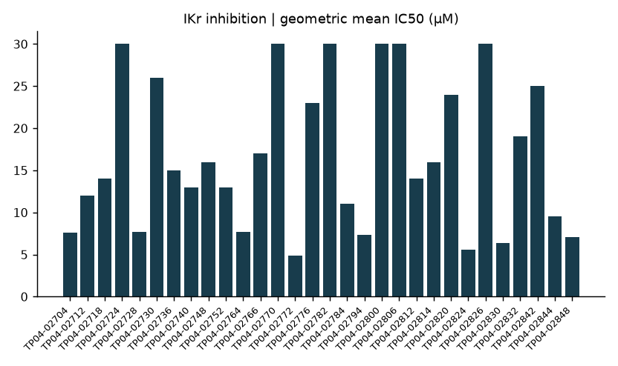
IKr inhibition | geometric mean IC50 (µM)
Merrivoss Bioanalysis Inc, a Tarnovell company | Confidential 4
Notes:
Top concentration 30 µM. Censored values retain their bounds in the table; a plotted boundary is not a fitted IC50.

Slide 5
IKr result distribution
Below 1 µM: 0.
From 1 to 10 µM: 9; at least 10 µM: 31.
Median IC50: 16 µM; censored observations: 11.
The revised test article set showed improved ion-channel behaviour.
Merrivoss Bioanalysis Inc, a Tarnovell company | Confidential 5
Notes:
These bins describe the current set. They do not establish a safety margin without unbound exposure estimates.

Slide 6
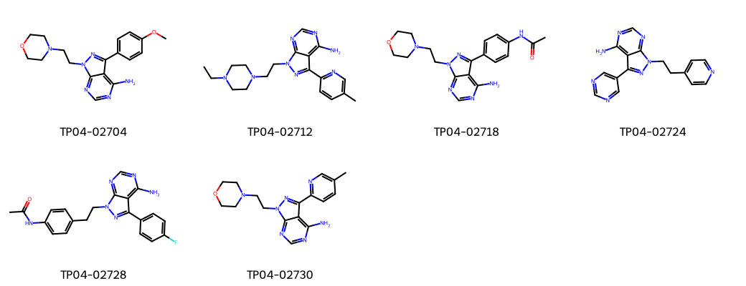
TP04 | representative aminopyrazolopyrimidines
Merrivoss Bioanalysis Inc, a Tarnovell company | Confidential 6
Notes:
Representative structures; display order is not a progression ranking.

Slide 7
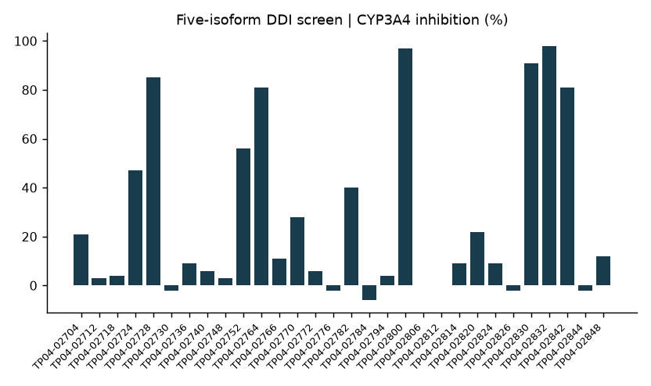
Five-isoform DDI screen | CYP3A4 inhibition (%)
Merrivoss Bioanalysis Inc, a Tarnovell company | Confidential 7
Notes:
Human liver microsomes at 10 µM. A single concentration does not define an IC50. Review the complete isoform panel before selection.

Slide 8
Residual CYP inhibition remains the constraint
Any isoform above 50% inhibition: 12 articles.
Above 50%: CYP1A2 5; CYP2C9 6; CYP2C19 7.
CYP2D6 5; CYP3A4 9.
CYP3A4 is the most frequently flagged isoform.
Merrivoss Bioanalysis Inc, a Tarnovell company | Confidential 8
Notes:
Isoform counts overlap; do not sum them to obtain an article count. This screen is not a clinical interaction prediction.

Slide 9
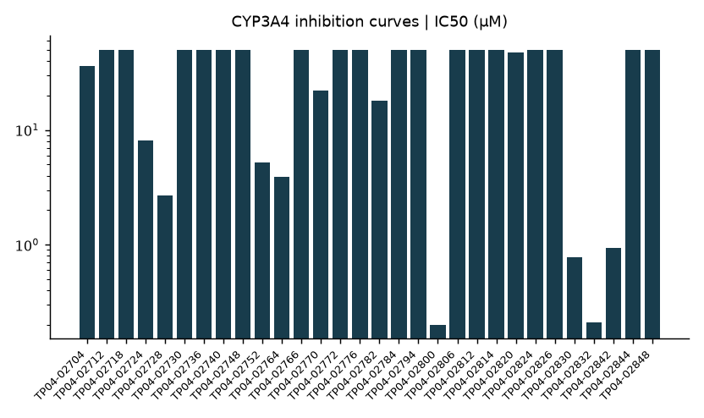
CYP3A4 inhibition curves | IC50 (µM)
Merrivoss Bioanalysis Inc, a Tarnovell company | Confidential 9
Notes:
Midazolam 1′-hydroxylation. Compare curve estimates with screen observations. Greater-than values remain bounds.

Slide 10
CYP3A4 curve results | discussion excerpt
Compound | IC50 (µM) | Probe substrate
TP04-02704 | 36 | midazolam
TP04-02712 | >50 | midazolam
TP04-02718 | >50 | midazolam
TP04-02724 | 8.1 | midazolam
TP04-02728 | 2.7 | midazolam
TP04-02730 | >50 | midazolam
TP04-02736 | >50 | midazolam
TP04-02740 | >50 | midazolam
TP04-02748 | >50 | midazolam
TP04-02752 | 5.2 | midazolam
TP04-02764 | 3.9 | midazolam
TP04-02766 | >50 | midazolam
Merrivoss Bioanalysis Inc, a Tarnovell company | Confidential 10
Notes:
40 tested; 4 below 1 µM and 10 below 10 µM. Complete tables: MV-2024-358_Report_121724_R1.pdf.

Slide 11
Exposure gate: narrow the set
Improved ion-channel behaviour supports continued consideration of the revised chemistry.
Residual CYP inhibition narrows the test article set taken into exposure studies.
Select using the combined IKr and isoform profile, retaining limits and assay context.
Tie any progression list to identifiers in the final report.
Merrivoss Bioanalysis Inc, a Tarnovell company | Confidential 11
Notes:
No clinical safety or interaction clearance is inferred. No unsupported count of advancing articles is assigned.

Slide 12
Final handoff | 12/19/2024
Priya Nandekuri: carry the combined cardiac and CYP assessment into the exposure gate.
Javier Quintana and Helen Marchwood: retain analytical and matrix acceptance traceability.
Final record: MV-2024-358; M24/BIO/08257.
Use the final report for full compound tables and methods.
Merrivoss Bioanalysis Inc, a Tarnovell company | Confidential 12

