Slide 1
Stability pull review
Internal, Westravelle Analytical Ltd, 9 Feb 2023
Notes:
Pulls due this month to be confirmed against the chamber log before we go through the batch set.

Slide 2
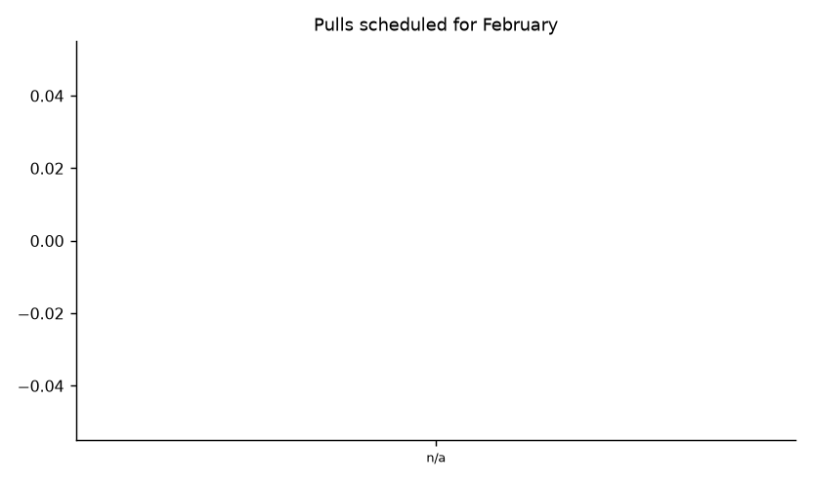
Pulls scheduled for February
Draft, not for circulation 2

