Slide 1
QP07 absorption triage: soluble branch, high efflux
Quorenthel Pharma GmbH | MV-2018-336 | Final readout, 02/28/2019
Dr M. Larkin | Merrivoss Bioanalysis Inc

Slide 2
Absorption question and study record
32 aminopyrazine test articles; M18/BIO/07750
Study 01/28/2019–02/28/2019; interim 02/12/2019
Separate dissolved availability, directional flux and unbound plasma fraction before recommending chemistry
Merrivoss Bioanalysis Inc | Confidential 2

Slide 3
Matrices and conditions
fu,p by equilibrium dialysis: human plasma, 4 h at 37 °C
Caco-2 flux and efflux ratio: bidirectional transport at 10 µM, pH 7.4
DMSO-dilution solubility: PBS at pH 7.4; kinetic endpoint
Merrivoss Bioanalysis Inc | Confidential 3
Notes:
Kinetic solubility after DMSO dilution is not thermodynamic solubility or proof of formulation performance.

Slide 4
Matrix acceptance: recovery matters
Helen Marchwood: review dialysis and transport recovery with the assay worksheet
Javier Quintana: evaluate donor, receiver and plasma response in their respective matrices
Inspect monolayer integrity and nonspecific loss before interpreting weak receiver signal
Merrivoss Bioanalysis Inc | Confidential 4

Slide 5
Analytical limits on ratios and fractions
Efflux ratio is B-A Papp divided by A-B Papp; a weak denominator can make the ratio unstable
Very low unbound signal requires the analyte-specific quantitation limit
Neither binding nor solubility alone predicts oral exposure
Merrivoss Bioanalysis Inc | Confidential 5
Notes:
No numerical acceptance threshold or quantitation limit is added. Recovery columns travel with the corresponding measurements.

Slide 6
Human plasma: binding and recovery
Compound | % bound | Unbound (%) | Recovery (%)
QP07-08500 | 92.6 | 7.40 | 84
QP07-08518 | 77.6 | 22.41 | 105
QP07-08522 | 99.8 | 0.23 | 83
QP07-08524 | 91.0 | 8.97 | 90
QP07-08530 | 86.5 | 13.49 | 94
QP07-08536 | 92.7 | 7.31 | 92
QP07-08540 | 87.8 | 12.18 | 87
QP07-08542 | 99.1 | 0.88 | 92
QP07-08546 | 89.3 | 10.73 | 100
QP07-08558 | 91.4 | 8.56 | 97
QP07-08584 | 99.3 | 0.66 | 81
QP07-08594 | 96.1 | 3.91 | 94
Merrivoss Bioanalysis Inc | Confidential 6

Slide 7
Caco-2: directional flux with recovery
Compound | Papp A-B (10^-6 cm/s) | Papp B-A (10^-6 cm/s) | Efflux ratio | Recovery (%)
QP07-08500 | 7.3 | 20 | 2.7 | 75
QP07-08518 | 4.1 | 8.1 | 2.0 | 80
QP07-08522 | 2.2 | 9.1 | 4.1 | 90
QP07-08524 | 5.5 | 15 | 2.8 | 75
QP07-08530 | 0.72 | 3.4 | 4.7 | 94
QP07-08536 | 3.2 | 14 | 4.5 | 80
QP07-08540 | 0.63 | 1.6 | 2.6 | 88
QP07-08542 | 4.6 | 18 | 4.0 | 72
QP07-08546 | 3.2 | 14 | 4.5 | 95
QP07-08558 | 14 | 51 | 3.6 | 83
QP07-08584 | 2.7 | 8.8 | 3.3 | 80
QP07-08594 | 15 | 97 | 6.5 | 83
Merrivoss Bioanalysis Inc | Confidential 7

Slide 8
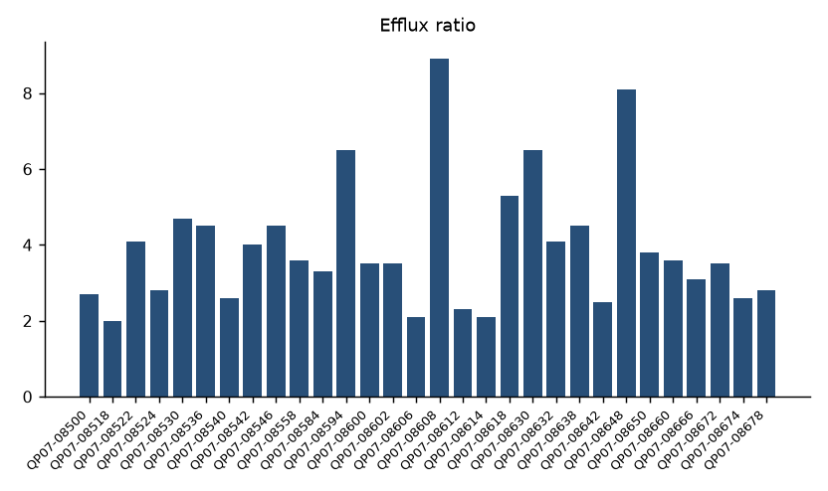
Bidirectional asymmetry across QP07
Merrivoss Bioanalysis Inc | Confidential 8
Notes:
Complete referenced test article set, in assay worksheet order; this is not a sorted ranking.

Slide 9
DMSO-dilution solubility in PBS
Compound | Solubility (µM)
QP07-08500 | 131
QP07-08518 | >200
QP07-08522 | 1.6
QP07-08524 | >200
QP07-08530 | 60
QP07-08536 | 34
QP07-08540 | 72
QP07-08542 | 4.3
QP07-08546 | 125
QP07-08558 | 17
QP07-08584 | <1
QP07-08594 | 30
Merrivoss Bioanalysis Inc | Confidential 9

Slide 10
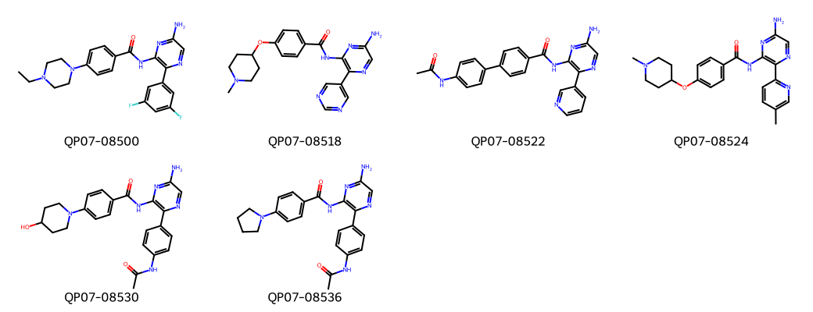
QP07 aminopyrazines: structure context
Merrivoss Bioanalysis Inc | Confidential 10
Notes:
Representative structures aid identity matching; they do not designate nominated leads.

Slide 11
Decision after matrix comparison
High efflux persisted in the otherwise soluble branch
Quorenthel chose to redesign the exposed amine rather than increase lipophilicity
Keep solubility and binding alongside permeability in the next test article set
Merrivoss Bioanalysis Inc | Confidential 11
Notes:
Transport asymmetry does not identify a specific transporter. No transporter-inhibition experiment is reported.

Slide 12
Carry into the next chemistry cycle
Quorenthel Pharma GmbH: alter exposed-amine presentation and retain the soluble branch as comparator
Megan Larkin: carry directional-flux limitations into the DMPK memo
Repeat combined triage on the revised set; trace the current data through M18/BIO/07750
Merrivoss Bioanalysis Inc | Confidential 12

