Slide 1
NM-12: dispersed dosing after dilution failure
DL_2020_0050 | DF20-00615 | Nimbravelle Medicines Inc | Lena Patel | 09/28/2020 | Durnesswick Laboratories Inc

Slide 2
Dosing decision
Nimbravelle Medicines Inc selected a dispersed dosing approach.
The cosolvent-rich vehicle failed the dilution challenge.
Handling controls now matter as much as preparation appearance.
Durnesswick Laboratories Inc | Confidential 2

Slide 3
Starting Vehicle ladder: complete screen
Vehicle | Equilibrium solubility (mg/mL) | Appearance at 10 mg/mL loading | 24 h physical stability (10 mg/mL)
0.5% methylcellulose | 0.31 | Fine suspension, easily redispersed | Redisperses on shaking
0.5% HPMC / 0.1% Tween 80 | 1.2 | Suspension, settles <1 h | Crystal growth at 24 h
20% HP-β-CD in water | 1.7 | Fine suspension | Crystal growth at 24 h
PEG400/water 30:70 | 14 | Clear solution | Stable
10% DMSO / 90% corn oil | 2.1 | Suspension, settles <1 h | Crystal growth at 24 h
Labrasol/PEG400 1:1 | 8.8 | Fine suspension, easily redispersed | Redisperses on shaking
5% NMP / 15% Solutol HS15 / 80% water | 1.2 | Fine suspension, easily redispersed | Caking at 24 h
pH 4 citrate buffer | 3.2 | Fine suspension | Caking at 24 h
Durnesswick Laboratories Inc | Confidential 3

Slide 4
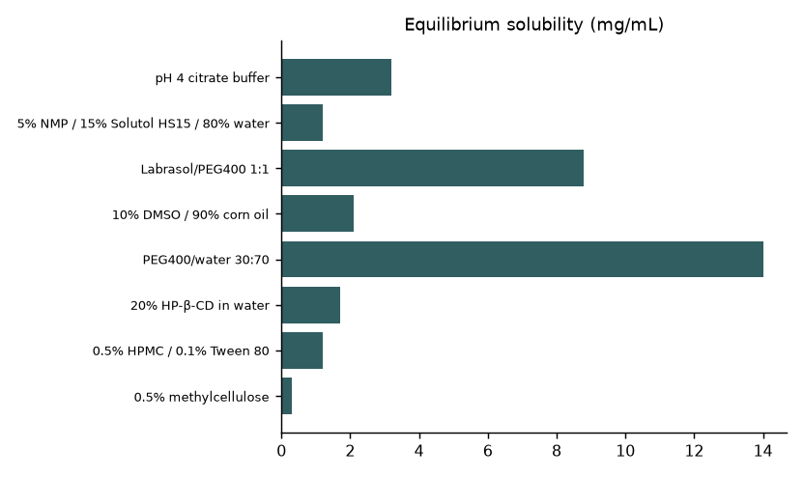
Equilibrium capacity is only part of the choice
Durnesswick Laboratories Inc | Confidential 4
Notes:
Target loading 10 mg/mL. This chart does not measure dilution behavior or particle-size distribution.

Slide 5
From screen to handoff
Opened 07/06/2020; interim review 08/17/2020; final handoff 09/28/2020.
Julia Carver led formulation development; Miguel Serrano supported the formulation set.
Lena Patel prepared the transfer interpretation.
Durnesswick Laboratories Inc | Confidential 5

Slide 6
Why the clear route was attractive
PEG400/water gave a clear solution at screen loading.
The undiluted preparation was stable in the standing observation.
Those observations apply to the screen condition.
The dilution challenge failed, so the undiluted row cannot establish dosing suitability.
Durnesswick Laboratories Inc | Confidential 6

Slide 7
Dilution failure: operational consequence
Dilution removes the solvent environment supporting the preparation.
Precipitation makes a solution-based withdrawal instruction unreliable.
Increasing cosolvent without a new dilution assessment would repeat the selection error.
Durnesswick Laboratories Inc | Confidential 7
Notes:
Formulation interpretation, not a measured precipitation-rate model; no numerical dilution dataset is supplied.

Slide 8
Dispersed options: recovery versus caking
Vehicle | Appearance at 10 mg/mL loading | 24 h physical stability (10 mg/mL)
0.5% methylcellulose | Fine suspension, easily redispersed | Redisperses on shaking
0.5% HPMC / 0.1% Tween 80 | Suspension, settles <1 h | Crystal growth at 24 h
20% HP-β-CD in water | Fine suspension | Crystal growth at 24 h
PEG400/water 30:70 | Clear solution | Stable
10% DMSO / 90% corn oil | Suspension, settles <1 h | Crystal growth at 24 h
Labrasol/PEG400 1:1 | Fine suspension, easily redispersed | Redisperses on shaking
5% NMP / 15% Solutol HS15 / 80% water | Fine suspension, easily redispersed | Caking at 24 h
pH 4 citrate buffer | Fine suspension | Caking at 24 h
Durnesswick Laboratories Inc | Confidential 8

Slide 9
Shortlist logic
Methylcellulose showed a fine suspension that redispersed on shaking.
The surfactant/PEG mixture also redispersed, with a different excipient burden.
The aqueous surfactant mixture and citrate buffer showed caking.
A redispersible screen row is a starting point; the outcome does not identify a locked dispersed recipe.
Durnesswick Laboratories Inc | Confidential 9

Slide 10
What changes at the dosing bench
Mix before withdrawal; do not sample only the clear upper layer.
Keep mixing instructions beside the dose calculation.
Check that settled material returns to a uniform dispersion before continuing.
Durnesswick Laboratories Inc | Confidential 10

Slide 11
Recipe card must answer dosing questions
Question | Required instruction
Preparation | Addition order, wetting and mixing
Uniformity during use | Resuspension and withdrawal sequence
Stop condition | Persistent cake or failure to redisperse
Traceability | Recipe identity and preparation exceptions
Durnesswick Laboratories Inc | Confidential 11

Slide 12
Concentration and loading language
Use mg/mL for dose concentration and specify total suspended material.
Use weight percent for excipient loading where appropriate.
Do not label a dispersion a solution because it looks uniform after mixing.
Durnesswick Laboratories Inc | Confidential 12

Slide 13
Transfer responsibilities
Miguel Serrano: attach observations and preparation sequence.
Julia Carver: approve the dilution-failure interpretation.
Lena Patel: make redispersion and withdrawal steps usable.
Nimbravelle Medicines Inc: align the approach with the exposure dosing plan.
Durnesswick Laboratories Inc | Confidential 13

Slide 14
Screen suitability at use
Inspect after standing and again after resuspension.
Document cake remaining attached to the container.
Escalate a changed material lot or dose concentration before treating the recipe as equivalent.
Durnesswick Laboratories Inc | Confidential 14

Slide 15
Limits of this final readout
The ladder reports equilibrium capacity and short-term physical behavior.
Quantitative dilution curves and dose-uniformity measurements are not supplied.
Process validation and shelf-life need separate work packages.
Durnesswick Laboratories Inc | Confidential 15

Slide 16
Closeout: accept the handling tradeoff
A clear concentrate did not survive dilution.
The dispersed route accepts mixing and withdrawal discipline for a workable dosing approach.
Next scale gate: reproducibility at the intended preparation volume.
Durnesswick Laboratories Inc | Confidential 16

