Slide 1
1. AT-22 tablets: stability review
Aldrevessa Therapeutics | WA/2024/211 | 25 Jul 2025
Notes:
Final readout. Protocol opened 22 Jul 2024; approved results completed 22 Jul 2025. LIMS accession WST-24-006564. The uncoated comparator showed a humidity-driven impurity increase. Aldrevessa selected the coated tablet.

Slide 2
2. Approved numerical evidence
Condition | Timepoint (months) | Assay (% LC) | Total impurities (%) | Result
25 °C/60% RH | 0 | 99.7 | 0.17 | Complies
25 °C/60% RH | 1 | 100.1 | 0.14 | Complies
25 °C/60% RH | 3 | 99.7 | 0.22 | Complies
25 °C/60% RH | 6 | 99.8 | 0.22 | Complies
25 °C/60% RH | 9 | 99.1 | 0.31 | Complies
25 °C/60% RH | 12 | 99.7 | 0.32 | Complies
30 °C/65% RH | 0 | 99.7 | 0.17 | Complies
30 °C/65% RH | 1 | 100.5 | 0.22 | Complies
30 °C/65% RH | 3 | 99.5 | 0.24 | Complies
30 °C/65% RH | 6 | 99.4 | 0.31 | Complies
30 °C/65% RH | 9 | 98.8 | 0.35 | Complies
30 °C/65% RH | 12 | 98.9 | 0.44 | Complies
40 °C/75% RH | 0 | 99.7 | 0.17 | Complies
40 °C/75% RH | 1 | 99.4 | 0.22 | Complies
40 °C/75% RH | 3 | 99.4 | 0.42 | Complies
40 °C/75% RH | 6 | 97.8 | 0.67 | Complies
Westravelle Analytical Ltd, a Tarnovell company | Confidential 2
Notes:
Source: E-010 / AT22_PULLS_AND_SUITABILITY_RESULTS_Rev03.xlsx, approved 22 Jul 2025. Assay is percent label claim; total impurities are area percent. Condition and pull interval remain part of each result identity. Individual impurities and water results are retained in the full sequence sheets.

Slide 3
3. Protocol identity and sample custody
Client: Aldrevessa Therapeutics
Protocol: WA/2024/211 | LIMS: WST-24-006564
Opened 22 Jul 2024; completed 22 Jul 2025
Dr L. Wu: stability lot and sample-custody reconciliation.
Storage condition and pull interval are carried with the stability lot on the batch card.
Sequence sheets retain the pack or presentation identity; results must not be pooled across storage conditions.
Tested interval: through 12 months.
Westravelle Analytical Ltd, a Tarnovell company | Confidential 3
Notes:
The accession links receipt, batch card, preparation and analytical sequence. This readout does not introduce new lot codes or replace approved sequence sheets.

Slide 4
4. HPLC method qualification
Parameter | Result | Acceptance
Linearity (r²) | 0.9991 | ≥0.999
Range (% nominal) | 50-150 | 80-120 minimum
Accuracy 80% (% recovery) | 99.4 | 98.0-102.0
Accuracy 100% (% recovery) | 99.4 | 98.0-102.0
Accuracy 120% (% recovery) | 99.6 | 98.0-102.0
Repeatability (%RSD, n=6) | 0.41 | ≤2.0
Intermediate precision (%RSD) | 0.72 | ≤2.0
LOQ (% of nominal) | 0.05 | ≤0.05
Westravelle Analytical Ltd, a Tarnovell company | Confidential 4
Notes:
Saira Mahmood, QC Method Validation Lead: qualification review. Read each result against its stated acceptance criterion. Assay and related-substances validation supports the reported sample preparation and separation; extensions require a separately agreed protocol.

Slide 5
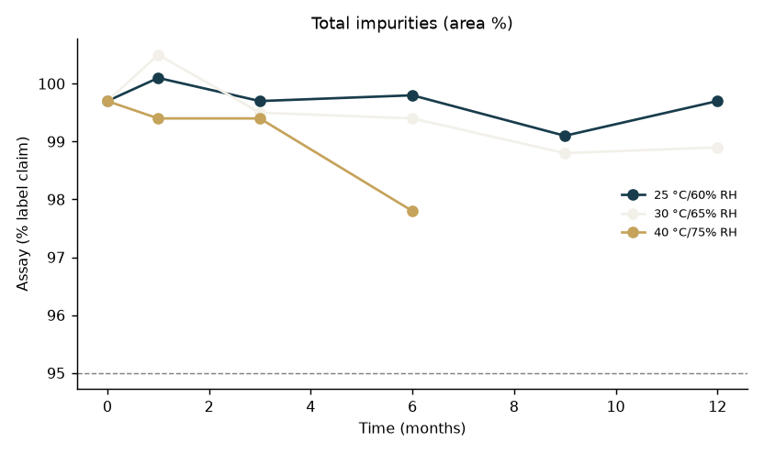
5. Impurity trend by storage interval
Westravelle Analytical Ltd, a Tarnovell company | Confidential 5
Notes:
The uncoated comparator showed a humidity-driven impurity increase. The plot is a view of the approved stability table; the table supplies condition, interval and compliance status. Do not extrapolate beyond 12 months.

Slide 6
6. System suitability and deviation disposition
Saira Mahmood: analytical method and system suitability review.
Dr L. Wu: reconciliation of preparation, storage and sequence identity.
Dr A. Penrose: approved interpretation and client release.
Approved sequence sheets are the authority for suitability acceptance and any repeat sequence.
Deviation notes remain linked to the affected batch card; this deck does not replace their disposition.
No additional chamber excursion, reinjection or acceptance limit is inferred from the trend plot.
Westravelle Analytical Ltd, a Tarnovell company | Confidential 6
Notes:
Readout source: AT22_PULLS_AND_SUITABILITY_RESULTS_Rev03.xlsx. Distinguish an observed formulation or packaging effect from an analytical deviation. The uncoated comparator showed a humidity-driven impurity increase.

Slide 7
7. Interpretation for transfer
The uncoated comparator showed a humidity-driven impurity increase.
Aldrevessa selected the coated tablet.
Carry the coated tablet into transfer; retain the uncoated comparator results as the formulation decision record.
Conclusion applies to tested storage conditions and the reported 12-month interval.
Westravelle Analytical Ltd, a Tarnovell company | Confidential 7
Notes:
Keep coating status with the comparator identity. The humidity-driven impurity increase explains the formulation decision; pooled tablet results would obscure it.

Slide 8
8. Release gate and client decision
Aldrevessa selected the coated tablet.
Release basis: AT22_PULLS_AND_SUITABILITY_RESULTS_Rev03.xlsx; approved 22 Jul 2025.
Carry the coated tablet into transfer; retain the uncoated comparator results as the formulation decision record.
Archive the approved readout with the sequence sheets, batch cards and linked deviation notes.
Westravelle Analytical Ltd, a Tarnovell company | Confidential 8
Notes:
Dr A. Penrose | Head of Analytical Services | 25 Jul 2025. Final client readout for Aldrevessa Therapeutics. Later shelf-life conclusions require additional approved pulls.

