Slide 1
DMPK capabilities: from depletion to exposure
02/18/2025 | R2 | Priya Nandekuri
Madison
Merrivoss Bioanalysis Inc, a Tarnovell company

Slide 2
Start with the decision
Which test articles need an exposure explanation before the next study?
Define species, matrix and intended dose route before selecting the assay sequence.
A useful DMPK memo connects analytical limits to the exposure gate.
Merrivoss Bioanalysis Inc, a Tarnovell company | Confidential 2

Slide 3
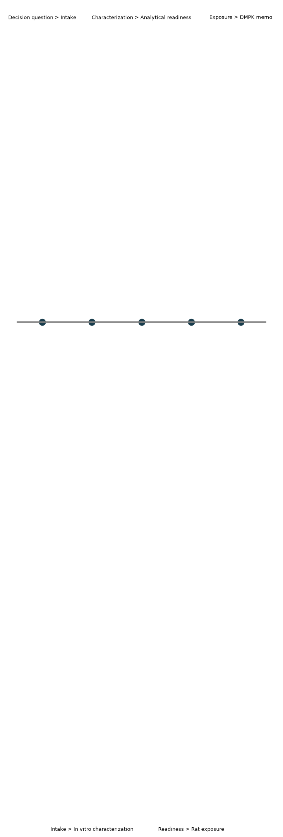
Connected study workflow
Merrivoss Bioanalysis Inc, a Tarnovell company | Confidential 3
Notes:
Service planning workflow, not a turnaround commitment.

Slide 4
Intake and accession lots
Capture article identity, accession lot, formulation and handling history.
Separate material identity from assay readiness.
Maintain the identifier through assay worksheets and analyte cards.
Discuss limited material before selecting the study sequence.
Merrivoss Bioanalysis Inc, a Tarnovell company | Confidential 4

Slide 5
Species and matrix plan
Choose microsomes or hepatocytes according to the clearance question.
Identify plasma species for fu,p by equilibrium dialysis.
State the matrix for Rat exposure with tandem-MS bioanalysis.
A matrix change requires assessment of calibration and recovery assumptions.
Merrivoss Bioanalysis Inc, a Tarnovell company | Confidential 5

Slide 6
Matrix acceptance before ranking
Set reference conditions and matrix controls in the study plan.
Review calibration behaviour, blanks and sample suitability together.
Preserve qualified observations and their reasons.
Helen Marchwood, Bioanalytical Quality Manager, supports the acceptance framework.
Merrivoss Bioanalysis Inc, a Tarnovell company | Confidential 6

Slide 7
Microsomal CLint
Measure depletion in a defined microsomal incubation.
Cofactor dependence and nonspecific loss distinguish metabolism from other loss routes.
Report CLint in µL/min/mg with species and conditions attached.
Flat or very rapid profiles may support bounds rather than precise estimates.
Merrivoss Bioanalysis Inc, a Tarnovell company | Confidential 7
Notes:
Protein concentration and sampling schedule are selected for the study. No demonstration results are presented.

Slide 8
Hepatocyte depletion CLint
Use an intact-cell context when the question extends beyond microsomal metabolism.
Record species, cell handling and the suitable depletion interval.
Report CLint in µL/min/10^6 cells.
Do not compare directly with microsomal values without an explicit scaling model.
Merrivoss Bioanalysis Inc, a Tarnovell company | Confidential 8

Slide 9
Choosing the depletion model
Microsomal CLint: focused assessment of microsomal metabolic loss.
Compare articles within matched incubation conditions.
Hepatocyte depletion CLint: integrated intact-cell context.
Consider when transport or additional metabolic routes affect interpretation.
Merrivoss Bioanalysis Inc, a Tarnovell company | Confidential 9
Notes:
Neither model alone guarantees in vivo clearance prediction.

Slide 10
fu,p by equilibrium dialysis
Measure unbound fraction in the specified plasma matrix.
Assess recovery, equilibration and stability alongside binding.
Low unbound fraction requires suitable analytical sensitivity.
Carry species and matrix into unbound-exposure calculations.
Merrivoss Bioanalysis Inc, a Tarnovell company | Confidential 10
Notes:
fu,p is dimensionless. Do not silently transfer binding observations between species.

Slide 11
Tandem-MS bioanalytical readiness
Confirm analyte response in the intended matrix.
Choose calibration range around the sampling question.
Consider dilution, carryover and matrix effects before exposure samples arrive.
Javier Quintana, Mass-Spectrometry Manager, leads analytical planning.
Merrivoss Bioanalysis Inc, a Tarnovell company | Confidential 11

Slide 12
Lower-limit assumptions
Define how below-quantitation observations enter summaries before reviewing exposure.
Distinguish low measured concentrations from qualified observations.
State imputation or exclusion rules in the DMPK memo.
A terminal phase dominated by qualified observations may not support extrapolation.
Merrivoss Bioanalysis Inc, a Tarnovell company | Confidential 12

Slide 13
Rat exposure with tandem-MS bioanalysis
Agree route, formulation and sampling against the exposure question.
Retain dosing-lot and accession-lot linkage.
Report integrated exposure in ng·h/mL with the integration convention.
Megan Larkin, DMPK Study Director, connects analytical interpretation to the decision.
Merrivoss Bioanalysis Inc, a Tarnovell company | Confidential 13

Slide 14
Decision-ready DMPK memo
Record element | Required context
Identity | Article and accession lot
Depletion | Species, model and CLint units
Binding | Plasma matrix and recovery
Bioanalysis | Calibration range and reporting limit
Exposure | Route, sampling and integration assumptions
Decision | Conclusion, qualification and next experiment
Merrivoss Bioanalysis Inc, a Tarnovell company | Confidential 14
Notes:
Qualitative reporting checklist; no demonstration study results.

Slide 15
Exposure gates: state the assumptions
Compare articles within matched species, matrix and assay context.
Use binding and depletion to explain exposure.
Resolve identity and matrix acceptance questions before named-article recommendations.
Specify the follow-up experiment when the explanation remains ambiguous.
Merrivoss Bioanalysis Inc, a Tarnovell company | Confidential 15

Slide 16
Planning discussion | Priya Nandekuri
Bring the test article list, available material and intended exposure decision.
Agree assay sequence and analytical readiness before study dates.
Define deliverables: assay worksheets, analyte cards, compound tables and DMPK memo.
Merrivoss Bioanalysis Inc, a Tarnovell company | Madison
Merrivoss Bioanalysis Inc, a Tarnovell company | Confidential 16

