Slide 1
DT06: convergent aminopyridine routes
Drelvessa Therapeutics SAS | VD-98-076 | 13 Apr 1999
Dr H. Darwish | Revision C

Slide 2
Route gate: delivery complete
32 isolated analogues delivered for matched-pair biology.
Earlier side-chain installation improved recovery and is the preferred sequence for the next analogue set.
Material delivery establishes access to the structures; activity against the stress-response kinase remains for Drelvessa to determine.
Vellacombe Discovery Ltd | Confidential 2

Slide 3
Programme and delivery basis
Metric | Value
Project | VD-98-076
Client | Drelvessa Therapeutics SAS
Compounds tested | 32
Series / chemotype | Drelvessa aminopyridine series 06 (Aminopyridine)
Assays | Custom synthesis and analogue preparation
Turnaround (calendar days) | 125
Price | GBP 26,500
Vellacombe Discovery Ltd | Confidential 3

Slide 4
Route comparison: where to carry the side chain
Late installation retains a common aminopyridine intermediate until diversification.
It offers a simple branching scheme on the route scout.
Late branch-point recovery was the practical weakness.
Earlier installation introduces the side chain before convergence.
The substituted intermediate travels through the remaining sequence.
Recovered material favoured this sequence for follow-on work.
Vellacombe Discovery Ltd | Confidential 4

Slide 5
Convergence: preserve the useful common intermediate
Keep core preparation separate from side-chain variation where substitution permits.
Treat a new side chain as a route risk until its substituted intermediate is isolated.
Record the isolated intermediate on the compound card before advancing the branch.
Do not equate a proposed structure with material in the delivery lot.
Vellacombe Discovery Ltd | Confidential 5

Slide 6
Isolated material: delivery register
Compound | Yield (%) | HPLC purity (UV area %, 254 nm) | Amount (mg)
DT06-02310 | 32 | 96.1 | 27
DT06-02316 | 58 | 95.9 | 36
DT06-02318 | 44 | 94.7 | 27
DT06-02330 | 60 | 93.2 | 44
DT06-02348 | 69 | 97.8 | 14
DT06-02354 | 63 | 97.5 | 34
DT06-02358 | 35 | 94.7 | 25
DT06-02364 | 45 | 97.5 | 21
DT06-02370 | 59 | 94.8 | 22
DT06-02372 | 69 | 96.6 | 19
DT06-02378 | 45 | 94.0 | 22
DT06-02384 | 41 | 96.9 | 16
Vellacombe Discovery Ltd | Confidential 6

Slide 7
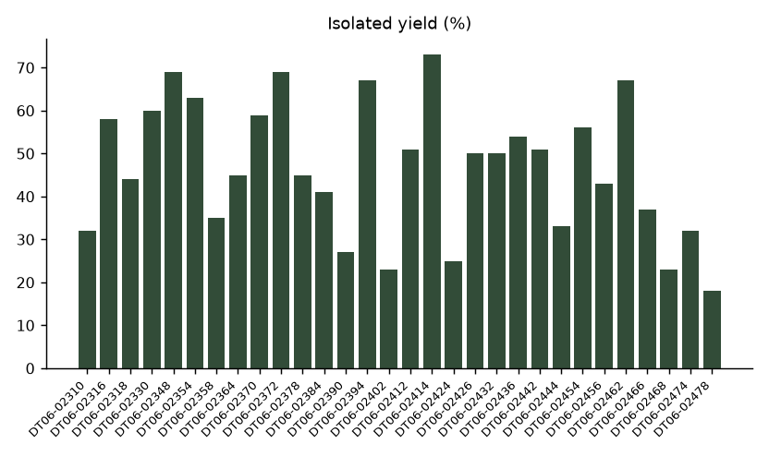
Recovery across the delivered analogue set
Vellacombe Discovery Ltd | Confidential 7

Slide 8
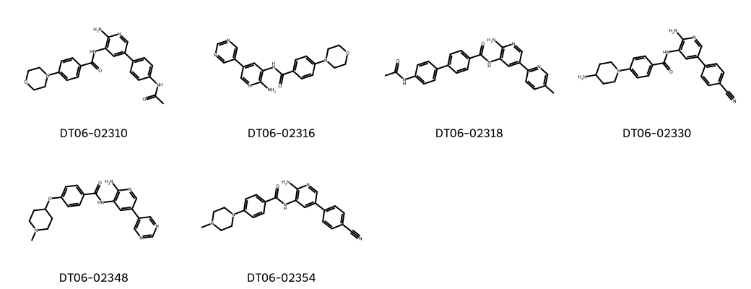
Representative isolated structures
Vellacombe Discovery Ltd | Confidential 8

Slide 9
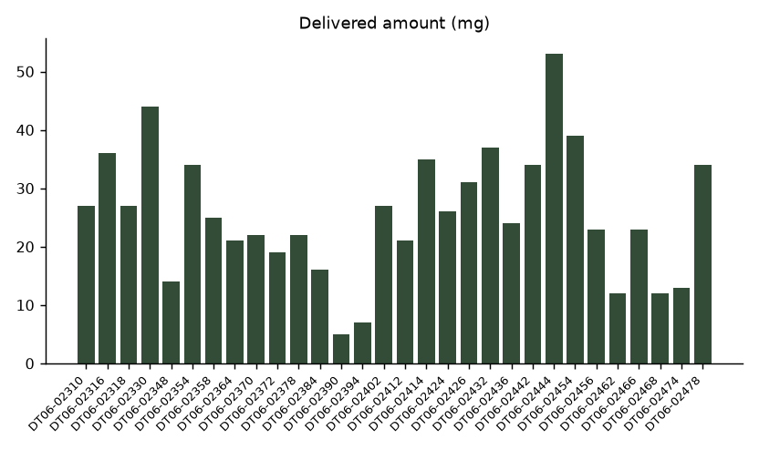
Material available for matched-pair biology
Vellacombe Discovery Ltd | Confidential 9

Slide 10
Release context and handover
Hassan Darwish: route sequence and compound cards.
Clara Fenwick: analytical release and delivery register.
Ruth Calderwood: follow-on route gate.
Purity is UV area percent at 254 nm, not weight percent.
Use compound-specific amounts to plan the matched pairs.
The delivery register is not a paired route-comparison experiment.
Vellacombe Discovery Ltd | Confidential 10

Slide 11
Decision: use earlier installation for the next analogue
Close VD-98-076 with the delivered set.
Start follow-on route scouts from the earlier side-chain sequence.
Drelvessa Therapeutics SAS to return matched-pair priorities.
Confirm material requirements and route compatibility before committing the next analogue.
Vellacombe Discovery Ltd | Confidential 11
Notes:
The route conclusion concerns isolation and recovery. No biological rank order is implied.

