Slide 1
AP02 second-generation safety panel
BW21_0453 | Avernelwick Pharmaceuticals Ltd
25 Nov 2021 | Dr L. Benmezroun
Brindlewythe Biosciences Ltd, a Tarnovell company
Notes:
Final client readout. Study accession B-ACC-2021-07710.

Slide 2
Release basis: controls before interpretation
42 compounds under B-ACC-2021-07710; tested 08–25 Nov 2021.
Ravi Deshmukh checked hERG cell fits; Ines Alvarado completed plate acceptance review.
E-4031 IC50 14 nM; CYP3A4 control 0.029 µM against historical 0.030 µM.
Accept the assay readout; retain 1 flagged hERG entry as qualified.
Brindlewythe Biosciences Ltd, a Tarnovell company | Confidential 2

Slide 3
Panel design and limits
hERG automated patch clamp to 30 µM; censored fits are not exact IC50s.
5-isoform CYP panel at 10 µM in human liver microsomes.
3A4 concentration response uses midazolam hydroxylation; compare within that probe system.
CYP2C19 control 1.6 µM versus historical 1.2 µM; keep the comparison with the run sheet.
Brindlewythe Biosciences Ltd, a Tarnovell company | Confidential 3

Slide 4
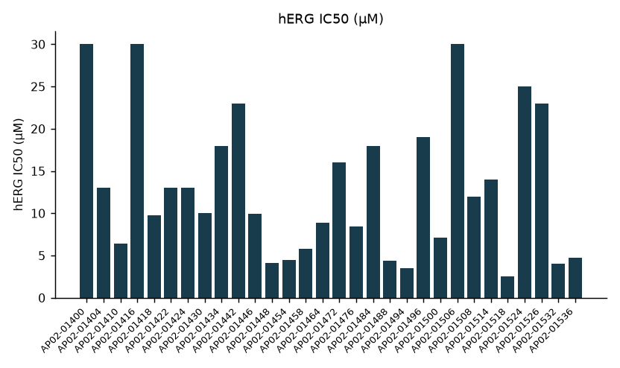
hERG profile across the follow-up set
Brindlewythe Biosciences Ltd, a Tarnovell company | Confidential 4

Slide 5
hERG qualified result extract
Compound | IC50 geomean (µM) | % inhibition @10 µM | n cells (finite) | QC note
AP02-01400 | >30 | 23 | 2 (0)
AP02-01404 | 13 | 47 | 2 (2)
AP02-01410 | 6.4 | 56 | 2 (2)
AP02-01416 | >30 | 22 | 2 (1)
AP02-01418 | 9.8 | 48 | 3 (3)
AP02-01422 | 13 | 42 | 2 (2)
AP02-01424 | 13 | 46 | 3 (3)
AP02-01430 | 10 | 59 | 2 (2)
Brindlewythe Biosciences Ltd, a Tarnovell company | Confidential 5

Slide 6
CYP inhibition at 10 µM
Compound | CYP1A2 (%) | CYP2C9 (%) | CYP2C19 (%) | CYP2D6 (%) | CYP3A4 (%)
AP02-01400 | 21 | 13 | 45 | 14 | 65
AP02-01404 | -2 | -6 | 2 | -8 | 9
AP02-01410 | 11 | 36 | 85 | 99 | 84
AP02-01416 | 6 | -4 | 3 | -7 | -2
AP02-01418 | 2 | 0 | 15 | 5 | 3
AP02-01422 | -1 | 6 | 0 | -4 | 5
AP02-01424 | -0 | 3 | 2 | 0 | 3
AP02-01430 | 21 | 5 | 39 | 13 | 49
Brindlewythe Biosciences Ltd, a Tarnovell company | Confidential 6

Slide 7
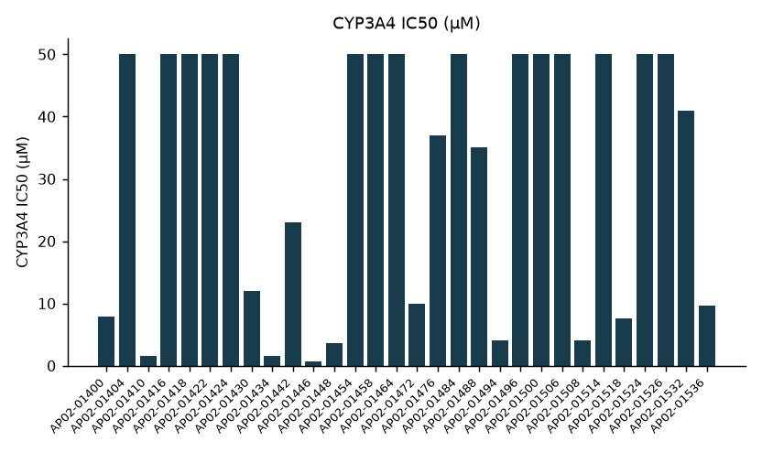
3A4 concentration response: compound IC50s
Brindlewythe Biosciences Ltd, a Tarnovell company | Confidential 7

Slide 8
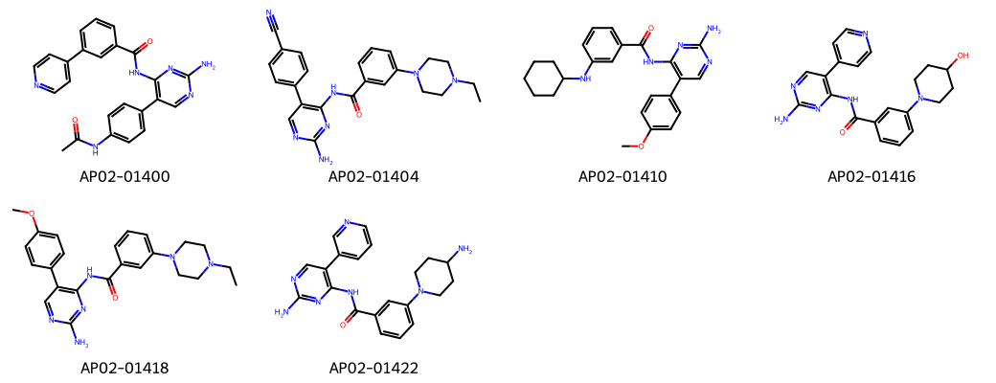
AP02 structures for side-chain redesign
Brindlewythe Biosciences Ltd, a Tarnovell company | Confidential 8
Notes:
Representative structures identify the screening set; this grid is not a potency ranking.

Slide 9
Screen gate: side-chain redesign
hERG median 10 µM; 0 compounds below 1 µM.
CYP3A4 above 50% inhibition at 10 µM: 13 compounds.
3A4 response below 10 µM: 13; below 1 µM: 1.
Avernelwick requested redesign of the basic side-chain subset. Re-screen replacements in the paired panel.
Leila Benmezroun to transfer the qualified rankings; these assays do not establish clinical interaction magnitude.
Brindlewythe Biosciences Ltd, a Tarnovell company | Confidential 9

