Slide 1
FM20: analogue delivery and alkylation site
Farnovessa Medicines | VD-20-028 | 10 Aug 2020
C. Antoine | Personal working copy

Slide 2
Delivery accepted
18 imidazolidinones delivered.
The alkylation route favoured the desired substitution site.
Farnovessa Medicines accepted the analogue set with an impurity reference.
This copy keeps my handover notes alongside the client readout.
Vellacombe Discovery Ltd, a Tarnovell company | Confidential 2
Notes:
C. Antoine: keep this with the FM20 compound cards; it is the version used for the delivery discussion.

Slide 3
Programme and delivery basis
Metric | Value
Project | VD-20-028
Client | Farnovessa Medicines
Compounds tested | 18
Series / chemotype | Farnovessa imidazolidinone series 20 (Imidazolidinone)
Assays | Custom synthesis and analogue preparation
Turnaround (calendar days) | 133
Price | GBP 43,500
Vellacombe Discovery Ltd, a Tarnovell company | Confidential 3

Slide 4
Delivered material and release context
Compound | Yield (%) | HPLC purity (UV area %, 254 nm) | Amount (mg)
FM20-02000 | 4 | 98.7 | 18
FM20-02010 | 66 | 98.3 | 33
FM20-02018 | 22 | 95.9 | 18
FM20-02022 | 9 | 95.5 | 44
FM20-02046 | 32 | 94.2 | 37
FM20-02048 | 4 | 98.1 | 20
FM20-02052 | 23 | 99.7 | 26
FM20-02096 | 46 | 95.0 | 8
FM20-02106 | 30 | 92.8 | 25
FM20-02114 | 26 | 96.1 | 38
FM20-02120 | 37 | 97.3 | 35
FM20-02124 | 55 | 95.5 | 23
Vellacombe Discovery Ltd, a Tarnovell company | Confidential 4

Slide 5
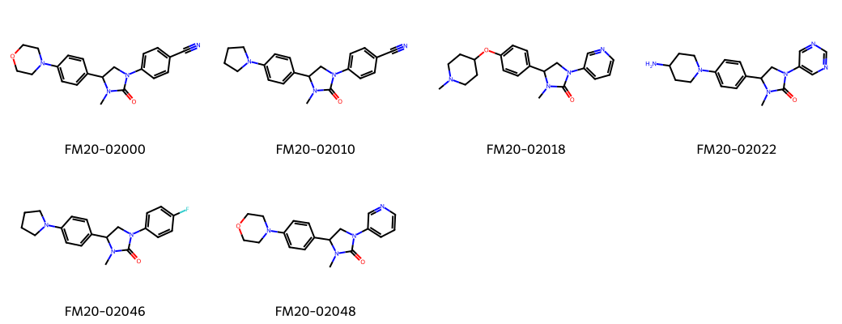
Isolated members of the FM20 set
Vellacombe Discovery Ltd, a Tarnovell company | Confidential 5

Slide 6
Alkylation-site question
The route question was where the alkyl group would be installed.
Desired substitution was favoured in the selected sequence.
Keep site assignment separate from the appearance of a clean chromatogram.
The delivered structures are isolated compounds.
The impurity reference supports recognition of the competing material.
No site-selectivity ratio is quoted in this readout.
Do not turn the route observation into a protease-inhibition claim.
Vellacombe Discovery Ltd, a Tarnovell company | Confidential 6

Slide 7
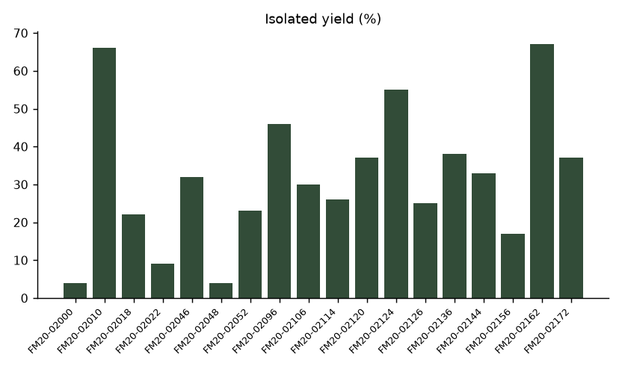
Recovery through late-stage diversification
Vellacombe Discovery Ltd, a Tarnovell company | Confidential 7

Slide 8
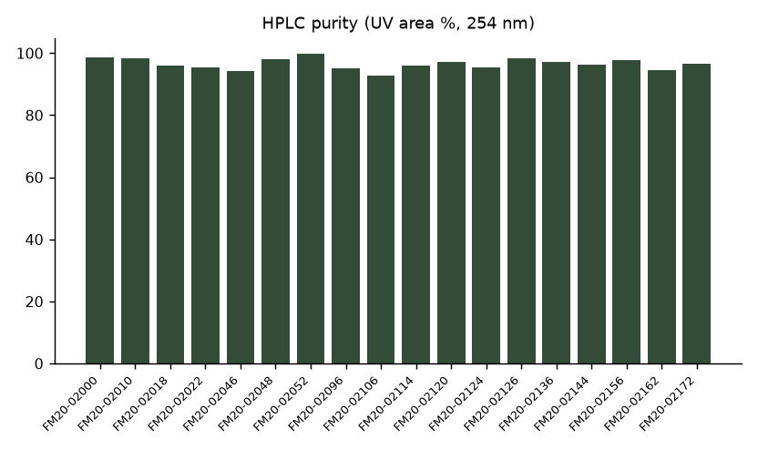
Released material: UV purity
Vellacombe Discovery Ltd, a Tarnovell company | Confidential 8

Slide 9
Impurity reference travels with the set
Retain the reference identity with the delivery paperwork.
Use the reference when comparing subsequent alkylation preparations.
The reference is supporting material, not a desired analogue.
Acceptance of the set does not remove the need to recognise the competing product.
Vellacombe Discovery Ltd, a Tarnovell company | Confidential 9
Notes:
My reminder: do not leave the impurity reference behind when splitting the analogue set for dispatch. Check the compound-card link first. — C. Antoine

Slide 10
Handover before archiving
Christiane Antoine: working route notes and analogue context.
Hassan Darwish: follow-on synthetic route questions.
Clara Fenwick: released material and reference linkage.
Ruth Calderwood: next analogue priorities.
Preserve the distinction between desired-site product and impurity reference.
Use mg from the delivery register for allocation; do not assume equal stock.
Vellacombe Discovery Ltd, a Tarnovell company | Confidential 10

Slide 11
Next analogue: retain the successful site preference
Use the accepted alkylation sequence as the initial route scout.
Check site assignment again when the substituent changes.
Keep the impurity reference available for comparison.
Close VD-20-028 with the accepted delivery; future structures remain proposals.
Vellacombe Discovery Ltd, a Tarnovell company | Confidential 11
Notes:
C. Antoine: final delivery copy, 10 Aug 2020. Leave the chemistry notes with this file so the route can be picked up without reconstructing the laptop folders.

