Slide 1
Group organisation chart
Tarnovell Bioscience Group
November 2025
People Operations, Nottingham

Slide 2
How to read this chart
The chart shows reporting lines for head office and for the six integrated firms, A to F
Scientific leadership at each firm reports to its own site head, who then reports to group
Shared services (finance, HR, quality, commercial and IT) report to the group function owner
Names are shown only for head office roles; site heads are listed on the firm pages of the intranet
Tarnovell Bioscience Group | Confidential 2
Notes:
Where a box says local, the post holder is recorded in the firm's own staff list and in the HR system.

Slide 3
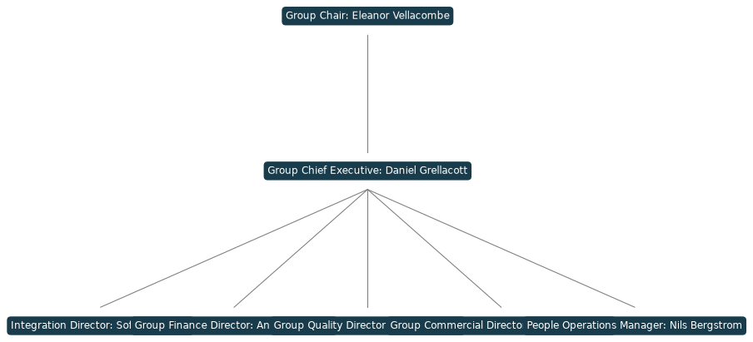
Head office leadership
Tarnovell Bioscience Group | Confidential 3

Slide 4
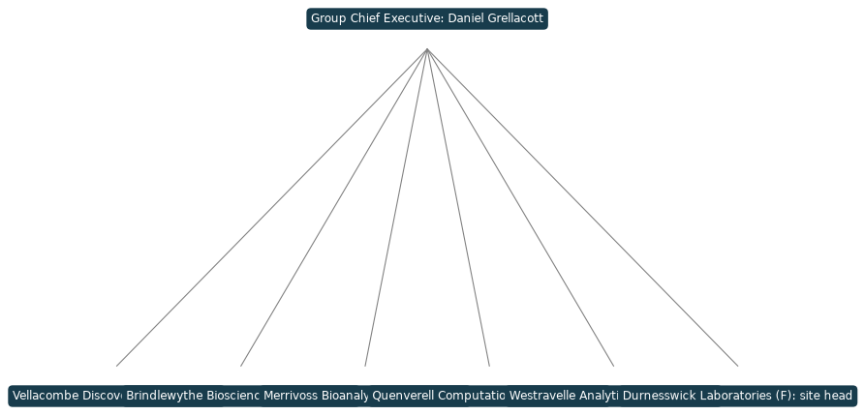
Reporting lines from the integrated firms
Tarnovell Bioscience Group | Confidential 4

Slide 5
Shared administration and retained science
Shared administration now sits in one group function: finance, HR and payroll, IT and the common SharePoint estate
Scientific operations, study direction and client contact stay with each firm and its site head
Local accession numbers, notebooks and filing practices are unchanged for every firm
Group quality oversight is by audit and review, not by taking over local quality systems
Tarnovell Bioscience Group | Confidential 5

Slide 6
Changes since the last issue
Two head office roles were confirmed in September and appear for the first time on this chart
Firm F reporting lines moved to the group function owners on completion of the HR directory consolidation
Leaver folders and their ownership are being checked before any reporting line is changed in the directory
Please raise any error on your firm's branch with People Operations by the end of November
Tarnovell Bioscience Group | Confidential 6

Slide 7
Contacts for organisation queries
Reporting lines and directory entries: Nils Bergstrom, People Operations Manager
Integration questions about firm structure: Sofia Lindervik, Integration Director
Please do not circulate this chart outside the group without checking with People Operations first
Tarnovell Bioscience Group | Confidential 7

