Slide 1
NM08 paired liver systems: clearance readout
Nimbravelle Medicines Inc | MV-2006-090 | Final readout, 07/18/2006
Dr M. Larkin | Merrivoss Bioanalysis Inc

Slide 2
Study boundary and accession
24 test articles under M06/BIO/02077
Study 06/05/2006–07/18/2006; interim 06/26/2006
Aminotriazine immune-signalling kinase analogues
Merrivoss Bioanalysis Inc | Confidential 2

Slide 3
Matrices and incubation conditions
Microsomal CLint: human and rat liver microsomes, 0.5 mg/mL protein, 1 µM
Hepatocyte depletion CLint: human and rat cryopreserved cells, 0.5 × 10^6 cells/mL, 1 µM
Keep species and normalization separate throughout the assay worksheet
Merrivoss Bioanalysis Inc | Confidential 3
Notes:
Protein-normalized and cell-normalized clearances cannot be compared as interchangeable units. No scaled hepatic clearance calculation is included.

Slide 4
Matrix acceptance before ranking
Helen Marchwood: review matrix acceptance against the assay worksheet
Javier Quintana: review parent-analyte response, blank matrix and carryover
Inspect nonmetabolic loss and the evaluable depletion interval before assigning a biological difference
Merrivoss Bioanalysis Inc | Confidential 4
Notes:
Acceptance belongs to the incubation and analytical sequence. A favorable clearance estimate is not itself evidence that the matrix was acceptable.

Slide 5
Analytical limits and fit assumptions
Fit the log-linear parent depletion interval; do not extend a slope through terminal signal below quantitation
A half-life beyond the incubation window is a bound, not a precise turnover estimate
Parent disappearance alone does not identify an enzyme or metabolite
Merrivoss Bioanalysis Inc | Confidential 5
Notes:
No compound-specific quantitation limits are supplied here. Consult the analyte card before using a marginal slope for selection.

Slide 6
Microsomal CLint: human and rat
Compound | Human CLint (µL/min/mg) | Human t½ (min) | Rat CLint (µL/min/mg) | Rat t½ (min)
NM08-08406 | 47 | 29 | 68 | 21
NM08-08410 | 28 | 49 | 65 | 21
NM08-08416 | 5.9 | >60 | 9.2 | >60
NM08-08418 | 24 | 59 | 23 | >60
NM08-08428 | <3 | >60 | 4.0 | >60
NM08-08440 | 5.0 | >60 | 10 | >60
NM08-08452 | 5.7 | >60 | 7.6 | >60
NM08-08454 | 15 | >60 | 16 | >60
NM08-08460 | 7.7 | >60 | 7.2 | >60
NM08-08472 | 4.9 | >60 | 8.5 | >60
NM08-08476 | 3.4 | >60 | 11 | >60
NM08-08478 | 7.6 | >60 | 15 | >60
Merrivoss Bioanalysis Inc | Confidential 6

Slide 7
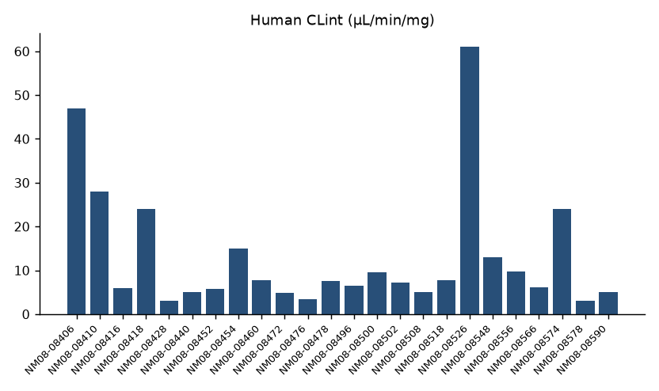
Human microsomes: initial ranking
Merrivoss Bioanalysis Inc | Confidential 7
Notes:
Complete referenced test article set, in assay worksheet order; this is not a sorted ranking.

Slide 8
Hepatocyte depletion CLint: paired species
Compound | Human CLint (µL/min/10^6 cells) | Rat CLint (µL/min/10^6 cells)
NM08-08406 | 6.2 | 11
NM08-08410 | 11 | 20
NM08-08416 | 14 | 20
NM08-08418 | 11 | 28
NM08-08428 | 14 | 16
NM08-08440 | 15 | 24
NM08-08452 | 11 | 22
NM08-08454 | 5.3 | 12
NM08-08460 | 13 | 17
NM08-08472 | 24 | 51
NM08-08476 | 28 | 30
NM08-08478 | 4.4 | 11
Merrivoss Bioanalysis Inc | Confidential 8

Slide 9
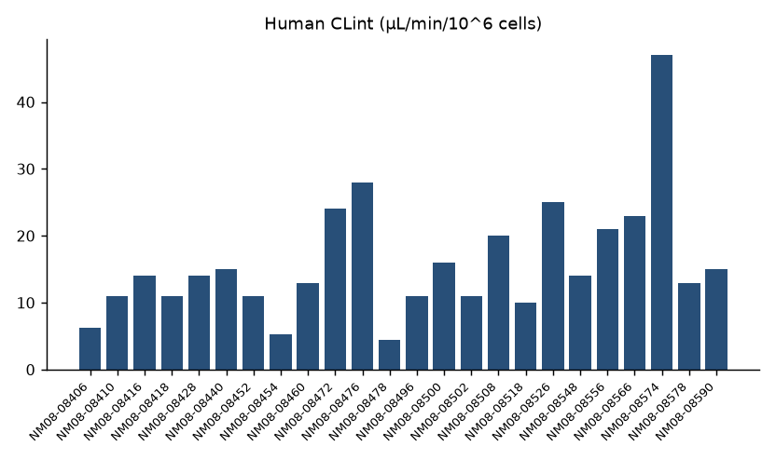
Human hepatocytes: turnover comparison
Merrivoss Bioanalysis Inc | Confidential 9
Notes:
Complete referenced test article set, in assay worksheet order; this is not a sorted ranking.

Slide 10
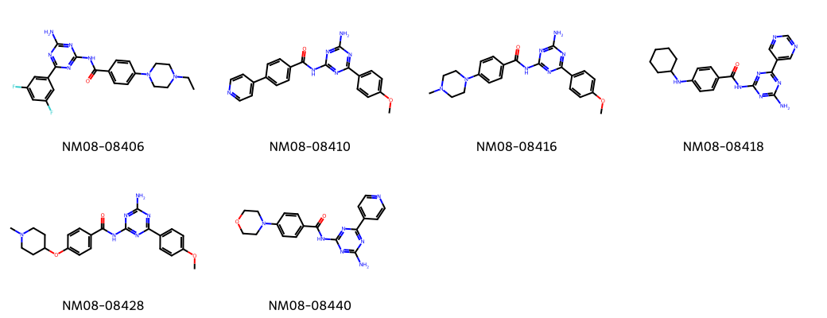
NM08 test article structures
Merrivoss Bioanalysis Inc | Confidential 10
Notes:
Representative structures aid identity matching; they do not designate nominated leads.

Slide 11
Exposure gate: paired-system interpretation
Nimbravelle advanced the analogues whose slower hepatocyte turnover agreed with their microsomal ranking.
Use concordance to support selection of the slower-turnover branch
These incubations do not establish oral exposure
Merrivoss Bioanalysis Inc | Confidential 11
Notes:
The decision is the recorded project outcome. No individual shortlist or new progression threshold is supplied. Cross-system disagreement does not identify its mechanism.

Slide 12
Final handoff and next use
Megan Larkin: retain the paired-system assumptions in the DMPK memo
Nimbravelle Medicines Inc: use the recorded selection direction for the next exposure assessment
Keep both matrix tables with selected analyte cards under M06/BIO/02077
Merrivoss Bioanalysis Inc | Confidential 12

