Slide 1
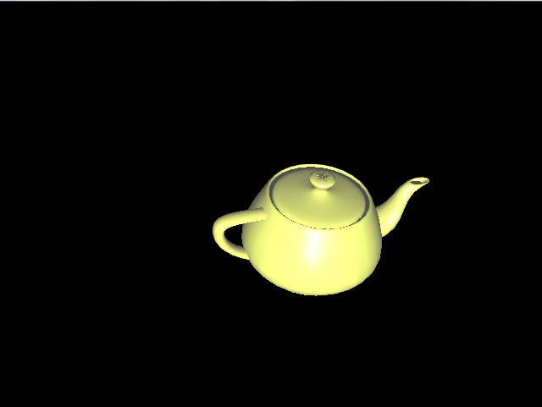
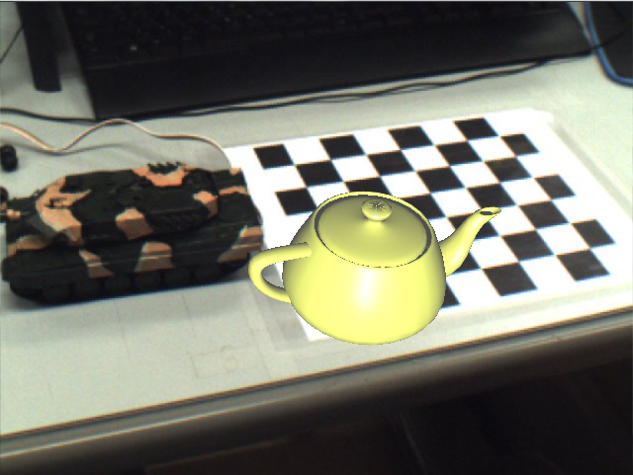
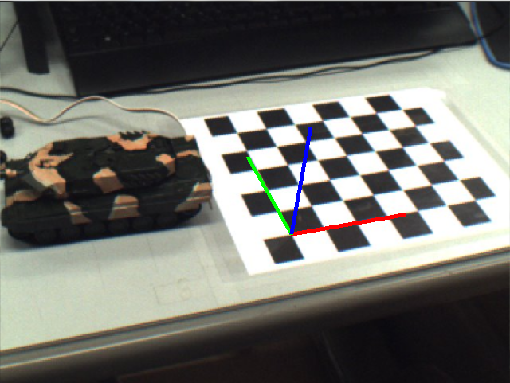
Computer Graphics
Computer Vision

Slide 2
P
p
Camera
center
Principal point

Slide 3
P
p
Camera
center
Principal point

Slide 4
Camera
center
Image plane
Principal point

