Slide 1

破密分析-從古典密碼學到現代密碼學
古典密碼及其破密分析
Cryptanalysis
Kryptós + analýein

Slide 2
classical ciphers
古典密碼
及其
破密分析

Slide 3
古典密碼 classical ciphers
https://en.wikipedia.org/wiki/Outline_of_cryptography
Substitution ciphers 替換加密 | https://en.wikipedia.org/wiki/Substitution_cipher
Monoalphabetic substitution | 凱撒密碼Caesar cipher(ROT13) [https://en.wikipedia.org/wiki/Caesar_cipher]
 | Affine cipher Atbash cipher Keyword cipher
Polyalphabetic substitution | Vigenère cipher (https://en.wikipedia.org/wiki/Vigen%C3%A8re_cipher) Autokey cipher Homophonic substitution cipher
Polygraphic substitution | Playfair cipher Hill cipher
Transposition ciphers 換位加密法 | https://en.wikipedia.org/wiki/Transposition_cipher
 | Rail Fence cipher Route cipher
 | Scytale Grille Permutation cipher VIC cipher

Slide 4
凱撒密碼@替換式密碼 Caesar cipher(ROT13) @Substitution cipher

Slide 5
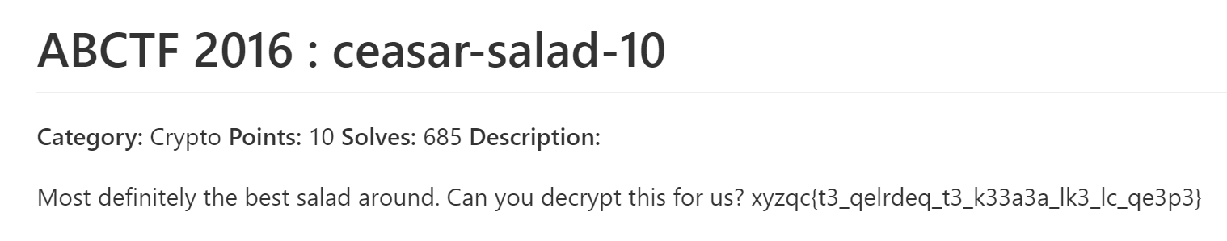
CTF- cryptography
ABCTF 2016 : ceasar-salad-10
https://github.com/ctfs/write-ups-2016/tree/master/abctf-2016/crypto/ceasar-salad-10

Slide 6
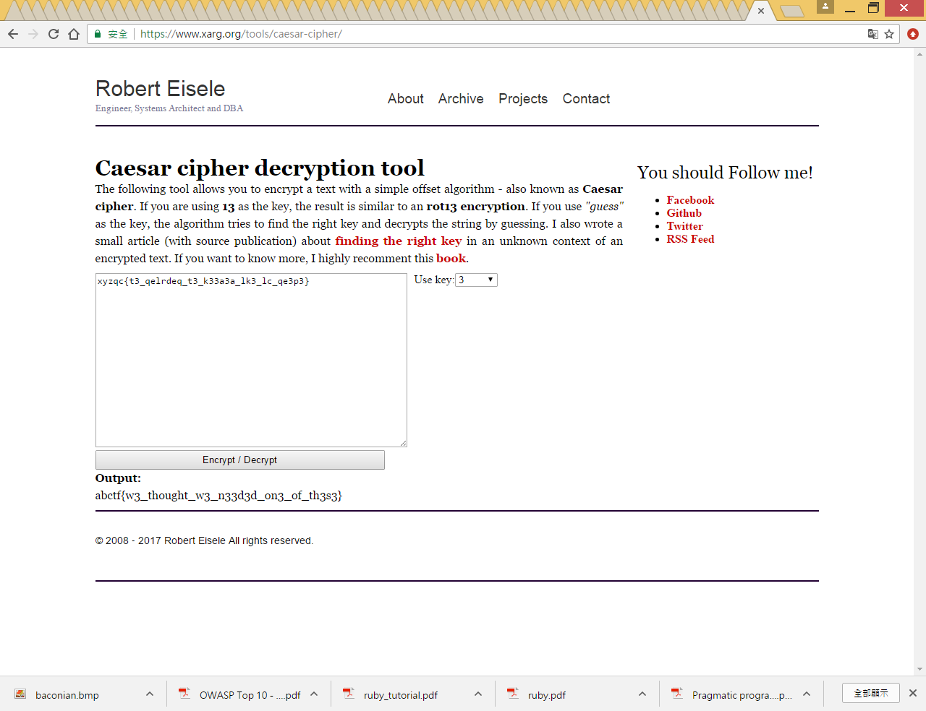
解法一::使用線上工具:輸入看看 http://www.xarg.org/tools/caesar-cipher/

Slide 7
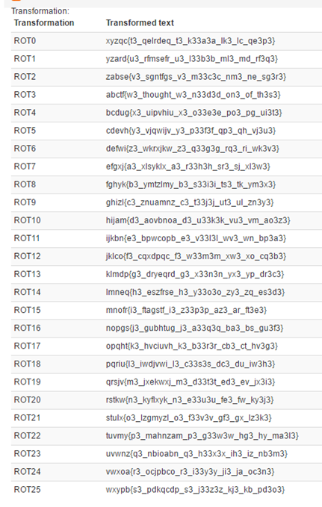
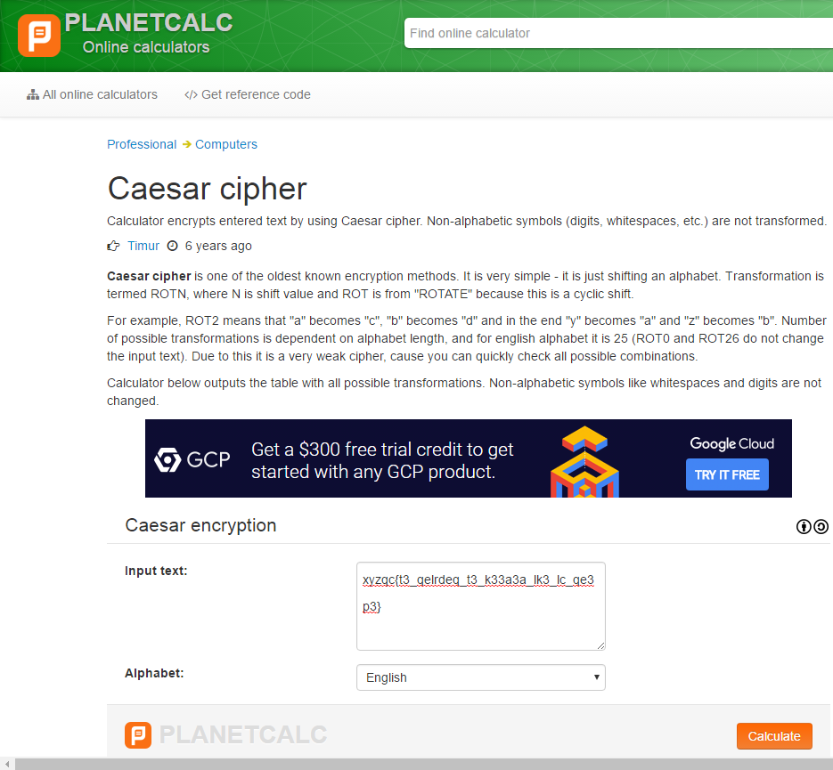
解法二::暴力破解法
https://planetcalc.com/1434/
暴力破解法[窮舉法]
Brute Force
把所有可能的方法都執行看看

Slide 8
解法三::直覺法
xyzqc{t3_qelrdeq_t3_k33a3a_lk3_lc_qe3p3}
abctf{FLAG}
https://kimiyuki.net/blog/2016/07/23/abctf-2016/
xyzqc
t3_qelrdeq_t3_k33a3a_lk3_lc_qe3p3
Caesar cipher
abctf
ROT-3
w3_thought_w3_n33d3d_on3_of_th3s3
https://en.wikipedia.org/wiki/Caesar_cipher

Slide 9
解法四::使用tr指令
echo 'xyzqc{t3_qelrdeq_t3_k33a3a_lk3_lc_qe3p3}' | tr x-za-w a-z
tr -help

Slide 10
解法四::使用Python解解看
https://github.com/rickvg/RC3-Fall-CTF-2016-write-ups/blob/master/Write-up-Salad/caesar.py
import sys
# Prepared alphabet for Caesar Cipher. Can be changed.
caesaralpha = "ABCDEFGHIJKLMNOPQRSTUVWXYZ0123456789"
def caesar(input_string, rot):
strFileInp = open(sys.argv[2], 'rb')
out = ""
strInp = strFileInp.read().decode("utf-8").rstrip("\n")
if sys.argv[1] == "all":
for i in range(1,len(caesaralpha)):
out += "ROT " + str(i) + ": " + caesar(strInp, i) + "\n"
else:
out = "ROT " + sys.argv[1] + ": " + caesar(strInp, sys.argv[2])
out = out.encode("utf-8")
print("Output: " + out.decode("utf-8"))
下一頁

Slide 11
解法四::使用Python解解看
def caesar(input_string, rot):
print("Rotating characters by: " + sys.argv[1])
output_string = ""
for i in range(0, len(input_string)):
introtation = int(rot)
if caesaralpha.index(input_string[i].upper()) + introtation >= len(caesaralpha):
intavailable = len(caesaralpha) - caesaralpha.index(input_string[i].upper())
introtation = introtation - intavailable
else:
introtation += caesaralpha.index(input_string[i].upper())
output_string += caesaralpha[introtation]
return output_string

Slide 12
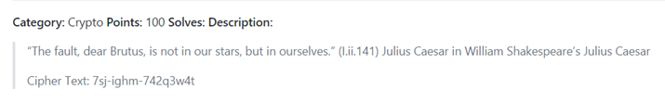
Your Turn
擴充版本
RC3 CTF 2016 : salad-100
https://github.com/ctfs/write-ups-2016/tree/master/rc3-ctf-2016/crypto/salad-100
RC3-2016-ROMANGOD
7sj-ighm-742q3w4t

Slide 13
7sj
RC3
0123456789ABCDEFGHIJKLMNOPQRSTUVWXYZ
ABCDEFGHIJ
KLMNOPQRSTUVWXYZ0123456789

Slide 14
0123456789ABCDEFGHIJKLMNOPQRSTUVWXYZ
KLMNOPQRSTUVWXYZ0123456789ABCDEFGHIJ
7sj-ighm-742q3w4t
RC3-2016-ROMANGOD

Slide 15
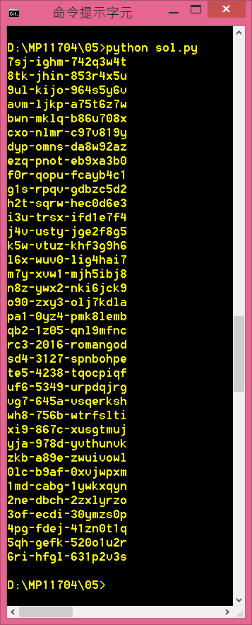
#!/usr/bin/env python3
alpha = 'abcdefghijklmnopqrstuvwxyz'
num = '0123456789'
alnum = alpha + num
ctext = '7sj-ighm-742q3w4t'
def rotate(s, num):
new1 = ''
for c in s:
if c in alnum:
new1 += alnum[(alnum.index(c) + num) % 36]
else:
new1 += c
return new1
for x in range(36):
print("{}".format(rotate(ctext, x)))

Slide 16
#!/usr/bin/env python3
import string
alphabet = string.ascii_lowercase + string.ascii_uppercase + string.digits
ctext = "7sj-ighm-742q3w4t"
def shift(n):
message = ""
for index, char in enumerate(ctext):
if char == "-":
message += char
else:
message += alphabet[(alphabet.index(ctext[index])+n)%len(alphabet)]
return message.upper()
for i in range(len(alphabet)):
message = shift(i)
if "RC3" in message:
print(message)

Slide 17
替換式密碼の頻率分析法 Substitution cipher
https://zh.wikipedia.org/wiki/%E9%A2%91%E7%8E%87%E5%88%86%E6%9E%90

Slide 18
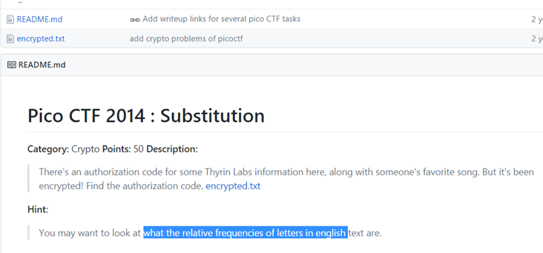
Pico CTF 2014 : Substitution
https://github.com/ctfs/write-ups-2014/tree/master/pico-ctf-2014/crypto/substitution-50

Slide 19
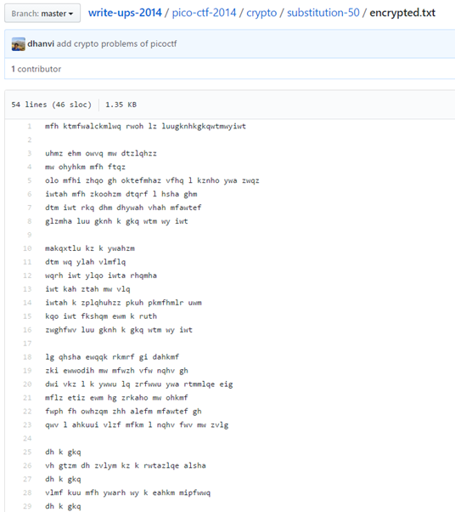

Slide 20
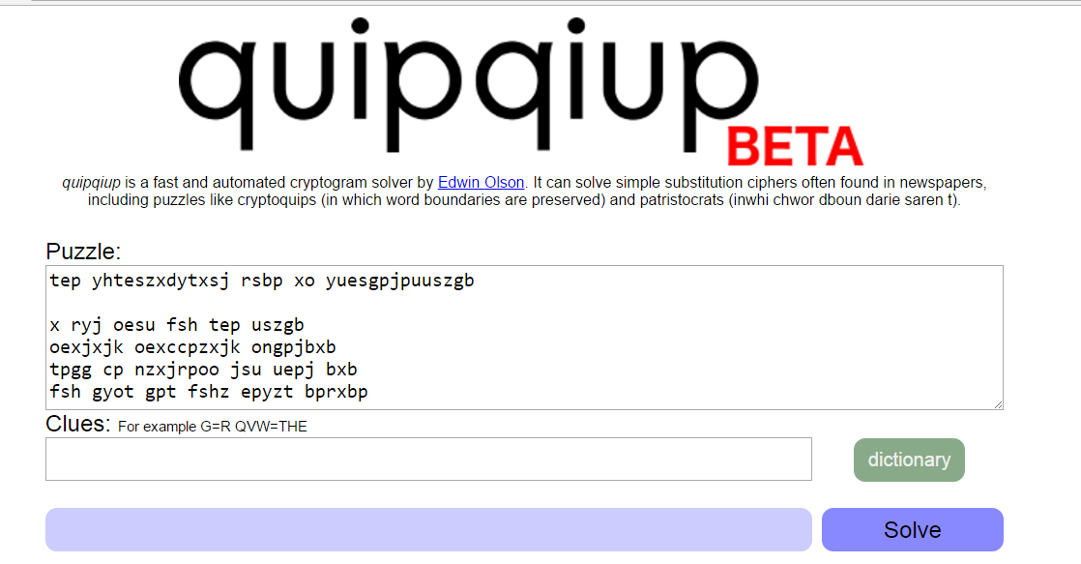
解法一:使用線上工具http://www.dcode.fr/scytale-cipher
①
②

Slide 21


解法一:使用線上工具
http://quipqiup.com/
③
答案

Slide 22
換位加密法 Transposition cipher

Slide 23
Scytale cipher
密碼棒

Slide 24
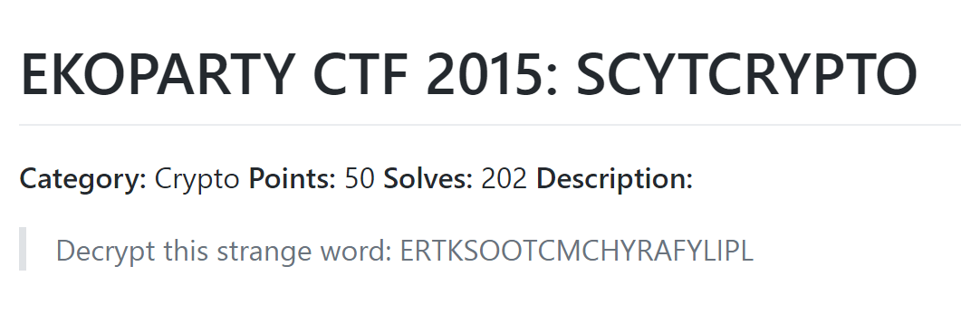
EKOPARTY CTF 2015: SCYTCRYPTO
https://github.com/ctfs/write-ups-2015/tree/master/ekoparty-ctf-2015/crypto/cry50
答案格式:EKO{XXXXXXXXXXXXXXXX}

Slide 25
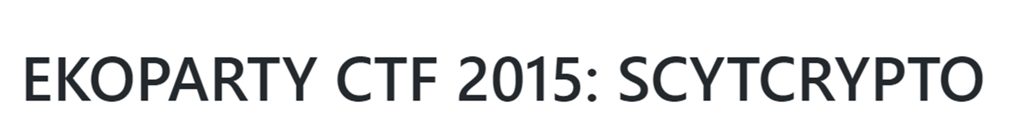
神猜法
題目告訴你
SCYTCrypto
題目又是密碼問題
scytale-cipher
www.dcode.fr/scytale-cipher

Slide 26
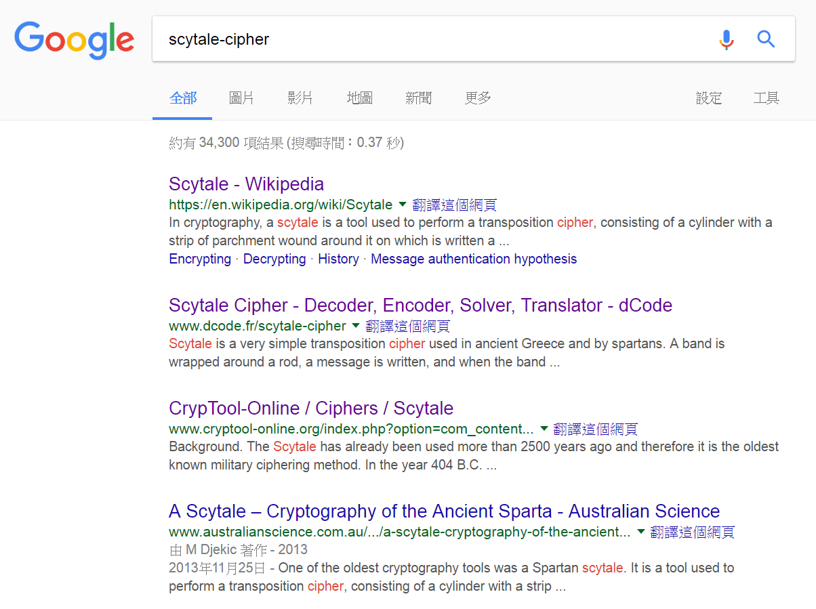
善用Google 看看

Slide 27
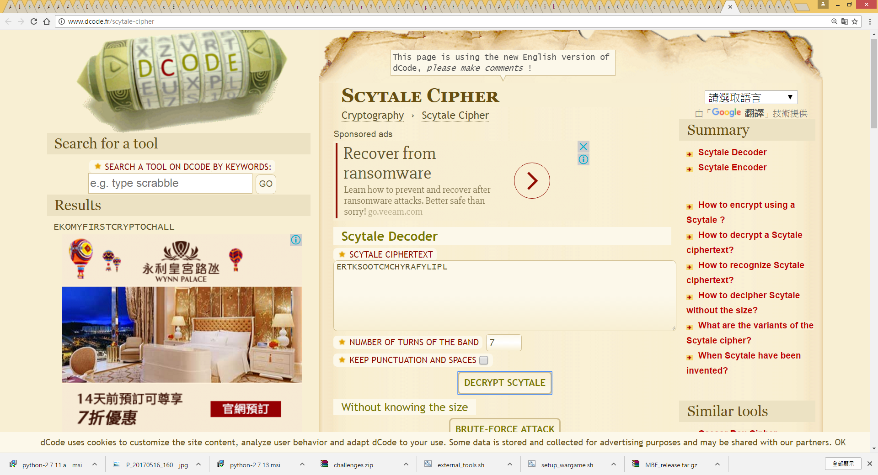
解法一:使用線上工具
http://www.dcode.fr/scytale-cipher
(3)解答在此
(1)輸入
(2)選擇

Slide 28
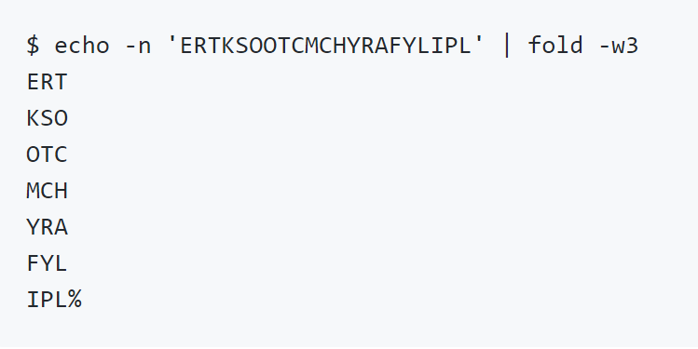
解法二:使用linux command
EKO{MYFIRSTCRYPTOCHALL}
ERTKSOOTCMCHYRAFYLIPL
Usage: fold [OPTION]... [FILE]...
Wrap input lines in each FILE, writing to standard output.
With no FILE, or when FILE is -, read standard input.
Mandatory arguments to long options are mandatory for short options too.
-b, --bytes count bytes rather than columns
-s, --spaces break at spaces
-w, --width=WIDTH use WIDTH columns instead of 80
--help display this help and exit
--version output version information and exit

Slide 29
AlexCTF Fore1-Hit_the_core
https://github.com/R3dCr3sc3nt/AlexCTF/blob/master/Fore1-Hit_the_core/README.md
fore1.core

Slide 30
解法
file fore1.core
strings fore1.core
cvqAeqacLtqazEigwiXobxrCrtuiTzahfFreqc{bnjrKwgk83kgd43j85ePgb_e_rwqr7fvbmHjklo3tews_hmkogooyf0vbnk0ii87Drfgh_n kiwutfb0ghk9ro987k5tfb_hjiouo087ptfcv}
cvqAeqacLtqazEigwiXobxrCrtuiTzahfFreqc{bnjrKwgk83kgd43j85ePgb_e_rwqr7fvbmHjklo3tews_hmkogooyf0vbnk0ii87Drfgh_n kiwutfb0ghk9ro987k5tfb_hjiouo087ptfcv}

Slide 31
解法
cvqAeqacLtqazEigwiXobxrCrtuiTzahfFreqc{bnjrKwgk83kgd43j85ePgb_e_rwqr7fvbmHjklo3tews_hmkogooyf0vbnk0ii87Drfgh_n kiwutfb0ghk9ro987k5tfb_hjiouo087ptfcv}
a='cvqAeqacLtqazEigwiXobxrCrtuiTzahfFreqc{bnjrKwgk83kgd43j85ePgb_e_rwqr7fvbmHjklo3tews_hmkogooyf0vbnk0ii87Drfgh_n kiwutfb0ghk9ro987k5tfb_hjiouo087ptfcv}'
a=a[3:]
flag = ''
for x in range(0,len(a),1):
if x%5==0:
flag+=a[x]
print flag
python sol.py
ALEXCTF{K33P_7H3_g00D_w0rk_up}

Slide 32
School CTF 2015: affine-cipher-100
Decrypt the message, which was encrypted with following rules:
for each letter of cipher text its position in the alphabet is the position of the original letter multiplied by 4 and shifted by 15 character
shift over alphabet is cyclic, so 'z' shifted by 1 is '_' and '_' shifted by 1 is 'a'
aplhabet consists of letters from 'a' to 'z' and symbol '_'
letter 'a' has position 0, symbol '_' has position 26 ( following 'z' )
Encrypted message: ifpmluglesecdlqp_rclfrseljpkq

Slide 33
shift over alphabet is cyclic, so 'z' shifted by 1 is '_' and '_' shifted by 1 is 'a'
aplhabet consists of letters from 'a' to 'z' and symbol '_'
letter 'a' has position 0, symbol '_' has position 26 ( following 'z' )
position 25
abcdefg………………………z_
position 0
position 26

Slide 34
abcdefg………………………z_
plain text
S[0] | S[1] |  |  | S[11] |  | S[15] |  | S[25] | S[26]
a | b |  |  | l |  | p |  | z | _
for each letter of cipher text its position in the alphabet is the position of the original letter multiplied by 4 and shifted by 15 character
d[4*0+15] =d[15] | d[4*1+15] =d[19] |  |  |  |  |  |  | S[25] | d[(4*26+15)%27] =d[(119)%27] =d[11]
cipher text
 |  |  |  | D[11] |  | D[15]
 |  |  |  | _ |  | a

Slide 35
使用dict來存對應表
cipher text
plain text
p
a
key
value

Slide 36
d[s[(c*4 + 15)%27]] = s[c]
a
plain text
d[s[(0*4 + 15)%27]] = s[0]
d[s[15]] ==d[p]
= s[0]=a
cipher text
ifpmluglesecdlqp_rclfrseljpkq

Slide 37
import string
s = string.ascii_lowercase # a-z
s += '_'
d = {}
for c in range(len(s)):
d[s[(c*4 + 15)%27]] = s[c]
ciphertext = 'ifpmluglesecdlqp_rclfrseljpkq'
s1 = ''
for x in ciphertext :
s1 += d[x]
print s1
for each letter of cipher text its position in the alphabet is the position of the original letter multiplied by 4 and shifted by 15 character

Slide 38
alphabet = "abcdefghijklmnopqrstuvwxyz_"
dictionary = {}
alphabet.each_char{|c|
dictionary[alphabet[(alphabet.index(c) * 4 + 15) % alphabet.length]] = c
}
puts "ifpmluglesecdlqp_rclfrseljpkq".chars.map{|c| dictionary[c]}.join
# => "flag_is_every_haxor_love_math"

