Slide 1
Citizen Identity (CID) Programme:
NHS login Service.
GP Credentials – scope and processing overview
Version 2
Presenter: Tom Mallon

Slide 2
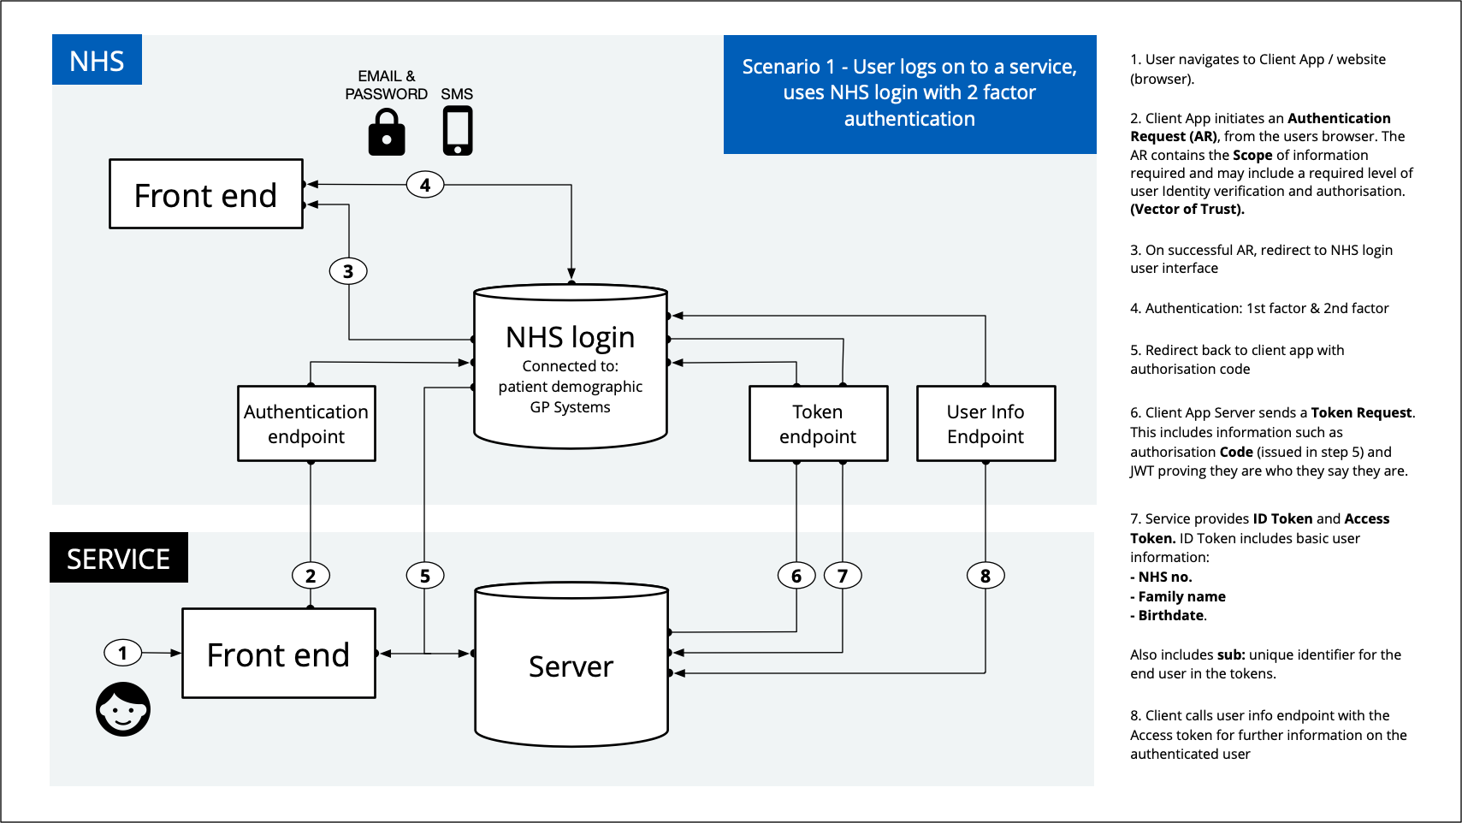
1. Introduction
The NHS login service (The Service) federation interface will be published on the NHS login partners website. It can also be accessed here.
https://stub.signin.nhs.uk/client?eis=true

Slide 3
1. Introduction
The Service supports a scope of "gp_integration_credentials" which will allow a Relying Party System (RPS) which has an IM1 pairing to retrieve:
GP Account ID,
GP ODS Code; and
GP Linkage Key information.
These three pieces of information are required to retrieve a user-and-client-specific token (aka passphrase) which is then used by the RPS to invoke the GP system Patient-Facing APIs.

Slide 4
1. Introduction
Retrieving these items of information via NHS login removes the need for the user of the RPS to enter it manually.
The following diagrams illustrate:
How NHS login processes a request from a RPS for gp_integration_credentials via the /userinfo endpoint; and
How a RPS can request new/refreshed gp_integration_credentials if they determine that the information held by NHS login is out of date.

Slide 5
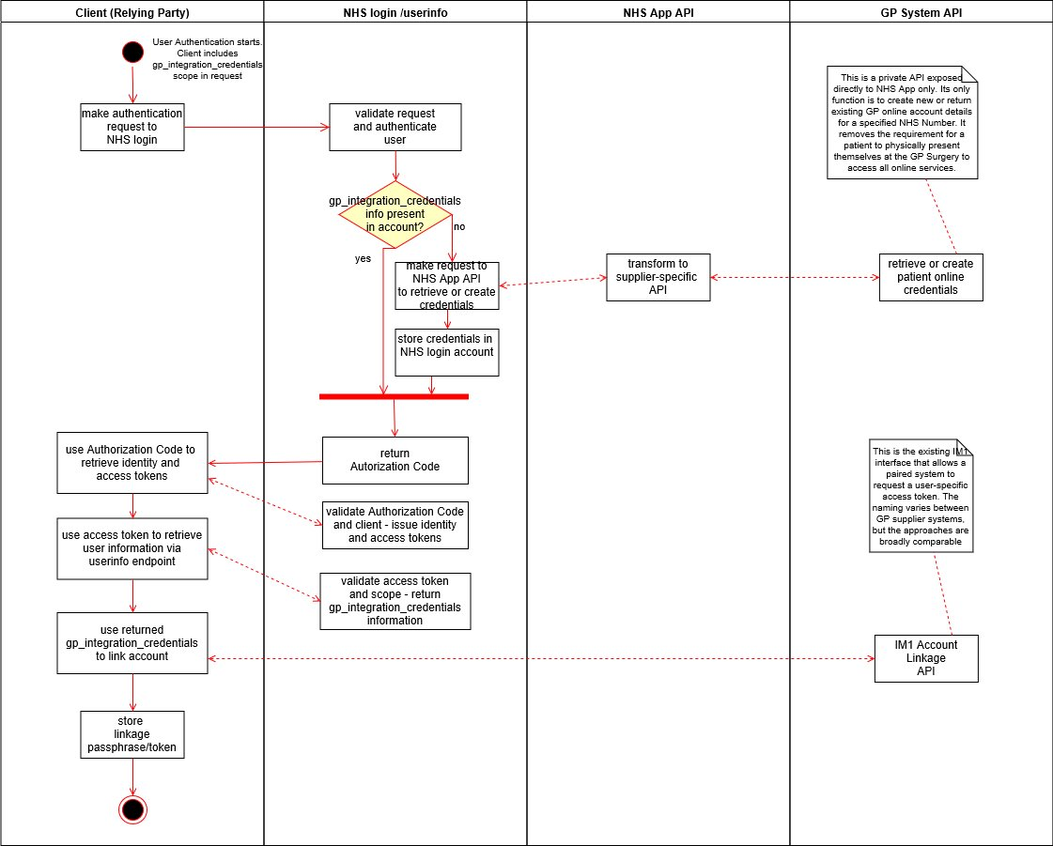
1. Retrieve or create a user’s GP login credentials

Slide 6
1. RPS determines the credentials are out of date/no longer valid.
When GP Integration Credentials are requested, NHS login perform a background check of the validity of stored GP Integration Credential information. As this check runs in the background it is also the responsibility of the Relying Party to validate that the credentials information returned by NHS login are valid (as the background check may not have completed before the login process completes).
If the RPS determines that the GPIC are not valid (or are not present in the /userinfo response) it can request that refreshed GPIC from NHS login by re-starting the login process. The “asserted_login_identity”* parameter can be utilised to avoid the need for the user to re-authenticate themselves. The RPS must keep the user informed of
*The EIS contains full details on utilising this parameter in an authentication request

Slide 7
1. RPS determines the credentials are out of date/no longer valid.
The reasons that the credentials might no longer be valid are:
The user has moved GP Practice.
The GP Practice has changed GP systems.
GP Practices merge / divides.
The user User keys have been revoked at the GP system “end”. This could be for multiple failed login attempts for example.
In cases 1,2 and 3 the ODS code for the user changes and will be detected by NHS login automatically via a separate background process that validates PDS information relating to the user.

Slide 8
1. RPS determines the credentials are out of date/no longer valid.
Assumptions made:
When linkage keys expire or get invalidated all the IM1 tokens generated using them also expire/get invalidated.

