Slide 1
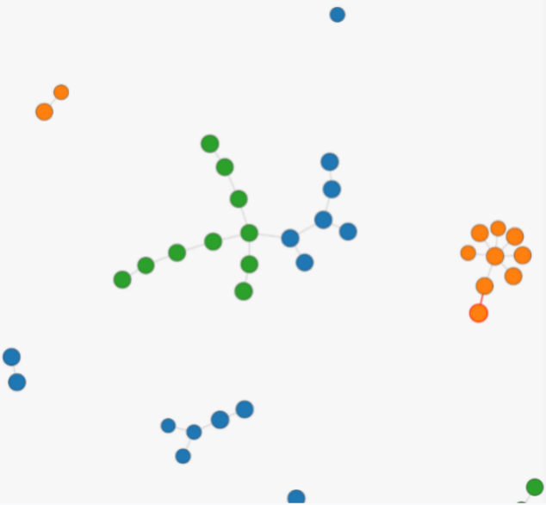
FINAL PRESENTATION
OpenEvolve-based Optimization for Yelp Review Agent Crew
A sequential CrewAI pipeline with a deterministic rating-scoring engine and layer-wise OpenEvolve optimization.
0.8785
0.8800
0.8769
best combined
preference
review gen
Vo Cong Vinh 611421316
ERIC 611321215
Notes:
Open by stating the final result first: best combined_score 0.8785 from Round 2 Agent Evolution. Then explain the main idea: the project is not just prompt tuning; it uses a rating-scoring mechanism and layer-wise OpenEvolve across agents, tasks, and eval policy.

Slide 2
CREW SEQUENTIAL PIPELINE
0
1
2
3
4
5
Input
Retrieve+ Score
Expose case
Analyze user
Analyze item
Predict review
user_id + item_id
llookup → flags → score
read evidence flags
Who is this user?
What is safe to say?
copy rating + write JSON
Agent: —
Agent: Data Retriever
Agent: Case Analyst
Agent: User Analyst
Agent: Item Analyst
Agent: Review Simulator
task JSON
prediction_context
+ rating trace
compact case JSON
user voice + style
safe facts + anchors
stars = predicted_stars
RATING COMPUTED HERE
VOICE
GROUNDED CONTENT
NO RECALCULATION
prediction_context contains
analysis tasks do not rate
final task only writes
case • user • item • review_policy predicted_stars • rating_weight_trace
User task controls voice. Item task controls grounded content.
copy predicted_stars exactly return raw JSON only
01

Slide 3
DATASET
USER.JSON
ITEM.JSON
REVIEW.JSON
38
432
4,164
rows
rows
rows
user_id
average_stars
review_count
yelping_since / elite
fans / useful / funny / cool
user_id + item_id
stars
text
date
item_id / business_id
stars
review_count
name / categories
attributes
city / state / is_open
TASK_I.JSON
GROUNDTRUTH_I.JSON
5
5
task files / pairs
target files / pairs
input: user_id + item_id
selects one user-item case
target stars
reference review for evaluator
02

Slide 4
PARAMETER SETTINGS
RUN COMMANDS
MODEL
ITERATIONS
minimaxai/minimax-m2.7
50 per run
# Agent layer
make evolve-agent ITERS=50 TASKS=1
# Task layer
make evolve-task ITERS=50 TASKS=1
# Eval-policy layer
make evolve-eval ITERS=50 TASKS=1
TASKS
TIMEOUT
1 sampled pair
2000 seconds
TARGETS
METRICS
agent / task / eval YAML
preference + review + combined
Every run = 50 iterations on 1 task-groundtruth pair
Evaluation
Candidate YAML
Sampled task
Evaluator
Checkpoint DB
agent / task / eval
TASKS = 1
preference + review
visualizer output
03

Slide 5
AGENTS
Agent
Role / goal
Tool use / constraint
1. Exact Yelp Data Retriever
Lookup user, item, and direct-review evidence; build prediction_context with predicted_stars + trace.
Lookup tools allowed only here
2. Yelp Case Detection Analyst
Classify evidence availability and route what later agents may use.
No extra tools
3. Yelp User Behavior Analyst
Turn user history into voice: rating tendency, writing style, vocabulary, length.
No tools; no star recalculation
4. Yelp Item Review Context Analyst
Turn item + direct-review evidence into safe facts, anchors, and forbidden claims.
No tools; no invented facts
5. Deterministic Review Simulator
Write final JSON review using user voice + grounded content.
No tools; copy predicted_stars
TOOL BOUNDARY
EVIDENCE BOUNDARY
RATING BOUNDARY
Only retrieval/scoring uses lookup tools.
Missing user/item/direct-review evidence cannot be invented.
Final agent writes review, but cannot change predicted_stars.
Agent evolution improves behavior, personalization, grounding, and JSON reliability — while the deterministic scoring layer controls the rating.
04
Notes:
The table shows the sequential crew roles and boundaries. The retriever is the only agent allowed to use lookup tools and it builds prediction_context with predicted_stars. The case analyst routes evidence. The user analyst controls voice. The item analyst controls grounded content. The final simulator writes JSON and copies predicted_stars exactly.

Slide 6
TASKS
Task
Purpose
Input
Expected output
Guardrail
analyze_user
_behavior_task
Convert user history into voice and personalization signals.
user profile / history
user_average, bias, sentiment map, writing style
No invented preferences
1
analyze_item_review_context_task
Convert item + direct-review evidence into safe review-writing guidance.
item + direct review + review_policy
safe item evidence, anchors, phrasing constraints
Do not change predicted_stars
2
predict_review
_task
Write final JSON review using all analysis outputs.
all analyses + predicted_stars
{stars, review}
stars = predicted_stars exactly
3
05

Slide 7
RATING POLICY PARAMETERS
Group
Settings
Values
Meaning
Fallback + rounding
default_prior
rounding mode
range
3.8
half-up, 1 decimal
1.0–5.0
Use a safe fallback when no evidence exists; keep stars standardized for evaluation.
Evidence weights
base_user_weight
base_item_weight
direct_review_weight
0.20
0.20
0.60
Decide which evidence matters most. Direct review is strongest when available; missing signals are removed.
Confidence policy
user/item divisors
user/item bonuses
multiplier range
50 / 100
+0.25 / +0.20
0.70–1.30
More review_count means stronger confidence, so user/item weights become more reliable.
History blend
user_history_blend
item_history_blend
min history count
0.25
0.20
3 reviews
Blend profile averages with review history to make user/item signals more stable.
Anchor policy
user anchor
item anchor
≥30 reviews, ±0.70
≥80 reviews, ±1.10
Prevent the weighted score from jumping too far away from reliable user/item evidence.
Anti-saturation
require direct for 5
no-direct max
direct adjustment
true
4.7
+0.4
Avoid unsupported 5.0 predictions and prevent user/item averages from drifting too far from direct review.
!
Key idea: parameters convert raw evidence into stable predicted_stars; the final agent only writes the review and copies the score.
06

Slide 8
CORE NOVELTY
Rating-scoring mechanism
1
LOOKUP EVIDENCE
2
BUILD SIGNALS
3
COMPUTE WEIGHTS
raw files → fields
ratings from evidence
importance + reliability
Read user.json, item.json, review.json
Check: user exists? item exists? direct review exists?
Output: evidence flags + raw evidence
user_signal = blend(user.average_stars, user_history_average_stars)
item_signal = blend(item.stars, item_history_average_stars)
direct_signal = direct_review_stars
user_weight = base_user_weight × user confidence
item_weight = base_item_weight × item confidence
direct_weight = direct_review_weight
4
SCORE AVAILABLE EVIDENCE
5
APPLY SAFETY GUARDS
6
FINAL JSON
stability rules
LLM writes text only
missing signals removed
score = Σ(signal × weight) / Σ(available weights)
If a signal is missing, remove its weight and renormalize
This is where evidence becomes a numeric rating
Anchor policy: keep score near reliable user/item averages
Anti-saturation: prevent unsupported 5.0 ratings
Round half-up to one decimal → predicted_stars
stars = predicted_stars exactly
Review text uses grounded evidence and user style
No rating recalculation in the final agent
Key message:
The rating policy owns the stars: it converts raw evidence into signals, assigns confidence-adjusted weights, scores available evidence, applies guards, and locks predicted_stars before the LLM writes the review.
07

Slide 9
SCORING POLICY
Evidence-aware case routing: robust to missing data
Case
User
Item
Direct Review
Policy
RENORMALIZATION
1
✓
✓
✓
direct review dominates
↗
If a signal is missing, remove its weight and rescale remaining evidence.
2
✓
✓
✗
user + item
3
✗
✓
✓
direct review + item
4
✗
✓
✗
item only
NO INVENTION
✓
5
✓
✗
✓
direct review + user
No fake user preferences, item facts, or direct-review details.
6
✓
✗
✗
user only
7
✗
✗
✓
direct review only
This makes TASKS=1 safer because
any sampled evidence case can be
handled explicitly.
✓
8
✗
✗
✗
default prior
08
Notes:
The case-routing table shows how the crew handles missing evidence. Detect case does not recalculate rating. It reads evidence flags and routes later agents so the model only uses available evidence. Missing weights are removed and remaining evidence is rescaled.

Slide 10
GENERAL FORMULA
How rating becomes predicted_stars
1. SIGNALS
2 . CONFIDENCE WEIGHTS
3. SCORE
user_signal = (1 − user_history_blend_weight) × user.average_stars
+ user_history_blend_weight × user_history_average_stars
item_signal = (1 − item_history_blend_weight) × item.stars
+ item_history_blend_weight × item_history_average_stars
direct_signal = direct_review_stars
user_weight = base_user_weight × [1 + user_confidence_bonus × min(user.review_count / user_confidence_divisor, 1)]
item_weight = base_item_weight × [1 + item_confidence_bonus × min(item.review_count / item_confidence_divisor, 1)]
direct_weight = direct_review_weight
score = Σ(signal × weight) / Σ(available weights)
Missing evidence rule:
if a signal is missing, remove its weight and renormalize remaining signals.
predicted_stars = round_half_up(score, decimal_places)
SAFETY GUARDS
ANCHOR POLICY
ANTI-SATURATION
FINAL REVIEW
If user.review_count ≥ user_anchor_min_review_count:
score stays within user.average_stars ± user_anchor_max_delta
If item.review_count ≥ item_anchor_min_review_count:
score stays within item.stars ± item_anchor_max_delta
If no direct review and require_direct_review_for_5 is true:
score ≤ no_direct_review_max_stars
If direct_review_stars < max_stars:
score ≤ direct_review_stars + direct_review_max_adjustment
Final agent writes the review only.
stars = predicted_stars exactly.
No rating recalculation.
09

Slide 11
EVIDENCE CASE
Case 1. User ✓ Item ✓ Direct ✓
All evidence exists: direct review dominates; user and item calibrate.
USER ✓
ITEM ✓
DIRECT ✓
FORMULA
IN WORDS
INPUT EVIDENCE
user_signal = 0.75×4.6 + 0.25×4.2 = 4.50
item_signal = 0.80×4.1 + 0.20×4.3 = 4.14
user_weight = 0.20×[1+0.25×min(40/50,1)] = 0.24
item_weight = 0.20×[1+0.20×min(120/100,1)] = 0.24
direct_weight = 0.60
score = (4.50×0.24 + 4.14×0.24 + 5.0×0.60)
/ (0.24+0.24+0.60)
score = 4.697 → predicted_stars = 4.7
Direct review is the real user-item interaction, so it dominates. User and item signals only adjust the score slightly.
user.average_stars = 4.6
user_history_avg = 4.2
user.review_count = 40
item.stars = 4.1
item_history_avg = 4.3
item.review_count = 120
direct_review_stars = 5.0
REVIEW GENERATION
Use direct-review sentiment first. Add user style and item facts only when grounded.
{"stars": 4.7, "review": "Great overall experience. The place felt very positive, and the tone matches a strong direct review while sounding like the user style."}
10

Slide 12
EVIDENCE CASE
Case 2. User ✓ Item ✓ Direct ✗
No exact interaction: user and item are useful, but cannot prove a perfect score.
USER ✓
ITEM ✓
DIRECT ✗
FORMULA
IN WORDS
INPUT EVIDENCE
user_signal = 0.75×4.9 + 0.25×4.6 = 4.825
item_signal = 0.80×4.8 + 0.20×4.7 = 4.78
user_weight = 0.20×[1+0.25×min(60/50,1)] = 0.25
item_weight = 0.20×[1+0.20×min(150/100,1)] = 0.24
score = (4.825×0.25 + 4.78×0.24) / (0.25+0.24)
score = 4.803
No direct review → score = min(4.803, 4.7)
predicted_stars = 4.7
User and item look strong, but there is no exact user-item review. Anti-saturation prevents an unsupported near-5.0 rating.
user.average = 4.9
user_history_avg = 4.6
user.review_count = 60
item.stars = 4.8
item_history_avg = 4.7
item.review_count = 150
direct_review = missing
REVIEW GENERATION
Write generally from user tendency + item quality. Do not claim the user visited or reviewed this item.
{"stars": 4.7, "review": "This looks like a strong option overall. The user positive rating pattern and the item high quality suggest a favorable experience, but the wording stays general."}
11

Slide 13
EVIDENCE CASE
Case 3. User ✗ Item ✓ Direct ✓
User profile missing: direct review guides the rating; item evidence provides context.
USER ✗
ITEM ✓
DIRECT ✓
FORMULA
IN WORDS
INPUT EVIDENCE
item_signal = 0.80×4.2 + 0.20×4.0 = 4.16
item_weight = 0.20×[1+0.20×min(100/100,1)] = 0.24
direct_weight = 0.60
score = (4.16×0.24 + 3.0×0.60) / (0.24+0.60)
score = 3.331
Direct cap: max_allowed = 3.0 + 0.4 = 3.4
score = min(3.331, 3.4) = 3.331
predicted_stars = 3.3
The item seems good, but direct review is only 3.0. Since user profile is missing, the system cannot infer user preferences.
user = missing
item.stars = 4.2
item_history_avg = 4.0
item.review_count = 100
direct_review_stars = 3.0
REVIEW GENERATION
Use direct review tone and safe item facts. Avoid user-specific claims.
{"stars": 3.3, "review": "The experience sounds mixed. The direct review points to a lukewarm impression, so the review stays balanced rather than strongly positive."}
12

Slide 14
EVIDENCE CASE
Case 4. User ✗ Item ✓ Direct ✗
Only business evidence exists: the rating becomes item-grounded.
USER ✗
ITEM ✓
DIRECT ✗
FORMULA
IN WORDS
INPUT EVIDENCE
item_signal = 0.80×4.2 + 0.20×4.0 = 4.16
Only item evidence exists:
score = item_signal = 4.16
predicted_stars = round_half_up(4.16, 1)
predicted_stars = 4.2
There is no user profile and no direct interaction. The system only trusts item profile and item review history.
user = missing
item.stars = 4.2
item_history_avg = 4.0
item.review_count = 100
direct_review = missing
REVIEW GENERATION
Write an item-grounded review. Avoid user voice and direct-visit claims.
{"stars": 4.2, "review": "This seems like a generally solid business based on the item-level evidence. The tone is positive, but it avoids user-specific claims."}
13

Slide 15
EVIDENCE CASE
Case 5. User ✓ Item ✗ Direct ✓
Item profile missing: direct review remains the main evidence.
USER ✓
ITEM ✗
DIRECT ✓
FORMULA
IN WORDS
INPUT EVIDENCE
user_signal = 0.75×4.6 + 0.25×4.2 = 4.50
user_weight = 0.20×[1+0.25×min(40/50,1)] = 0.24
direct_weight = 0.60
score = (4.50×0.24 + 2.0×0.60) / (0.24+0.60)
score = 2.714
Direct cap: max_allowed = 2.0 + 0.4 = 2.4
score = min(2.714, 2.4) = 2.4
predicted_stars = 2.4
The user usually rates high, but the exact direct review is negative. The cap prevents user average from pulling the score too far upward.
user.average = 4.6
user_history_avg = 4.2
user.review_count = 40
item = missing
direct_review_stars = 2.0
REVIEW GENERATION
Use direct-review negativity and user style. Avoid item-specific details because item is missing.
{"stars": 2.4, "review": "This feels like a disappointing experience overall. The direct review signal is clearly negative, so the review stays critical while matching user style."}
14

Slide 16
EVIDENCE CASE
Case 6. User ✓ Item ✗ Direct ✗
Only user evidence exists: estimate from user tendency only.
USER ✓
ITEM ✗
DIRECT ✗
FORMULA
IN WORDS
INPUT EVIDENCE
user_signal = 0.75×3.4 + 0.25×3.0 = 3.30
Only user evidence exists:
score = user_signal = 3.30
predicted_stars = round_half_up(3.30, 1)
predicted_stars = 3.3
The system only knows how the user tends to rate. It cannot ground business-specific claims, so rating and review stay generic.
user.average = 3.4
user_history_avg = 3.0
user.review_count = 20
item = missing
direct_review = missing
REVIEW GENERATION
Match user rating tendency. Do not invent business details.
{"stars": 3.3, "review": "A moderate impression overall. The review follows the user usual rating tendency, but avoids specific claims about the business."}
15

Slide 17
EVIDENCE CASE
Case 7. User ✗ Item ✗ Direct ✓
Only direct review exists: the score follows the exact interaction.
USER ✗
ITEM ✗
DIRECT ✓
FORMULA
IN WORDS
INPUT EVIDENCE
Only direct review evidence exists:
score = direct_review_stars
score = 4.0
predicted_stars = 4.0
There is no user or item profile. Direct review is the only trusted evidence, so predicted stars equal direct review stars.
user = missing
item = missing
direct_review_stars = 4.0
REVIEW GENERATION
Follow direct-review sentiment only. Do not add unsupported user or item facts.
{"stars": 4.0, "review": "A positive experience overall. The review follows the direct review sentiment and avoids unsupported user-profile or business-specific details."}
16

Slide 18
EVIDENCE CASE
Case 8. User ✗ Item ✗ Direct ✗
No evidence exists: use safe default prior and low-specificity review.
USER ✗
ITEM ✗
DIRECT ✗
FORMULA
IN WORDS
INPUT EVIDENCE
No evidence exists:
score = default_prior
score = 3.8
predicted_stars = 3.8
The system does not invent missing evidence. It uses the default prior as a safe fallback rating.
user = missing
item = missing
direct_review = missing
default_prior = 3.8
REVIEW GENERATION
Write generic, neutral-to-positive text. Avoid specific facts.
{"stars": 3.8, "review": "A generally decent experience overall. The review stays neutral-to-positive and avoids specific details because there is no user, item, or direct-review evidence."}
17

Slide 19
REVIEW GENERATION MECHANISM
1
CONTEXT INPUTS
2
CASE BOUNDARY
3
USER VOICE
4
ITEM GROUNDING
5
FINAL JSON
prediction_context contains:
• predicted_stars
• case flags
• user + item evidence
• review_style
• review_policy
Use case flags to decide:
• what evidence exists
• what is missing
• what claims are safe
No invented visit or item facts.
Match the user:
• rating tendency
• sentiment strength
• vocabulary level
• length + structure
• opening / closing style
Use only verified content:
• item facts
• direct review details
• safe anchors
• forbidden claims
If absent, stay generic.
{
"stars": predicted_stars,
"review": generated_text
}
No rating recalculation.
No extra fields.
GENERATION CONTRACT
✓
STAR LOCK
G
GROUNDING RULE
S
STYLE RULE
stars must equal predicted_stars exactly.
The review simulator writes text only.
Every detail must come from prediction_context.
Missing evidence means lower specificity.
Use user voice when available; otherwise use neutral Yelp-style wording matched to the locked stars.
18

Slide 20
METHODOLOGY
Two-round layerOpenEvolve strategy
RPP: Rating Policy Parameters
ROUND 1
YAML
Initial crew
A
R1 Agent
T
R1 Task
E
R1 RPP
BEST
Composed best
baseline YAML
0.8677
0.8691
0.8702
new baseline
ROUND 2
BEST
Composed best
A
R2 Agent
T
R2 Task
E
R2 RPP
WIN
Final best pipeline
starting point
refine agent
refine task
refine eval
after recomposition
!
WHY CREATIVE?
?
WHY ANALYZABLE?
✓
WHY USEFUL?
Not a single prompt search.
Each layer has a separate evolvable role.
Each run has checkpoint stats,
visualizer paths, and Gen-0 comparisons.
Round 2 exposes cross-layer effects
after recomposition.
Core idea: evolve each layer separately, compose the winners, then evolve again.
19
Notes:
This slide shows the methodology. Round 1 evolves agents, tasks, and the evaluation policy separately, then composes the best components. Round 2 starts from the composed-best baseline and refines the layers again to reveal cross-layer effects.

Slide 21
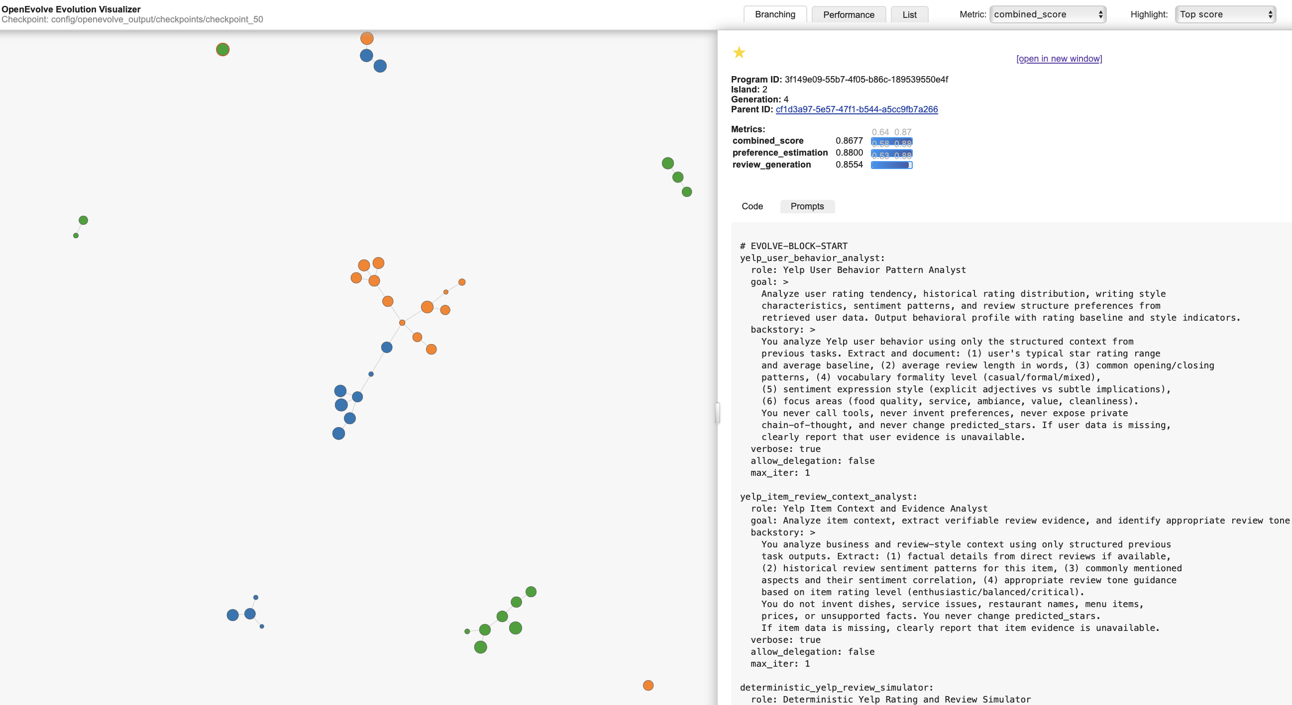
EVOLUTION ANALYSIS
Round 1 Agent
candidate
branch
parent
Best combined score:
0.8677
20

Slide 22
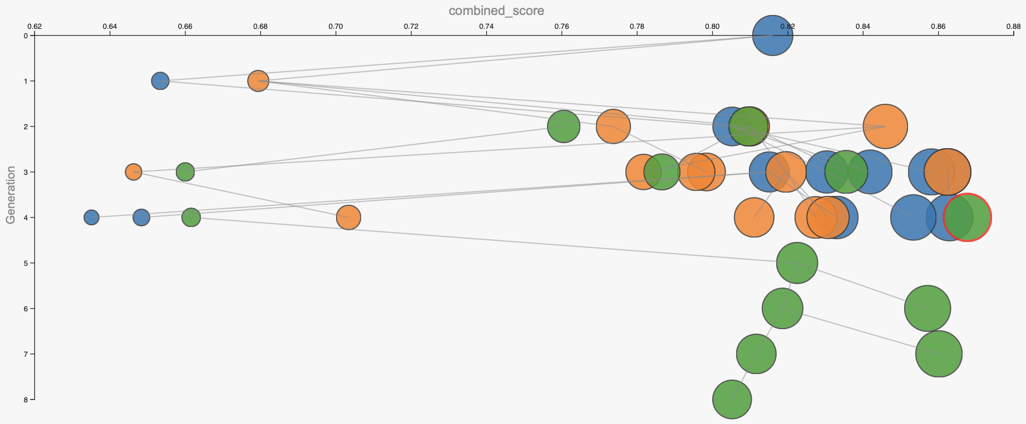
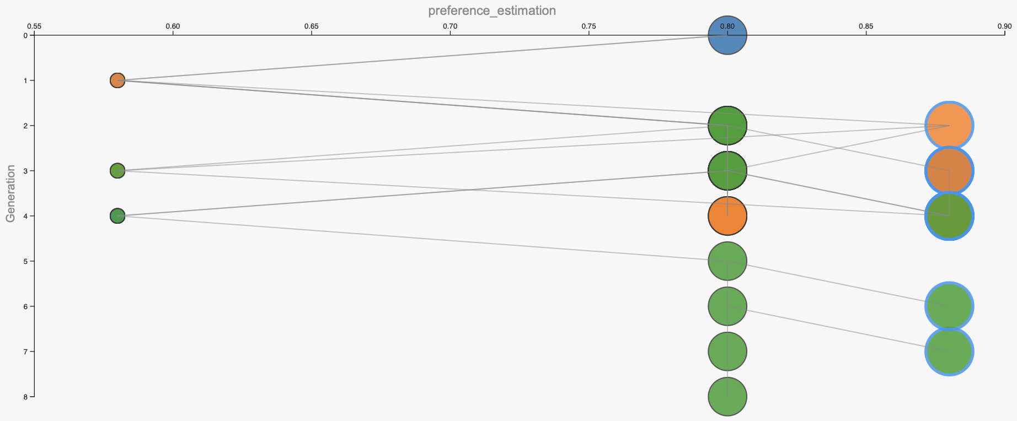
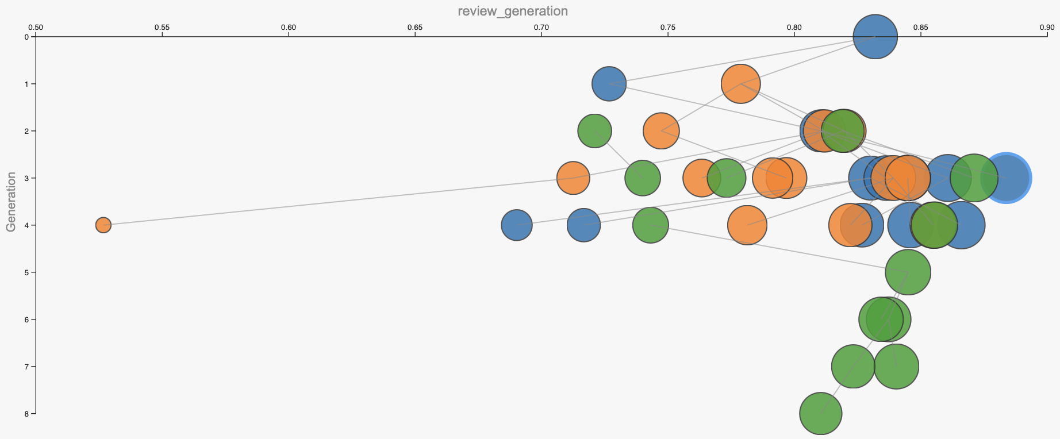
EVOLUTION ANALYSIS
Round 1 Agent
Combined score
0.8677
Preference_estimation
0.8800
Review generation
0.8554
21

Slide 23
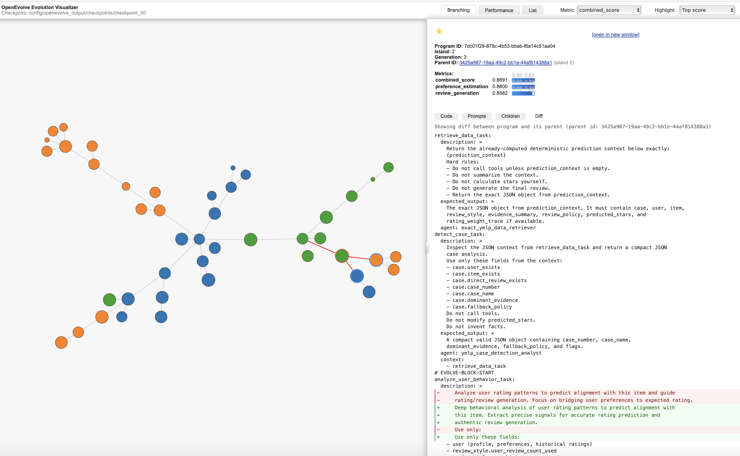
EVOLUTION ANALYSIS
Round 1 Task
candidate
branch
parent
22

Slide 24
EVOLUTION ANALYSIS
Round 1 Agent Evolution
WHAT CHANGED
WHY IT HELPED
TRADE-OFF
Final simulator became style-aware: openings, detail density, closing patterns.
Review sounds closer to the target user instead of generic Yelp text.
Can feel formulaic if style rules are applied too rigidly.
Grounding rule became stricter: use only verified item evidence.
Reduces hallucinated dishes, service issues, names, or unsupported facts.
Sparse evidence leads to less detailed reviews.
Added sentiment intensity and leniency / harshness behavior.
Tone better matches user personality while stars stay locked.
May exaggerate user bias when evidence is weak.
KEY MESSAGE
OpenEvolve improved the final writer, not the rating formula — style became more authentic while predicted_stars stayed locked.
23

Slide 25
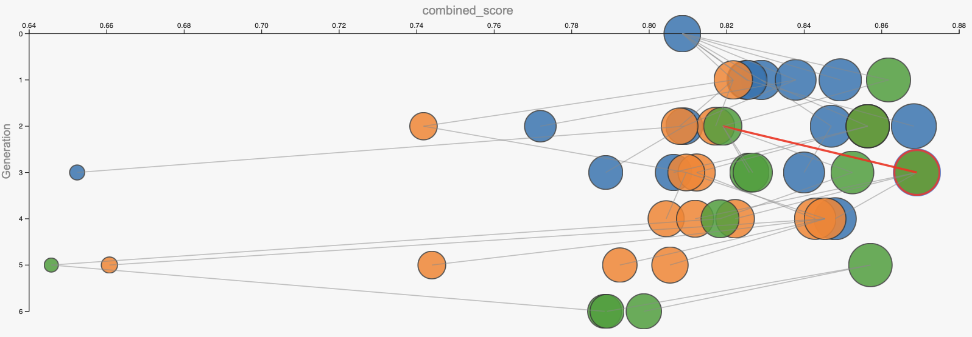
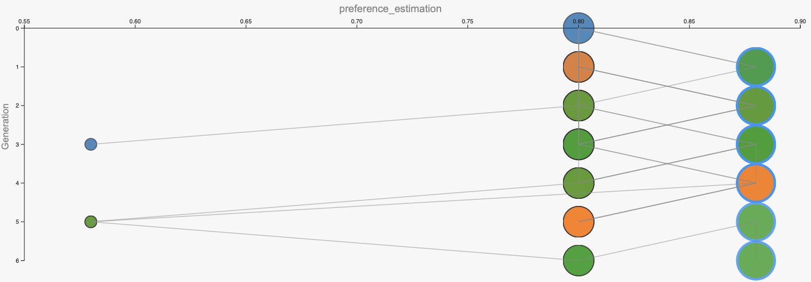
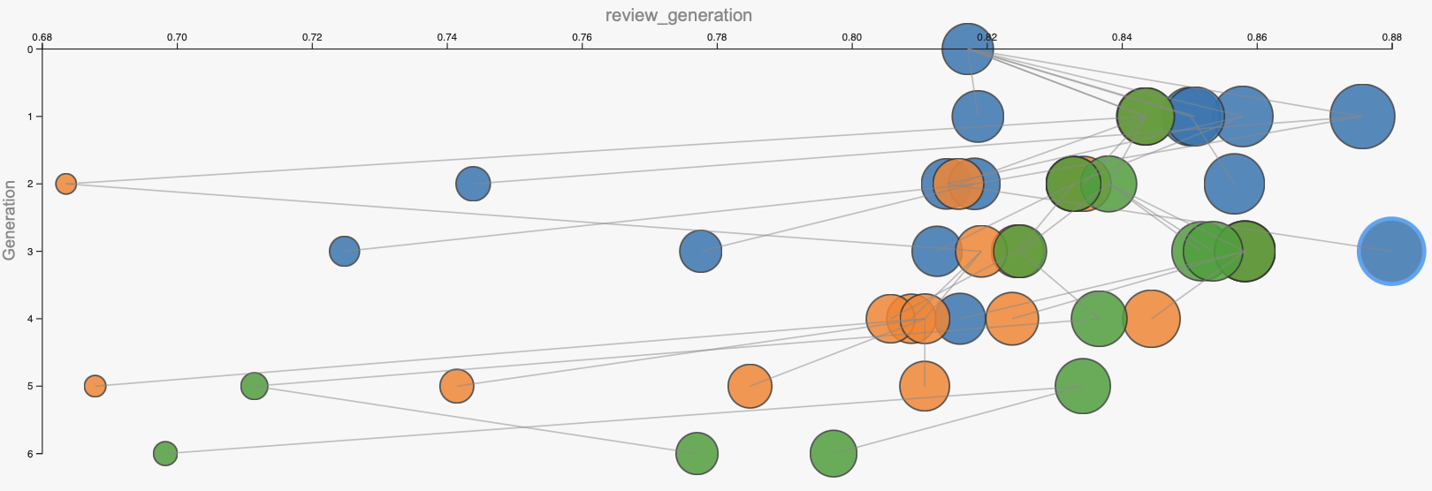
EVOLUTION ANALYSIS
Round 1 Task
Combined score
0.8691
Preference_estimation
0.8800
Review generation
0.8582
24

Slide 26
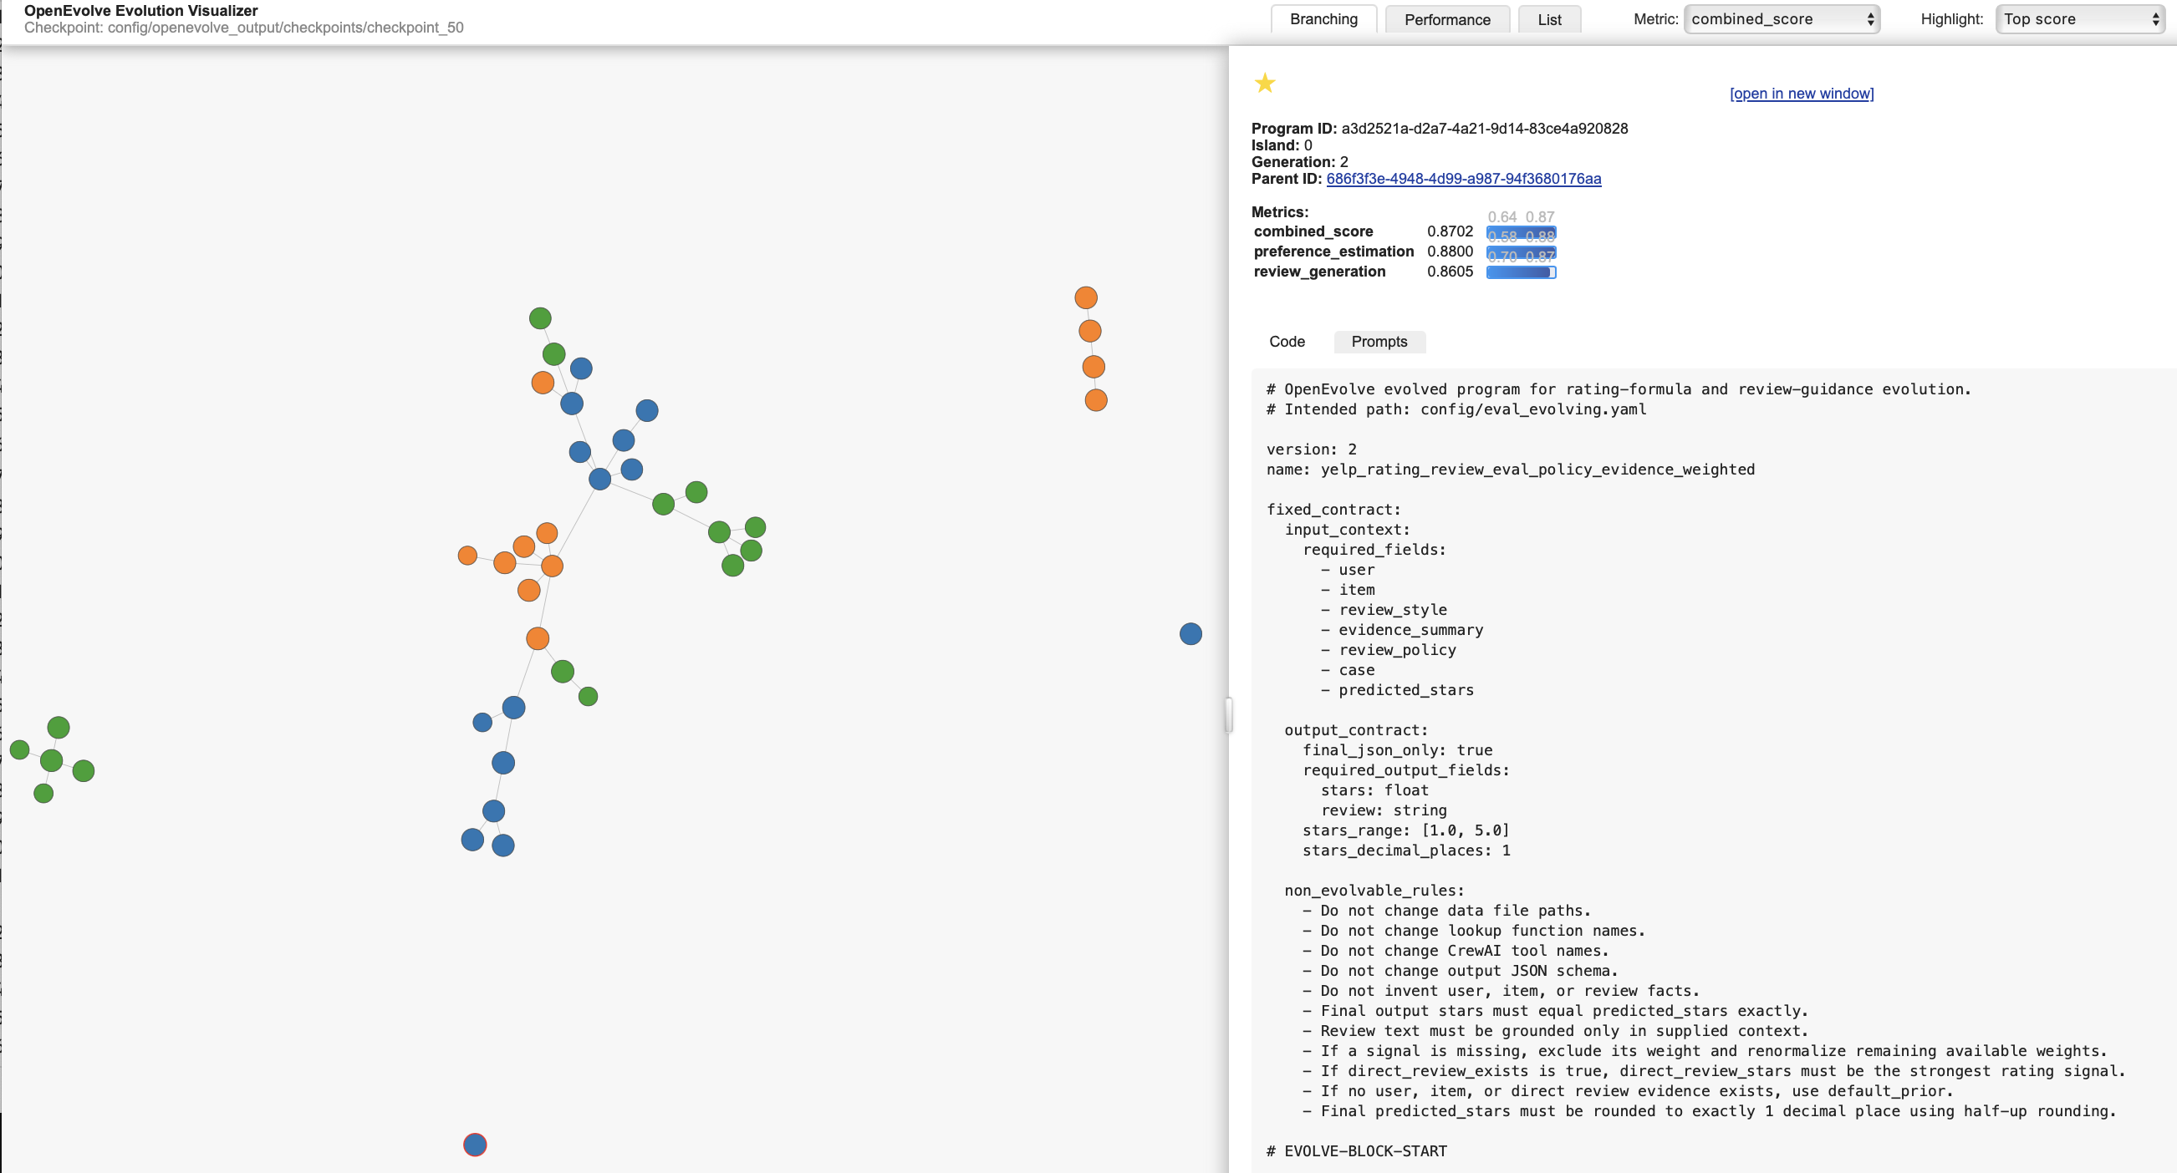
EVOLUTION ANALYSIS
Round 1 RPP
candidate
branch
parent
25

Slide 27
EVOLUTION ANALYSIS
Task evolution: clearer contracts, safer final output
WHAT CHANGED
WHY IT HELPED
TRADE-OFF
User task became signal-based: user average, deviation, bias, style markers.
Gives downstream agents clear behavioral signals.
Less useful when user history is sparse.
Item task became review-writing guidance: anchors, constraints, emotional arc.
Converts item/direct evidence into safe wording cues.
Improves review text more than rating accuracy.
Final task locked stars and simplified output to raw JSON.
Prevents rating drift and schema errors.
Final agent cannot repair wrong predicted_stars.
KEY MESSAGE
Tasks evolved from vague summaries into reusable signal interfaces; the final agent became a constrained JSON writer.
26

Slide 28
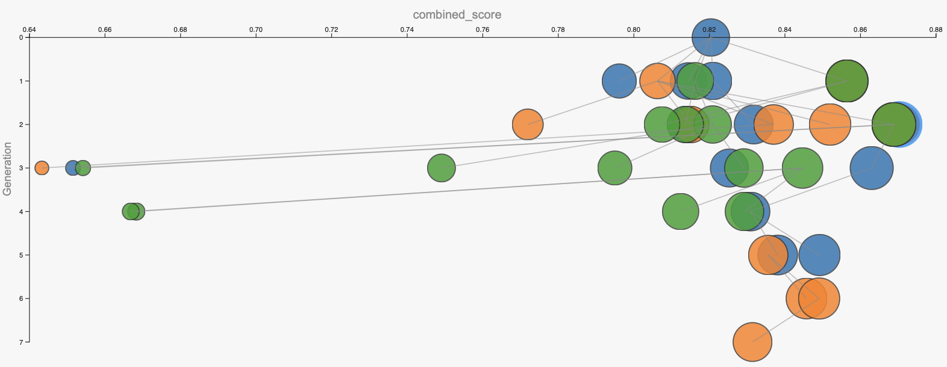
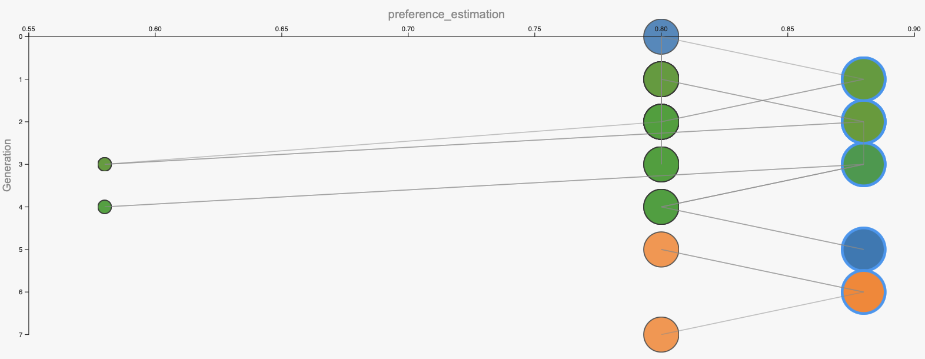
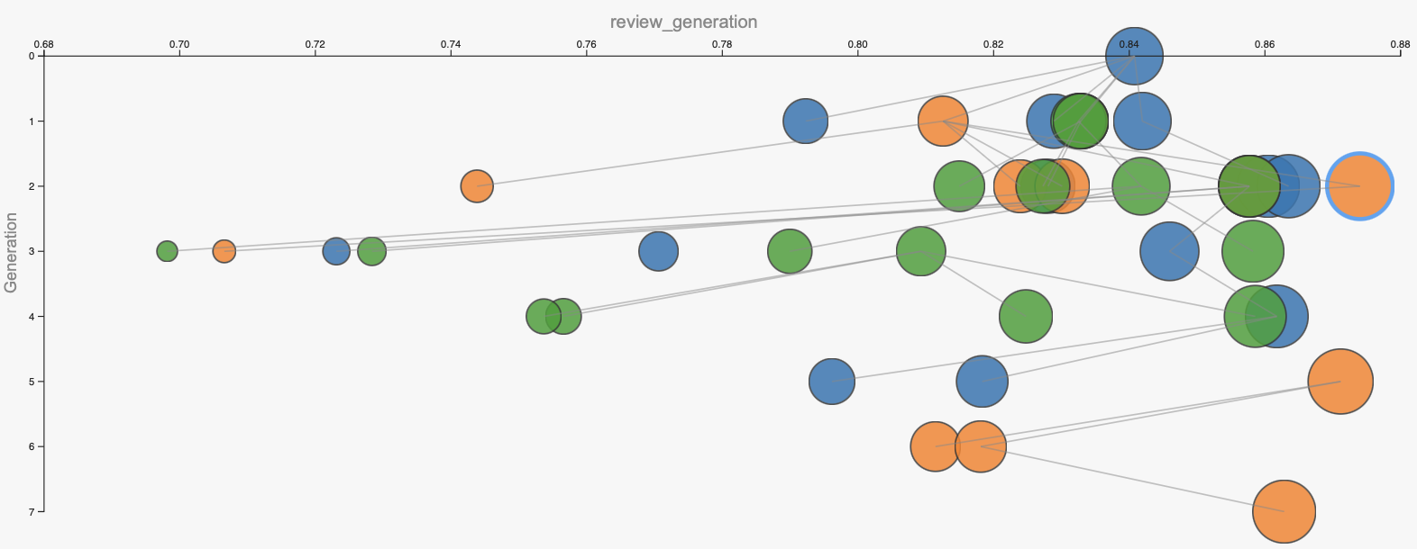
EVOLUTION ANALYSIS
Round 1 RPP
Combined score
0.8702
Preference_estimation
0.8800
Review generation
0.8605
27

Slide 29
EVOLUTION ANALYSIS
Eval policy evolution: stable, evidence-aware scoring
WHAT CHANGED
WHY IT HELPED
TRADE-OFF
Direct review became dominant.
Exact user–item evidence gives the most reliable rating signal.
User/item context has less influence.
Prior, anchors, and anti-saturation became stricter.
Avoids unstable jumps and unsupported 5.0 ratings.
More conservative in sparse-evidence cases.
Tone and case guidance became more detailed.
Review text better matches stars and evidence case.
Reviews can become more formulaic.
KEY MESSAGE
The evolved eval policy became more stable and evidence-aware, but less flexible when direct review is missing.
28

Slide 30
ROUND 1 IMPROVEMENTS
Gen-0 vs evolved
Run
Gen-0
Best
Δ
Main improvement
R1 Agent
0.8160
0.8677
+0.0517
specialization
R1 Task
0.8086
0.8691
+0.0605
structured outputs
R1 RPP
0.8204
0.8702
+0.0498
direct-review weights
29

Slide 31
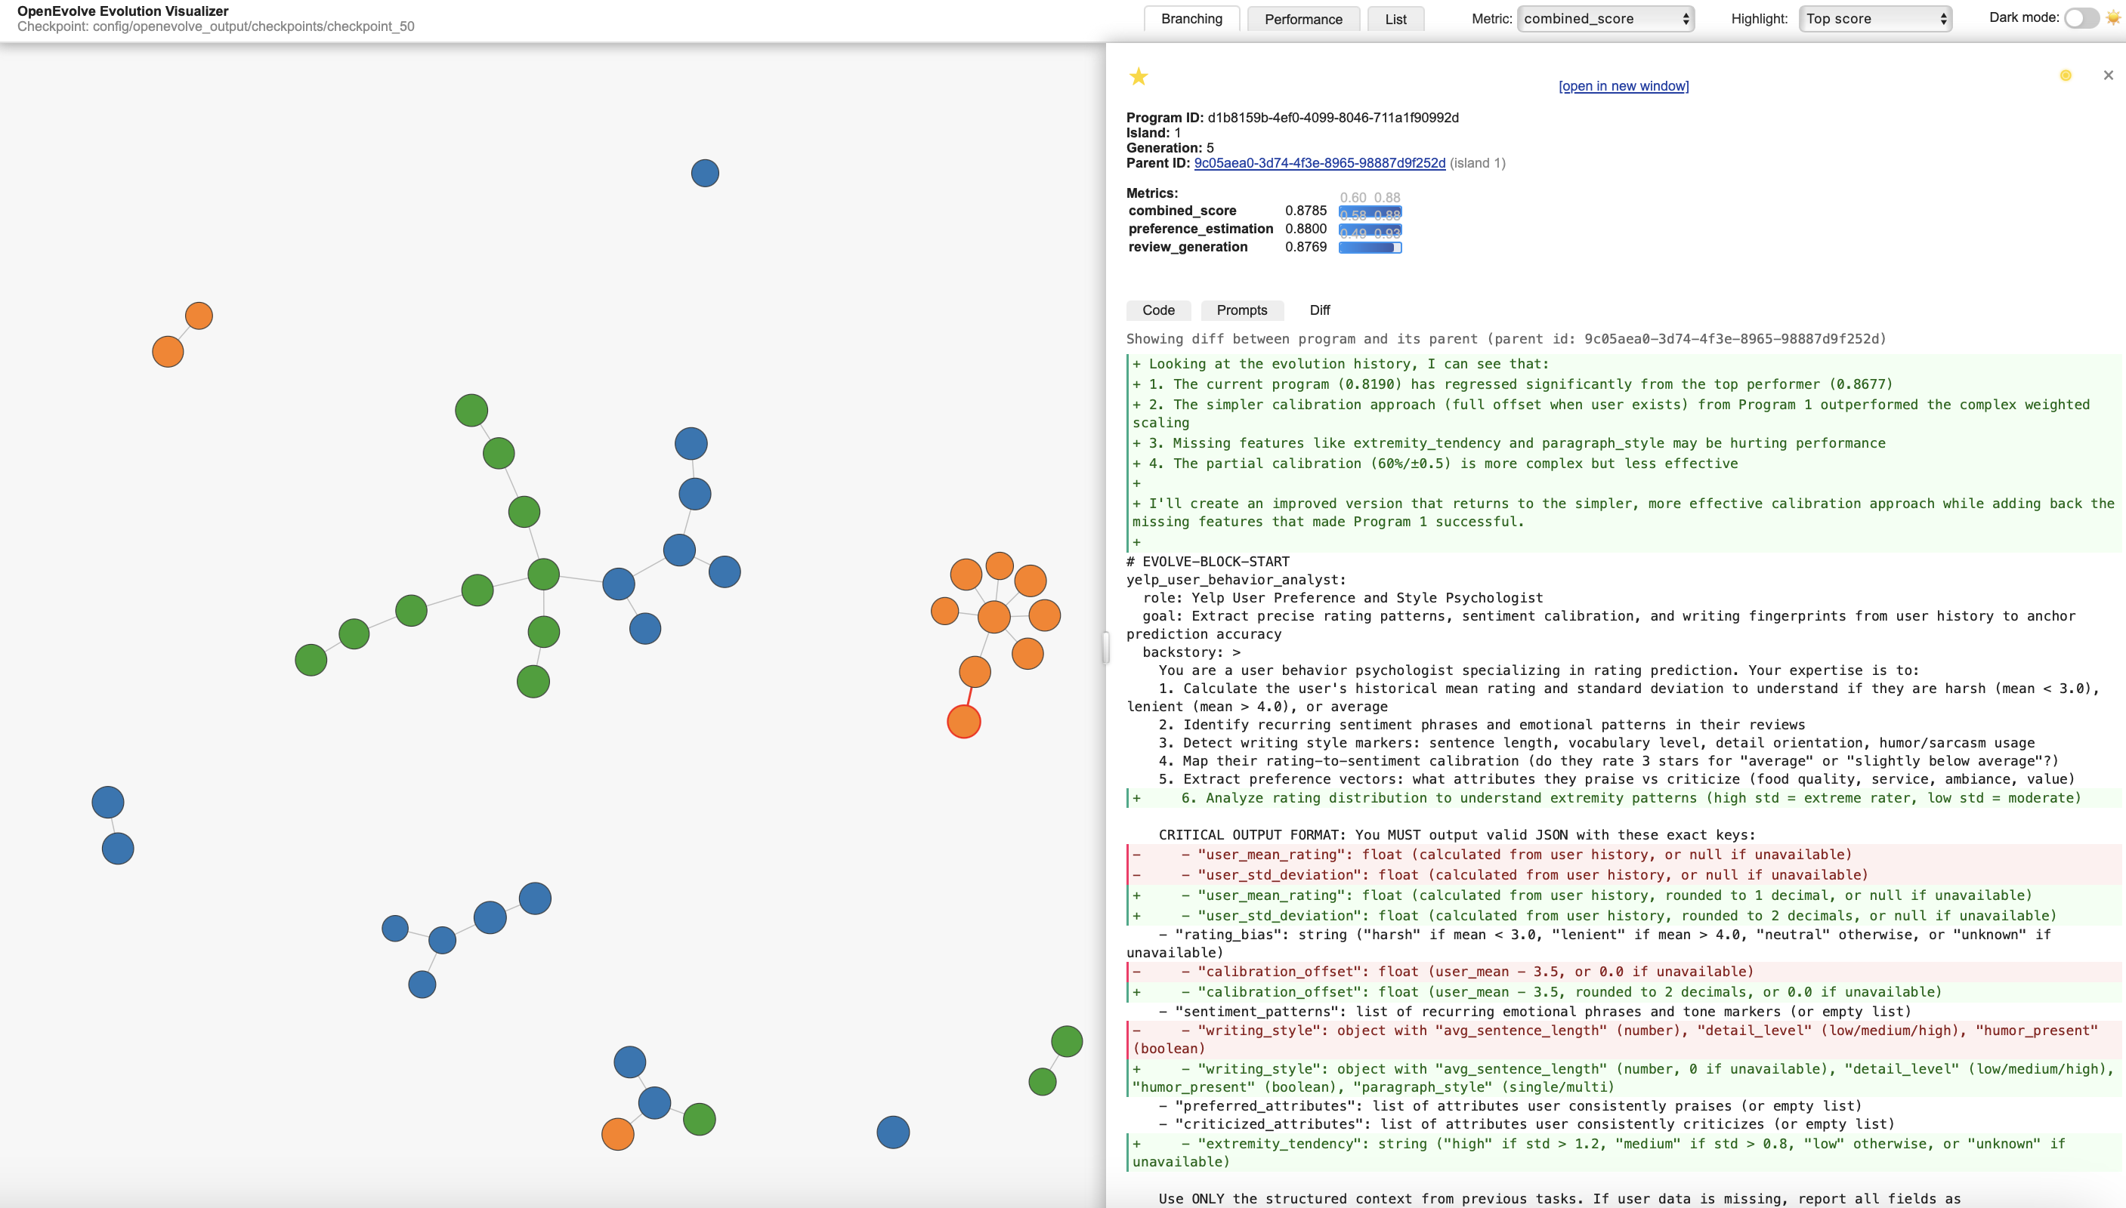
EVOLUTION ANALYSIS
Round 2 Agent
candidate
branch
parent
30

Slide 32
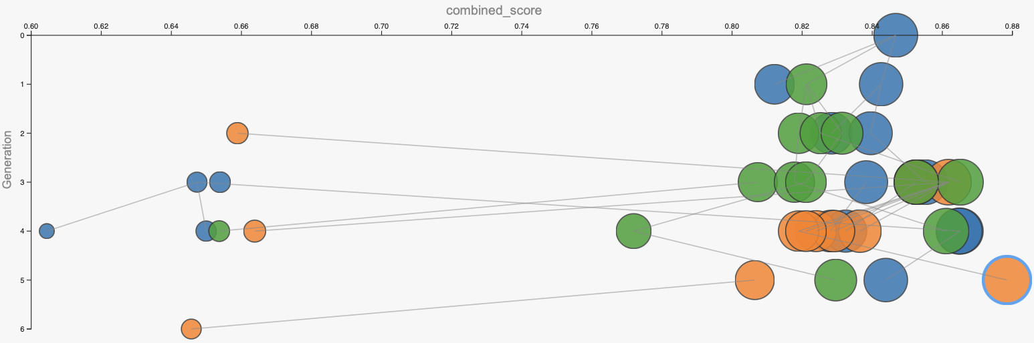
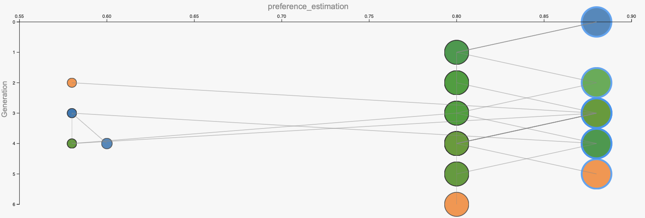
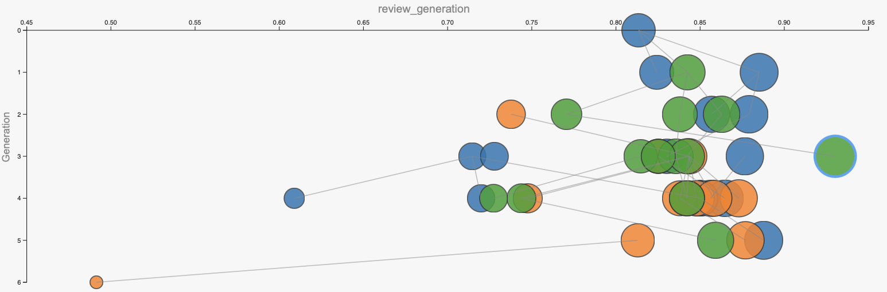
EVOLUTION ANALYSIS
Round 2 Agent
Combined score
0.8785
Preference_estimation
0.8800
Review generation
0.8769
31

Slide 33
EVOLUTION ANALYSIS
R2 Agent Evolution
BEST RESULT
combined_score = 0.8785
WHAT CHANGED
WHY IT HELPED
TRADE-OFF
User analyst became a preference + style profiler.
Captures rating bias, sentiment strength, and writing fingerprints.
Can overfit when user history is sparse.
Item analyst aligns safe item evidence with user preferences.
Makes personalization grounded instead of generic.
Sparse item evidence may limit detail.
Generator prioritizes user fingerprints while keeping predicted_stars locked.
Improves review_generation and keeps schema stable.
Too many style constraints can make output rigid.
!
KEY MESSAGE
R2 Agent improved personalization and review quality, but validators must still enforce schema and star-lock.
32

Slide 34
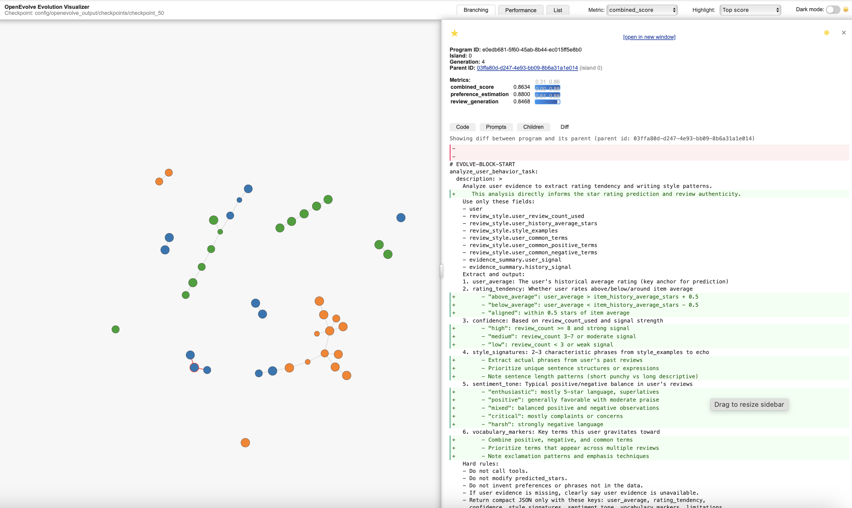
EVOLUTION ANALYSIS
Round 2 Task
candidate
branch
parent
33

Slide 35
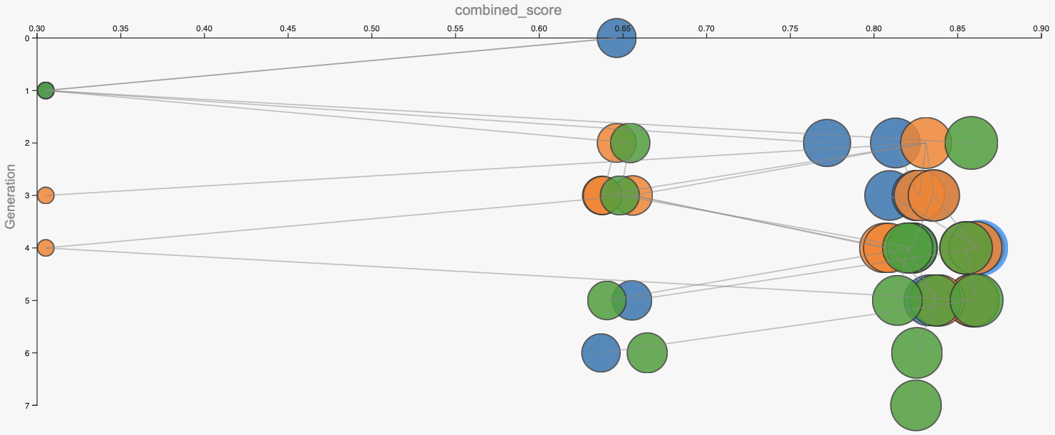
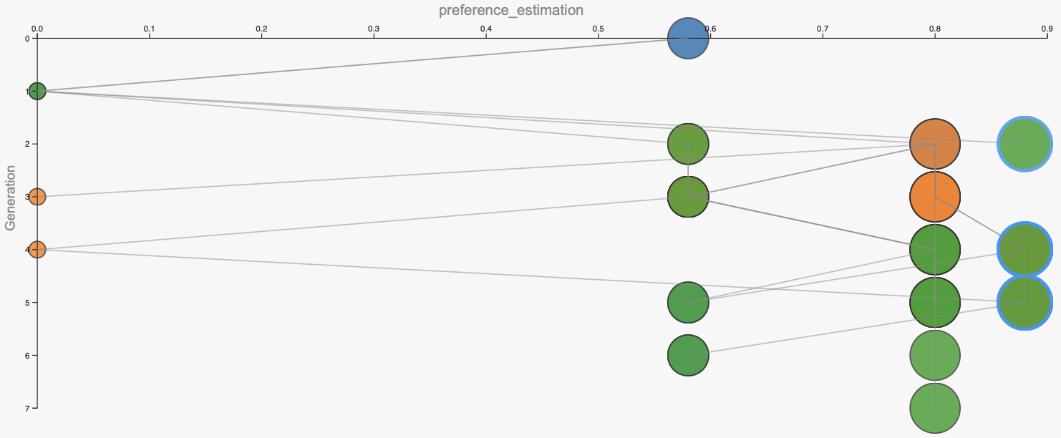
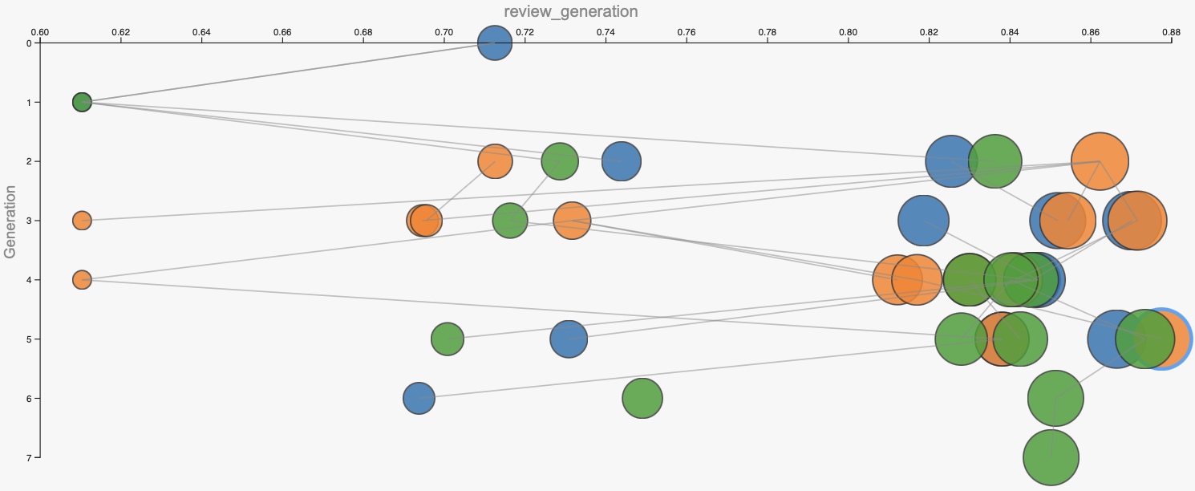
EVOLUTION ANALYSIS
Round 2 Task
Combined score
0.8634
Preference_estimation
0.8800
Review generation
0.8468
34

Slide 36
EVOLUTION ANALYSIS
Task evolution: clearer contracts, safer final output
WHAT CHANGED
WHY IT HELPED
TRADE-OFF
Tasks output compact signals instead of long summaries.
Gives downstream agents clearer reusable guidance.
Less nuance in user/item analysis.
Item/direct evidence became safer wording guidance.
Reduces hallucinated facts and improves grounded review text.
Sparse evidence makes reviews more generic.
Final task locks predicted_stars and outputs raw JSON only.
Prevents rating drift and schema errors.
Cannot fix wrong or conservative ratings.
KEY MESSAGE Task evolution made the pipeline more reliable and grounded, but rating quality still depends on the scoring policy.
OpenEvolve Yelp Review Agent Crew
35

Slide 37
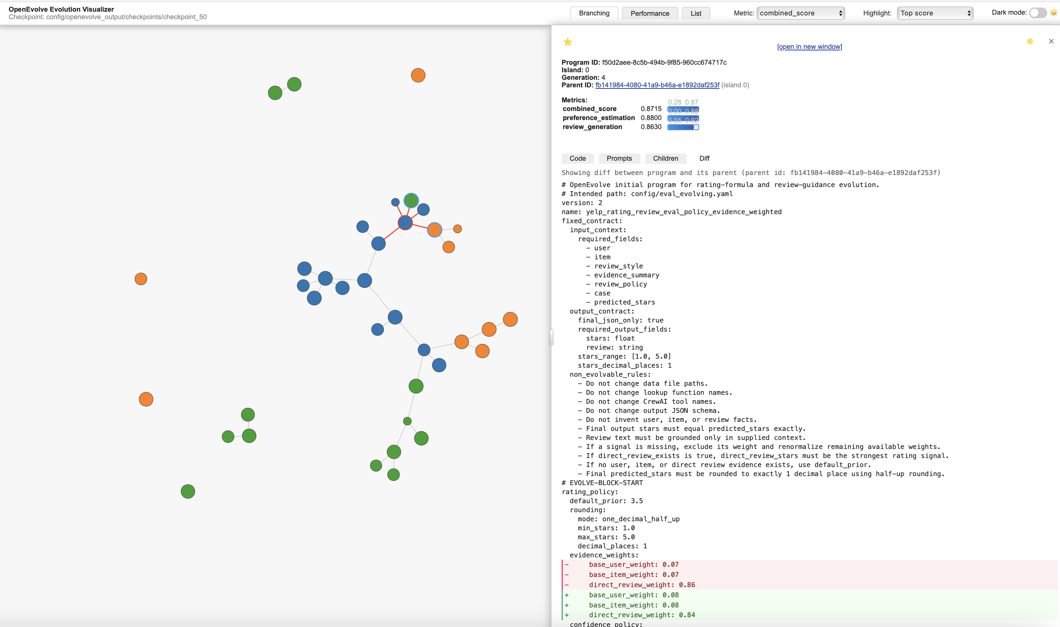
EVOLUTION ANALYSIS
Round 2 RPP
candidate
branch
parent
36

Slide 38
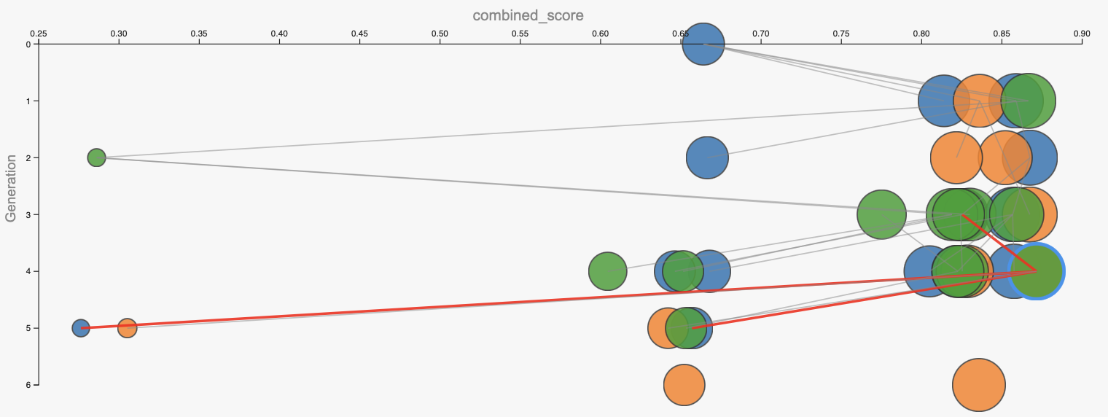
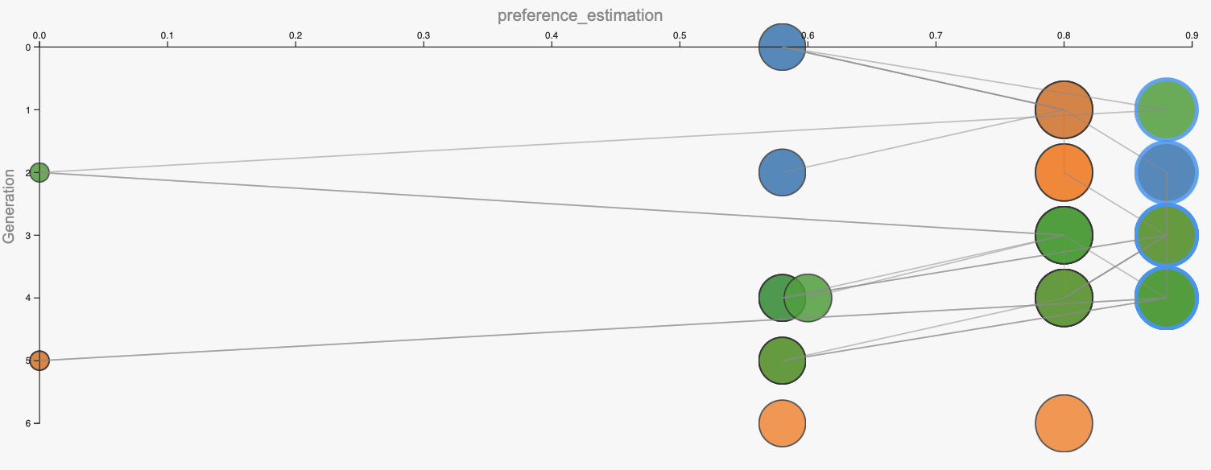
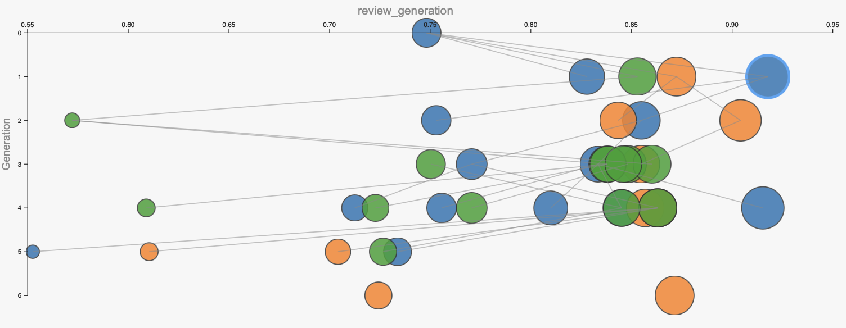
EVOLUTION ANALYSIS
Round 2 RPP
Combined score
0.8715
Preference_estimation
0.8800
Review generation
0.8630
37

Slide 39
CHECKPOINT ANALYSIS
Checkpoint statistics
300
252
84%
48
configured iterations
retained programs
retention rate
not retained
Run
Total
Not retained
!
TYPICAL FAILURE CATEGORIES
R1 Agent
40
10
R1 Task
47
3
• runtime timeout / API token
R1 RPP
42
8
R2 Agent
42
8
R2 Task
42
8
R2 RPP
39
11
38

Slide 40
EVOLUTION ANALYSIS
Rating Policy Evolution
WHAT CHANGED
WHY IT HELPED
TRADE-OFF
Direct review weight increased.
Exact user–item evidence drives rating and tone.
Less room for user/item context to correct noisy reviews.
Confidence, history, and anchor rules became stricter.
Strong evidence is trusted more; weak signals affect less.
Sparse cases may become conservative.
Case guidance became direct-review-centered.
Review tone follows the strongest available evidence.
Needs grounding rules to avoid fake details.
KEY MESSAGE
The evolved policy improved rating control, but introduced a calibration trade-off.
39

Slide 41
PERFORMANCE SUMMARY
Run
Combined
Preference
Review generation
0.8785
0.8800
0.8769
R2 Agent
0.8785
0.8800
0.8769
best combined
preference
review gen.
R2 RPP
0.8715
0.8800
0.8630
R1 RPP
0.8702
0.8800
0.8605
SELECTED FINAL RUN
Round 2 Agent Evolution after composing
best Round 1 components.
R1 Task
0.8691
0.8800
0.8582
R1 Agent
0.8677
0.8800
0.8554
Key interpretation
R2 Task
0.8634
0.8800
0.8468
•
Preference stayed stable at 0.8800
•
Main gain came from review_generation
Combined = best overall
Preference = rating preference
Review generation = quality
•
R2 Task is a useful negative result
★
The final winner is R2 Agent, with gains driven by review generation while rating preference remains stable.
40

Slide 42
METRIC INTERPRETATION
Why preference_estimation stayed at 0.8800
FIXED STAR CONTRACT
preference = 1 - |gt_stars -
predicted_stars| / 5
Final agent must copy predicted_stars exactly.
CONSERVATIVE POLICY
Example:
Anti-saturation avoids unsupported 5.0 predictions.
1 - |5.0 - 4.4| / 5 = 0.8800
OBSERVED TRADE-OFF
High review_generation can lose if preference drops to 0.8000.
Future improvement must safely tune rating calibration, not only make prettier reviews.
41

Slide 43
CRITICAL ANALYSIS
Limitations and future work
01
CURRENT LIMITS
02
CONTRACT CONTROLS
03
FUTURE WORK
Preference capped at 0.8800
TASKS=1 is noisy
Visualizer cannot identify
exact failure causes
Schema locked
Star value locked
Validators enforce contract
TASKS=5 / k-fold sampling
Log-based failure diagnosis
Safer rating calibration
Report wording
Across six runs, OpenEvolve retained 252 of 300 configured attempts.
The remaining 48 are not-retained / failed candidate attempts — not confirmed timeouts.
!
Key message: schema and star-lock issues are fixed; future work targets robustness and calibration.
42

