Slide 1





Notes:
And Because it has been 20 days since our last meeting, so at first, I will briefly introduce our pervious works.

Slide 2






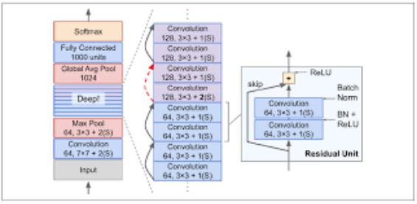



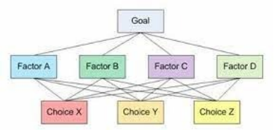

Notes:
In our paper, a deep RNN model have been proposed for TSDS research. Experiments will be conducted to verify the effectiveness of our RNN model.
Furthermore, a new systematic AHP method for evaluation process have been suggested to assess the performance of the deep learning models.

Slide 3

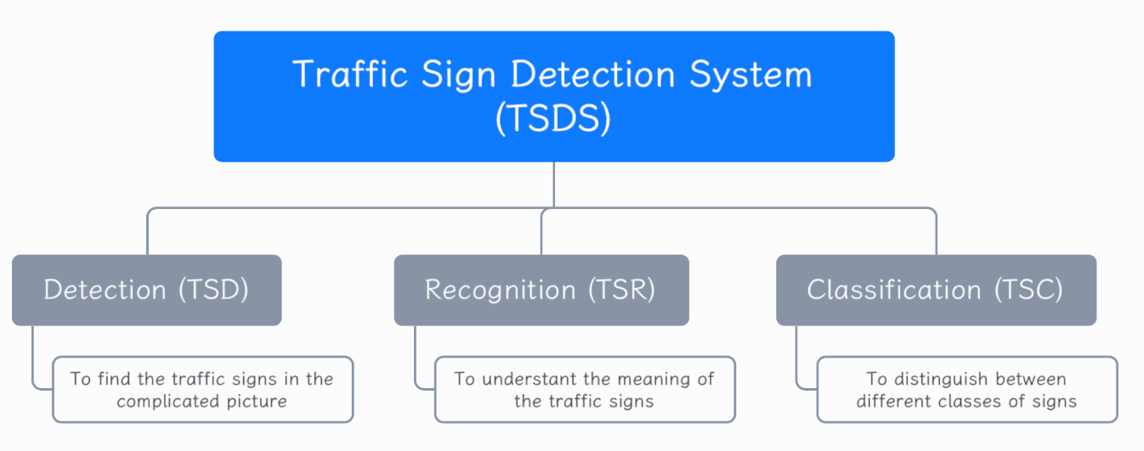
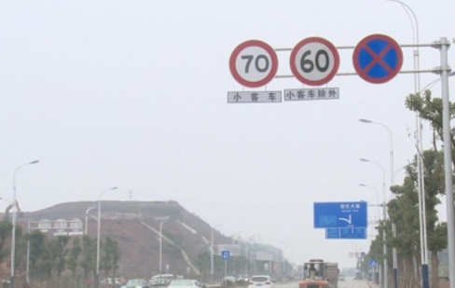







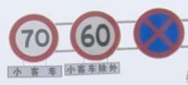


Notes:
As far as TSDS is concerned…
This research topic mainly includes 3 parts of things.
In this case, our paper have discussed these 3 domains step by step.

Slide 4

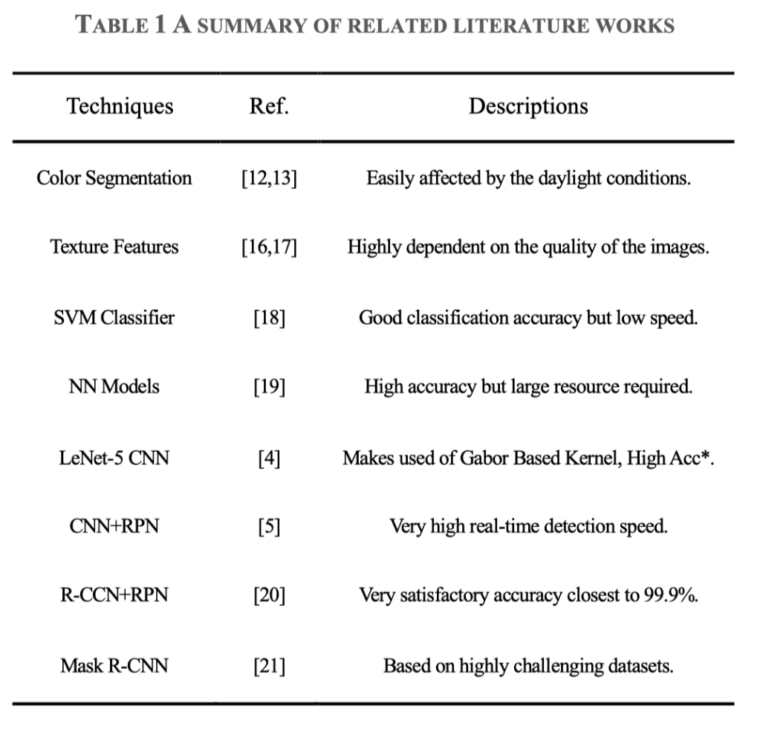





Notes:
The main contribution of our paper is that we have made a comprehensive literature review in the topic of TSDS problem since the year 2005 to the work state-of-the art.

Slide 5
Notes:
To the best of our knowledge, no research has focused on training and testing a RNN model based on the representative traffic sign datasets including large-scale categories. So we will try to train our model based on the large-scale categories datasets.
Besides, although many existing literature works have achieved good performance, most of the works are only evaluated by detection accuracy, precision and response time, which are all in the same key. However, a more reasonable and systematic evaluation methodology is absent in most of the measurement process. Therefore, our paper will suggest a new analytic hierarchy process (AHP) method for practical performance evaluations.

Slide 6

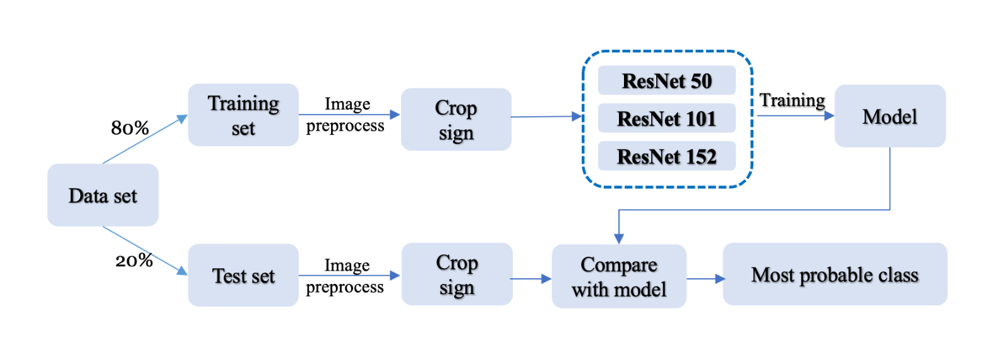

Slide 7

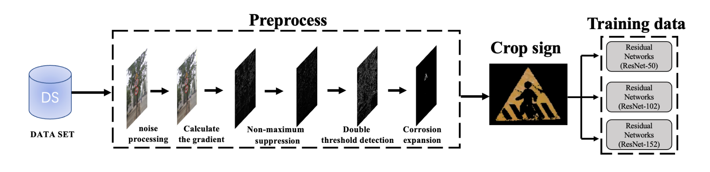

Slide 8

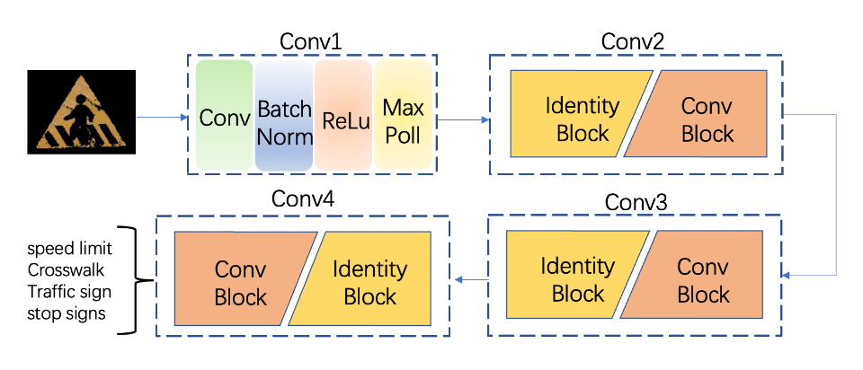
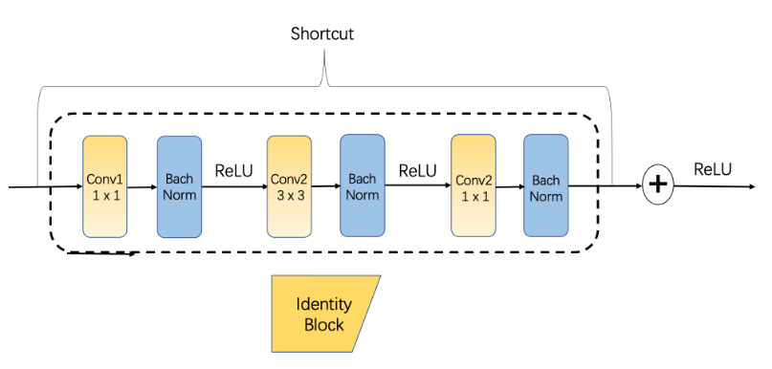
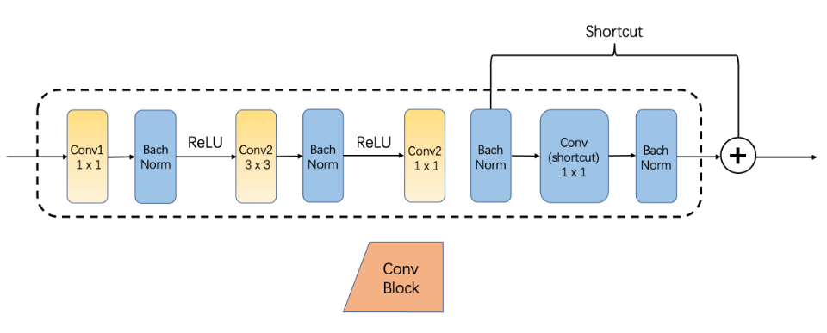

Slide 9





Slide 10
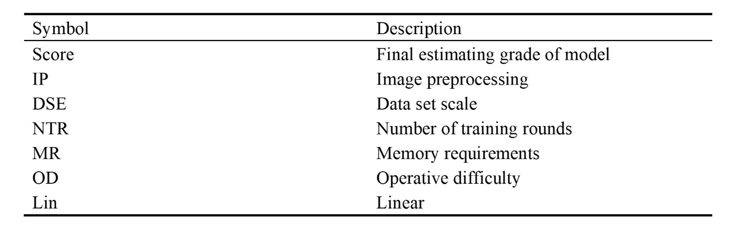
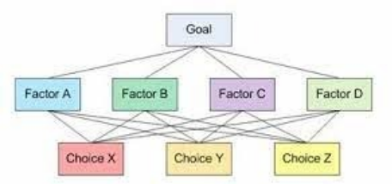

Slide 11
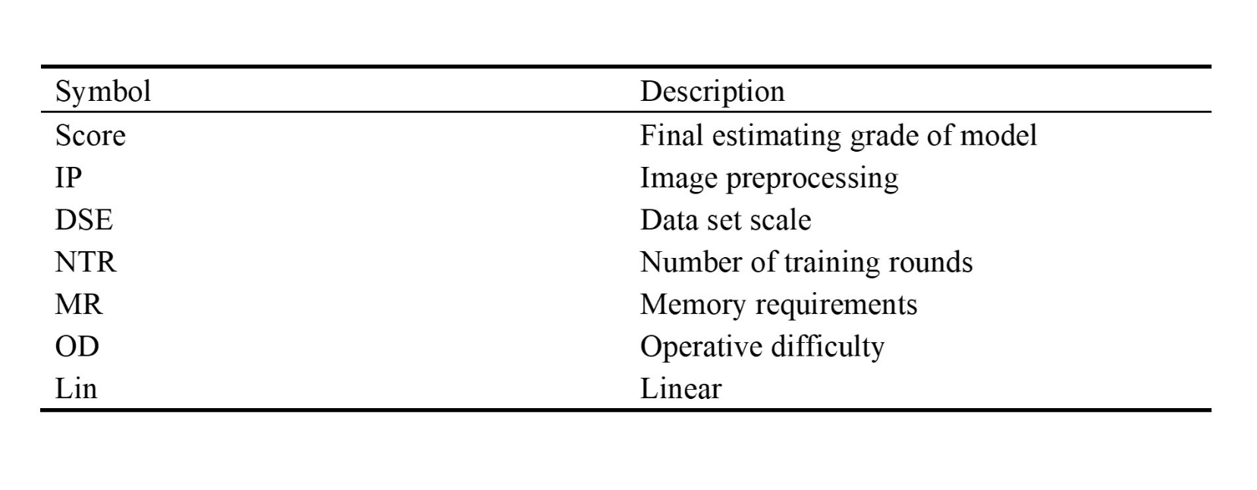

Slide 12
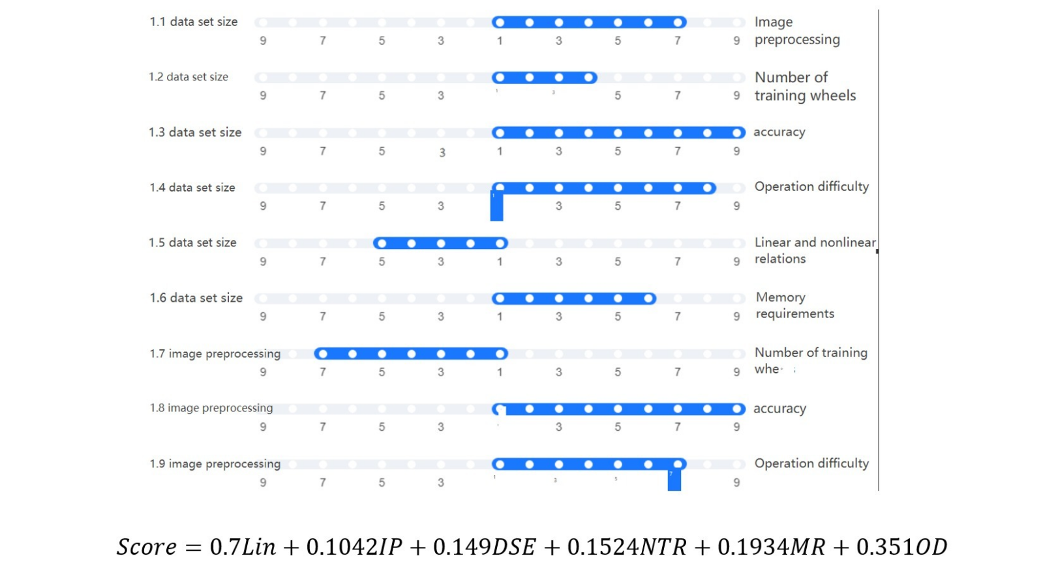


Slide 13
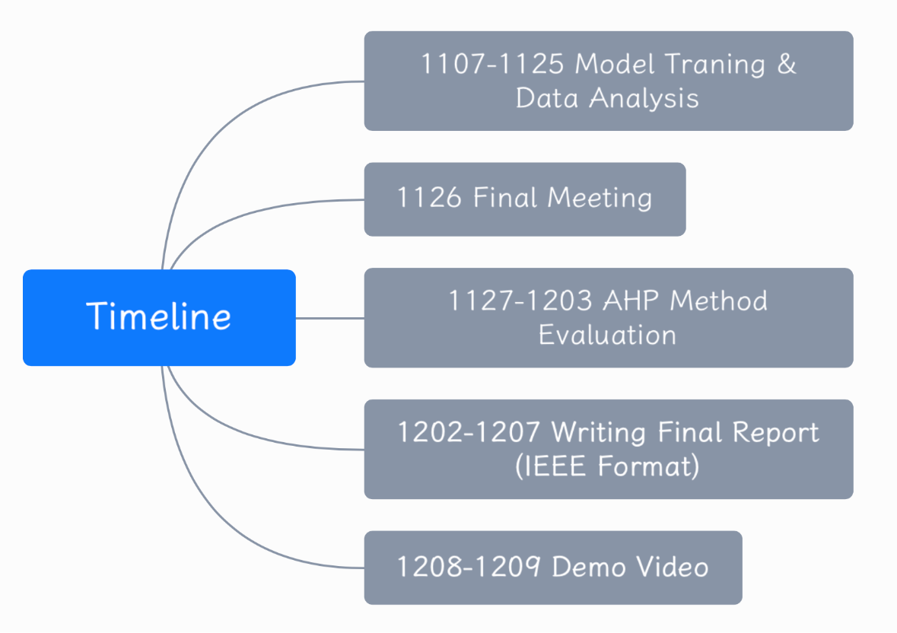

Notes:
Noted that the DDL is scheduled in 9th Dec., so as for the time arrangement.

Slide 14






