Slide 1
Fiji Final Presentation
Chloe Singer

Slide 2
Slide 1: Introduction
Fiji, an archipelago of over 330 islands in the South Pacific, is a cultural and economic hub of the region. Known for its stunning natural beauty, Fiji also plays a pivotal role in regional trade and tourism. This presentation delves into Fiji’s economic indicators, population trends, visitor statistics, and competitive position among Pacific Island states.

Slide 3
Slide 2: Key Facts About Fiji
Location: Fiji is situated in the South Pacific, northeast of New Zealand.
Population: Approximately 900,000, characterized by a diverse mix of indigenous Fijians, Indo-Fijians, and other ethnic groups.
Government: Parliamentary democracy with a strong emphasis on inclusivity.
Economy:
Tourism accounts for over 40% of GDP.
Agriculture (primarily sugarcane) and remittances play key roles.
Emerging focus on renewable energy and sustainable tourism.

Slide 4
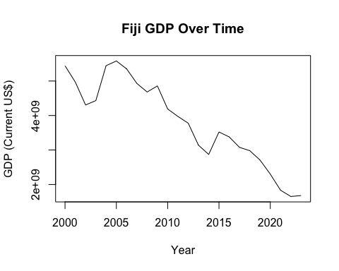
Slide 3: Economic Trends
GDP Trends
Fiji’s GDP has shown steady growth over the years, with significant contributions from tourism and exports. Efforts to diversify the economy are ongoing.

Slide 5
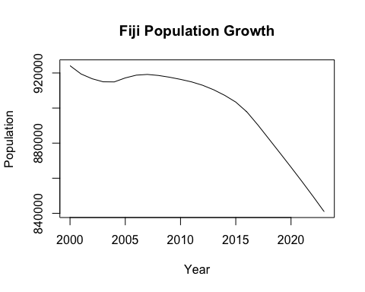
Population Trends
Fiji’s population growth reflects increasing urbanization and improvements in healthcare. The government aims to balance urban expansion with environmental sustainability.

Slide 6
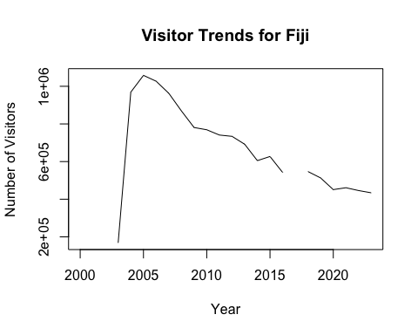
Slide 4: Visitor Statistics
Tourism remains the backbone of Fiji’s economy. Visitor numbers peaked pre-pandemic and are recovering rapidly as global travel resumes.
Key Markets: Australia, New Zealand, and the United States.
Trends: Growing interest in eco-tourism and cultural tourism.

Slide 7
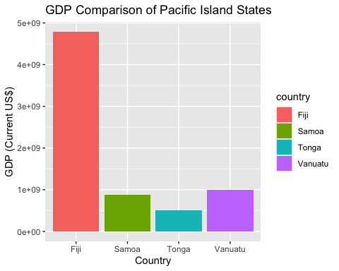
Slide 5: Comparison with Other Island States
Fiji outperforms many Pacific Island states in GDP, infrastructure, and tourism development. However, challenges such as climate vulnerability and reliance on external markets persist.

Slide 8
Slide 6: SWOT Analysis
Strengths:
World-class tourism infrastructure.
Abundant natural resources.
Strong cultural identity and heritage.
Weaknesses:
Overdependence on tourism.
Limited diversification in exports.
Opportunities:
Expansion into renewable energy.
Growth in eco-tourism and high-end hospitality sectors.
Threats:
Climate change impacts, particularly rising sea levels.
Global economic fluctuations affecting key industries.

Slide 9
Slide 7: Conclusion
Fiji exemplifies resilience and adaptability in a rapidly changing global environment. With strategic investments in sustainable industries and infrastructure, Fiji can secure long-term growth while preserving its natural beauty and cultural legacy.

Slide 10
References
World Bank Development Indicators (WDI): Comprehensive economic and population data.
Fiji Bureau of Statistics: Visitor trends and demographic insights.
Tourism Fiji Reports: Strategic direction and performance of the tourism sector.
```

