Slide 1

Group 1 Business Analytics, Data Science, and Machine Learning Trends

Slide 2
Agenda
Rationale Statement
Literature Review
Data Cleaning & Preprocessing
Exploratory Data Analysis
Skill Gap Analysis
Career Strategy
Supervised Machine Learning
Unsupervised Machine Learning
Final Takeaways

Slide 3

Purpose of Understanding

Slide 4

Literature Review
Hard Skills
Soft Skills
Evolving Skills

Slide 5
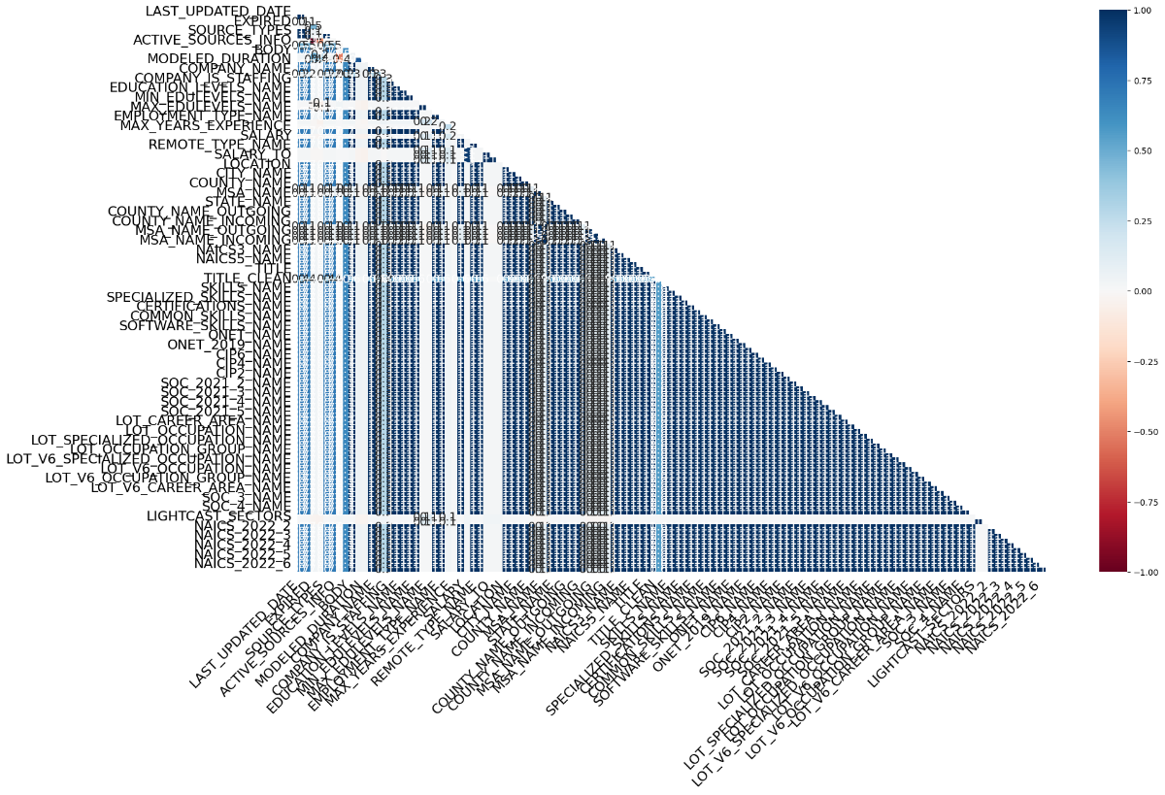
Data Cleaning & Preprocessing
Dropping Irrelevant columns
Handling NaN values
Removing Duplicates

Slide 6
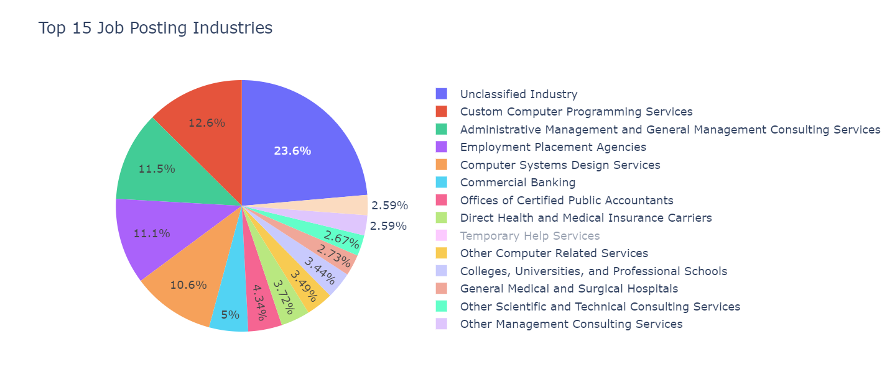
Exploratory Data Analysis (EDA)
Effective body language enhances your message, making it more impactful and memorable:
Meaningful eye contact
Purposeful gestures
Maintain good posture
Control your expressions

Slide 7
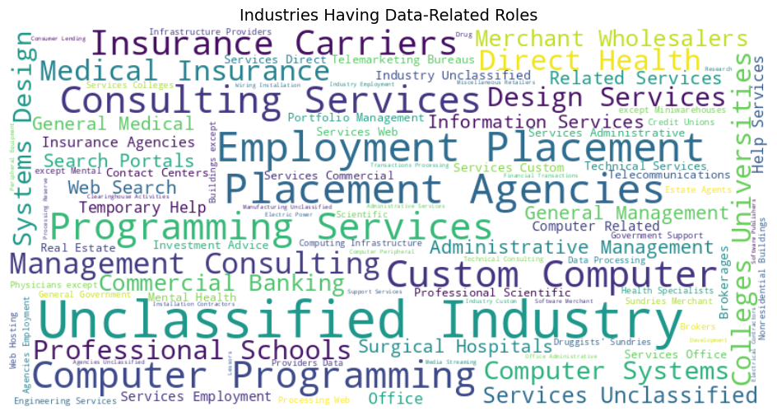
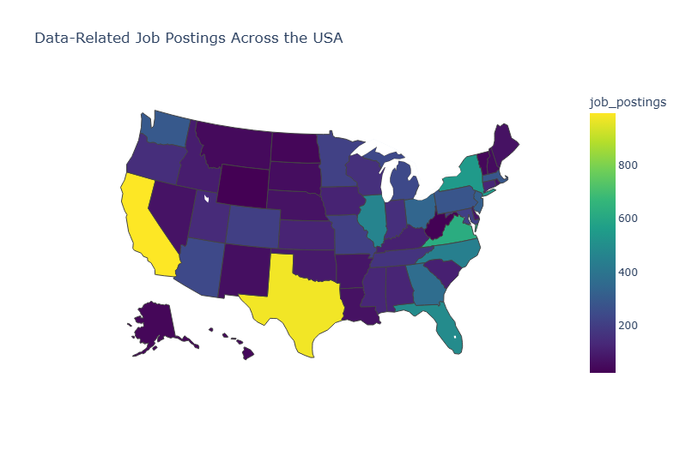
EDA

Slide 8
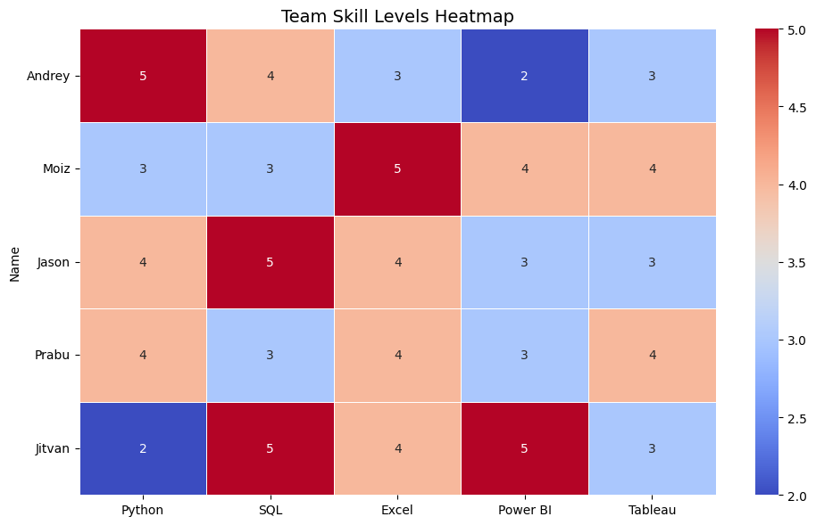
Skill Gap Analysis
Maintaining composure during the Q&A session is essential for projecting confidence and authority. Consider the following tips for staying composed:
Stay calm
Actively listen
Pause and reflect
Maintain eye contact

Slide 9
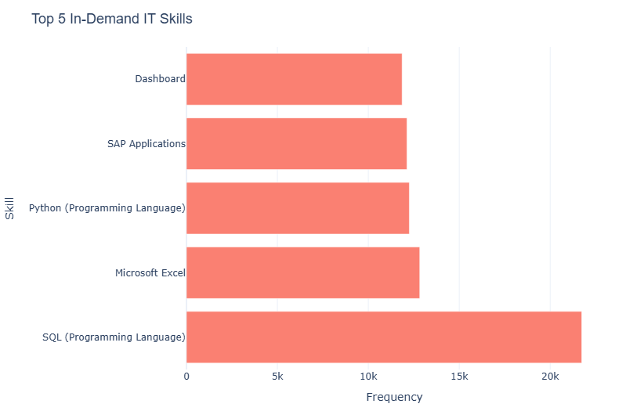
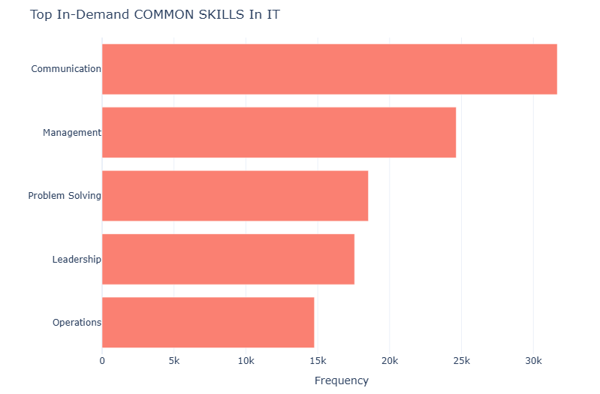
Skills

Slide 10

Carrer Strategy
Your ability to communicate effectively will leave a lasting impact on your audience
Effectively communicating involves not only delivering a message but also resonating with the experiences, values, and emotions of those listening

Slide 11
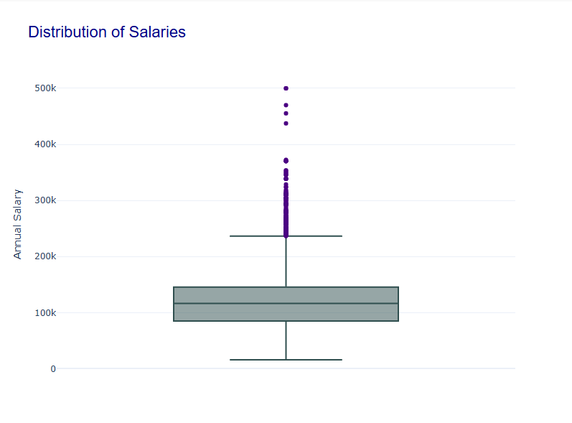
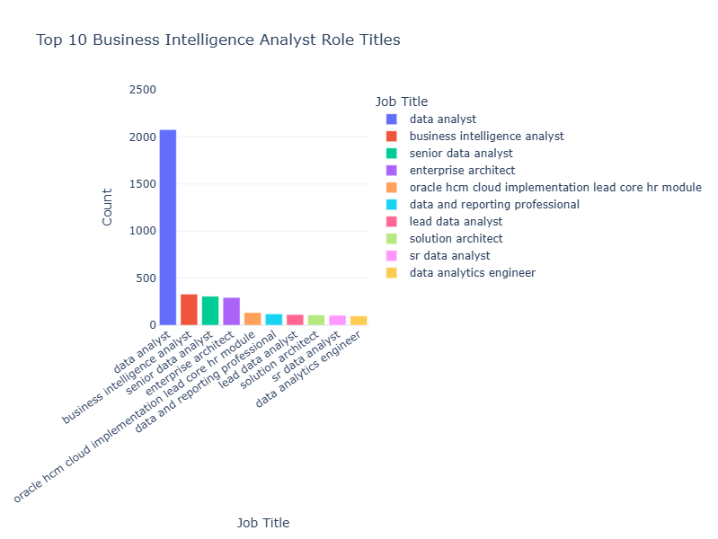
Supervised Machine Learning
Step 1.
*understand* the information!!
Step 2.
*prepare* the dataframe as needed
IQR = $85,000 to $145,000 (Median $116,300)

Slide 12
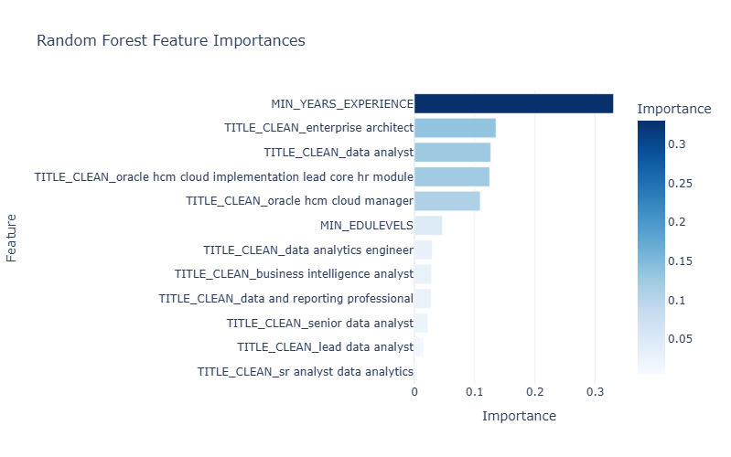

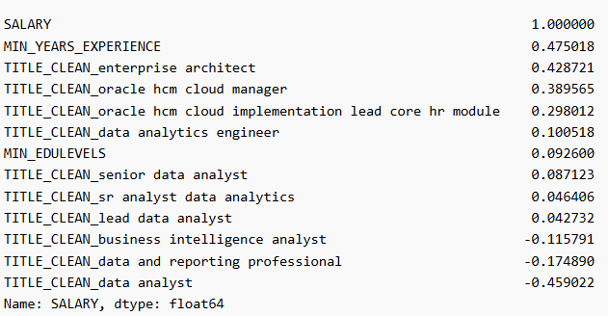
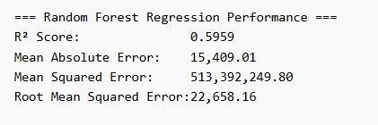
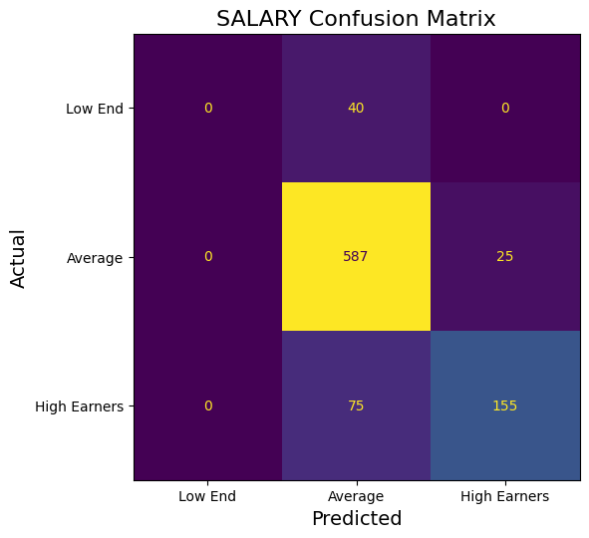
Supervised Machine Learning
PERFORMANCE
The model can be used to make predictions on SALARY based on EXPERENCE, EDUCATION LEVEL, and specific JOB TITLE within Business Analytic roles.

Slide 13
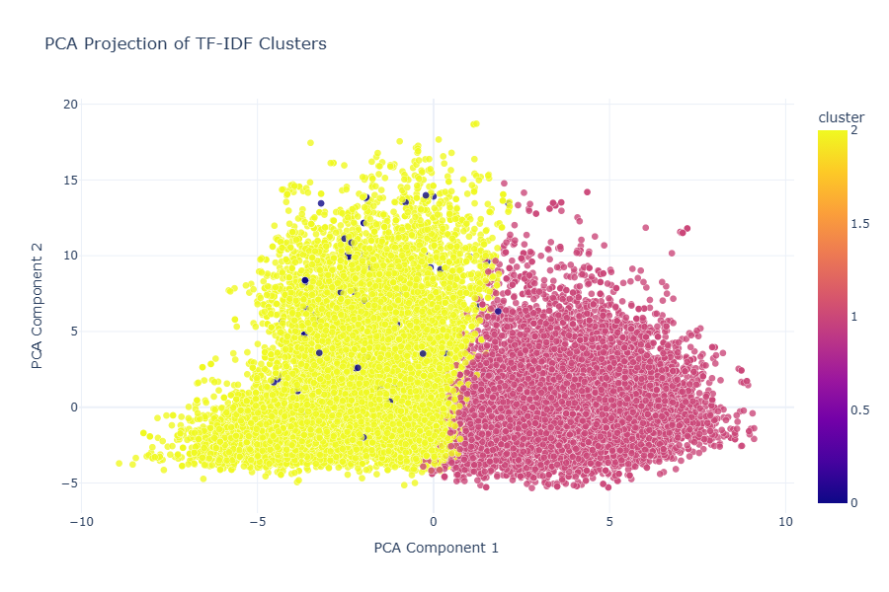
Unsupervised Machine Learning
Seek feedback
Reflect on performance
Explore new techniques
Set personal goals
Iterate and adapt

Slide 14
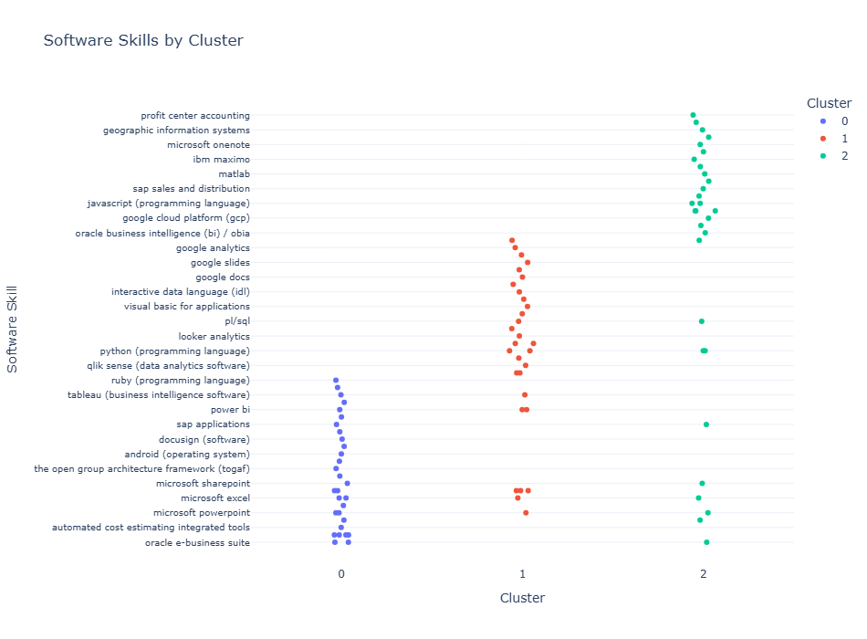
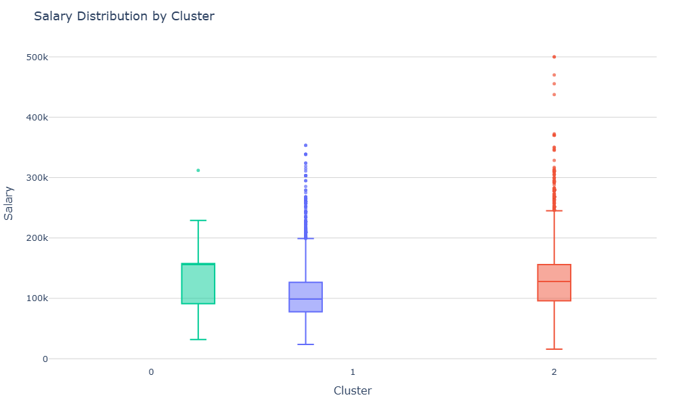
Unsupervised Machine Learning
Bullet points
Bullets points

Slide 15
Thank you
Team 1

