Slide 1

Product Sentiment/Text Analysis using Tweets
MISM 6213
Northeastern University
Team Members : Raghnya Valluru, Sayantani Roy

Slide 2
Project Overview
Problem formulation
Objectives
Data Collection & Profiling
Data Cleaning & Preparation
Data Analysis & Conclusion
Understanding user sentiment to develop products and services
Analyze twitter data to derive insights about user sentiment using the tweets
Collected publicly available twitter data on users of various phones and services like iPhone, iPad, google and other google products and services
Perform data profiling to get a summary of available data
Check for missing values
Measure dimensions of DQ
Improve data for modelling
Apply Machine Learning Modelling to understand accuracy of the data
Determine best model to perform predictions of sentiments

Slide 3
Problem Statement
Design a Machine Learning Algorithm that can help us understand user’s sentiments towards various products and services using twitter as a platform

Slide 4

Sentiment Analysis
Identifying as well as classifying the sentiments that are expressed in the text source.
Tweets are often useful in generating a vast amount of sentiment data upon analysis.
Understanding the opinion of the people about a variety of topics

Slide 5
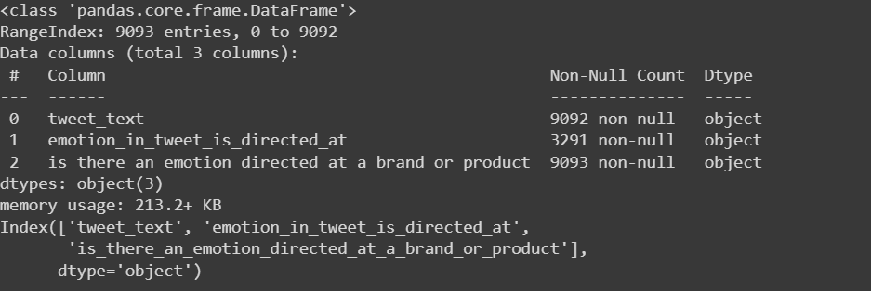
Data Profiling
Rows- 9093
Columns- 3
Data is of type objects so we cannot perform data profiling to understand quantiles and other measures

Slide 6
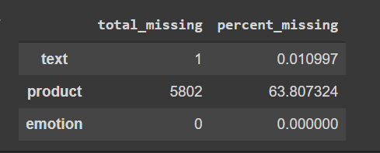
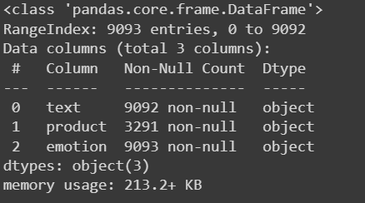
Data Quality
Completeness
Product column has 5802 missing values
Text column has 1 missing value
Emotion has no missing value
Validity
Variables are of data type object
Name of columns is changed for simplicity
Timeliness
Data quality issue
date/time is missing in the dataset

Slide 7
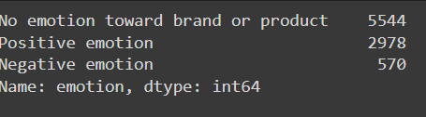
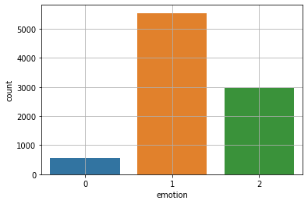
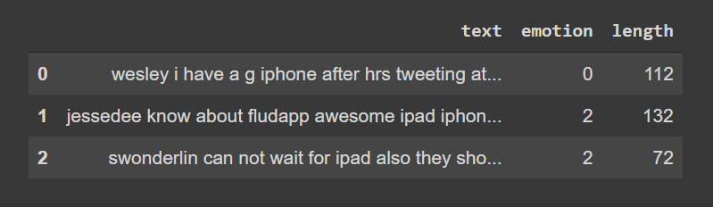
Data Preparation
- Mapped each type of emotion to numeric value : 0='Negative emotion', 1= 'No emotion toward brand or product' , 2= 'Positive emotion'
-Removed hyperlinks and alphabetical characters from text using lambda function
-Checked distribution of the length of the reviews
-Created bag of words using bow transformer
tweet_text - text
emotion_in_tweet_is_directed_at - product
is_there_an_emotion_directed_at_a_brand_or_product - emotion

Slide 8
Data Analytics
As we are analyzing product sentiment, we took x as 'text' which is the tweet text and predictor variable y as 'emotion' which is the sentiment
We divided the dataset in 75-25 split where 25% is our test data and 75% is our train data
Based on our dataset we decided to work on 4 Models : Multinomial Naive Bayes, Logistic Regression, Radom Forest Classifier, SVM
Based on our model analysis SVM has the highest accuracy score : 69%
We also tuned the SVM model to increase the accuracy to 70%

Slide 9
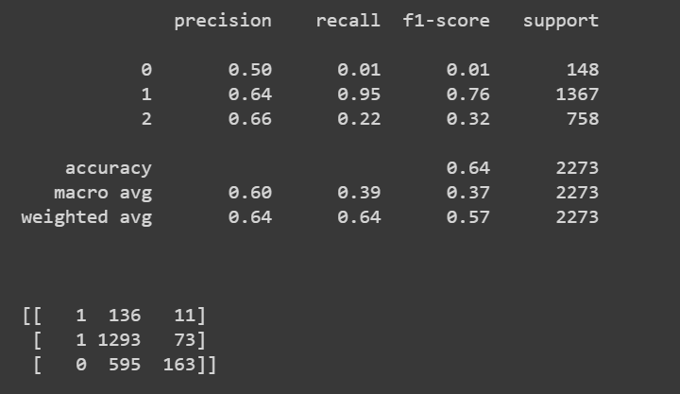
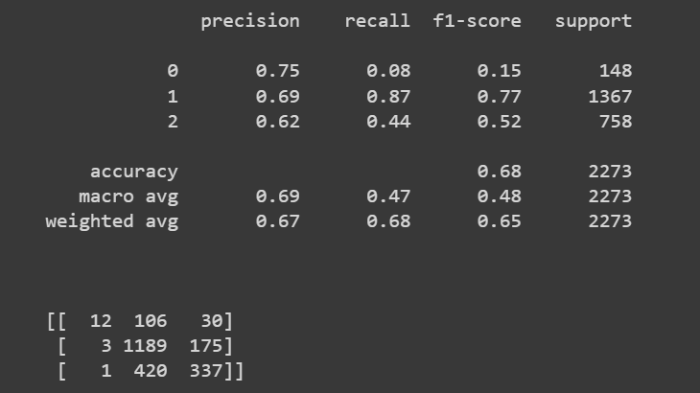
Data Models :
Model 1 : Multinomial Naive Bayes
Model 2 : Logistic Regression
Model 1 : accuracy 64%
Negative Emotion '0' : Precision 50%
No emotion toward brand or product '1': Precision 64%
Positive emotion '2' : Precision 64%
Model 2 : accuracy 68%
Negative Emotion '0' : Precision 75%
No emotion toward brand or product '1': Precision 69%
Positive emotion '2' : Precision 62%
Notes:
Precision can be seen as a measure of quality, and recall as a measure of quantity. Higher precision means that an algorithm returns more relevant results than irrelevant ones, and high recall means that an algorithm returns most of the relevant results (whether or not irrelevant ones are also returned).

Slide 10
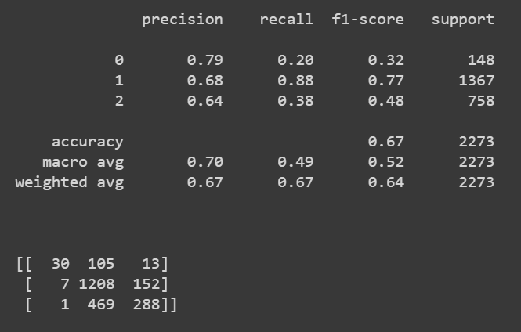
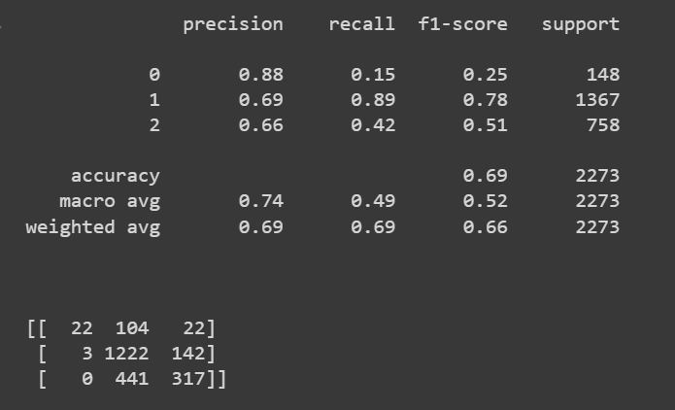
Data Models :
Model 3 : Random Forest Classifier
Model 4: SVM ( Classifier)
Model 3 : accuracy 67%
Negative Emotion '0' : Precision 79%
No emotion toward brand or product '1': Precision 68%
Positive emotion '2' : Precision 64%
Model 4 : accuracy 69%
Negative Emotion '0' : Precision 88%
No emotion toward brand or product '1': Precision 69%
Positive emotion '2' : Precision 66%

Slide 11
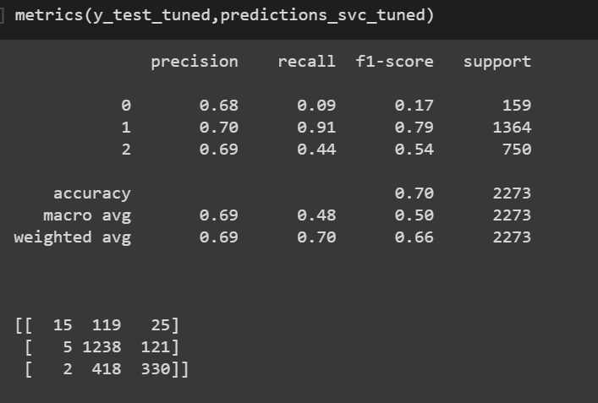
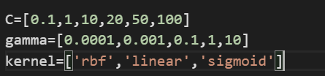
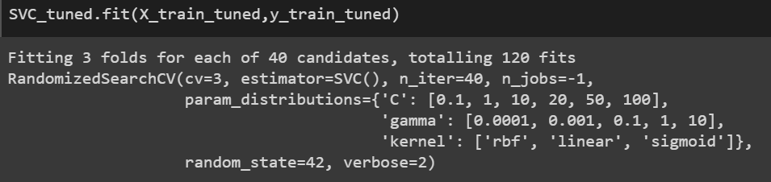
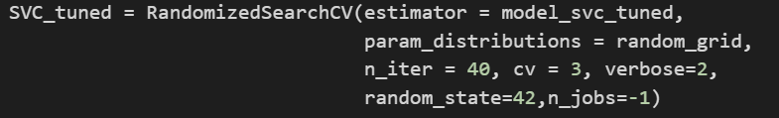
Tuned Data Model :
We used 3 fold grid search cv with below specifications :
Tuned SVM Model : accuracy 70%
Negative Emotion '0' : Precision 68%
No emotion toward brand or product '1': Precision 70%
Positive emotion '2' : Precision 69%

Slide 12
Results
With our analysis we could say that with SVM we could analyze the text sentiment with 70% accuracy
The accuracy score could be further improved with more sample size ( we have only 9092 entries)
Our model could help the business to understand the positive or negative sentiment analysis for any product or service
This could also be useful to understand customer feedback for a new product or service launch

Slide 13

Thank you!

