Slide 1
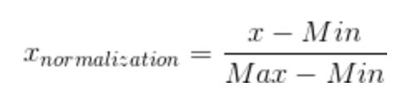
Classification
Feature: nodeName, id, class, inlineStyle, role, dataset
Vectorize
nodeName: word2vector
id/class: words get higher weight(*5)
inlineStyle/role/dataset: only count the key as syntax info
Normalization

Slide 2
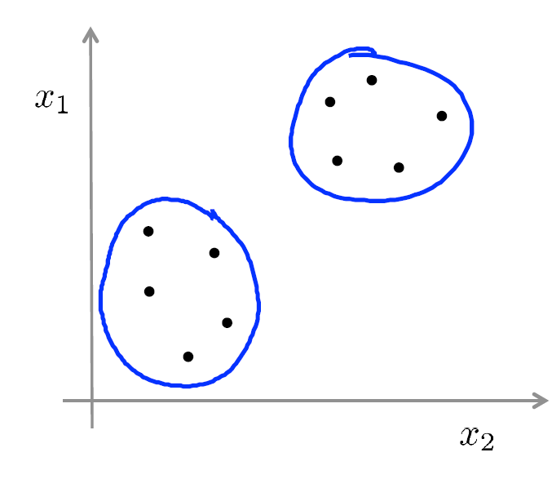
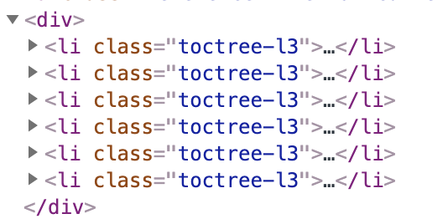
Classification
K-means

Slide 3
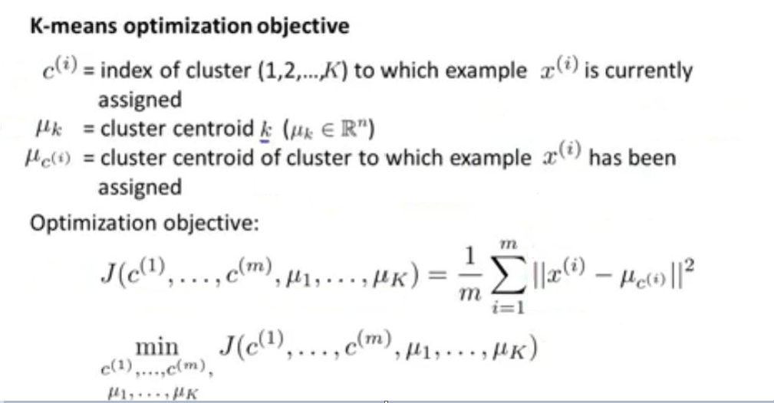
Classification

Slide 4
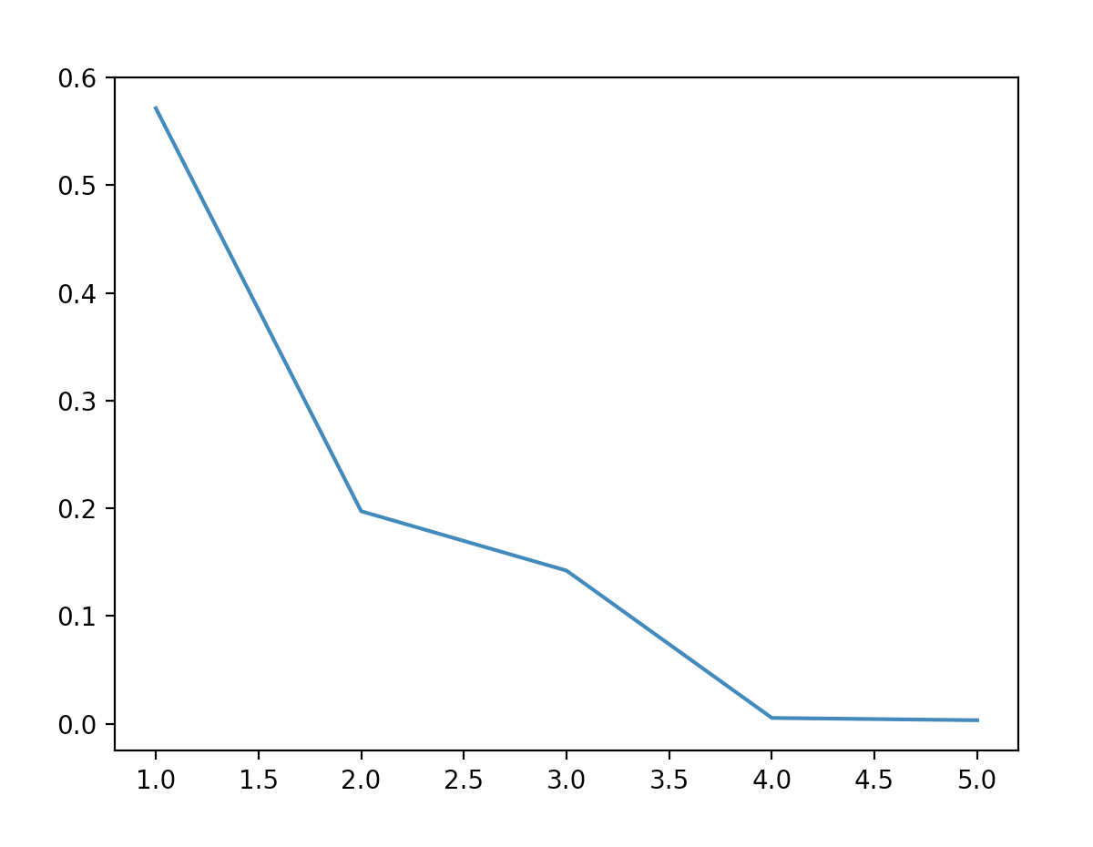
Classification
cost
Choose a max decreased value to choose which k is best.
If k=1, then it shows these
listitem belongs to one cluster.
k

Slide 5
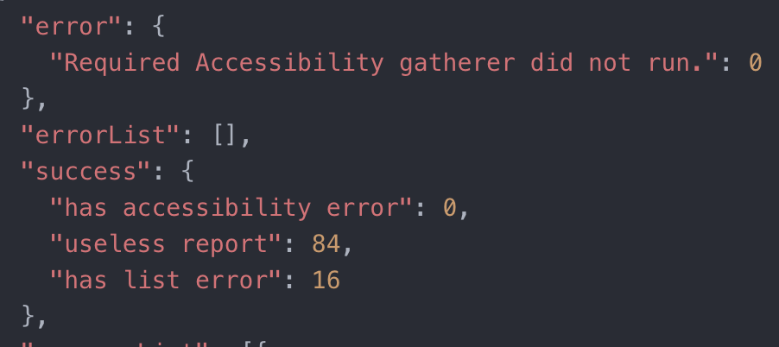
Experiment Data

