Slide 1
National Institute of Technology Andhra Pradesh
Adult Income: Accuracy and a Fairness Audit
Submitted by: Bodipaga Hima Vijaya Chandana
Roll Number: 623104
Course: EC-417 | Mini Project P08
EC-417 | P08 | Bodipaga Hima Vijaya Chandana | Roll No. 623104 1/10

Slide 2
Problem Statement & Objectives
Predict whether annual income is ≤$50K or >$50K using Adult census attributes.
Build and compare Logistic Regression, Random Forest and CatBoost models.
Measure selection-rate and true-positive-rate differences across sex and race.
Study the effect of removing sensitive attributes and changing the classification threshold.
Evaluate the final model on the official held-out test set.
EC-417 | P08 | Bodipaga Hima Vijaya Chandana | Roll No. 623104 2/10

Slide 3
Dataset & Exploratory Analysis
UCI Adult dataset: 48,842 records; 14 predictors and one income target.
Official training file: 32,561 records; official test file: 16,281 records.
Training target distribution: 75.92% ≤$50K and 24.08% >$50K.
Missing categorical values: occupation 5.66%, workclass 5.64%, native-country 1.79%.
The source encodes missing categories as '?'; education-num was dropped as a duplicate education representation.
EC-417 | P08 | Bodipaga Hima Vijaya Chandana | Roll No. 623104 3/10

Slide 4
Preprocessing & Experimental Workflow
Stratified 80:20 split of the provided training file: 26,048 train / 6,513 validation.
Official test set held out throughout model selection and threshold tuning.
Logistic Regression / Random Forest: imputation, scaling and one-hot encoding.
CatBoost: native categorical feature support; missing categories replaced with 'Missing'.
RandomizedSearchCV: 6 configurations × 3 stratified folds; ROC-AUC scoring.
EC-417 | P08 | Bodipaga Hima Vijaya Chandana | Roll No. 623104 4/10

Slide 5
Baseline Models & Main Model
Logistic Regression validation: accuracy 0.8554, F1 0.6720, ROC-AUC 0.9078.
Random Forest validation: accuracy 0.8595, F1 0.6797, ROC-AUC 0.9086.
CatBoost validation: accuracy 0.8775, F1 0.7225, ROC-AUC 0.9321.
Best CatBoost parameters: 700 iterations, depth 5, learning rate 0.05, L2 leaf regularization 5.
Best cross-validation ROC-AUC: 0.9272.
EC-417 | P08 | Bodipaga Hima Vijaya Chandana | Roll No. 623104 5/10

Slide 6
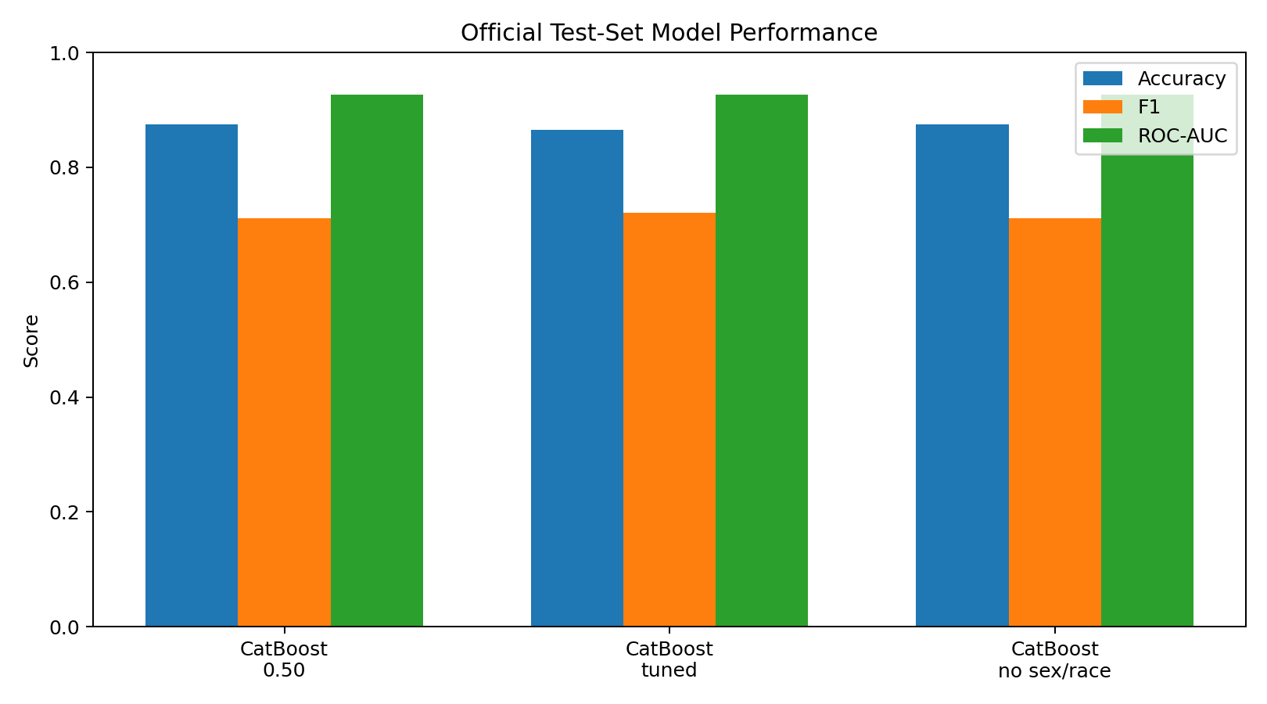
Official Test-Set Performance
Default threshold: 87.48% accuracy; F1 = 0.7111.
Tuned threshold 0.3939: F1 = 0.7203; recall = 0.7361.
Tuning lowers precision (0.7812 → 0.7051) and accuracy (0.8748 → 0.8649).
ROC-AUC remains 0.9270.
EC-417 | P08 | Bodipaga Hima Vijaya Chandana | Roll No. 623104 6/10

Slide 7
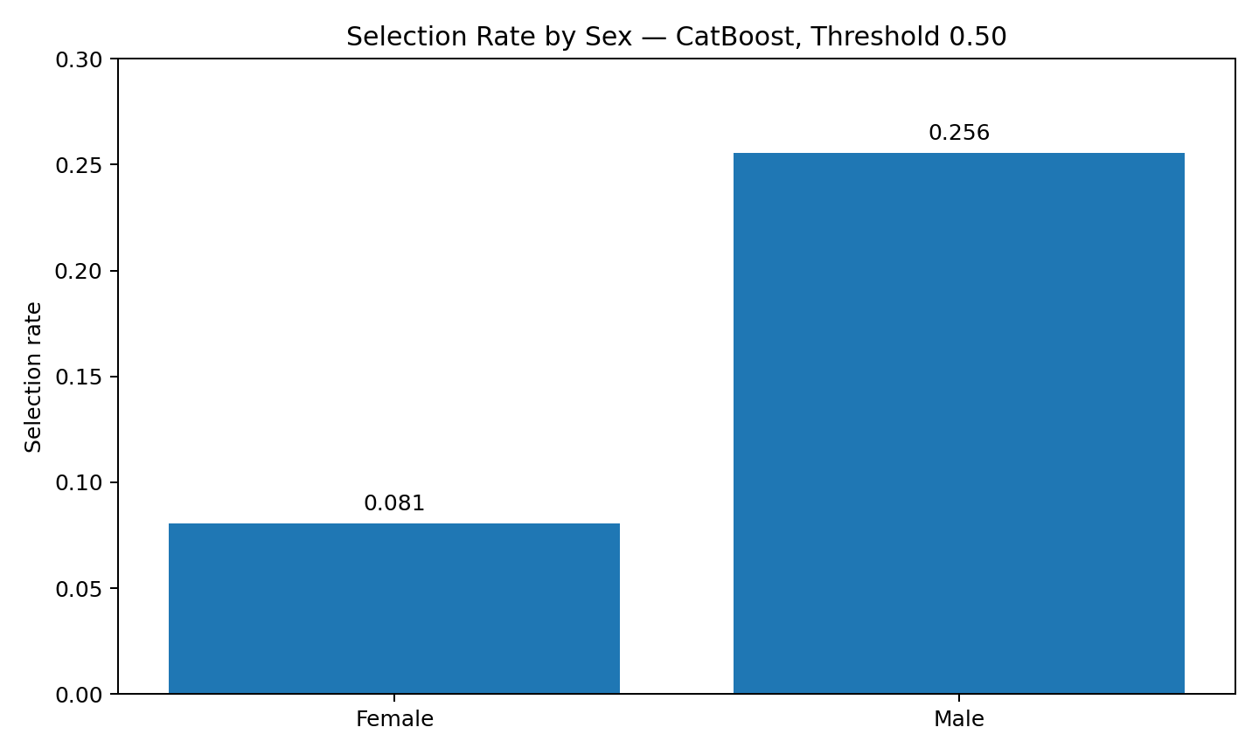
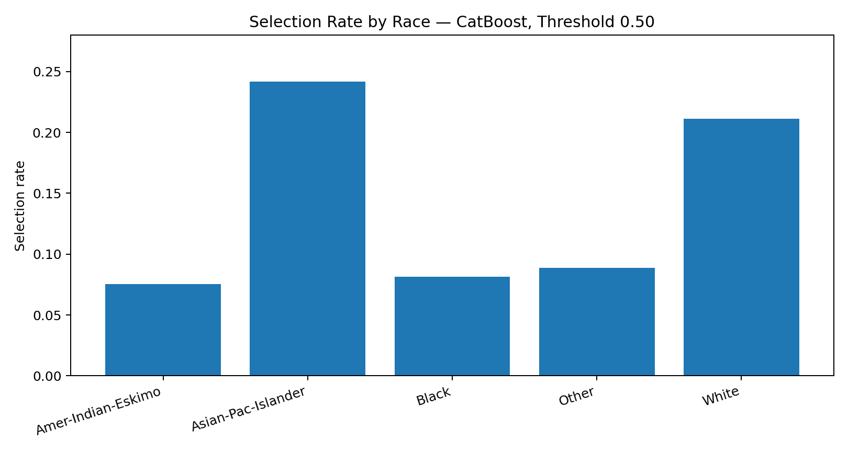
Fairness Audit — Sex & Race
Sex gaps: selection rate 17.50 percentage points; TPR 8.42 points.
Race gaps: selection rate 16.62 points; TPR 22.17 points.
Group sizes and actual positive counts are reported; smaller groups have less stable rates.
EC-417 | P08 | Bodipaga Hima Vijaya Chandana | Roll No. 623104 7/10

Slide 8
Does Removing Sensitive Attributes Solve Fairness?
Without sex/race inputs: accuracy 0.8748, F1 0.7108 and ROC-AUC 0.9268.
Sex gaps remain: selection rate 16.87 points; TPR 5.69 points.
Race gaps remain: selection rate 16.32 points; TPR 15.67 points.
Removing sensitive columns alone does not guarantee fairness: other features may act as proxies.
The result is a descriptive audit, not a causal or legal conclusion.
EC-417 | P08 | Bodipaga Hima Vijaya Chandana | Roll No. 623104 8/10

Slide 9
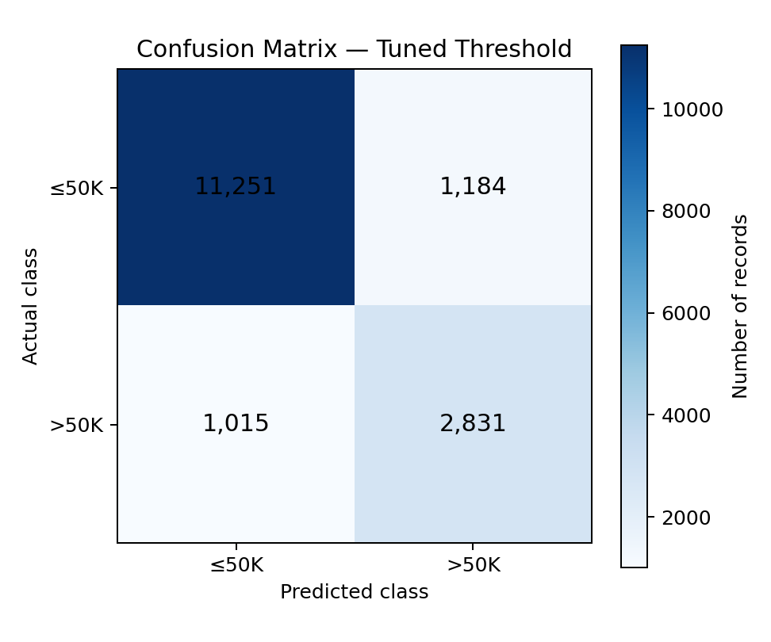
Error Analysis & Uncertainty
Tuned model: 14,082 correct predictions.
False positives: 1,184; false negatives: 1,015.
Bootstrap (1,000 resamples): ROC-AUC 95% CI = 0.9227–0.9313.
Tuned F1 95% CI = 0.7090–0.7315.
Confidence intervals describe sampling variability on this test sample.
EC-417 | P08 | Bodipaga Hima Vijaya Chandana | Roll No. 623104 9/10

Slide 10
Conclusion & Future Work
CatBoost achieved strong predictive ranking performance (test ROC-AUC 0.9270).
Threshold tuning improved positive-class F1 and recall, with a precision/accuracy trade-off.
Non-zero fairness gaps remained across sex and race, even after sensitive attributes were removed.
Limitations: historical dataset, class imbalance, unequal group sizes and a limited set of fairness metrics.
Future work: intersectional audits, group-level confidence intervals, calibration and stakeholder review.
EC-417 | P08 | Bodipaga Hima Vijaya Chandana | Roll No. 623104 10/10

