Slide 1










Open Data 2.0: Lightning talks
Starting soon…
ohbm.github.io/osr2020
@OHBMOpen
#OHBM2020 #OSR
hbm-open-science-room
osr-opendata

Slide 2
Open Data 2.0: Lightning talks
Tuesday 23rd June 2020
ohbm.github.io/osr2020
@OHBMOpen
#OHBM2020 #OSR
hbm-open-science-room
osr-opendata

Slide 3
Open Data 2.0: Lightning talks
What do we need to consider in the “next generation” of data sharing?
5 talks x 5 minutes + 20 min Q&A
Some speakers will be available for live Q&A
ohbm.github.io/osr2020
@OHBMOpen
#OHBM2020 #OSR
hbm-open-science-room
osr-opendata

Slide 4
Open Data 2.0: Lightning talks
Use Crowdcast Question for Q&A - please up-vote
Use chat here and the theme Mattermost channel below – tag speakers if possible
Please fill in the feedback poll before you leave the session – we ♥️ data!
Remember the Code of Conduct
ohbm.github.io/osr2020
@OHBMOpen
#OHBM2020 #OSR
hbm-open-science-room
osr-opendata

Slide 5
Open Data 2.0: Lightning talks
Privacy preserving tech: the tools for safe open data use
Concept annotations via NIDM-Terms fosters improved search of open datasets
Leveraging telehealth in underserved populations for open data research
The Courtois project on neuronal modelling - first data release
BIDS: a data standard to support the neuroimaging community
Emma Bluemke
David Keator
Linda Larson-Prior
Julie A. Boyle
Guiomar Niso
ohbm.github.io/osr2020
@OHBMOpen
#OHBM2020 #OSR
hbm-open-science-room
osr-opendata

Slide 7
Open Data 2.0: Keynote
Starting soon…
ohbm.github.io/osr2020
@OHBMOpen
#OHBM2020 #OSR
hbm-open-science-room
osr-opendata

Slide 8
Open Data 2.0: Keynote
Tuesday 23rd June 2020
ohbm.github.io/osr2020
@OHBMOpen
#OHBM2020 #OSR
hbm-open-science-room
osr-opendata

Slide 9
Open Data 2.0: Keynote
In-depth look at handling of a ‘big data’ set
1 talk x 25 minutes + 15 min Q&A
Speaker may be available for live Q&A
ohbm.github.io/osr2020
@OHBMOpen
#OHBM2020 #OSR
hbm-open-science-room
osr-opendata

Slide 10
Open Data 2.0: Keynote
Use Crowdcast Question for Q&A - please up-vote
Use chat here and the theme Mattermost channel below – tag speakers if possible
Please fill in the feedback poll before you leave the session – we ♥️ data!
Remember the Code of Conduct
ohbm.github.io/osr2020
@OHBMOpen
#OHBM2020 #OSR
hbm-open-science-room
osr-opendata

Slide 11
Open Data 2.0: Keynote
Phenotypes, Genotypes & Voxels: A playground next to a nuclear power plant
Anqi Qiu
ohbm.github.io/osr2020
@OHBMOpen
#OHBM2020 #OSR
hbm-open-science-room
osr-opendata

Slide 13
Open Data 2.0: Demonstrations
Starting soon…
ohbm.github.io/osr2020
@OHBMOpen
#OHBM2020 #OSR
hbm-open-science-room
osr-opendata

Slide 14
Open Data 2.0: Demonstrations
Tuesday 23rd June 2020
ohbm.github.io/osr2020
@OHBMOpen
#OHBM2020 #OSR
hbm-open-science-room
osr-opendata

Slide 15
Open Data 2.0: Demonstrations
What tools are available for the “next generation” of data sharing?
4 talks x 7 minutes + 20 min Q&A
Some speakers will be available for live Q&A
ohbm.github.io/osr2020
@OHBMOpen
#OHBM2020 #OSR
hbm-open-science-room
osr-opendata

Slide 16
Open Data 2.0: Demonstrations
Use Crowdcast Question for Q&A - please up-vote
Use chat here and the theme Mattermost channel below – tag speakers if possible
Please fill in the feedback poll before you leave the session – we ♥️ data!
Remember the Code of Conduct
ohbm.github.io/osr2020
@OHBMOpen
#OHBM2020 #OSR
hbm-open-science-room
osr-opendata

Slide 17
Open Data 2.0: Demonstrations
Bidsme: flexible bidsifier for multimodal datasets
Individual Brain Charting dataset extension: second and third releases
Open and Shared Representations for Neuroscience
Sharing MRI data while protecting participants’ privacy: Two ways to get started
Nikita Beliy
Ana Luísa Pinho
Paola Di Maio
Dorien Huijser
ohbm.github.io/osr2020
@OHBMOpen
#OHBM2020 #OSR
hbm-open-science-room
osr-opendata

Slide 19
Open Workflows: Lightning talks
Starting soon…
ohbm.github.io/osr2020
@OHBMOpen
#OHBM2020 #OSR
hbm-open-science-room
osr-workflows

Slide 20
Open Workflows: Lightning talks
Wednesday 24th June 2020
ohbm.github.io/osr2020
@OHBMOpen
#OHBM2020 #OSR
hbm-open-science-room
osr-workflows

Slide 21
Open Workflows: Lightning talks
How we can build robust and reproducible pipelines
5 talks x 5 minutes + 20 min Q&A
Some speakers will be available for live Q&A
ohbm.github.io/osr2020
@OHBMOpen
#OHBM2020 #OSR
hbm-open-science-room
osr-workflows

Slide 22
Open Workflows: Lightning talks
Use Crowdcast Question for Q&A - please up-vote
Use chat here and the theme Mattermost channel below – tag speakers if possible
Please fill in the feedback poll before you leave the session – we ♥️ data!
Remember the Code of Conduct
ohbm.github.io/osr2020
@OHBMOpen
#OHBM2020 #OSR
hbm-open-science-room
osr-workflows

Slide 23
Open Workflows: Lightning talks
dMRIPrep - A robust and reproducible pipeline for dMRI data pre-processing
shamo, a tool for electromagnetic modelling of the head and sensitivity analysis.
Programming Brain Mapping Hypotheses in NeuroLang
ARIbrain: Interactive clustering with spatial activation guarantees using all-resolutions inference
Conquering confounds and covariates in neuroscientific analyses with an open, high quality library
Michael Joseph
Martin Grignard
Gaston Zanitti
Xu Chen
Pradeep Reddy Raamana
ohbm.github.io/osr2020
@OHBMOpen
#OHBM2020 #OSR
hbm-open-science-room
osr-workflows

Slide 25
Open Workflows: Keynote
Starting soon…
ohbm.github.io/osr2020
@OHBMOpen
#OHBM2020 #OSR
hbm-open-science-room
osr-workflows

Slide 26
Open Workflows: Keynote
Wednesday 24th June 2020
ohbm.github.io/osr2020
@OHBMOpen
#OHBM2020 #OSR
hbm-open-science-room
osr-workflows

Slide 27
Open Workflows: Keynote
In-depth look at and end-to-end reproducible workflow
1 talk x 25 minutes + 15 min Q&A
Speaker may be available for live Q&A
ohbm.github.io/osr2020
@OHBMOpen
#OHBM2020 #OSR
hbm-open-science-room
osr-workflows

Slide 28
Open Workflows: Keynote
Use Crowdcast Question for Q&A - please up-vote
Use chat here and the theme Mattermost channel below – tag speakers if possible
Please fill in the feedback poll before you leave the session – we ♥️ data!
Remember the Code of Conduct
ohbm.github.io/osr2020
@OHBMOpen
#OHBM2020 #OSR
hbm-open-science-room
osr-workflows

Slide 29
Open Workflows: Keynote
Transparent MRI workflows: From scanner to publication
Agah Karakuzu
ohbm.github.io/osr2020
@OHBMOpen
#OHBM2020 #OSR
hbm-open-science-room
osr-workflows

Slide 31
Open Workflows: Demonstrations
Starting soon…
ohbm.github.io/osr2020
@OHBMOpen
#OHBM2020 #OSR
hbm-open-science-room
osr-workflows

Slide 32
Open Workflows: Demonstrations
Wednesday 24th June 2020
ohbm.github.io/osr2020
@OHBMOpen
#OHBM2020 #OSR
hbm-open-science-room
osr-workflows

Slide 33
Open Workflows: Demonstrations
Tools for building robust and reproducible pipelines
4 talks x 7 minutes + 20 min Q&A
Some speakers will be available for live Q&A
ohbm.github.io/osr2020
@OHBMOpen
#OHBM2020 #OSR
hbm-open-science-room
osr-workflows

Slide 34
Open Workflows: Demonstrations
Use Crowdcast Question for Q&A - please up-vote
Use chat here and the theme Mattermost channel below – tag speakers if possible
Please fill in the feedback poll before you leave the session – we ♥️ data!
Remember the Code of Conduct
ohbm.github.io/osr2020
@OHBMOpen
#OHBM2020 #OSR
hbm-open-science-room
osr-workflows

Slide 35
Open Workflows: Demonstrations
Reproducible Research Objects with DataLad
Open, Reproducible, and Decentralized Workflows with COINSTAC
Macapype: An open multi-software framework for non-human primate anatomical MRI processing
No-effort fully reproducible analysis code with FieldTrip
Adina Wagner
Eric Verner
David Meunier
Mats van Es
ohbm.github.io/osr2020
@OHBMOpen
#OHBM2020 #OSR
hbm-open-science-room
osr-workflows

Slide 37
Past, Present and Future of Neuroimaging: Lightning talks
Starting soon…
ohbm.github.io/osr2020
@OHBMOpen
#OHBM2020 #OSR
hbm-open-science-room
osr-future

Slide 38
Past, Present and Future of Neuroimaging: Lightning talks
Thursday 25th June
ohbm.github.io/osr2020
@OHBMOpen
#OHBM2020 #OSR
hbm-open-science-room
osr-future

Slide 39
Past, Present & Future: Lightning talks
Where have we been and where are we heading?
4 talks x 5 minutes + 20 min Q&A
Some speakers will be available for live Q&A
ohbm.github.io/osr2020
@OHBMOpen
#OHBM2020 #OSR
hbm-open-science-room
osr-future

Slide 40
Past, Present & Future: Lightning talks
Use Crowdcast Question for Q&A - please up-vote
Use chat here and the theme Mattermost channel below – tag speakers if possible
Please fill in the feedback poll before you leave the session – we ♥️ data!
Remember the Code of Conduct
ohbm.github.io/osr2020
@OHBMOpen
#OHBM2020 #OSR
hbm-open-science-room
osr-future

Slide 41
Past, Present & Future: Lightning talks
The Open Source Imaging Initiative
NeuroLibre : A cloud-based and curated repository for Jupyter Notebooks in neuroscience
AFNI - From Then to Now and Beyond
Nilearn: open, easy, and powerful statistical analysis of brain images
João Periquito
Loïc Tetrel
Robert Cox
Gael Varoquaux
ohbm.github.io/osr2020
@OHBMOpen
#OHBM2020 #OSR
hbm-open-science-room
osr-future

Slide 43
Past, Present and Future of Neuroimaging: Keynote
Starting soon…
ohbm.github.io/osr2020
@OHBMOpen
#OHBM2020 #OSR
hbm-open-science-room
osr-future

Slide 44
Past, Present and Future of Neuroimaging: Keynote
Thursday 25th June
ohbm.github.io/osr2020
@OHBMOpen
#OHBM2020 #OSR
hbm-open-science-room
osr-future

Slide 45
Past, Present & Future: Keynote
The next phase of open science
1 talk x 25 minutes + 15 min Q&A
Speaker may be available for live Q&A
ohbm.github.io/osr2020
@OHBMOpen
#OHBM2020 #OSR
hbm-open-science-room
osr-future

Slide 46
Past, Present & Future: Keynote
Use Crowdcast Question for Q&A - please up-vote
Use chat here and the theme Mattermost channel below – tag speakers if possible
Please fill in the feedback poll before you leave the session – we ♥️ data!
Remember the Code of Conduct
ohbm.github.io/osr2020
@OHBMOpen
#OHBM2020 #OSR
hbm-open-science-room
osr-future

Slide 47
Past, Present & Future: Keynote
Low Field MRI - a possible brain imaging modality for sub-Saharan Africa
Johnes Obungoloch
ohbm.github.io/osr2020
@OHBMOpen
#OHBM2020 #OSR
hbm-open-science-room
osr-future

Slide 48
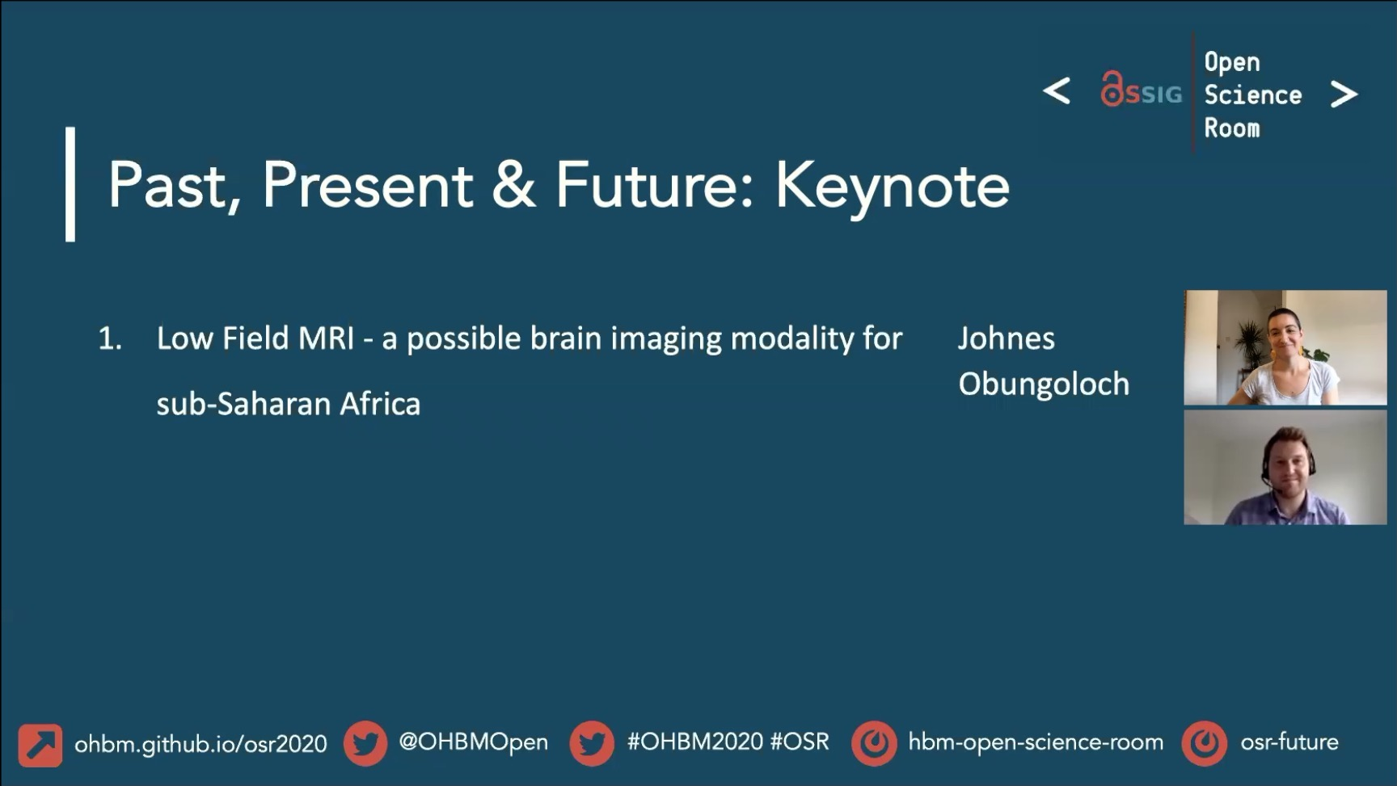
Past, Present & Future: Keynote
Low Field MRI - a possible brain imaging modality for sub-Saharan Africa
Johnes Obungoloch
ohbm.github.io/osr2020
@OHBMOpen
#OHBM2020 #OSR
hbm-open-science-room
osr-future

Slide 50
Past, Present and Future of Neuroimaging: Demonstrations
Starting soon…
ohbm.github.io/osr2020
@OHBMOpen
#OHBM2020 #OSR
hbm-open-science-room
osr-future

Slide 51
Past, Present and Future of Neuroimaging: Demonstrations
Thursday 25th June
ohbm.github.io/osr2020
@OHBMOpen
#OHBM2020 #OSR
hbm-open-science-room
osr-future

Slide 52
Past, Present & Future: Demonstrations
Where are our tools heading?
4 talks x 7 minutes + 20 min Q&A
Some speakers will be available for live Q&A
ohbm.github.io/osr2020
@OHBMOpen
#OHBM2020 #OSR
hbm-open-science-room
osr-future

Slide 53
Past, Present & Future: Demonstrations
Use Crowdcast Question for Q&A - please up-vote
Use chat here and the theme Mattermost channel below – tag speakers if possible
Please fill in the feedback poll before you leave the session – we ♥️ data!
Remember the Code of Conduct
ohbm.github.io/osr2020
@OHBMOpen
#OHBM2020 #OSR
hbm-open-science-room
osr-future

Slide 54
Past, Present & Future: Demonstrations
The Women in Neuroscience Repository (WiNRepo)
Status update on MNE-Python
Group ICA Toolbox: New features and developments
The INCF online training suite: a resource to advance and enable training and education in brain data science
Fabio Ferreira
Marijn van Vliet
Srinivas Rachakonda
Ariel Rokem
ohbm.github.io/osr2020
@OHBMOpen
#OHBM2020 #OSR
hbm-open-science-room
osr-future

Slide 56
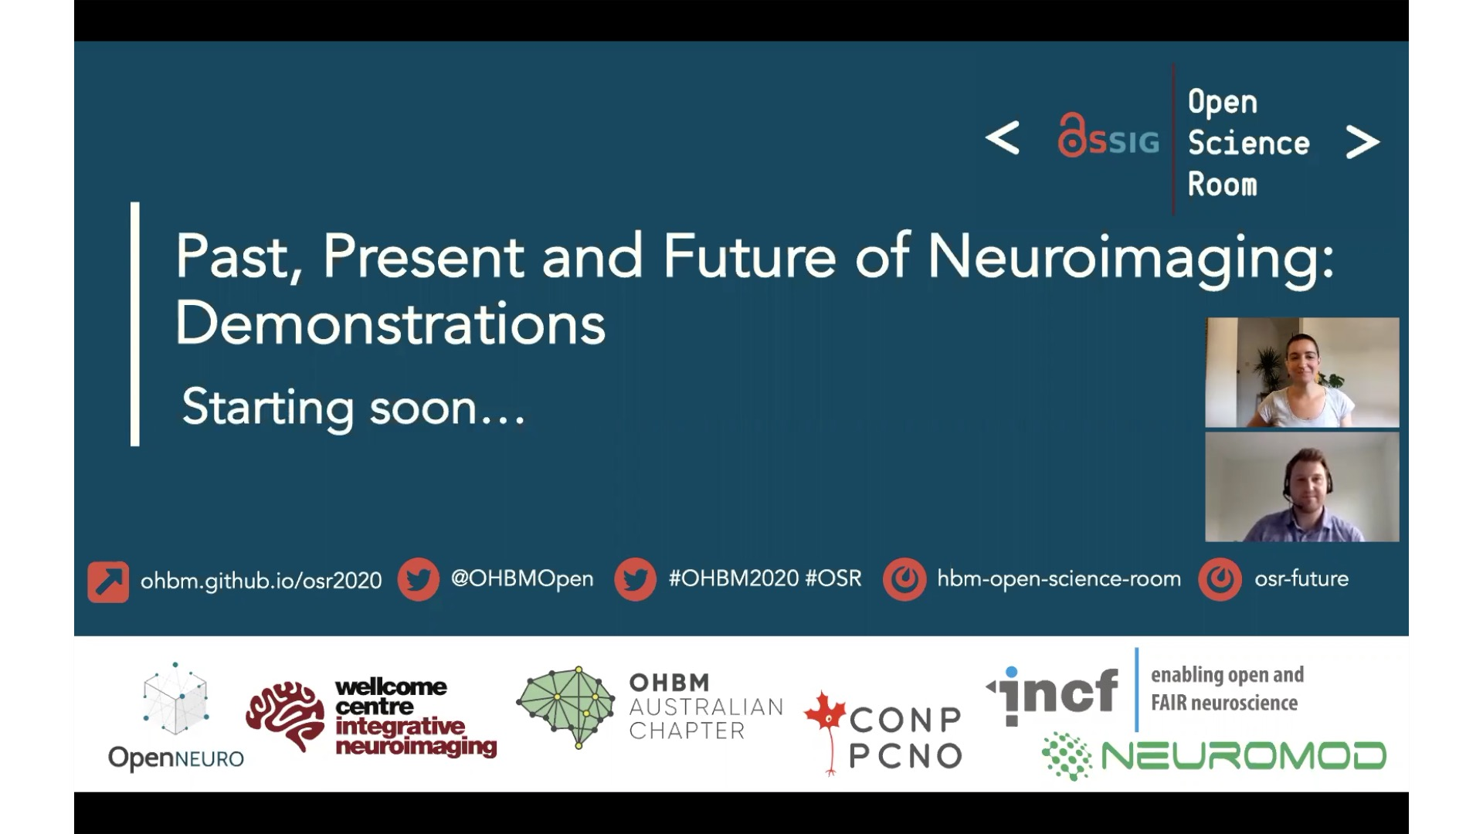

Slide 57
