Slide 2
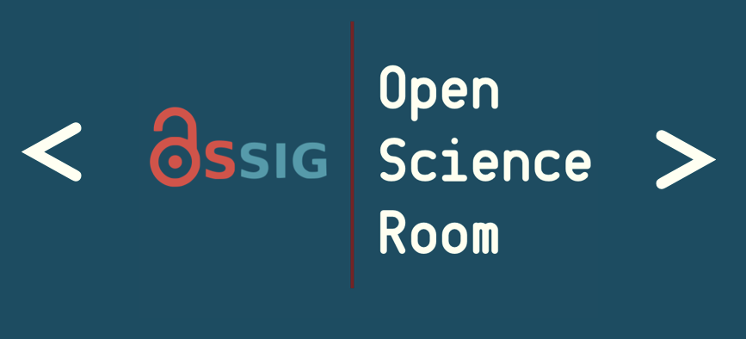



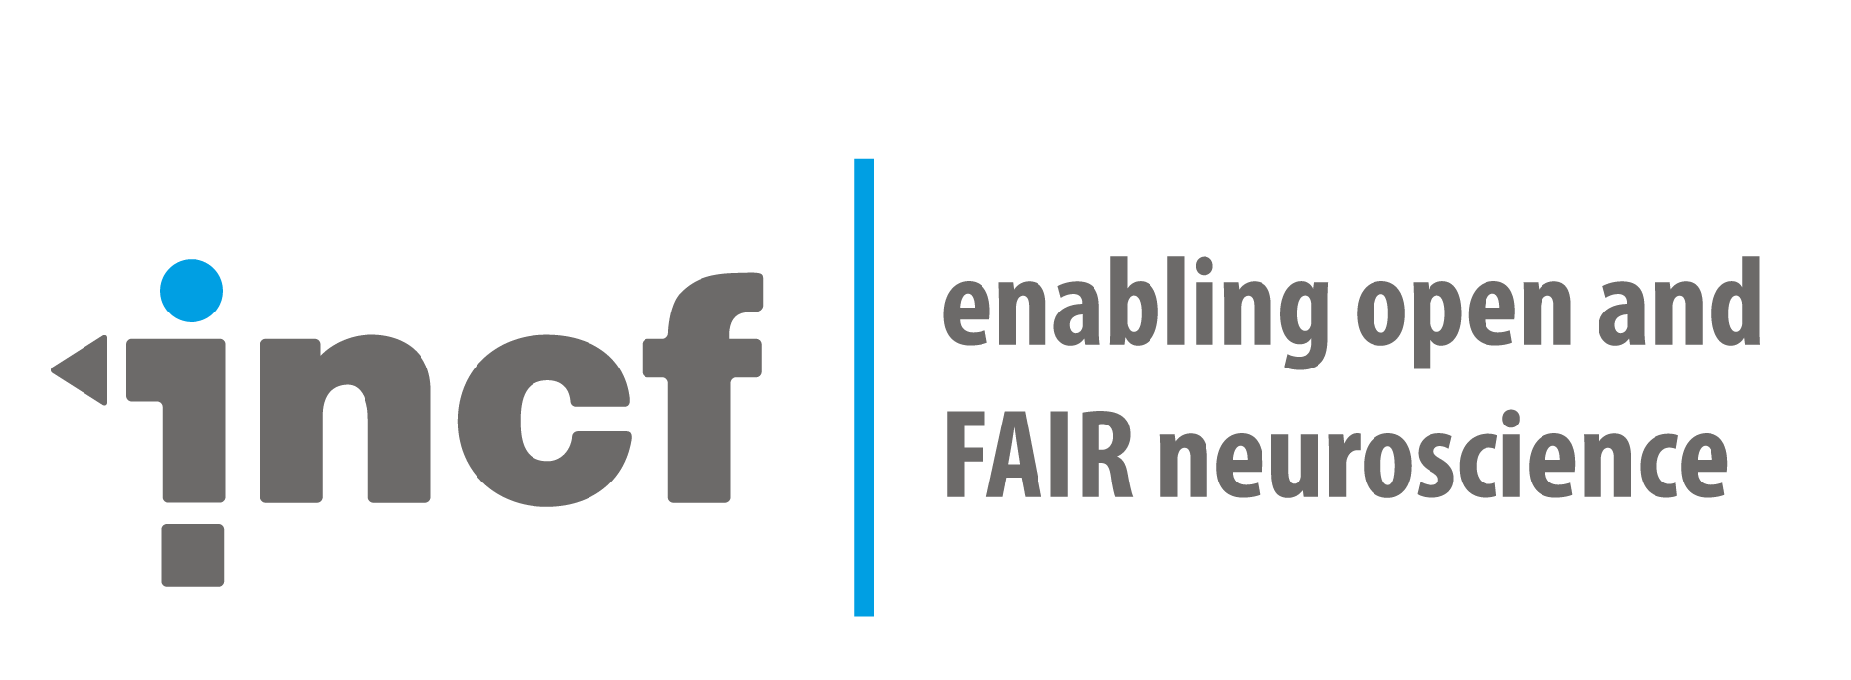
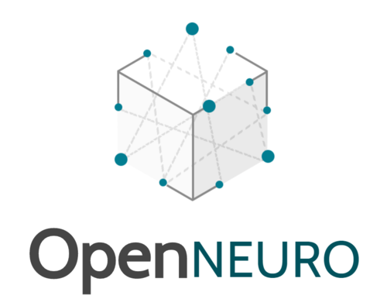
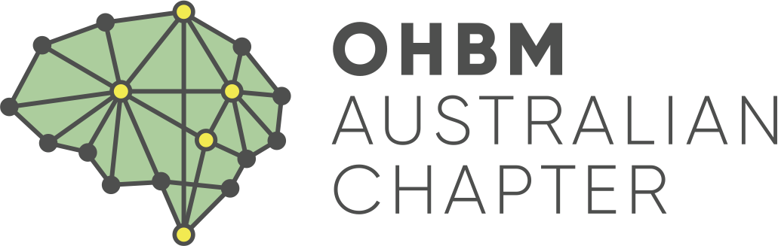
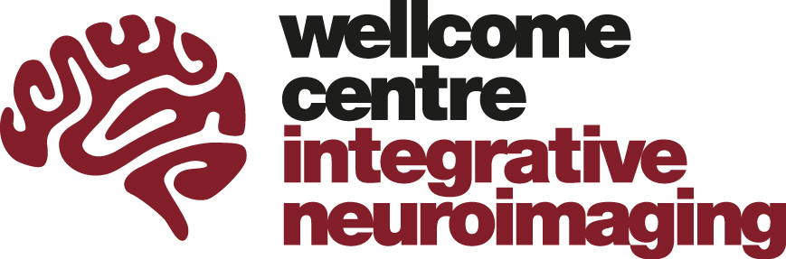


Open Data 2.0: Lightning talks
Starting soon…
ohbm.github.io/osr2020
@OHBMOpen
#OHBM2020 #OSR
hbm-open-science-room
osr-opendata

Slide 3
Open Data 2.0: Lightning talks
Privacy preserving tech: the tools for safe open data use
Concept annotations via NIDM-Terms fosters improved search of open datasets
Leveraging telehealth in underserved populations for open data research
The Courtois project on neuronal modelling - first data release
BIDS: a data standard to support the neuroimaging community
Emma Bluemke
David Keator
Linda Larson-Prior
Julie A. Boyle
Guiomar Niso
ohbm.github.io/osr2020
@OHBMOpen
#OHBM2020 #OSR
hbm-open-science-room
osr-opendata

Slide 4
Open Data 2.0: Keynote
Phenotypes, Genotypes & Voxels: A playground next to a nuclear power plant
Anqi Qiu
ohbm.github.io/osr2020
@OHBMOpen
#OHBM2020 #OSR
hbm-open-science-room
osr-opendata

Slide 5
Open Data 2.0: Demonstrations
Bidsme: flexible bidsifier for multimodal datasets
Individual Brain Charting dataset extension: second and third releases
Open and Shared Representations for Neuroscience
Sharing MRI data while protecting participants’ privacy: Two ways to get started
Nikita Beliy
Ana Luísa Pinho
Paola Di Maio
Dorien Huijser
ohbm.github.io/osr2020
@OHBMOpen
#OHBM2020 #OSR
hbm-open-science-room
osr-opendata

Slide 6
Open Workflows: Lightning talks
dMRIPrep - A robust and reproducible pipeline for dMRI data pre-processing
shamo, a tool for electromagnetic modelling of the head and sensitivity analysis.
Programming Brain Mapping Hypotheses in NeuroLang
ARIbrain: Interactive clustering with spatial activation guarantees using all-resolutions inference
Conquering confounds and covariates in neuroscientific analyses with an open, high quality library
Michael Joseph
Martin Grignard
Gaston Zanitti
Xu Chen
Pradeep Reddy Raamana
ohbm.github.io/osr2020
@OHBMOpen
#OHBM2020 #OSR
hbm-open-science-room
osr-workflows

Slide 7
Open Workflows: Keynote
Transparent MRI workflows: From scanner to publication
Agah Karakuzu
ohbm.github.io/osr2020
@OHBMOpen
#OHBM2020 #OSR
hbm-open-science-room
osr-workflows

Slide 8
Open Workflows: Demonstrations
Reproducible Research Objects with DataLad
Open, Reproducible, and Decentralized Workflows with COINSTAC
Macapype: An open multi-software framework for non-human primate anatomical MRI processing
No-effort fully reproducible analysis code with FieldTrip
Adina Wagner
Eric Verner
David Meunier
Mats van Es
ohbm.github.io/osr2020
@OHBMOpen
#OHBM2020 #OSR
hbm-open-science-room
osr-workflows

Slide 9
Past, Present & Future: Lightning talks
The Open Source Imaging Initiative
NeuroLibre : A cloud-based and curated repository for Jupyter Notebooks in neuroscience
AFNI - From Then to Now and Beyond
Nilearn: open, easy, and powerful statistical analysis of brain images
João Periquito
Loïc Tetrel
Robert Cox
Gael Varoquaux
ohbm.github.io/osr2020
@OHBMOpen
#OHBM2020 #OSR
hbm-open-science-room
osr-future

Slide 10
Past, Present & Future: Keynote
Low Field MRI - a possible brain imaging modality for sub-Saharan Africa
Johnes Obungoloch
ohbm.github.io/osr2020
@OHBMOpen
#OHBM2020 #OSR
hbm-open-science-room
osr-future

Slide 11
Past, Present & Future: Demonstrations
The Women in Neuroscience Repository (WiNRepo)
Status update on MNE-Python
Group ICA Toolbox: New features and developments
The INCF online training suite: a resource to advance and enable training and education in brain data science
Fabio Ferreira
Marijn van Vliet
Srinivas Rachakonda
Ariel Rokem
ohbm.github.io/osr2020
@OHBMOpen
#OHBM2020 #OSR
hbm-open-science-room
osr-future

