Slide 1

EDUCATOR
A productivity tool for educators of all levels
Group 3 – Round Rock
Adam, Alberto, Boris

Slide 2
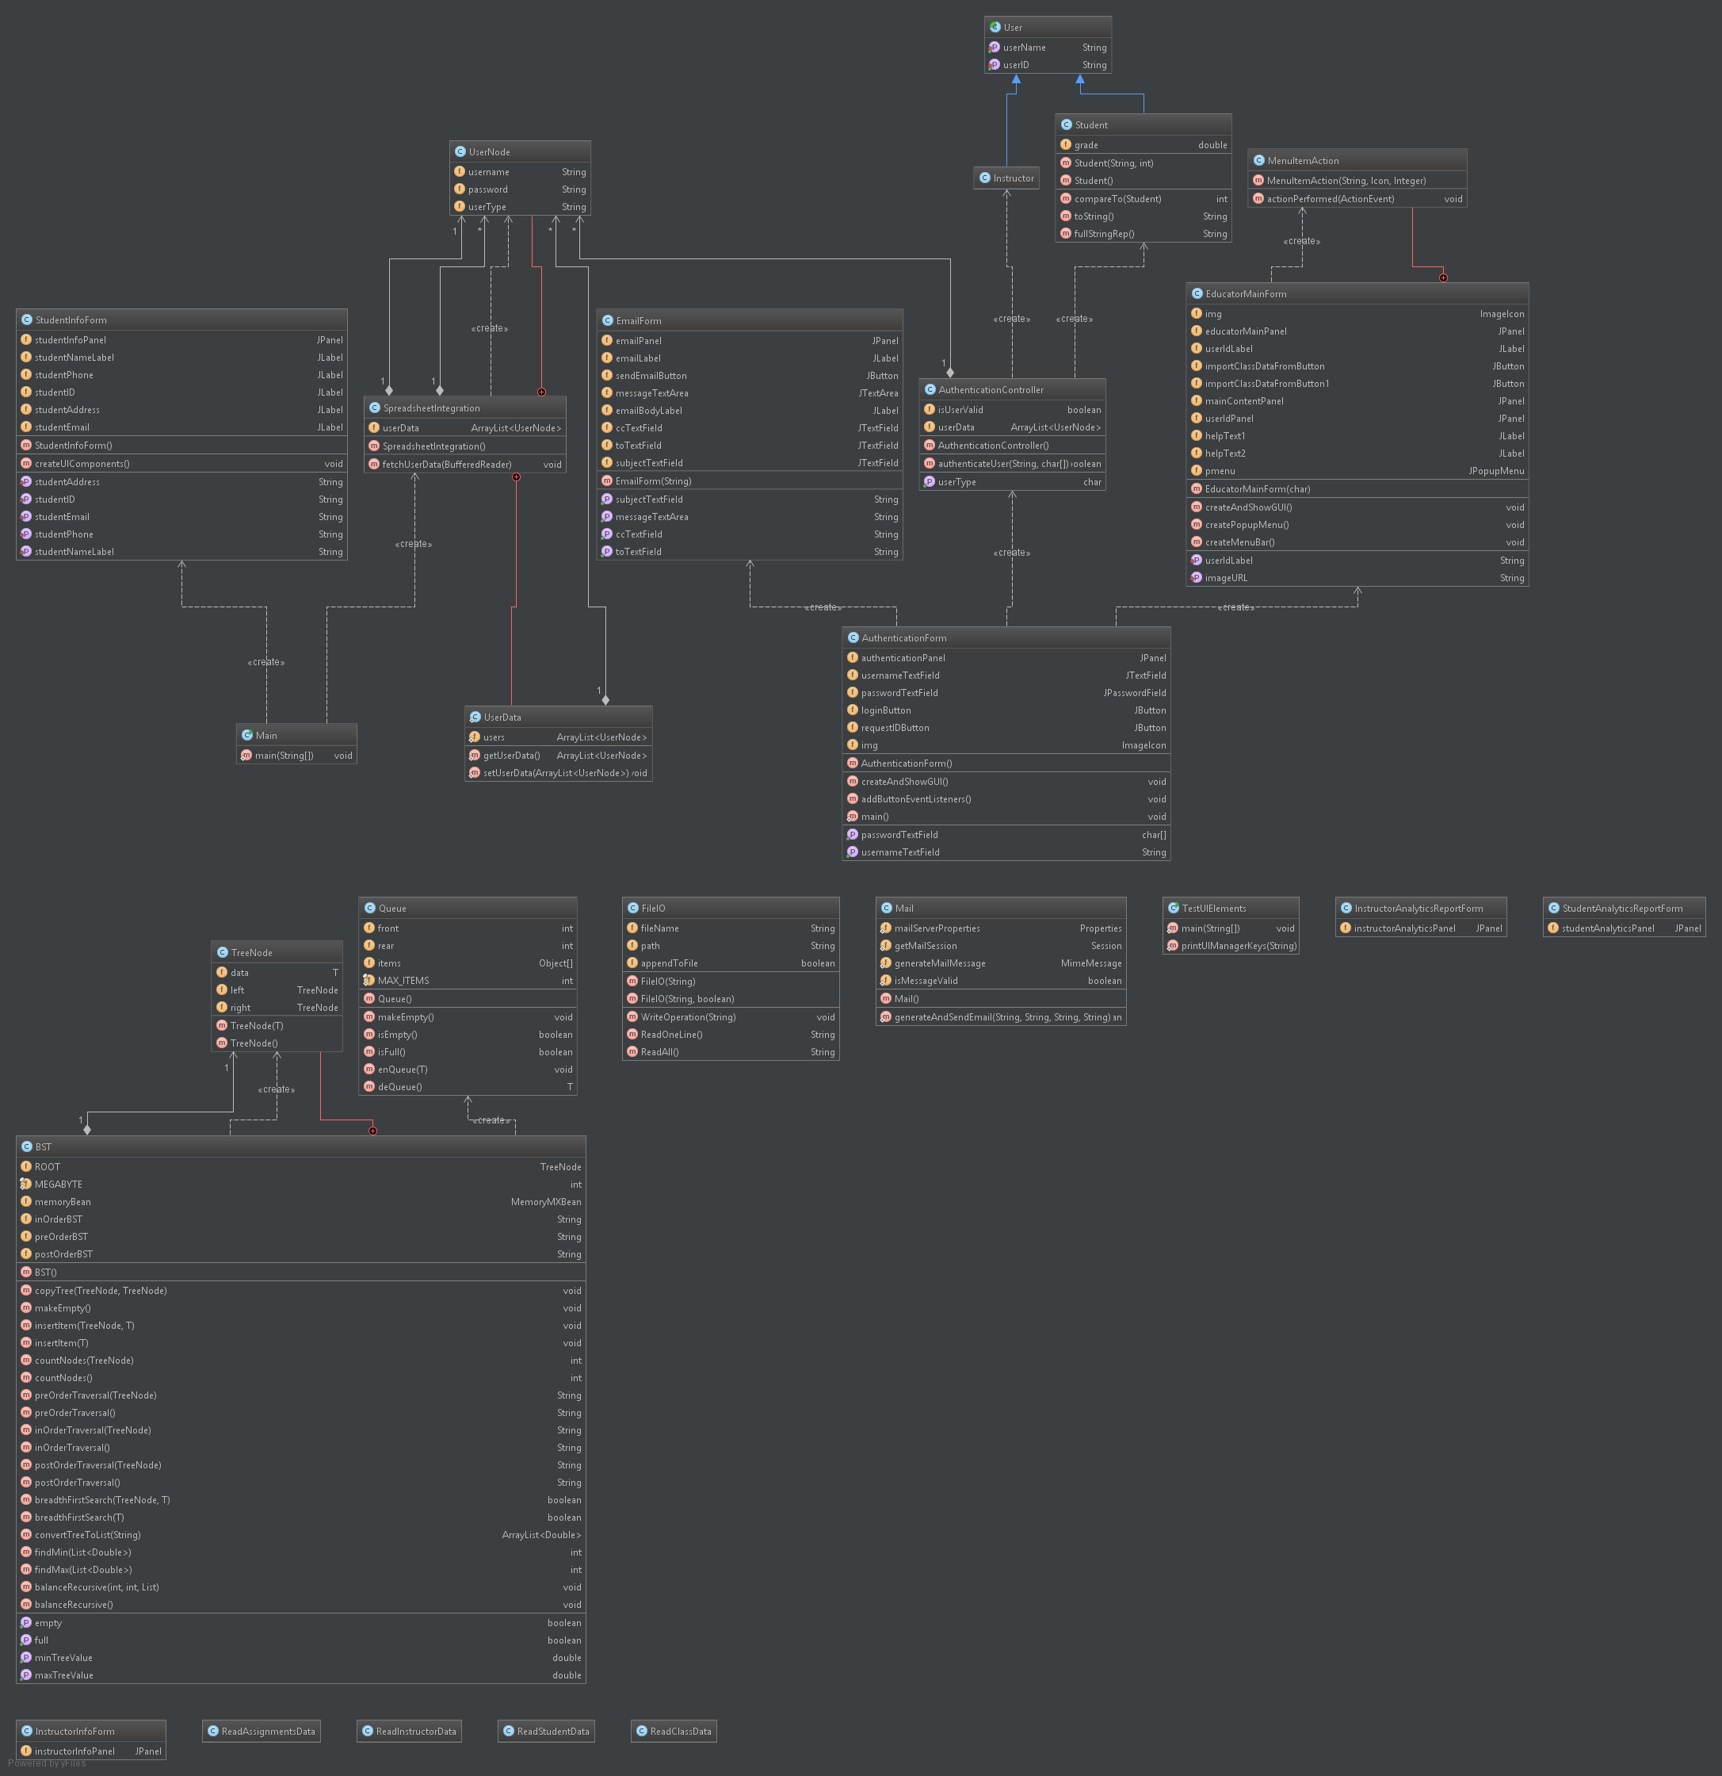

Slide 3
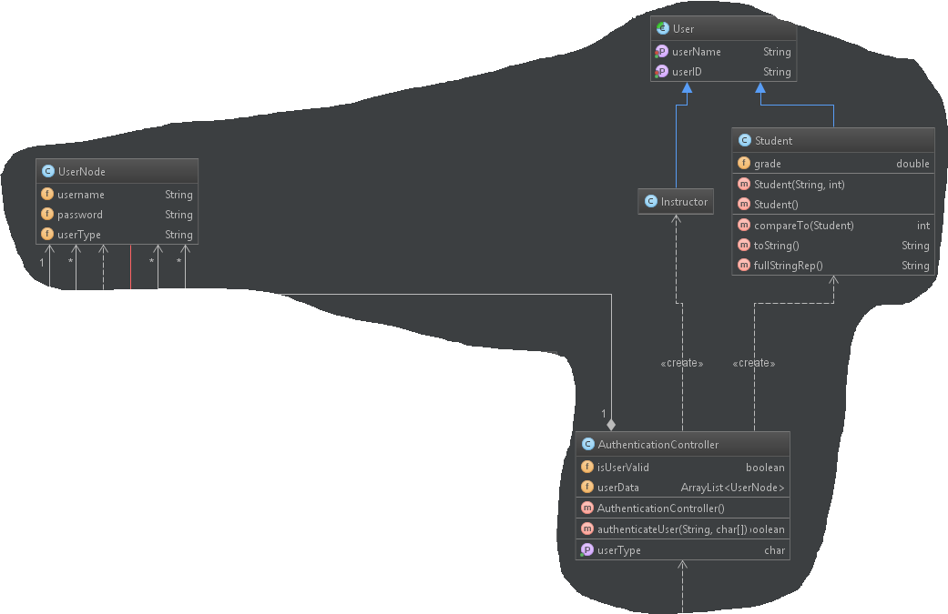
Noteworthy Classes

Slide 4
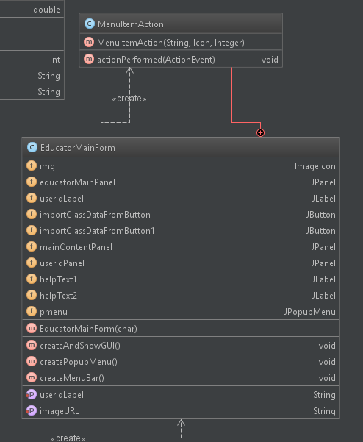

Slide 5
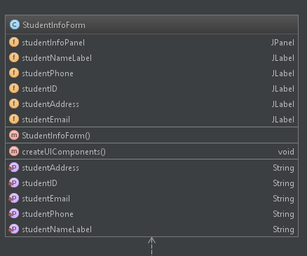

Slide 6
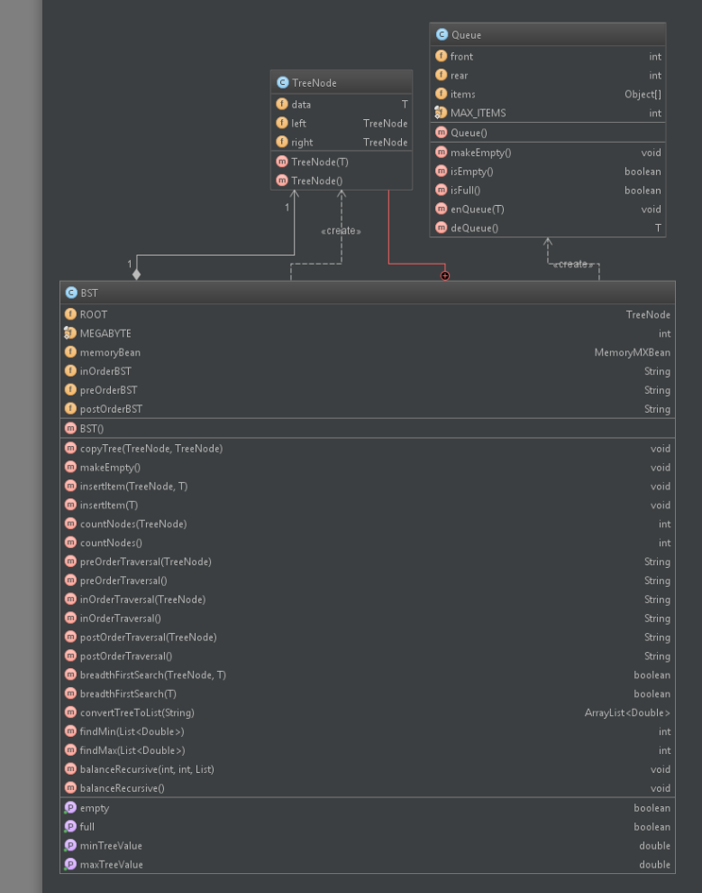

Slide 7
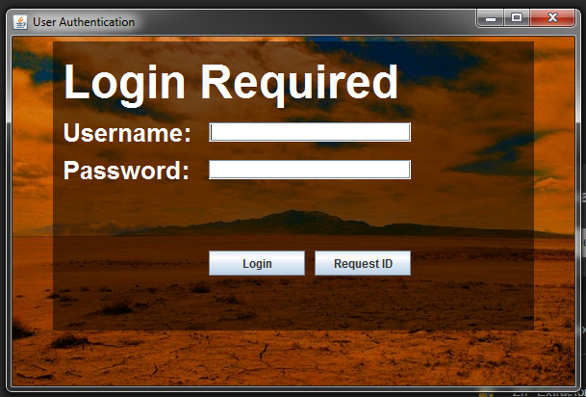
Application Features: Login Screen

Slide 8
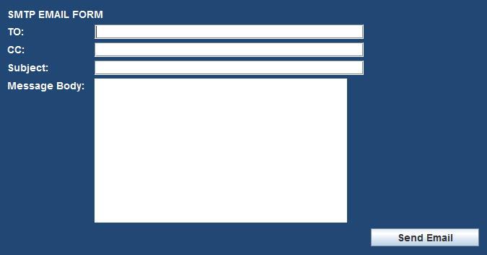
Application Features: Request ID

Slide 9
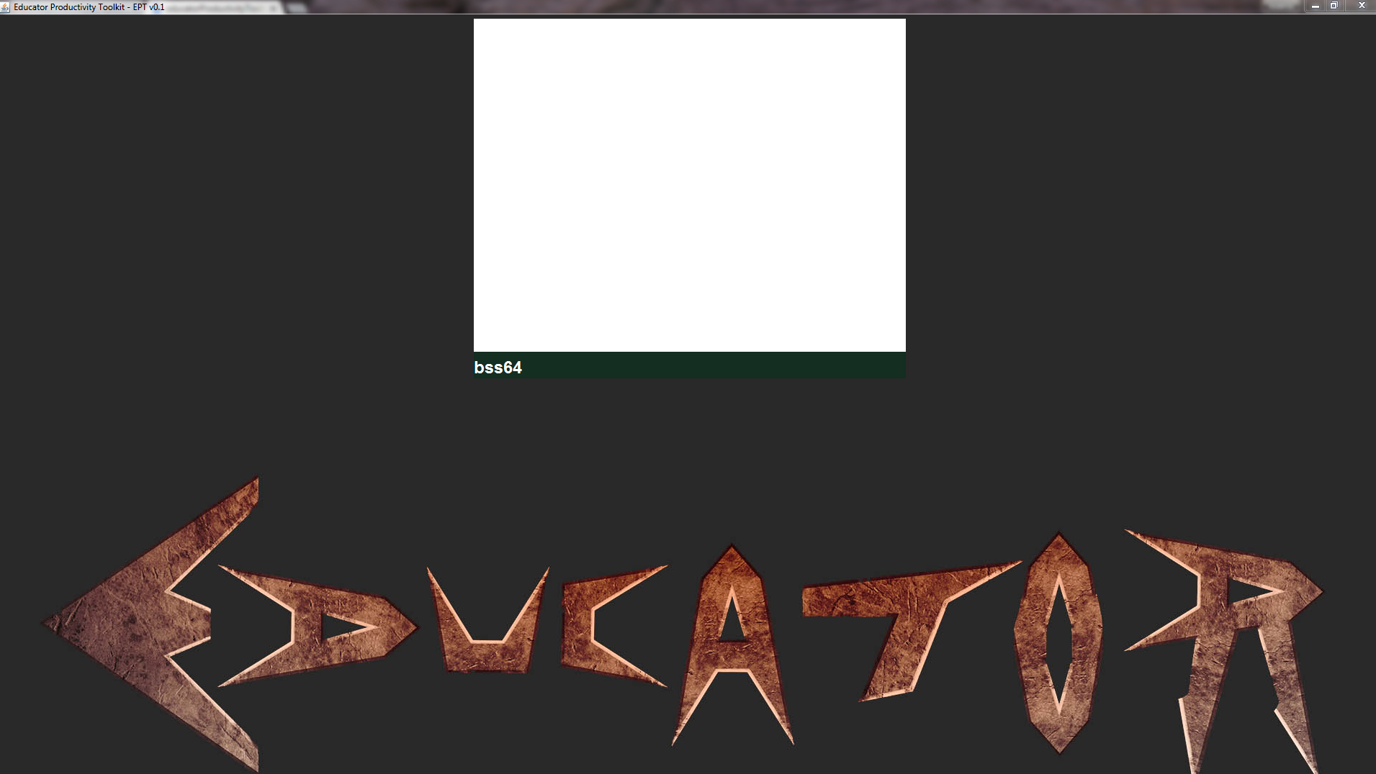
Application Features: Educator Main Screen

Slide 10
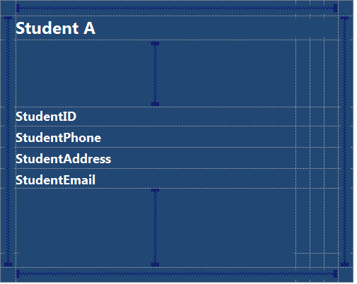
Application Features: Student Information

Slide 11
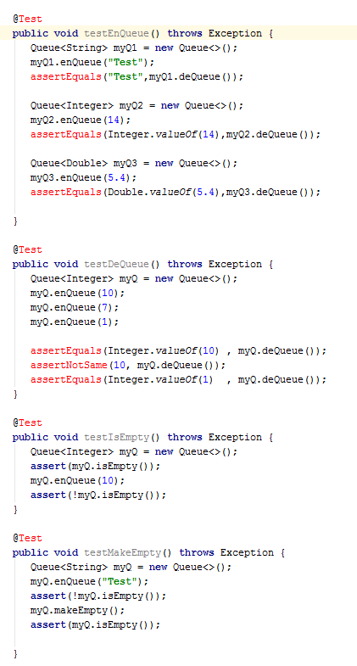
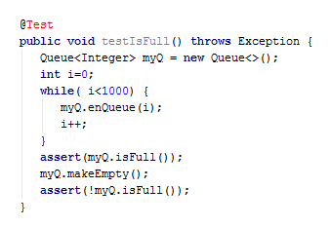
Testcases Queue Data Structure

Slide 12

Testcases Sending Emails

Slide 13
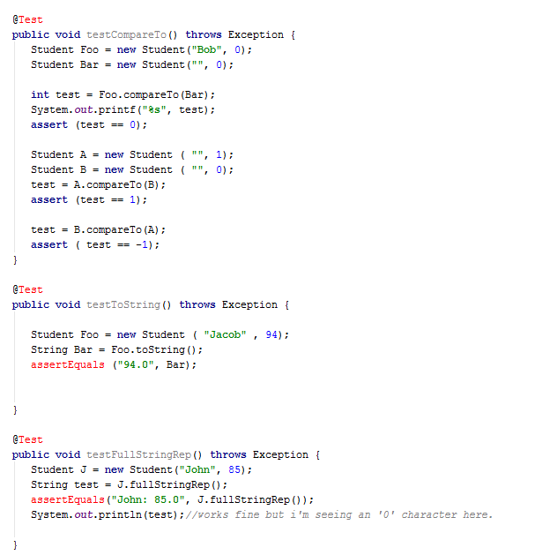
Testcases Student Class

