Slide 1
高级数据结构和算法分析
Advanced Data Structures and Algorithm Analysis
主讲教师： 杨 洋
Instructor: Yang, Yang
E-mail: yangya@zju.edu.cn
Courseware and homework sets can be downloaded from https://pintia.cn/

Slide 2



 教材 (Text Book)
Data Structures and
Algorithm Analysis in C
(2nd Edition)
Mark Allen Weiss
陈 越 改编
Email: weiss@fiu.edu

Slide 3


 教材 (Text Book)
Algorithm Design
Jon Kleinberg, Eva Tardos
Addison Wesley, 2005
Introduction to Algorithms
(3rd Edition)
Thomas H. Cormen, Charles E. Leiserson, Ronald L. Rivest and Clifford Stein
The MIT Press. 2009

Slide 4
 参考书目 (Reference)
➢ 数据结构课程设计
何钦铭、冯雁、陈越 著 浙江大学出版社
➢ 数据结构与算法分析（C语言版）
魏宝刚、陈越、王申康 编著 浙江大学出版社
➢ 数据结构学习与实验指导
陈越、何钦铭、徐镜春、魏宝刚、杨枨 编著
高等教育出版社

Slide 5






课程评分方法 (Grading Policies)
Homework
(10)
Discussions
(10)
Research Project (30)
MidTerm
(10*)
Total ≤ 60
Final Exam (40*)

Slide 6
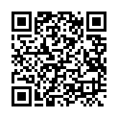
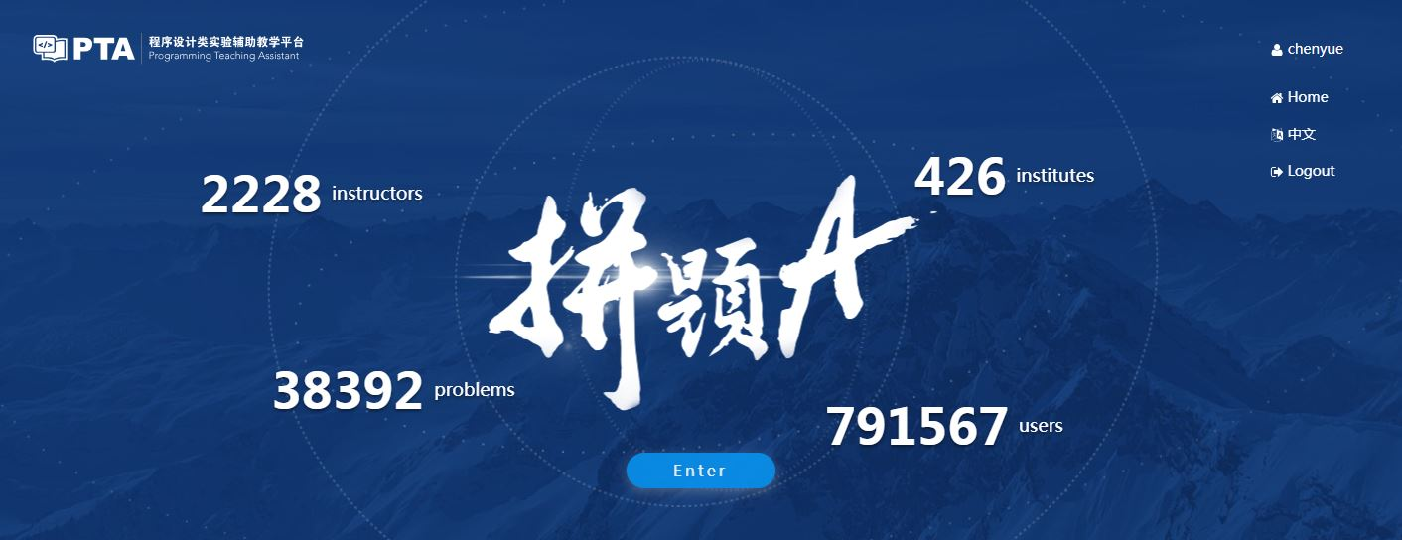
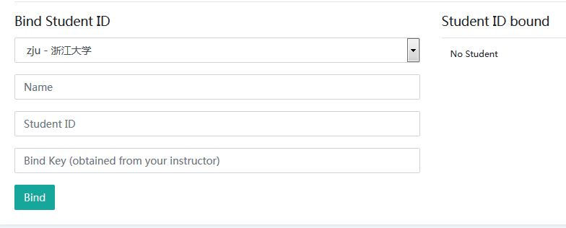
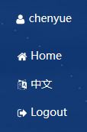
Homework Assignments (10)
Register and login at https://pintia.cn/
Bind your student ID with bind key
Enter
781406

Slide 7
Research topics (30)
Done in groups of 4
choose 2 out of 7 topics
Report (((20+20)/2 points)
In-class presentation (10 minutes, 10 points)
The speaker will be chosen randomly from all the contributors
If there are many volunteers, at first 4 groups will be chosen to give presentations (5 groups for the last 2 projects)
For those groups not to give presentations, each will gain bonus points = report points / 20
Notes:
Bonus points算入整个平时分

Slide 8

Research Reports
Peer Review
Spending at least 90 minutes per week on ADS
Group_Total = G_{T} × 50% + G_{PR} × 50%
Fullmark = 20

Slide 9
Discussions (10)
Done in individuals
Random in-class discussion topics
Each takes 3~5 minutes
Each full-mark is 10

Slide 10
诚信守则
（Code of Academic Honesty）
One must get a full mark to be eligible to take the final exam.
As long as there is one action of academic dishonesty in this semester, one will not be eligible to take the final exam and one’s course score will be zero.

Slide 11
Please send your group members’ names and student ID’s to denghaoran@zju.edu.cn before 3rd March. In return, you will receive your group ID.
If you want to take the first project, please send your team information before 1st March.
Please specify your group leader in the email.

