Slide 1
Systems Genetics
Yaqi Zhou, Shengqian Chen, Wenxue Zhang, Yanan Huo
April 2016

Slide 2
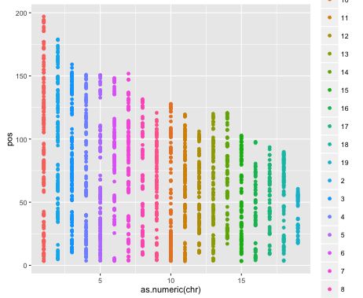
Problem 1
Demonstrate that markers near each other are more correlated than markers far away.
Define the “Correlation” by Jaccard Index: the total number of the same value in two target chromosomes divided by the size of observation. It’s like chromosomes’ similarity. We think the higher percent of the same value, the more correlative relationship there is.
Figure 1 : Map of the makers in 19 chromosomes

Slide 3
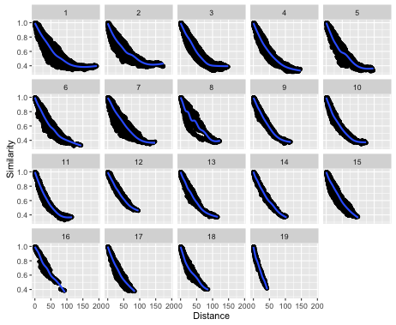


The similarity decreases as the distance increases and converges to 0.375.
Prob. (BB+BB) + Prob. (BR+BR) + Prob. (RR+RR) = + + = 0.375
$${1/4}^{2}$$
Figure 2: Correlation v.s. Distance in each chromosome

Slide 4
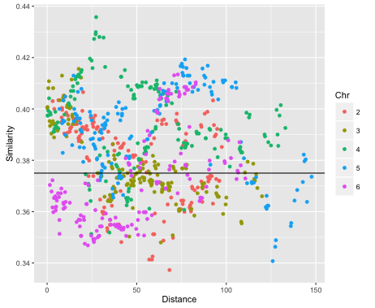
To show that markers on different chromosomes are uncorrelated with each other. We’d prefer to choose the marker in the median position of chromosomes 2 to 6 and compare it with all markers in chromosome 1. Then we got the figure 3 , which indicates that the performance has nothing to do with chromosomes.
Figure 3: Similarity v.s. Distance in different chromosomes

Slide 5
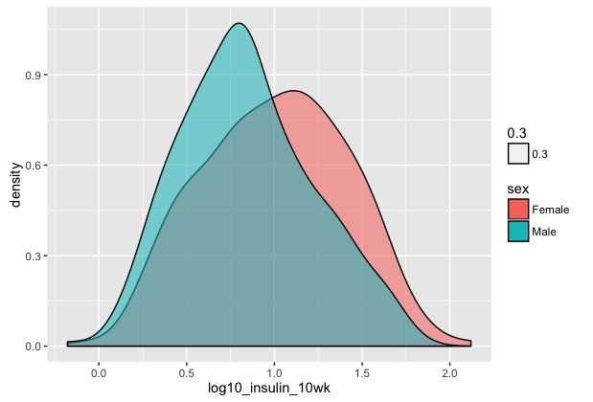
Problem 2
How is covariate SEX related to insulin？

Slide 6
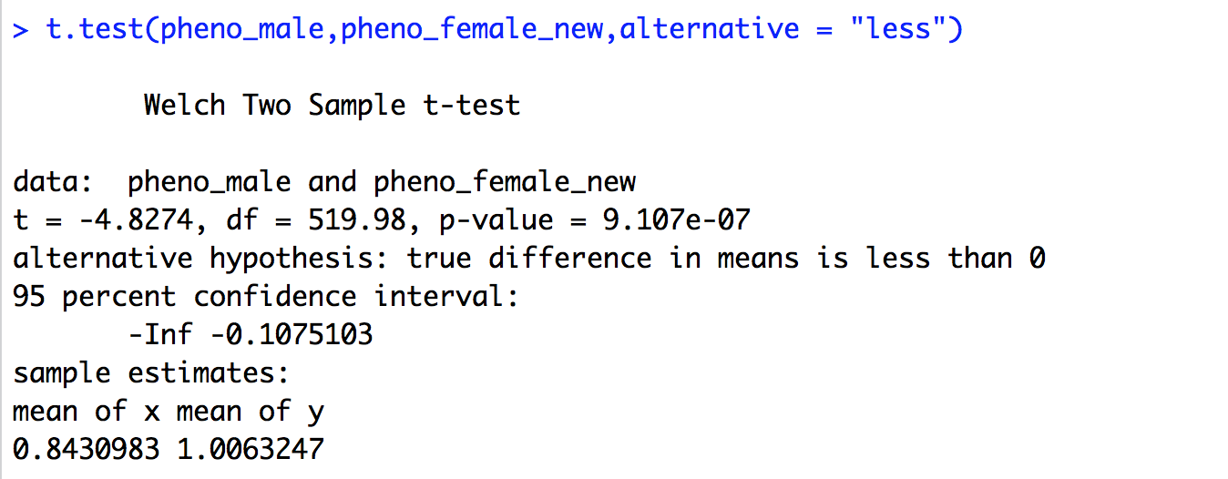
Welch t-test

Slide 7
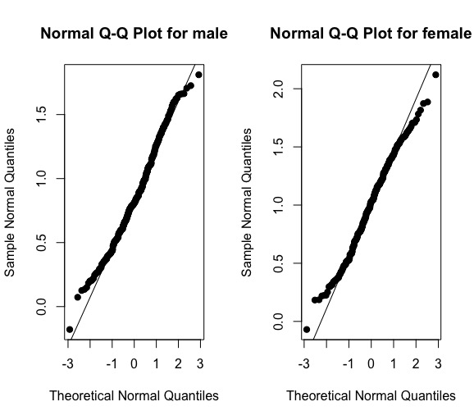
Normality test

Slide 8
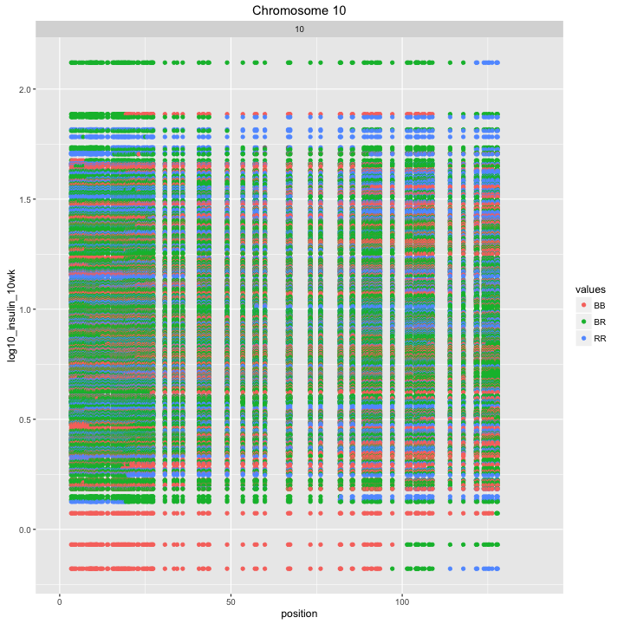
Problem 3
How genotypes are related to the key phenotype?
Stepwise Regression
Notes:
Stepwise Regression: find the markers that have the potential patterns in color from figures, then pick the corresponding markers and fit the model; use stepwise for variable selection → coefficients not significant; residual plots show patterns, indicating bad fit; hard to figure out the pattern for a single marker.

Slide 9
Random Forest
NAs exist for rows, which should be omitted when using randomForest function in R
Replace NA in a marker by the value of the same position in the nearest neighboring marker

Slide 10
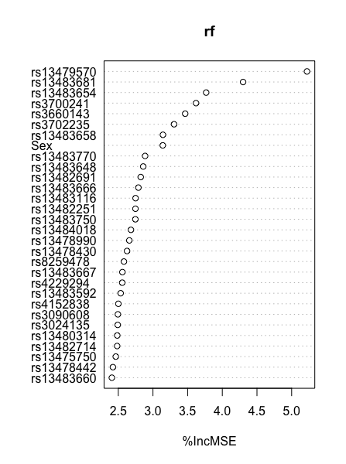
Marker | Chromosome | Position
rs3700241 | 7 | 146.97
rs3702235 | 7 | 147.11
rs13479570 | 7 | 151.81
rs13483654 | 19 | 48.46
rs13483658 | 19 | 49.96
rs13483681 | 19 | 54.92
rs3660143 | 19 | 55.10
Marker | Chromosome | Position
rs13479570 | 7 | 151.81
rs13483654 | 19 | 48.46
rs13483681 | 19 | 54.92
rs3660143 | 19 | 55.10

Slide 11
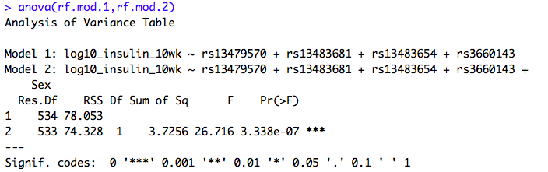
Do we need to include “Sex”?

