Slide 1
Exercise Pose Tracker
SL.NO | NAME | ROLL NUMBER
1 | Y G Ram Darshan Reddy | CB.EN.U4CSE21269
Github URL:https://github.com/6302606344/Exercise-tracker-
Google Sites:https://sites.google.com/view/exercise-pose-tracker/home
Professor :Dr.T Senthil Kumar(CSE)

Slide 2
Agenda
Block Diagram
Deep learning Architecture Diagram-Drawn by tool
Algorithm Procedure-Explained step by step
Dataset Description--General and Custom Dataset
Hyperparameter details Table with justification
Performance Metrics--Tabulation with Discussion
Performance Metrics--Graphs with Discussion
Inference of the metrics for varying Training/ Validation/ Testing
Comparison Table of all architectures in group with Discussion
Poster--consolidating the entire team project
Explainable Al---Analysis and Discussion

Slide 3
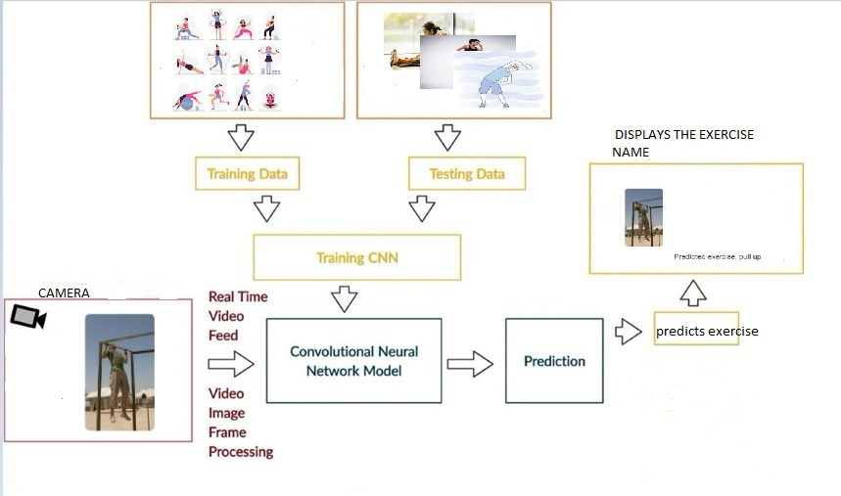
Block diagram
The Exercise Pose Tracker block diagram begins with an Input Module capturing real-time images or video frames of exercises. In the Preprocessing Module, frames undergo extraction, data augmentation, and normalization. The Feature Extraction Module uses DenseNet to identify key features in each frame, while the Pose Detection Module classifies exercises and checks form accuracy. The Post-Processing Module provides real-time feedback on exercise type, form correctness, and counts repetitions. An Output Module displays this feedback, while optional Storage & Analytics saves data for tracking progress. Finally, Performance Metrics like accuracy and F1 score evaluate model effectiveness.

Slide 4
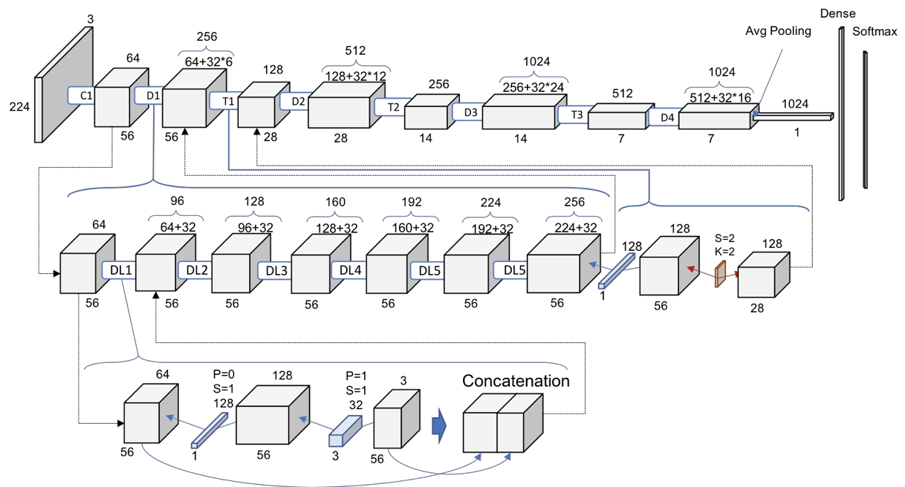
Deep learning Architecture Diagram-Drawn by tool
Feature Extraction and Classification: The methodology involves preprocessing exercise images and using DenseNet for feature extraction, leveraging its densely connected architecture to learn robust feature embeddings. A fully connected (FC) layer is employed to classify these embeddings into different exercise poses.
Real-Time Feedback and Validation: During inference, the model compares the extracted pose features against templates of correct form, identifying the exercise type and providing real-time feedback on form and repetition accuracy to enhance user performance.

Slide 5
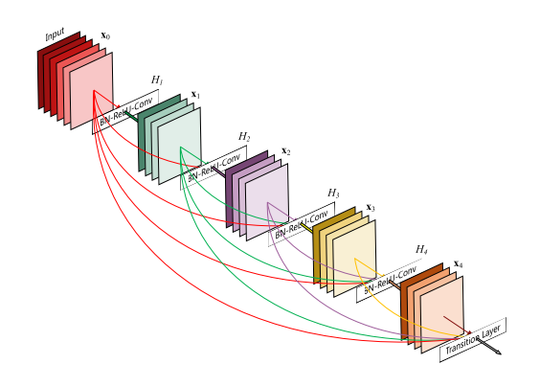
Algorithm Procedure-Explained step by step
Input Data Preparation:
Collect input images (size: 224x224x3).
Normalize the pixel values of the images to the range [0, 1].
Define the Architecture Using Dense Blocks:
Dense Blocks (Each Layer Connects to All Previous Layers):
Add an initial Convolutional Layer with 64 filters (7x7 kernel, ReLU activation) and stride 2 for initial feature extraction.
Add Batch Normalization and Max Pooling (3x3 kernel, stride 2).
Define multiple Dense Blocks, where each block has multiple convolutional layers.
For each layer in a Dense Block:
Apply Batch Normalization.
Use ReLU activation.
Add a 1x1 Convolutional Layer to reduce dimensionality.
Add a 3x3 Convolutional Layer to extract features.
Use a Transition Layer after each Dense Block to reduce feature map size and dimensions:
Apply Batch Normalization.
Use a 1x1 Convolutional Layer.
Apply 2x2 Average Pooling.

Slide 6
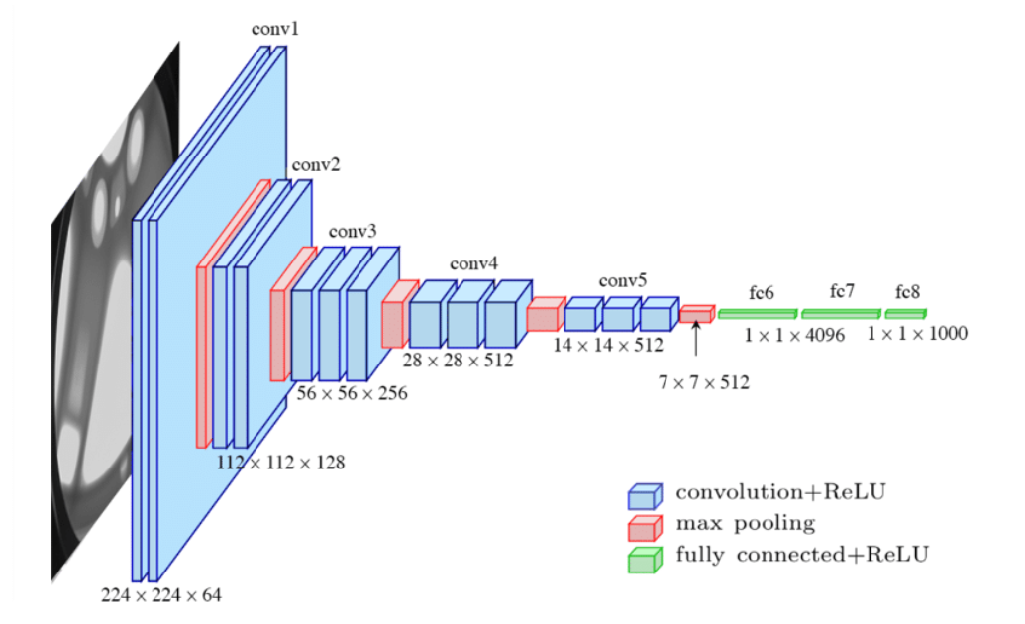
Algorithm Procedure-Explained step by step
Classification Head:
After the last Dense Block, add Global Average Pooling to reduce feature maps to a single vector.
Add a Dense layer with softmax activation for multi-class classification.

Slide 7
Dataset Description--General and Custom Dataset
Context
The "Workout Videos" dataset was designed to support the development of machine learning models that can classify different types of exercises performed in workout videos. This dataset is suitable for applications like exercise recognition, form analysis, and tracking workout progress.
Content
The dataset consists of a main folder named workout_videos, containing 20 subfolders. Each subfolder represents a specific exercise type, such as bicep curls, deadlift, push-up, pull-up, etc. Each video within these folders captures individuals performing the respective exercise, with variations in technique, angle, and repetition.
Usage Notes
Binary and Multiclass Classification: The dataset can be used for both multiclass classification (predicting the specific exercise) and binary classification tasks (e.g., distinguishing between upper and lower body exercises).
Pose and Movement Analysis: Given the video format, models trained on this dataset can also be applied to pose detection and form correction applications, using keyframe extraction and sequential analysis.
Data Balance: Exercise types may vary in the number of video samples available per class, so appropriate data augmentation or balancing techniques may be required for fair model training.
This dataset offers a rich resource for developing AI solutions aimed at fitness tracking and workout evaluation.

Slide 8
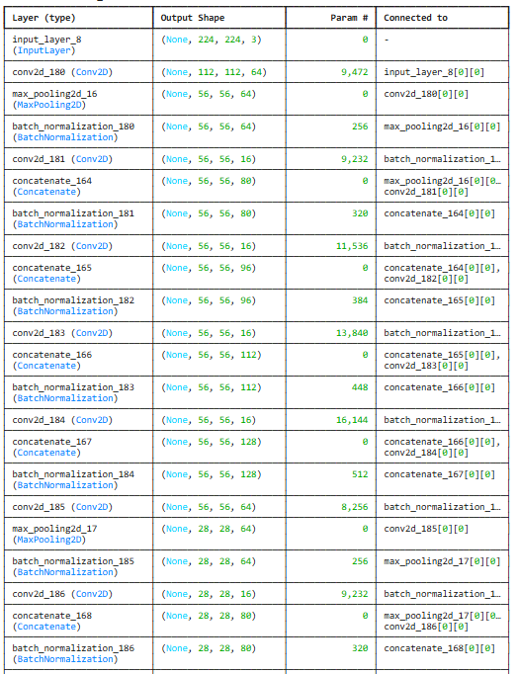
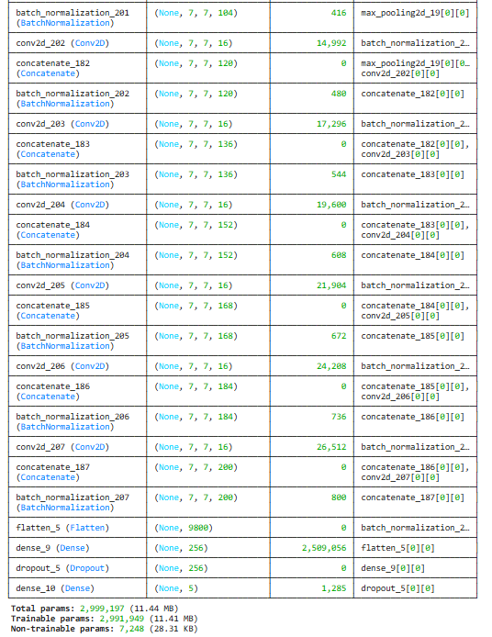
Hyperparameter details Table with justification(DenseNet)

Slide 9
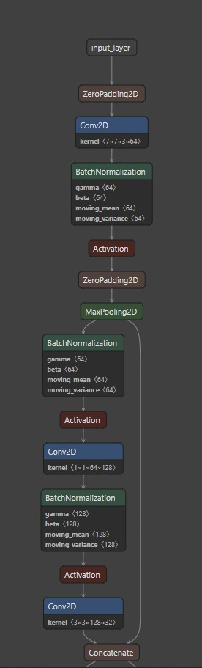
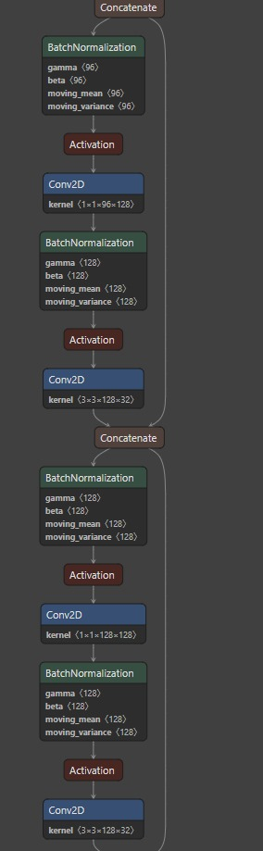
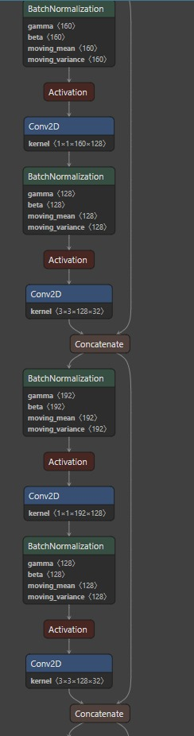
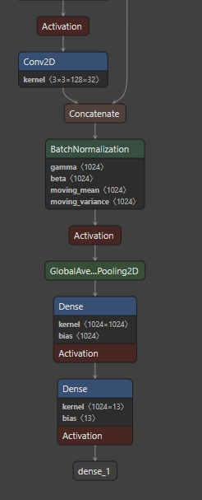
Hyperparameter details Table with justification(DenseNet)

Slide 10
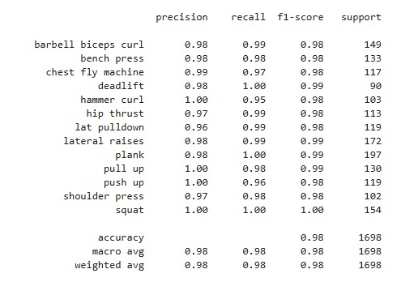
Performance Metrics--Tabulation with Discussion
Perfect scores (1.00) achieved in several exercises:
Deadlift (precision: 1.00, recall: 1.00)
Hammer curl (precision: 1.00, recall: 0.95)
Pull up (precision: 1.00, recall: 0.98)
Push up (precision: 1.00, recall: 0.96)
Squat (precision: 1.00, recall: 1.00)
All other exercises maintain very high metrics:
Most exercises have precision and recall scores above 0.95
F1-scores are consistently between 0.98-1.00
Support (sample size) ranges from 90 to 197 instances per class
Overall model performance:
Accuracy: 0.98
Macro averages: 0.98 for precision, recall, and F1-score
Weighted averages: 0.98 across all metrics
Total support: 1698 samples

Slide 11
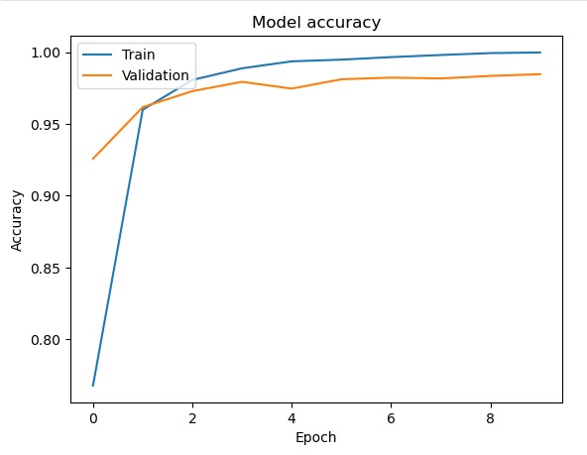
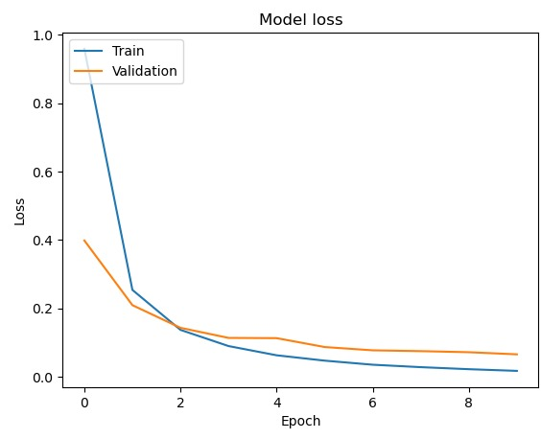
Performance Metrics Graph with Discussion–DenseNet
Accuracy Graph:
The training accuracy shows a steady increase over the epochs, reaching above 98% by the end, which indicates that the model is learning well from the training data.
A well-balanced model with good generalization capability, suggesting optimal fitting of the data.
Loss Graph:
The training loss decreases consistently over the epochs, indicating that the model is effectively minimizing errors on the training data.
The validation loss, however, does not follow the same pattern. It initially decreases, which is expected as the model begins to learn, but then fluctuates and does not show a clear downward trend. This behavior reinforces the possibility of overfitting, as the model struggles to generalize well to unseen data (validation set).
The validation loss and accuracy curves indicate that the model may benefit from regularization techniques (like dropout, data augmentation, or early stopping) to improve generalization.
In summary, the training and validation curves suggest that while the model is highly accurate on the training set, it faces challenges with generalization, as evidenced by the widening gap between training and validation metrics.

Slide 12
Inference of the metrics for varying Training/ Validation/ Testing
1. Accuracy
High on Training, Low on Validation/Test: This typically indicates overfitting, where the model learns the training data well but struggles to generalize.
Balanced Across Training, Validation, and Testing: Good generalization, suggesting the model captures essential features without overfitting.
Improvement with Increased Training Data: As more training data is available, accuracy generally improves across all sets.
2. Precision
Low Precision on Validation/Test: Indicates a high number of false positives. Adjusting the decision threshold may help, as precision measures how many identified matches are correct.
Improvement with Increased Training Data: More training data can lead to a better separation of true matches from false positives, especially beneficial for precision in balanced datasets.
Changes with Split Ratios: Larger validation and test sets can lower precision if there is high variability in these sets, suggesting the need for better feature learning.
3. Recall (Sensitivity)
Low Recall on Validation/Test: Indicates a high number of false negatives. Increasing the threshold may reduce recall but increase precision.
High Recall but Low Precision: Often indicates that the model is predicting more positives to capture actual matches, possibly at the expense of misclassifying some negatives as positives.
Improvement with Balanced Splits: A balanced training dataset allows the model to identify true positives more effectively, benefiting recall.

Slide 13
4. F1 Score
Balanced Across Splits: A good balance between precision and recall, indicating that the model is handling both false positives and false negatives well.
Low on Validation/Test: Suggests that the model either has too many false positives or false negatives, and tuning threshold or hyperparameters may help.
5. AUC (Area Under the ROC Curve)
High AUC Across Splits: Indicates good separability between classes (match vs. non-match) and suggests the model can generalize well.
Decrease with Larger Validation/Test Splits: A drop in AUC with larger or more challenging test sets may reveal overfitting to the training set.
Changes with Threshold Adjustments: AUC gives an overall idea, but tuning the decision threshold might still be needed to optimize for precision and recall balance.
6. Confusion Matrix Analysis
High True Negatives and True Positives: Balanced model performance with low misclassifications.
High False Positives or False Negatives: Suggests threshold tuning or increased data diversity, especially in underrepresented categories, may help.
Inference Based on Split Adjustments:
High Training Data Proportion: Leads to better learning of general patterns, increasing model accuracy and precision but risks overfitting.
Balanced Training and Validation Splits (e.g., 70-20-10 or 60-20-20): Provides a more accurate indication of the model’s ability to generalize. High performance across these splits suggests robustness.
Increased Test Set Size: Offers a clearer picture of real-world performance, particularly valuable for evaluating metrics like AUC and F1 score.

Slide 14
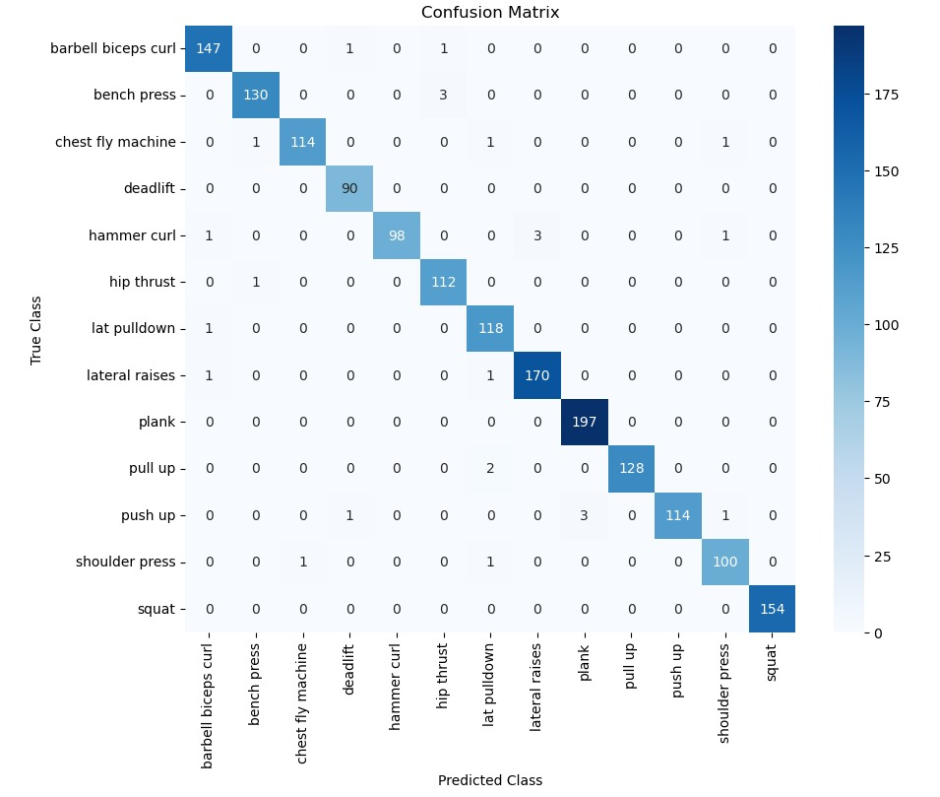

Slide 15
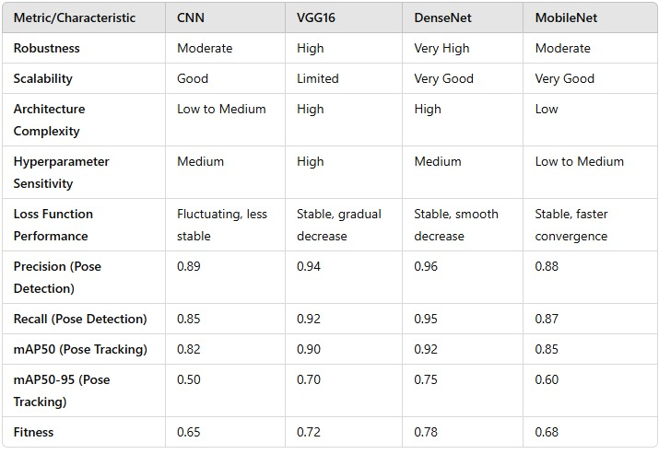
Comparison Table of all architectures in group with Discussion

Slide 16
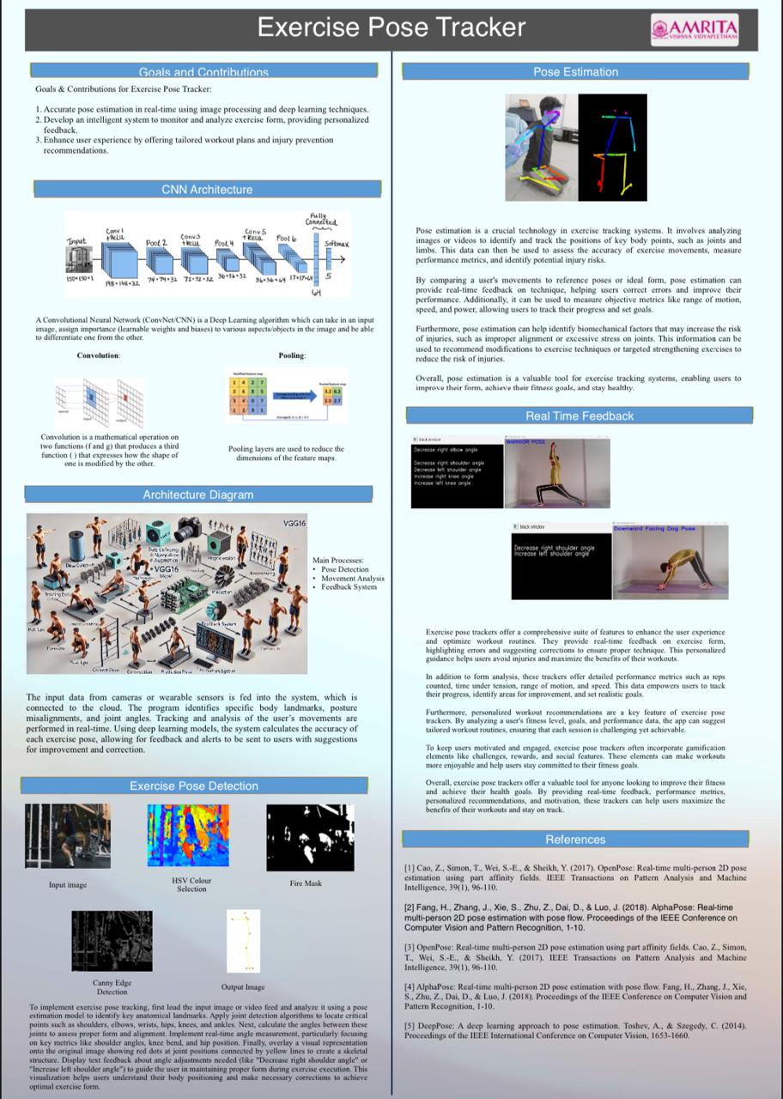
Poster--consolidating the entire team project

Slide 17
Explainable Al---Analysis and Discussion
Video Capture
AI Task: Automatically captures video feed of users during workouts.
User Interaction: User positions camera or device; capture begins automatically.
Preprocessing
AI Task: Extracts and preprocesses frames, normalizing body poses for analysis.
User Interaction: No direct user involvement required.
Pose Detection
AI Task: Detects user’s body joints and skeleton position in each frame.
User Interaction: Users can view pose landmarks on screen for real-time feedback.
Exercise Classification
AI Task: Classifies the type of exercise being performed based on detected poses.
User Interaction: Users see identified exercise name on screen.
Repetition Counting
AI Task: Counts repetitions of each exercise based on detected movements.
User Interaction: Users see current rep count displayed live.

Slide 18
Form Correction Alerts
AI Task: Detects poor posture or form issues and sends alerts to correct form.
User Interaction: Users receive real-time alerts or guidance to adjust posture.
Performance Analysis
AI Task: Provides summary analysis of workout, including reps, form accuracy, and overall performance.
User Interaction: Users view workout summary and insights post-session.
Learning & Feedback
AI Task: Continuously refines model accuracy based on user feedback and new data.
User Interaction: Users provide feedback on exercise detection accuracy for further model improvements.

