Slide 1

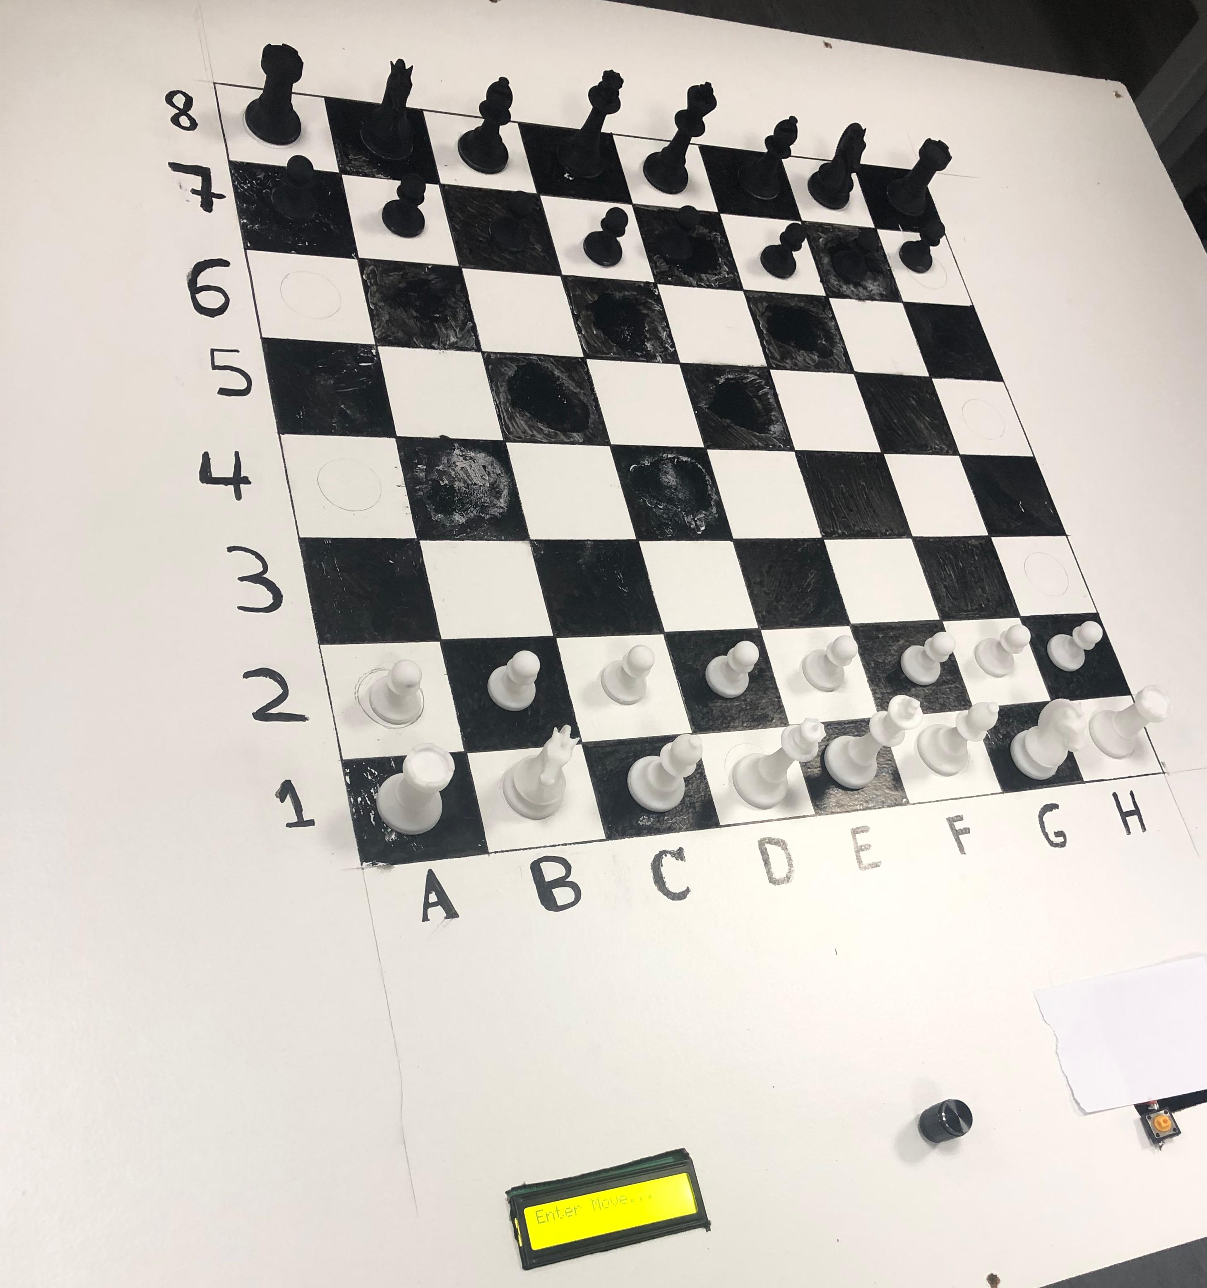
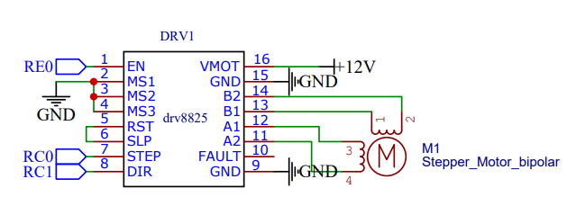
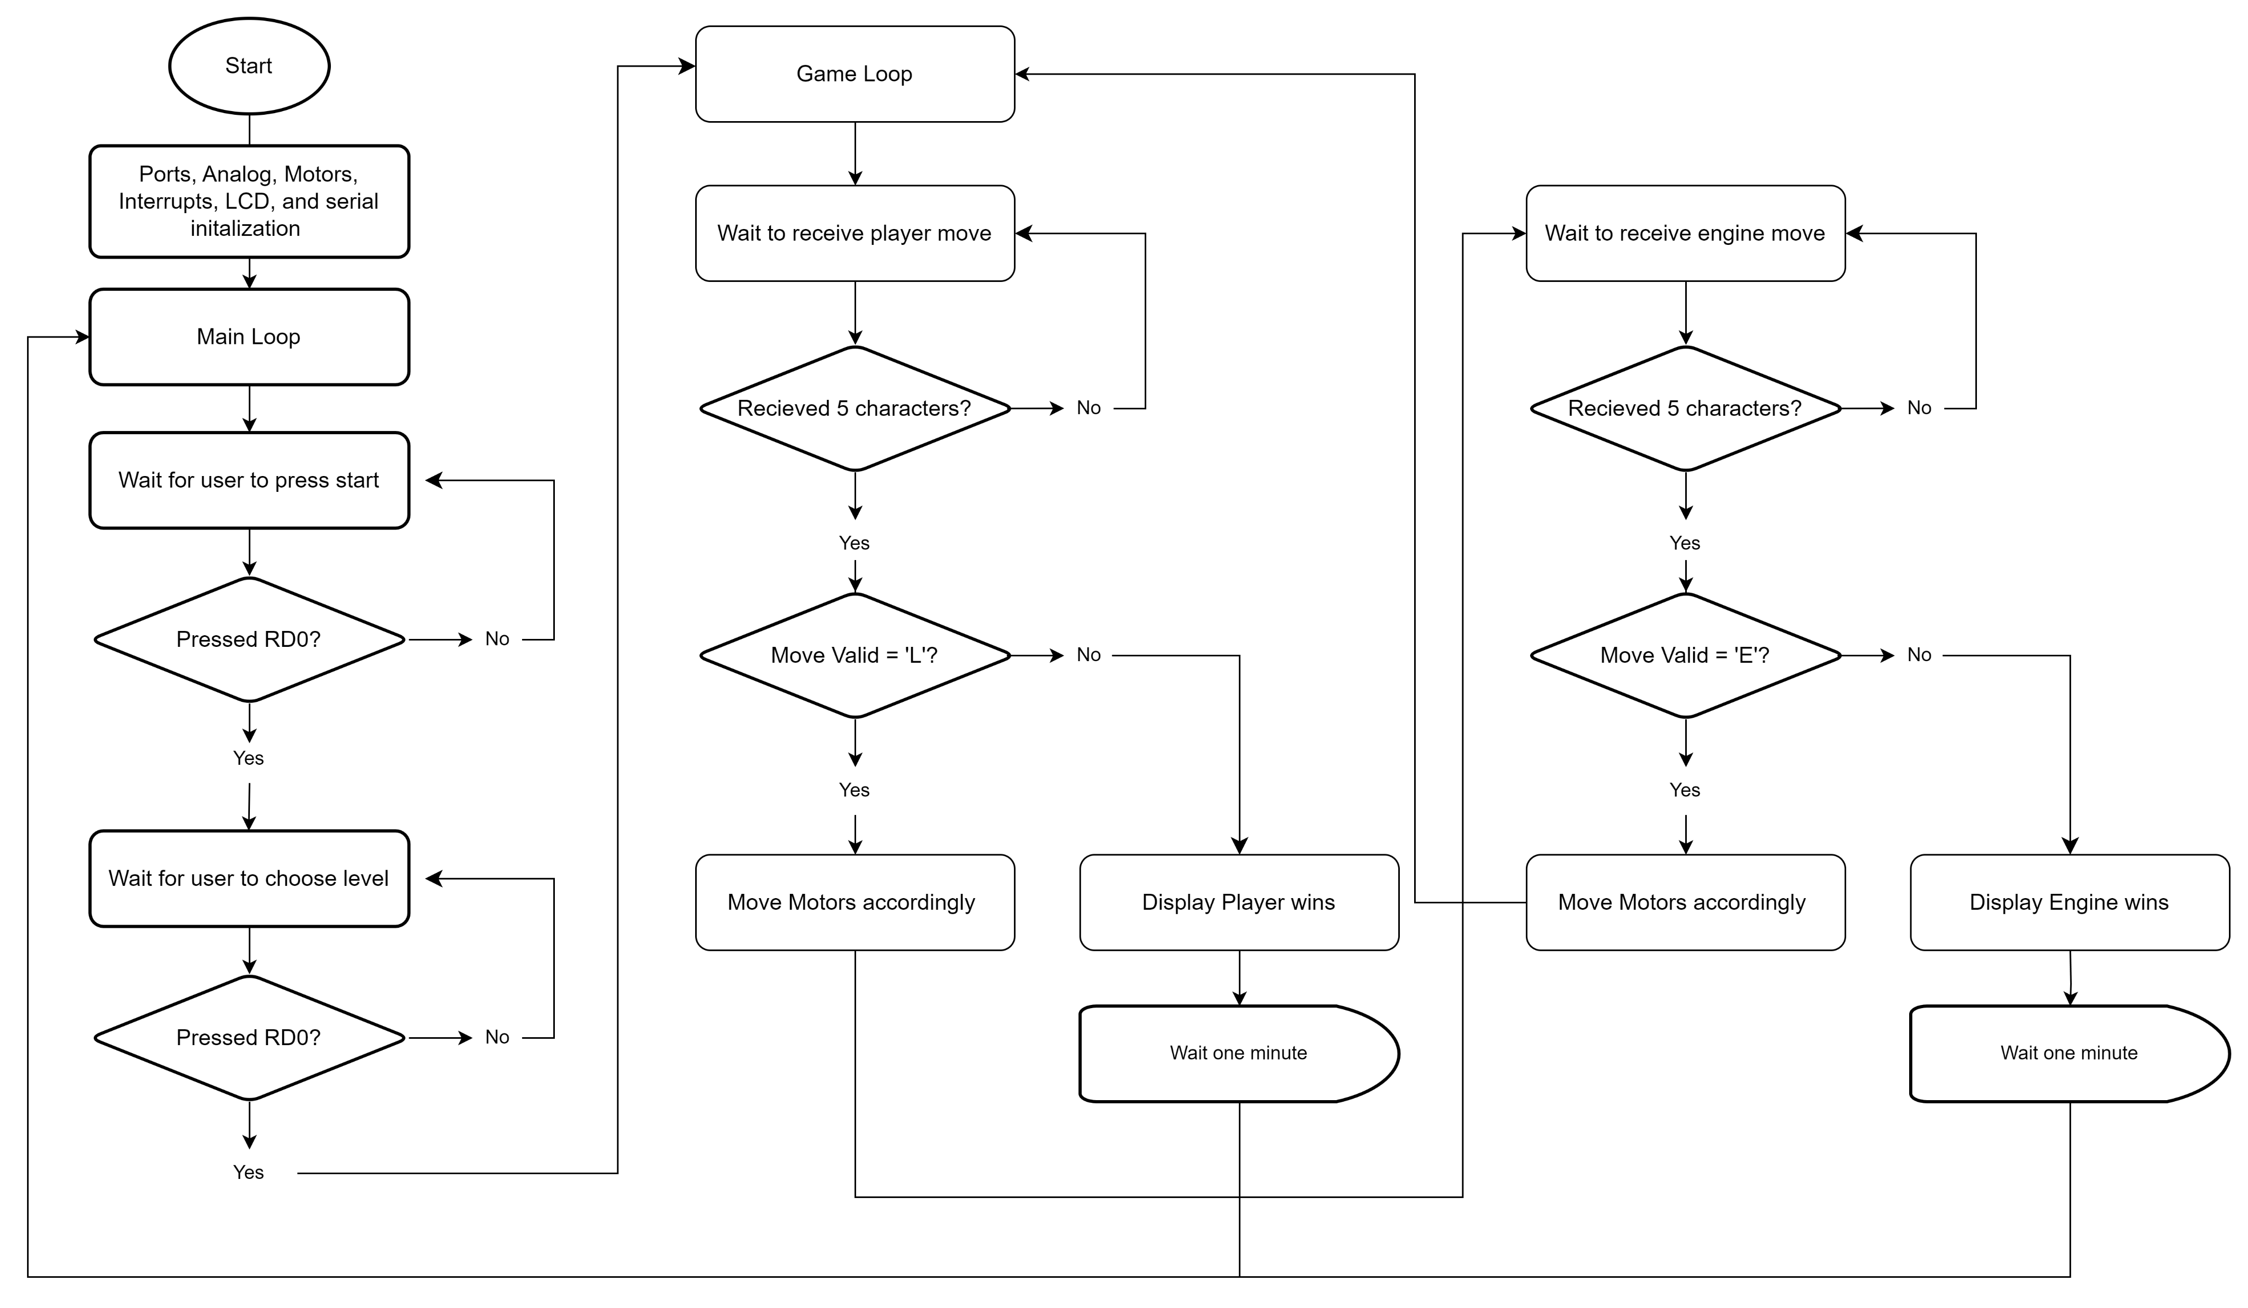
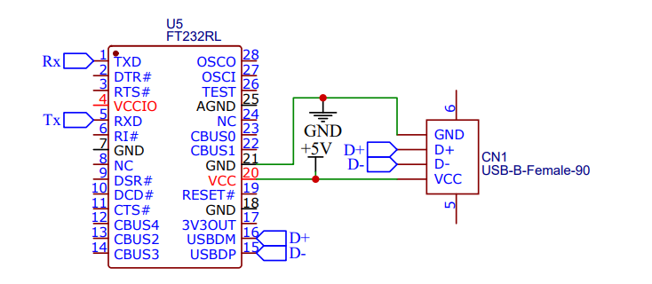
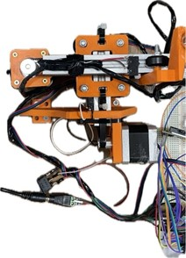
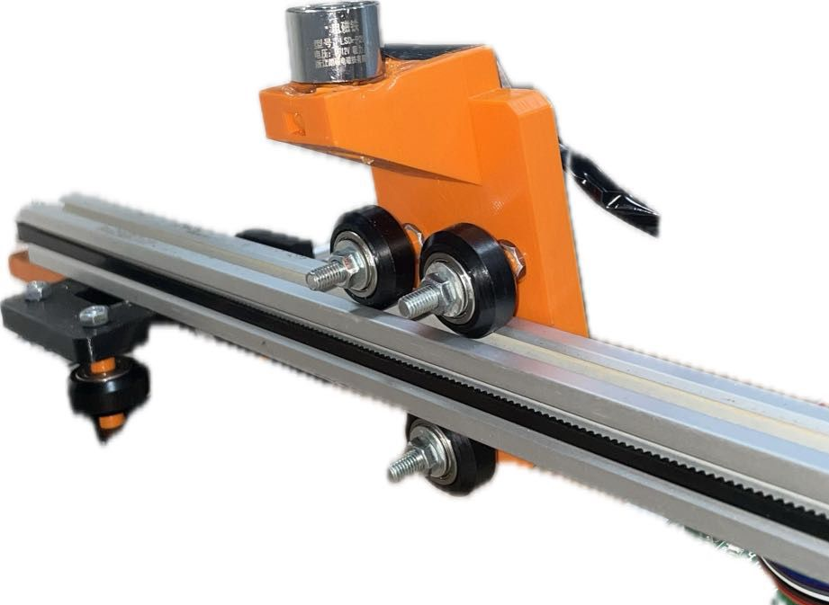
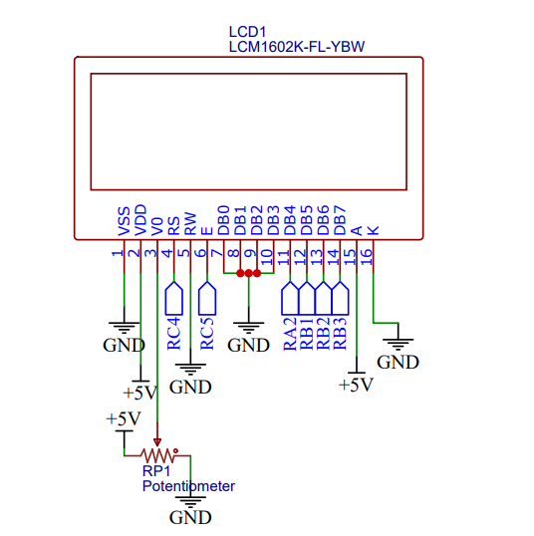
Automated Chess Board System
L. Taani, O. Al-Faqeh, A. Al-Sayeh
Supervisor: Dr. Belal Sababha
Embedded Systems Final Design Project, Fall 2023
King Abdullah II School of Engineering
Princess Sumaya University for Technology
Introduction
Chess is an ancient strategy game in which you aim to move pieces strategically to defeat your opponents and finally checkmate them. We want to combine the time-tested chess techniques with automation technology with our Automated Chess Board System. Chess players now have a platform to practice and enjoy the game by competing against artificial intelligence (AI). Players may successfully develop their skills and view their strategies play across the board. It transforms commands into movements on an electronic chessboard.
Results
Figure 4: Circuit Diagram
\
Figure 5: Software flowchart
(a) (b)
Figure 6: (a) ) X and Y Axes , (b) Electromagnet
The physical structure of the chessboard was constructed using 3D-printed parts, attached to aluminum profiles and GT belts for the X and Y axes.
Electromagnet was added for piece manipulation. The electromagnet was attached to a custom 3D-printed part.
Design
We used two drivers for two motors one on each axis, here’s a schematic for one of the motors
Figure 1: DRV8825 Driver, Nema 17 stepper motor.
The NEMA17 stepper motors, were linked to DRV8825 drivers. These motors function by converting a negative edged step signal into precise 1.8-degree rotational movement.
Figure 2: USB to serial chip DT23RL
With the physical components in place, the system's code was developed to interpret and execute chess moves received via serial communication from a Python script. The received data contains information on the type of move and the specific board squares involved. The microcontroller's program was refined to respond accurately to the serial commands, translating them into the precise movements of the chess pieces on the board.
Figure 3: LCD Screen
The LCD screen provides real-time updates on the game's status, indicating whether it's currently the player's round or the bot's round. It also displays whether the game is in progress or waiting for the user to initiate it. Additionally, the difficulty level is seamlessly controlled through a potensiometer, allowing users to fine-tune the challenge to their preference before starting the game.
Conclusion
With an astounding 80% accuracy in piece movement, the Automated Chess Board System demonstrates the effective integration of artificial intelligence with mechanical chess. Further improvement is possible, especially in the area of magnet alignment.

