Slide 1
Game of Thrones U.S. viewership by episode, writer, and director

Slide 2
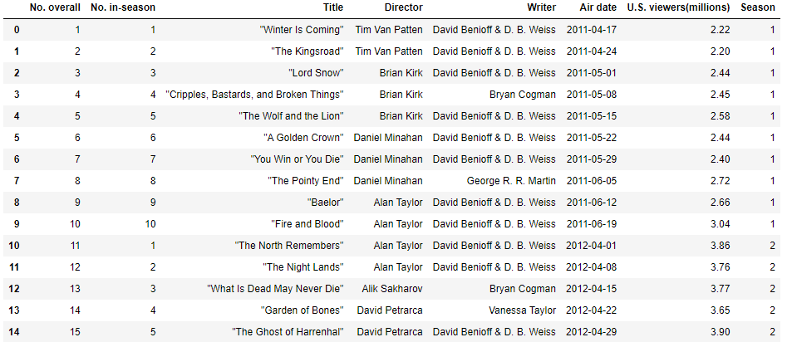
Game of Thrones is the most watched TV show of all time.
The data shows how the viewership changed by season and episode.
The data also shows the writer and director of each episode.

Slide 3
What questions can we answer with our data?
Could we see how each season was received by the viewers?
Which director/writer did the best work?
Which pairing of writer and director put out the best episodes?
Can this data help us choose a future director or writer to create the next big show?
Let's Dig into the data to find out!

Slide 4
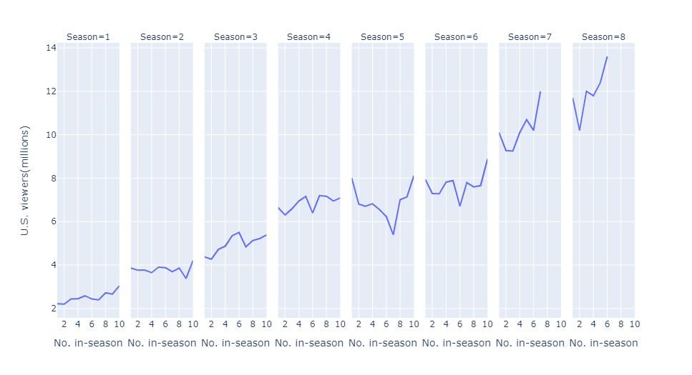
This chart shows U.S. viewership by season and episode. Seasons seven and eight only had 7 and 6 episodes instead of the usual 10.
We can see a clear upward trend across the entire span of the show.
There seems to be dips for almost every season.
Is this bad episodes?
Bad Directors?

Slide 5
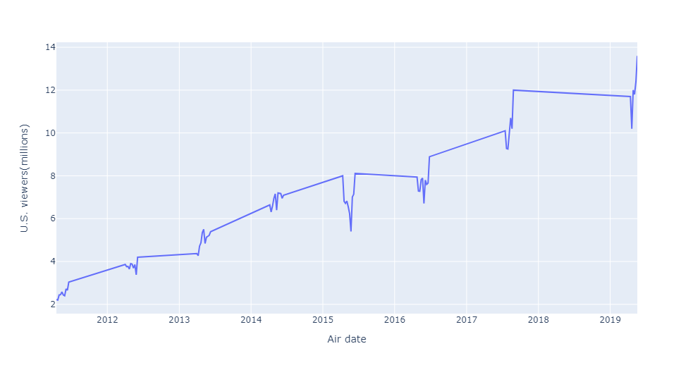
With the graph across time, we can see episodes with lower viewership seem to occur around the same time each year.
When looking at the low points by day, we found that the dips happen on holiday weekends.
After a dip of nearly 500k viewers in 2012, HBO didn’t air new episodes over memorial day weekend for the next two seasons.
For season three and four, Mother’s Day correlated with the largest drop in viewership between episodes
HBO returned to airing the shows on memorial day weekend in 2015 and lost almost 1,000,000 viewers that week in 2015 seemingly due to the holiday.

Slide 6
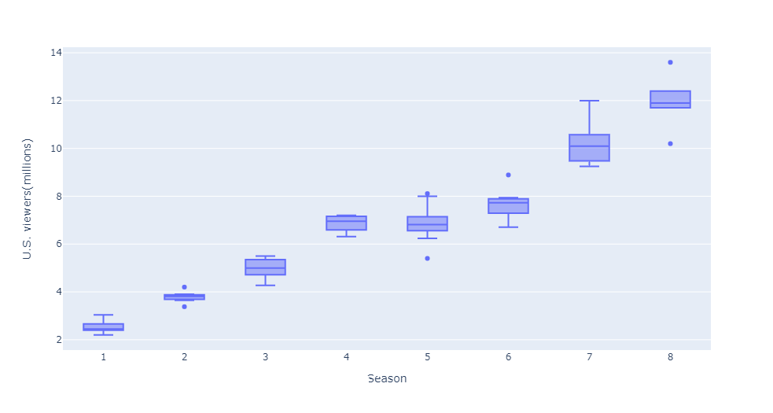
With these boxplots of each season, we can see the spread of viewership by season.
We see the average trend continues, with season 5 being the only season where median viewership drops slightly, possibly due to the lack of viewers on a holiday weekend.
Season 7 shows the largest spread of 2.75 million not containing outliers
Of the seven outliers in the data, the four that are above the upper bounds are season finales, while the three below the lower bounds all occurred on holiday weekends of Easter and Memorial Day.

Slide 7
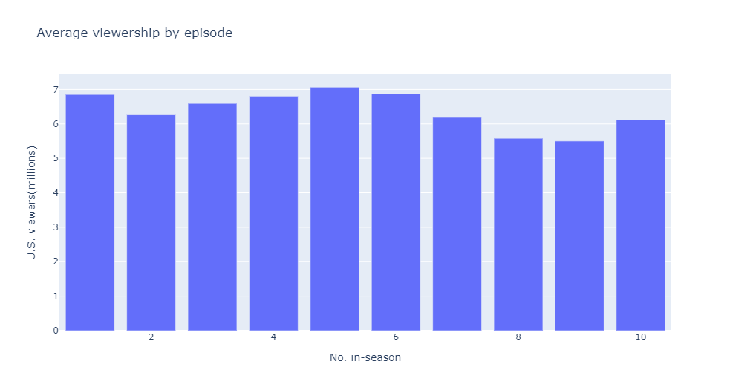
As we look at the average viewership by episode throughout a season, It shows us a wavy pattern that seems to suggest that a season’s midpoint would be the most watched.
This graph is thrown off by the fact that the last two season ended at episode 7 and 6. With the higher viewership for later seasons, it has disformed our average data to look as it crests at the halfway point. We can compare this with our line chart earlier and see that the season finales usually bring in far greater viewers.

Slide 8
What we know from our data so far, is that Game of Thrones gained in popularity over its 8 seasons, every season building up to a largely viewed finale. The viewership seemed to grow in a linear fashion, with season 5 maybe underperforming expectations, while seasons 7 and 8 seemed to be highly anticipated as the first episodes started out with larger numbers than ever before.
The data also showed that viewership may depend greatly on other national events. The episodes that premiered on a holiday weekend did far less than the season average. The memorial day episode in 2015 was down 1.5 million from the season average or 21.5% of the average viewers for that season.
Let’s look at the other columns of our data to see what else we can find.

Slide 9
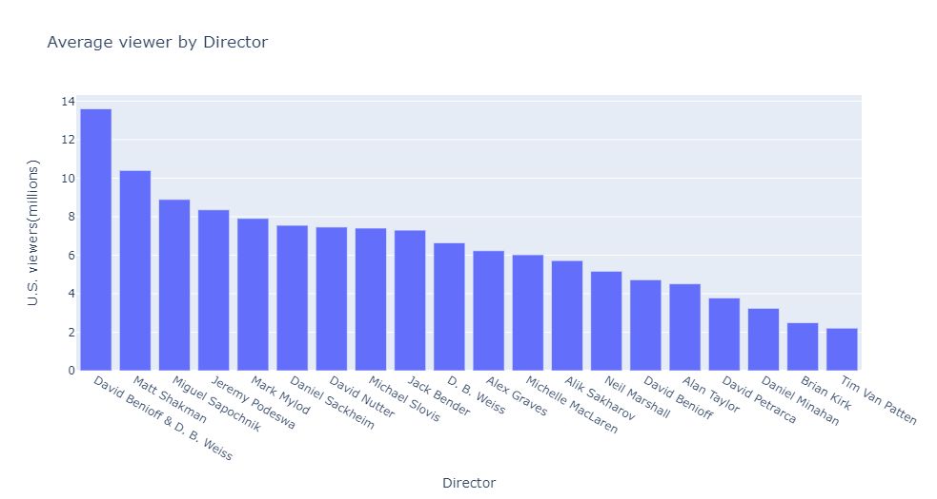
The average viewership by director may give us an indication of who created the best episodes.
Seems the team of Benioff and Weiss outpace the other directors by 2.2 million viewers per episode. They must be great directors.
Matt Shakman is the only other director to average over 10 million viewers. Seems that if we’re looking for directors, these are the guys to get.
RIGHT ?

Slide 10
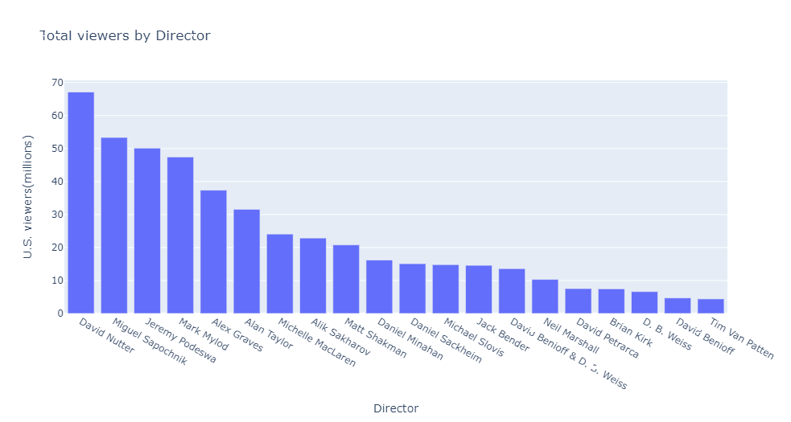
This is total number of viewers by director. It shows a very different picture.
Benioff and Weiss went from the top average viewership to 14th in total viewership. What’s going on?
David Nutter, who averaged less than 7.5 million viewers, topped all other directors by almost 14 million viewers.
What are we missing in our analysis?

Slide 11
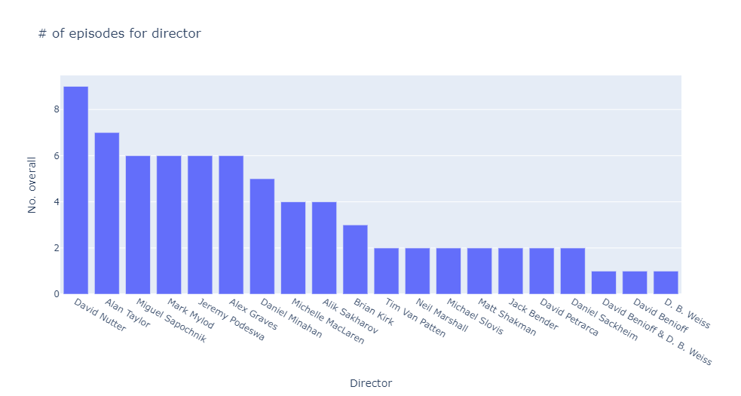
This graph gives us some answers.
David Nutter directed the most episodes (9), and two episodes more than any other director, which tells us why he has the most viewers.
What about Benioff and Weiss?
They had the largest average viewership but only directed one episode together. That episode happened to be the show finale and brough in the largest viewership in the show’s history.
What other questions might this piece of information have us asking?

Slide 12
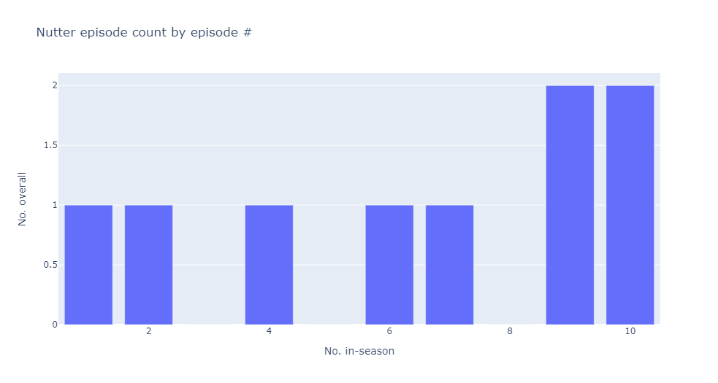
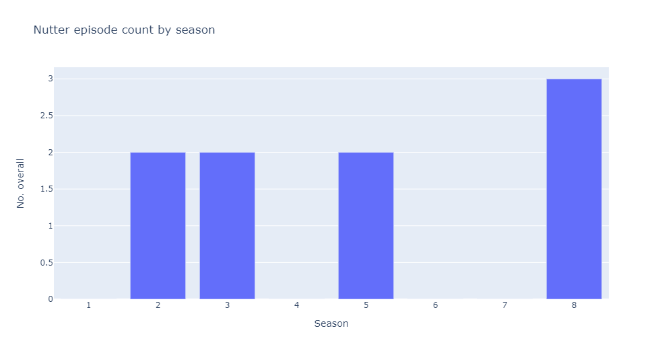
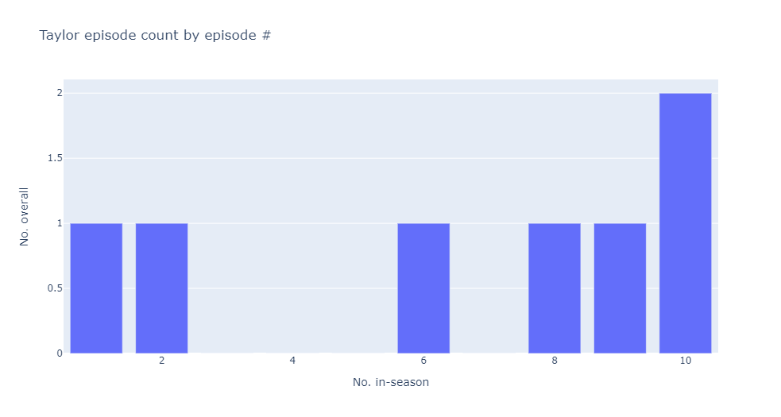
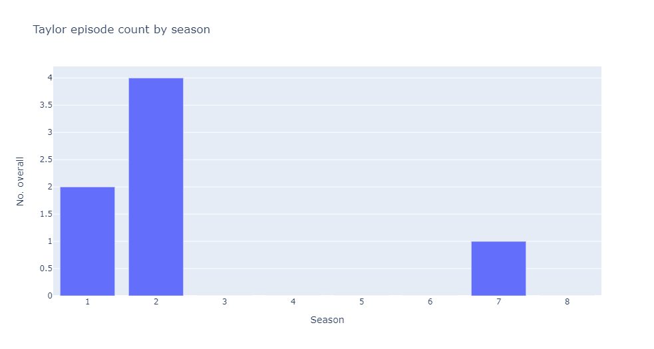
Here we have David Nutter and Alan Taylor’s episode counts by season and episode number in season.
On the left graphs, we see that both directed two season finale’s a piece, and both directed episodes near the beginning, middle and end of seasons. We would expect both to have similar viewership numbers by these graphs, but an earlier slide indicated that Nutter had nearly 70 million viewers while Taylor garnered barely over 30 million. Wow, Nutter must be a far superior director compared to Taylor.
The graphs on the right may disprove this theory though. As we can see, Taylor directed six of his seven episodes in the 1st and 2nd seasons when the show was just getting started and viewership numbers hadn’t skyrocketed. David Nutter directed 1/3 of his episodes in the last season when viewership averaged almost 12 million per episode.

Slide 13
Final Analysis
After this analysis of directors and viewership, can we make any judgements on the value of a director and their work?
No. As the different graphs have shown and you have heard, correlation does not equal causality. David Nutter episodes seem to imply large viewership, but when we look at the data from several dimensions, what becomes obvious to us is that which episode and which season dictates the viewership number and not the director. This seems to be obvious, as we don’t usually watch an episode of something knowing who wrote it but praise who wrote it after watching the episode. With this dataset, and some graphs that we’ve already seen, you could argue the wrong point if the right analysis wasn’t performed on the data.
SO, What do we need? More data to answer your director questions. We need reviews, Rotten Tomatoes scores on each episode, any feedback that comes after viewing the show. Then we can judge the directors on their work. With this dataset, what have we found? We now know that when we’re in a position to drop our latest show, movie release, or album, we need to wait till after the holidays. We know Game of Thrones had a consistently large viewer following. And we know we need more data.
P.S. (Benioff and Weiss wrote 51 of the 73 episodes, so little data insights could be shown from a column with little variation. )

