Slide 1









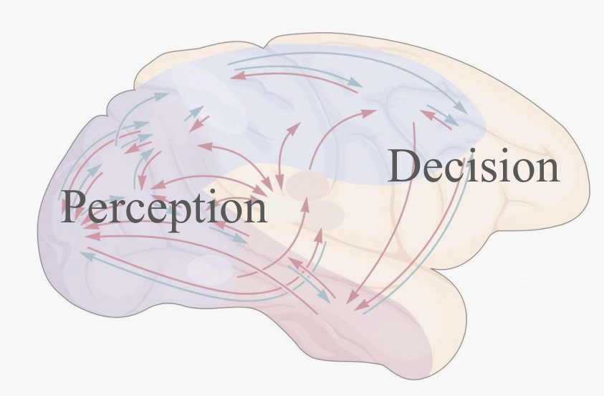


Decision Outpu
t
Environment Input
Perception
Decision
Network
Network
A
lignment
t
-1
Decision
Perception
Action
S
election
t

