Slide 1
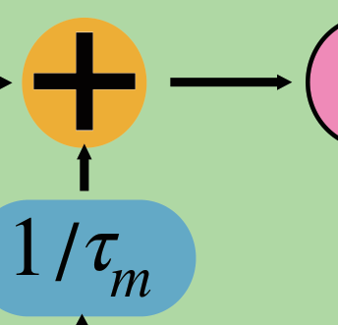
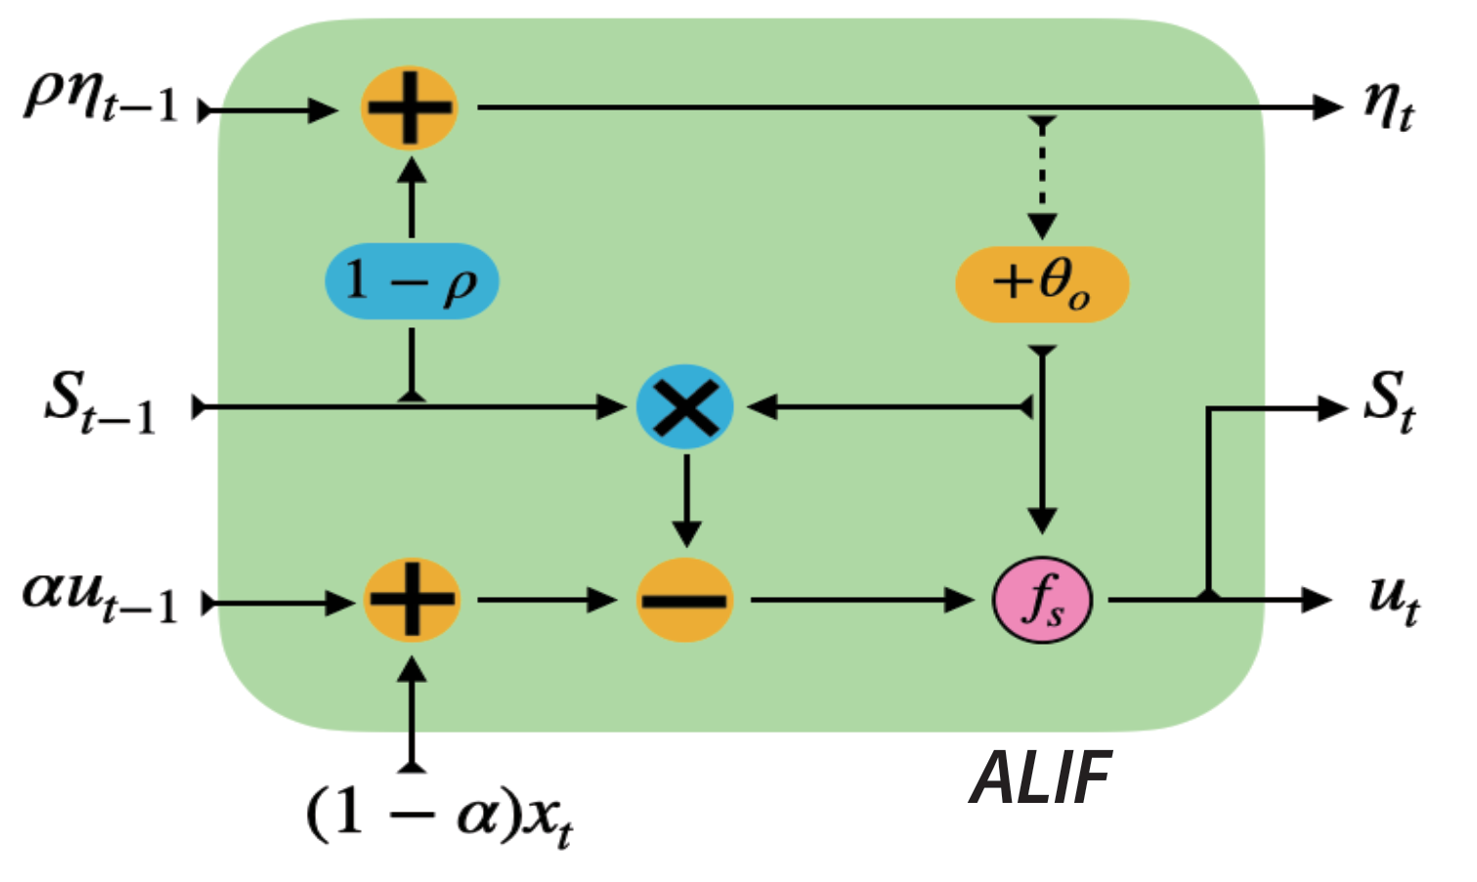
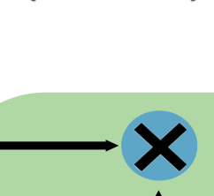
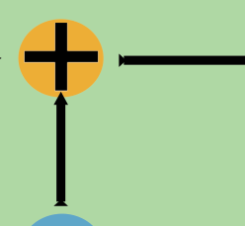
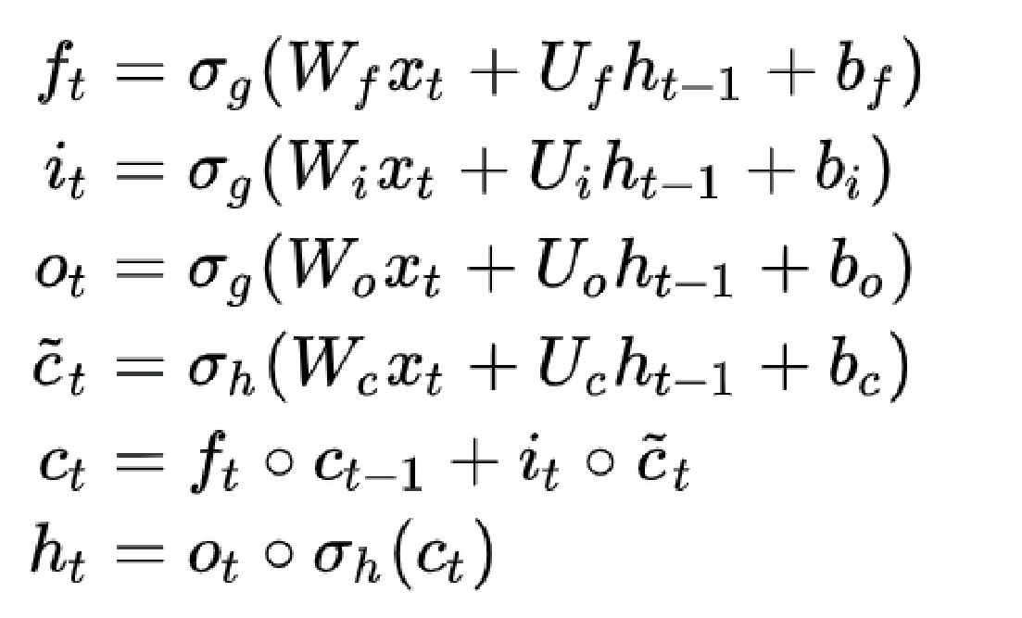
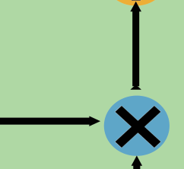

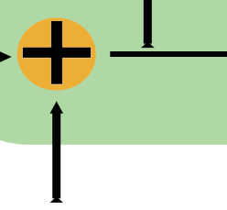
m
ab
W
,
n
Input_dim, output_dim
S
t
t
u
Reset
t
f
u
−1
1−1/
Time
τ
s
t
Energy
m
:
τ
1/
m
LIF
(
mnFr
+
nnFr
)
m
E
,
n
m
n
,
I
=[
W
X
+
W
n
nt
t
S
−1
]
in
out
AC
x
LIF
u
=
αu
+
I
+
nE
t
t
t
−1
t
MAC
Adaptive
m
,
n
m
n
,
I
=[
W
X
+
W
n
nt
t
S
]
E
−1
mnFr
AC
α
=exp(−
dt
in
/
τ
)
m
(
nn
+2
n
)
+
Fr
E
ρ
=exp(−
dt
out
AC
/
τ
)
adp
+3
nE
MAC
η
=
ρη
+(1−
ρ
)
t
t
S
−1
t
+
−1
θ
=
b
+
βη
0
t
u
=
αu
+(1−
α
)
t
t
R
I
−
S
θ
ALIFLSTM
−1
m
t
t
−1
LSTM
C
C
t−1
t
anht
4(
mn
+
nn
)
E
MAC
+17
nE
σ
σ
tanh
σ
MAC
h
h
t
−1
t
x
t

