Slide 1
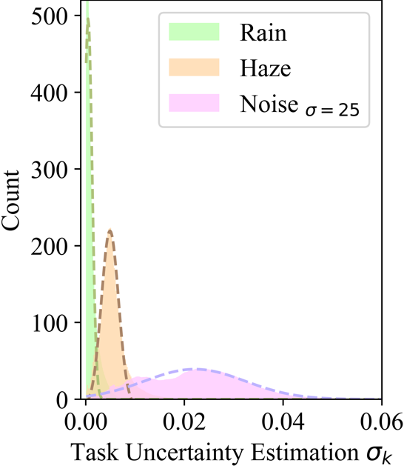
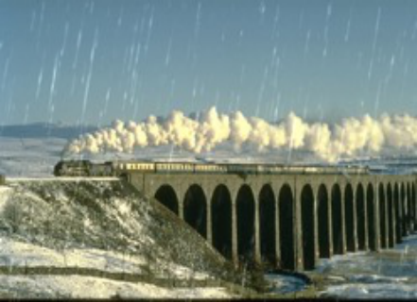
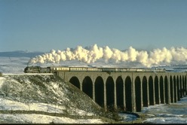
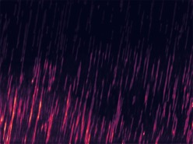

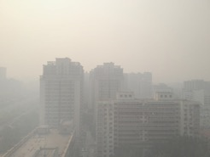
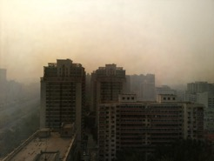
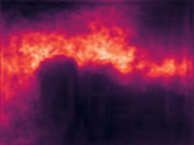
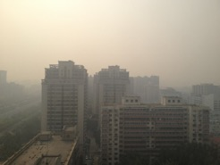
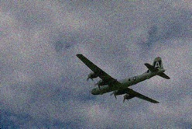
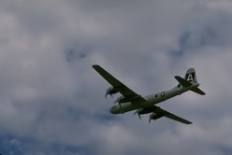
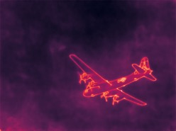
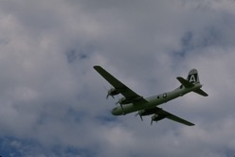
(a)
Input
Ours
𝜎
GT
!
(a)
(b)
Figure5:Illustrationoftaskuncertainty.(a)Distributionoftaskuncertaintyacrossmultipledegradationtypes,demon-stratingcleardistinctionsbetweendifferentdegradations.(b)Visualizationofthesample-wiseuncertaintymaps,wherehigheruncertaintyvaluesalignwithmoreseverelydegradedregions.
1.0
Noise
0.8
Rain
Percentage
Haze
0.6
0.4
0.2
0.0
50
100
150
200
250
Epoch

