Slide 1












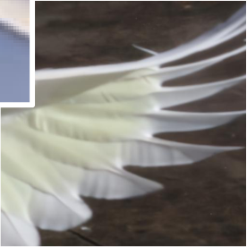






high fidelity images
higher
Generation Module
fidelity
BSR RM
T steps
s=1
Concat
BFR RM
I
s=0.5
I
BID RM
lq images
Restoration Module
Restoration Guidance
s=0
Region-adaptive
update
hq images

