Slide 1
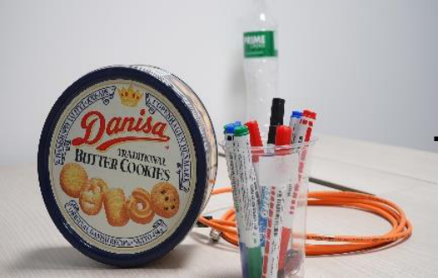

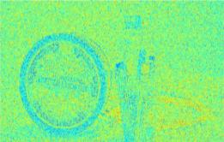



𝐿𝑎𝑡𝑒𝑛𝑡
𝑧
𝐼
𝐼
ℎ
𝑟
1
FE
-
block
Conv
𝐹
′
𝐹
FFT
IFFT

Channel
Channel
Conv
FFT
′′
𝐹
Channel
Sigmoid
𝐹
Conv
FFT
𝐹
Conv
′
𝐹

𝑓𝑟𝑞
FFT
IFFT
𝑓𝑟𝑞
Conv
DWconv

