Slide 1
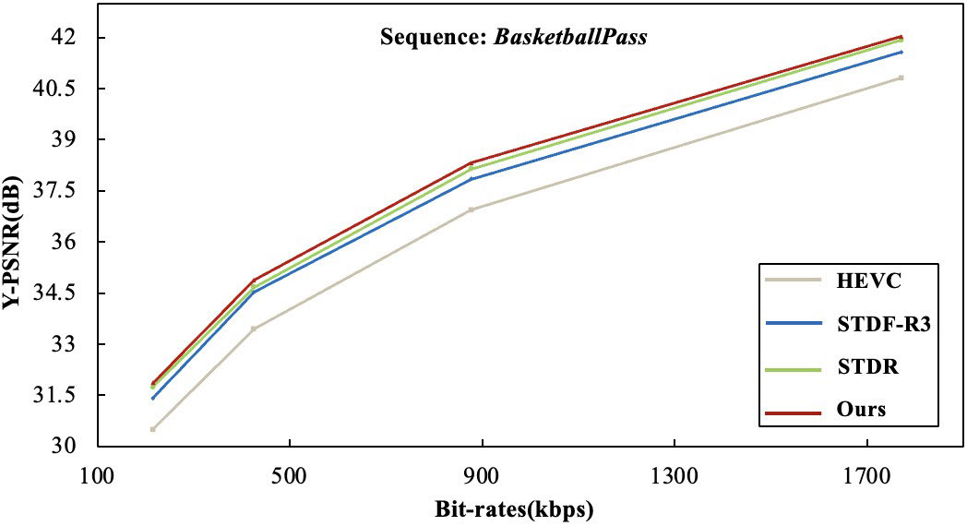
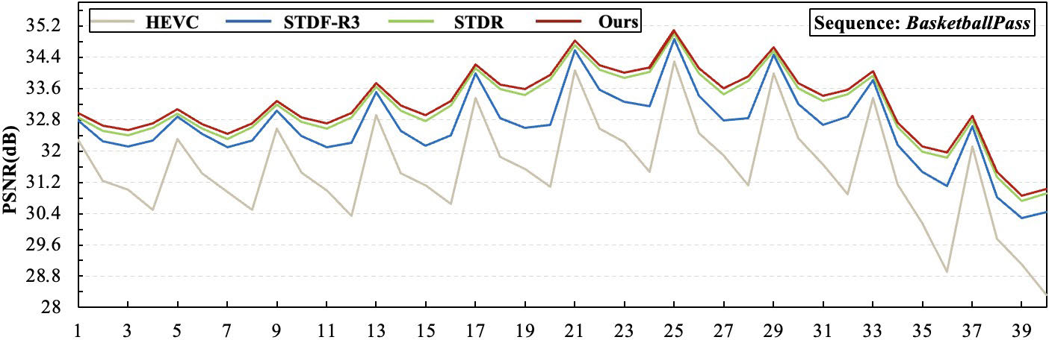
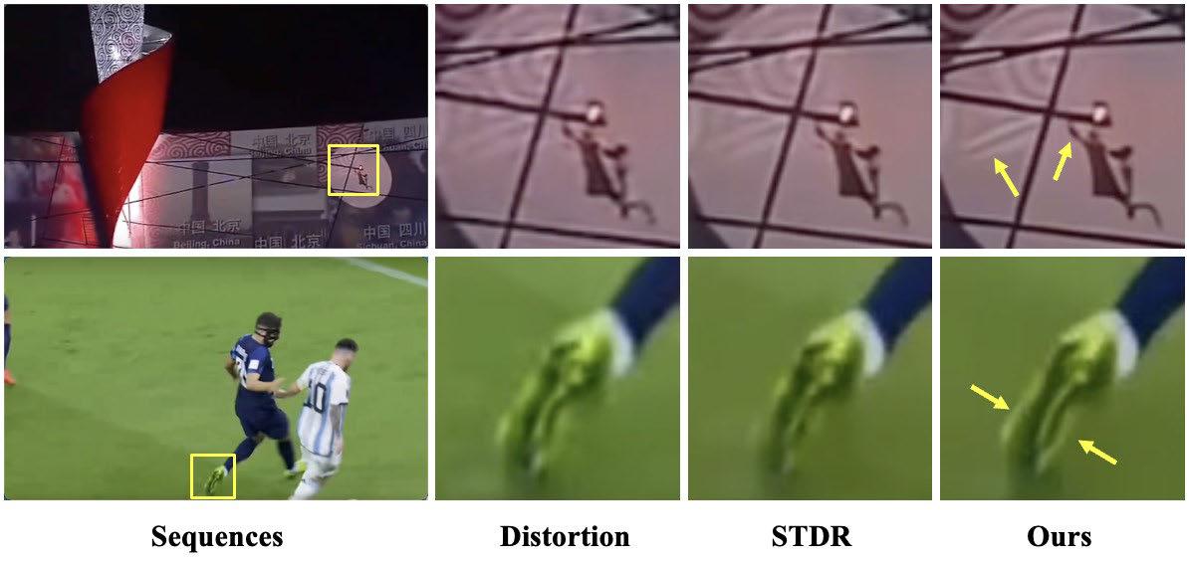
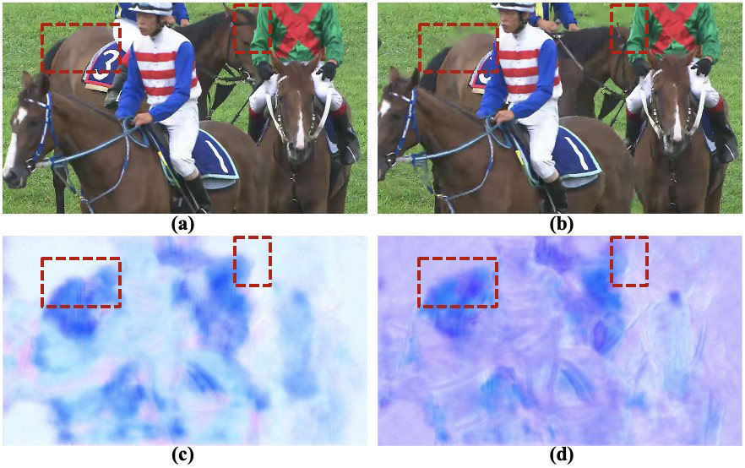
Fig.12.Qualityfluctuation.FluctuationtrendofPSNRvaluesforthesequence
BasketballPass
.Zoominforbestview.TABLEIVO
VERALL
P
ERFORMANCE
C
OMPARISONFOR
△
PSNR(dB)
AND
△
SSIM(
×
−
2
10
)O
VER
S
TANDARD
T
EST
S
EQUENCESAT
QP
=
37
Fig.9.TheRate-distortion(RD)curvebetweenvideoqualityandthenumberofbitsoccupiedbycompressedvideopersecond.Zoominforbestview.
Fig.10.Subjectivecomparisonofenhancementresultsforlow-qualityvideosequenceswithhybrid-distortion.ComparedwithSTDR,boththetextureinformationandtheboundaryofmovingobjectbecomeclearerandsharperinourmethod.Furthermore,thenoiseinthevideoiswellremoved.Zoominforbestview.

