Slide 1

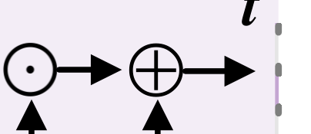






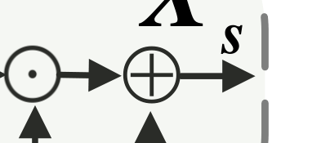
Spatial Forward Propagation
Temporal Attention (TA)
Temporal Forward Propagation
Average Pooling
X
C

...
DCT
X
...
Conv
LIF
o
Conv
t=n
Conv
T
t
T
+
...
...
based Spatial
HW

Max Pooling
...
...
...
...
...
...
...
...
Temporal Attention
C

...
...
...
...
T
C
1
...
Attention
Scale
X
...
T
...
Conv
s
LIF
t=2
+
o
-
DCT
-
based Spatial Attention (SA)
X
DCT
X
Mean
Conv
DCT
Conv
...
Conv
LIF
HW

s
t=1
o
H
H
Scale
C
freq
1) Multiple sets of convolutional kernels
t
T
W
W
2) Fixed weights that are not learnable
(a) Overview of the FSTA Module
(b) Overview of the Attention Submodule
(c) The Operations of DCT
Structure
Structure
Conv

