Slide 1
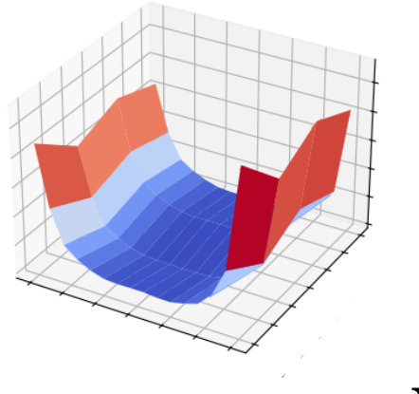
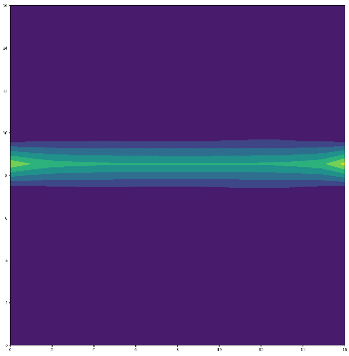
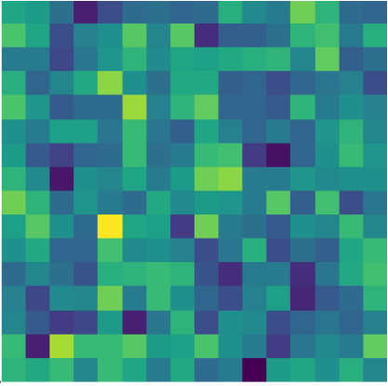
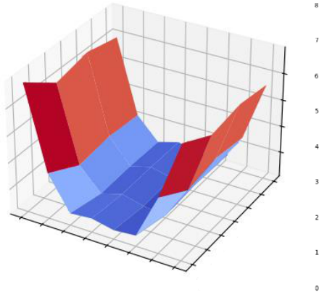
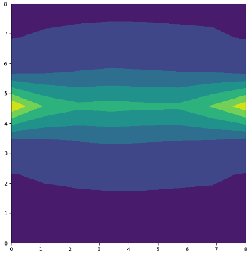
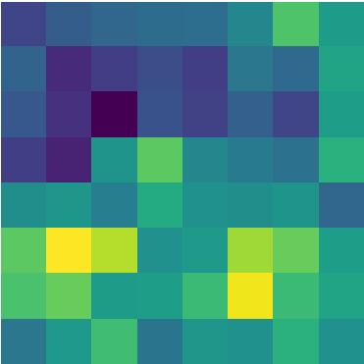
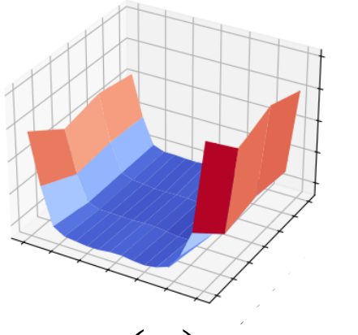
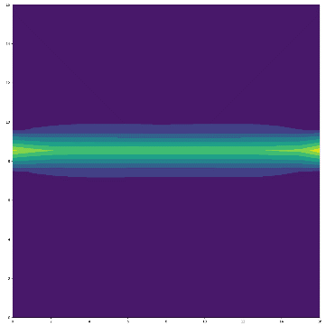
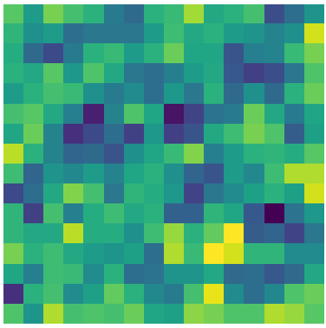
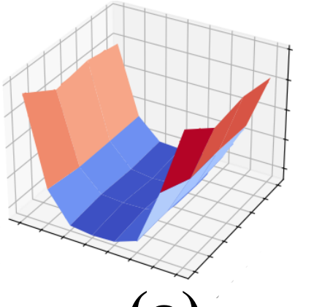
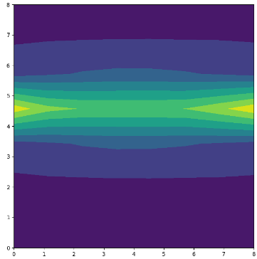
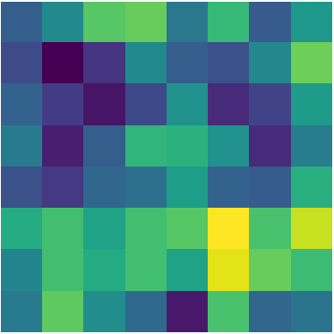
DatasetArchitectureResolutionTimestepACsMACsFLOPsParam(M)Energy(mJ)
CIFAR100ResNet2032x324260.05M67.26M880.36M11.30.54CIFAR10-DVSResNet20128x128102.14G582.87M8.71G11.24.60ImageNetSEWResNet18224x22442.45G1.05G7.37G11.77.03
Table5:Energycostsandmodelstructureacrossdifferentdatasets
FSTA
-
SNN
FSTA
-
KernelSizeFrequencyRangePaddingAccuracy
SNN
3x39192.36%5x525292.58%7x749393.01%
Vanilla SNN
Vanilla SNN
Table6:PerformancecomparisonofdifferentfrequencyrangesusingResNet20structureonCIFAR-10
(a)
(b)
(c)
(a)
(b)
(c)
Shallow Layer
Deep Layer

