Slide 1
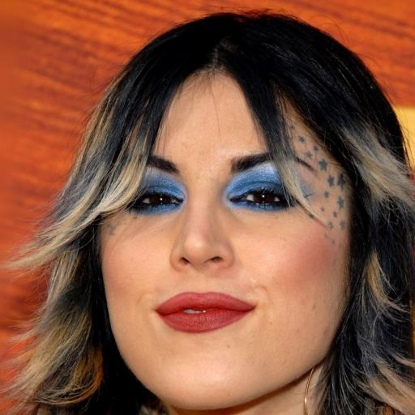



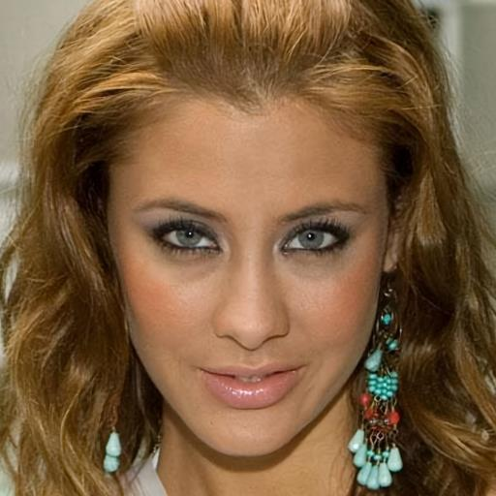



w/o code
-
pred
-
w/ code
-
pred
Original Image
-
based loss
based loss

