Slide 1
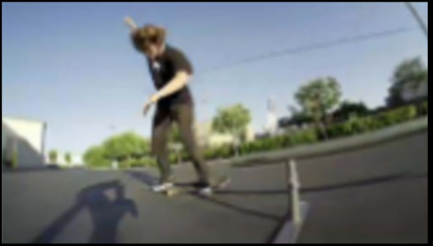
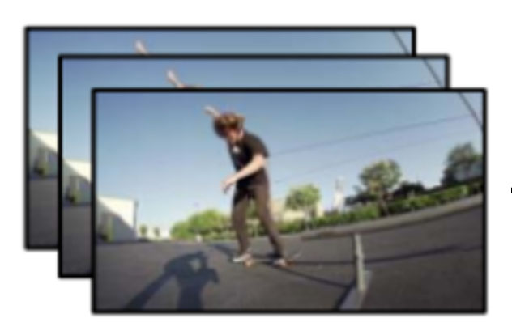
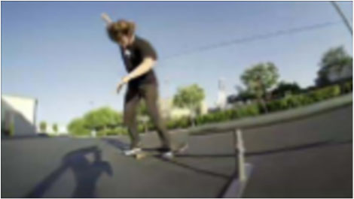
EnhancementModel
HQ frame
Transcoder
Decoder
FramesBitstream
Source Video
EnhancementModel
Coding Priors
e.g., Motion vectors, Predictive frames, Residual frames
Our MethodCompression DegradationPrevious Methods
HQ frame

