Slide 1
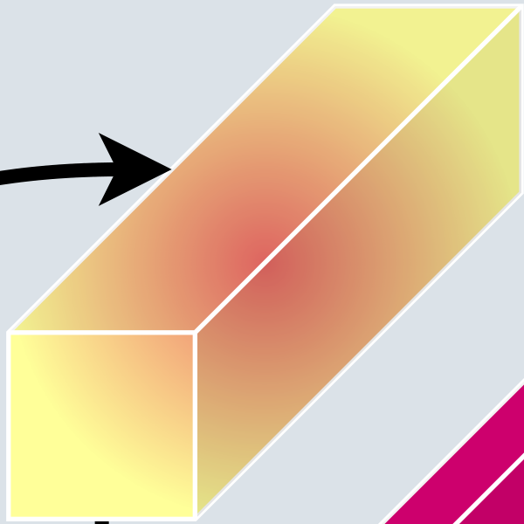
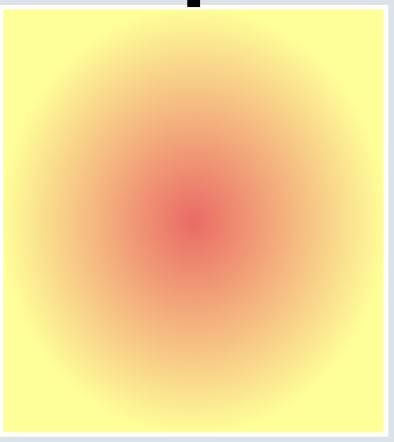
Generalized Quantization Block
Channel Attention
Input
Features
Two Conv, 3x3xN,
LeakyReLU
Output
Input QPs
Shared Weights
Spatial Attention

