Slide 1







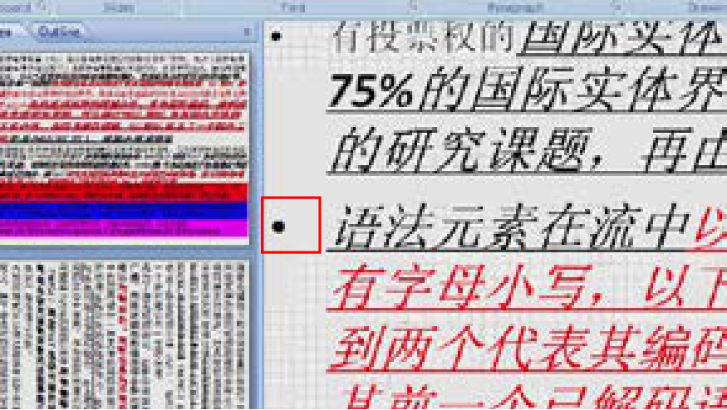
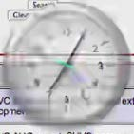
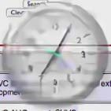
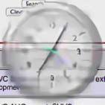
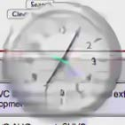
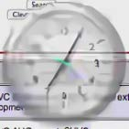
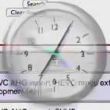
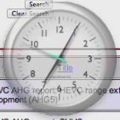
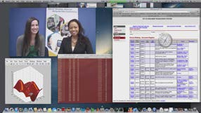








Sequences
STDF-R3[14]QECF[17]CAT[24]TGAF[26]ProposedLSFMD
BigBuck
-5.33-6.09-6.13-7.24
-7.90
ChineseEditing
-1.39-1.44-1.25-2.06
-3.03
EnglishDocumentEditing
-2.67-2.59-2.68-3.53
-4.33
MissionControlClip3
-6.02-6.24-5.91-7.17
-8.21
Paperpdf
-4.17-4.53-4.19-5.81
-7.03
Sephora
-5.81-6.07-5.78-7.25
-10.07
mixvideo
-2.05-2.25-2.00-2.69
-3.34
scSlideShow
-9.94-10.05-9.85-11.19
-12.50
scmap
-7.22-6.42-6.00-7.58
-8.56
scprogramming
-5.81-6.39-6.33-8.02
-8.66
scwebbrowsing
-3.14-2.91-2.90
-3.67
-3.66MissionControlClip1
-7.27-7.44-7.44-9.09
-10.87
MissionControlClip2
-7.25-7.54-7.19-8.65
-9.70
Average
-5.24-5.38-5.20-6.46
-7.53
Compressed
STDF-R3
QECF
CAT
TGAF
LSFMD
Raw
ChineseEditing
MissionControlClip3
scwebbrowsing

