Slide 1
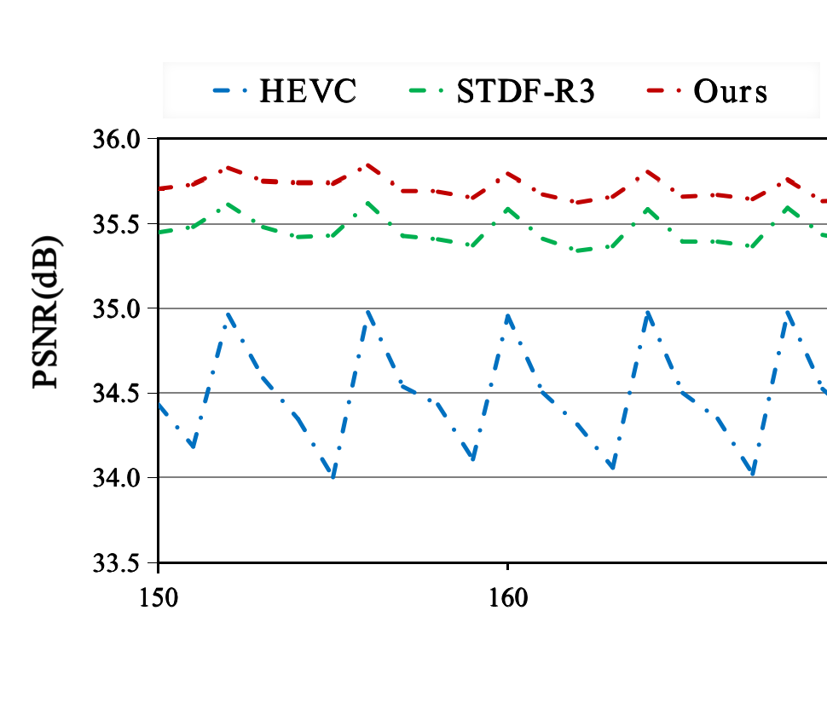
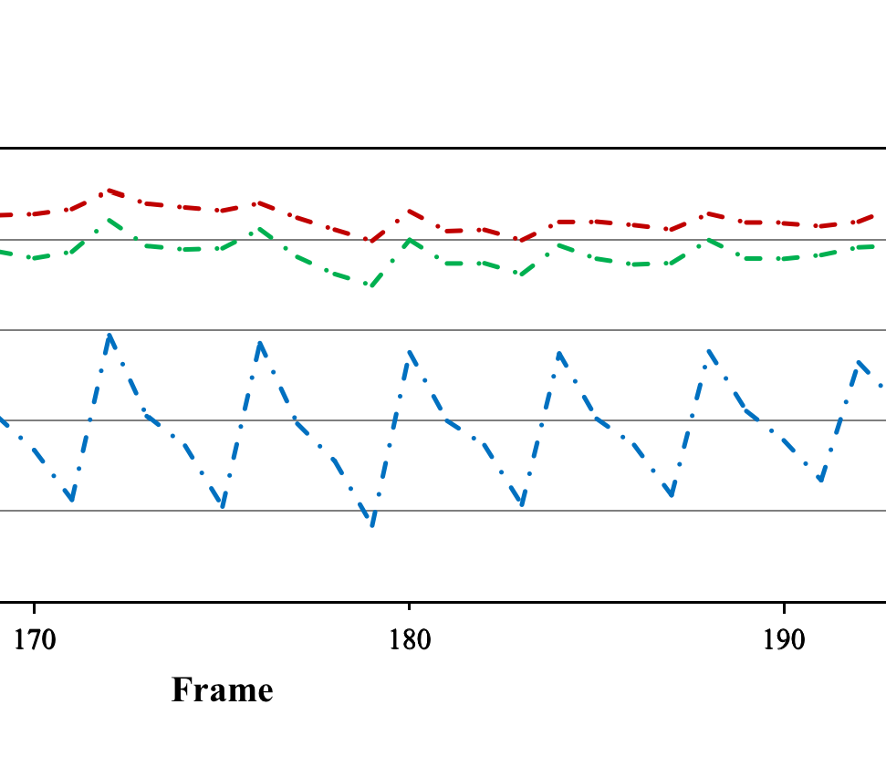
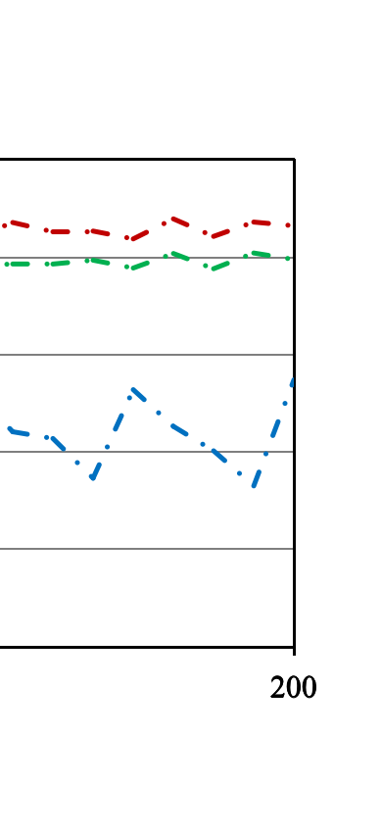
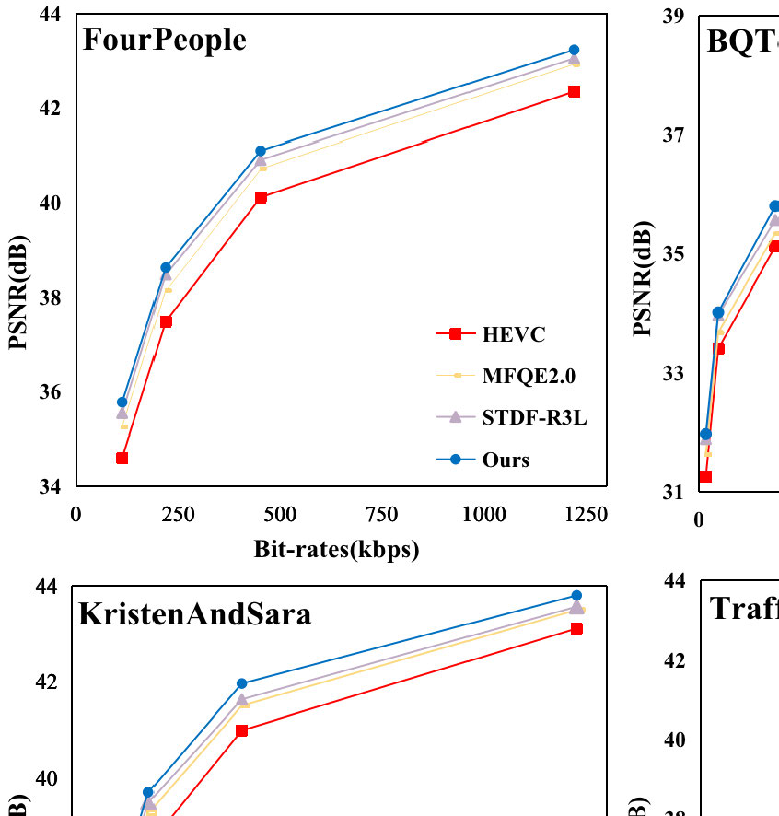
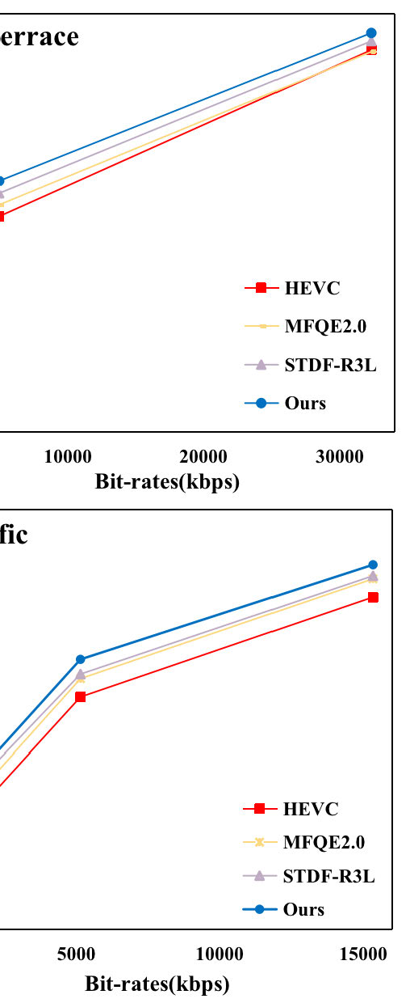
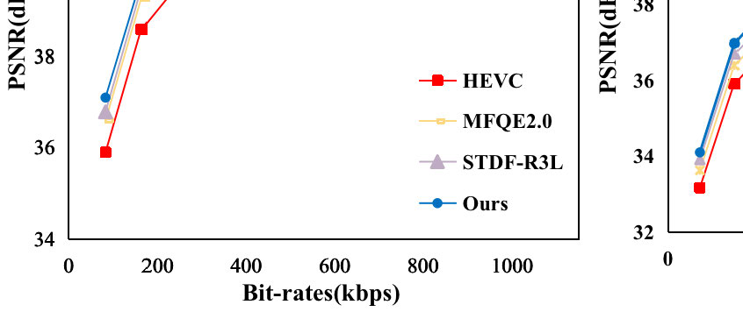
Fig.7.PSNRcurvesofHEVCbaseline,STDF-R3L,andoursontwotestsequencesatQP
=
37.Videoindexoftop:Kimonoandbottom:FourPeople.
theotherisusedforglobalqualityfluctuationassessment.Table
II
liststheaverageSDandaveragePVDofcurrentmainstreammethodsandtheproposedMDEformeronalltestedvideosequences.ItcanbeseenthatourmethodhasthesmallestaverageSDandaveragePVD,whichrepresentsthehigheroverallvideoqualityandhigherQoEafterqualityenhancementofourmethod,andourmethodismorerobust.WeplotthePSNRcurvesofvideosafterHEVCcom-pressionandqualityenhancementbySTDF-R3Landourmethodontworepresentativetestvideosequences,KimonoandFourPeople,tobetterdemonstratetheeffectivenessandrobustnessofourmethod.FromFig.
7

