Slide 1
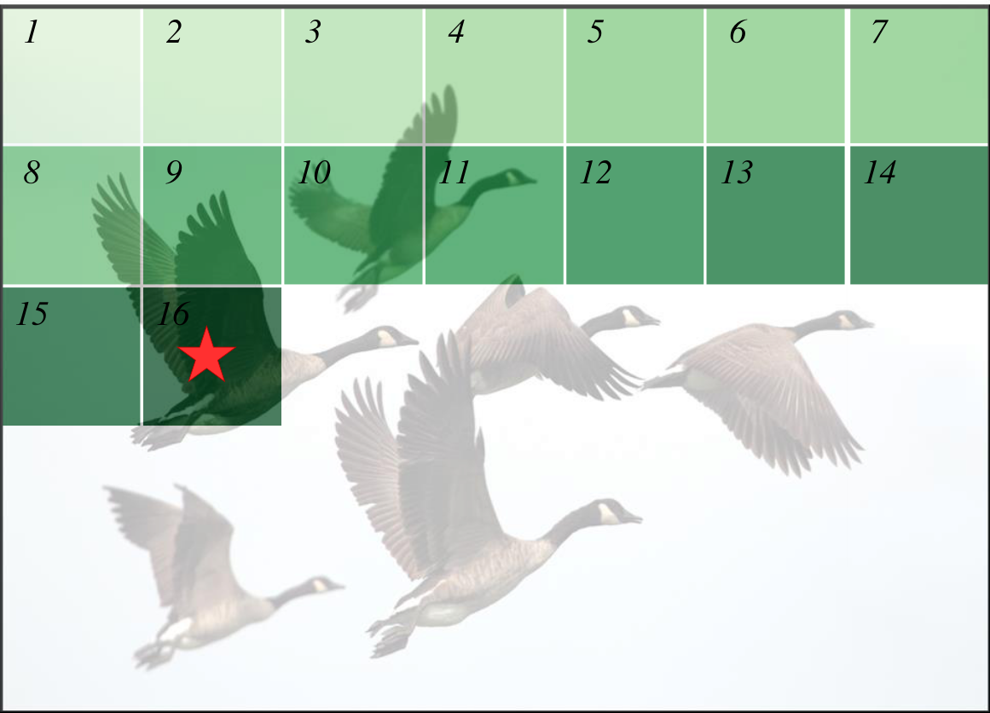
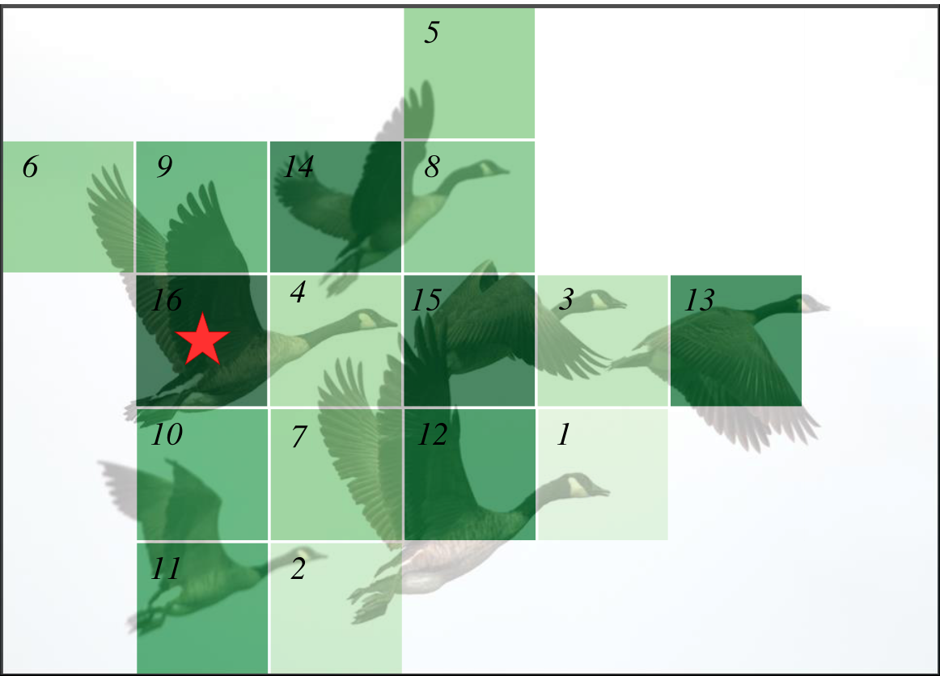
query pixel
scanned pixels
unscanned pixels
scan order
1
1
2
2
3
3
1
2
3
4
5
6
7
5
8
9
10
11
12
13
14
6
9
14
8
15
16
16
4
15
3
13
10
7
12
1
11
2
(a) Existing Causal State
-
space Modeling
(b) Our Attentive State
-
space Modeling
constrained perception for unscanned pixels
perception across the whole image
cost and redundant multi
-
directional scans
only one single scan needed
weak interaction for long
strong interaction between distant pixels
-
range pixels

