Slide 1






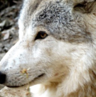

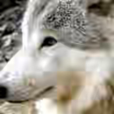


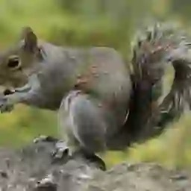







MoE-DiffIR7
eae
Visual2Text
Decoder
Adapter
𝑍
lq
Compensator
Visual2Text
Image
×
(
Adapter
𝑇
−
1
Encoder
)
KL
-
𝑍
𝑍
𝑍
VAE
t
t
0
Enhancer
−
1
Decoder
MoE
a
Prompt
MoE
Module
Training Stage II
-
KL
Prompt
-
VAE
𝑍
Encoder
lq
Module
Training Stage
I
ese
MoE
ese
eEe
⋮
Prompt Generator
A
⋮e⋮E
Cross Attention
⋮
P Gen)
MoE
–
P Gen
MoE
a
Prompt Experts
P Gen
SPADE Layer
VIT
Prompt
Prompt
Prompt
Prompt
VIT
Element
-
Layer I
Layer IV
Conv
A
wise
Addition
C
𝑍
VIT
VIT
Features
Matrix
Top
lq
Conv
Conv
Multiplication
a
K
Degradation Prior
Downsample
Gate
𝑍
MoE
a
Scale: 32x32
Scale: 4x4
lq
P Gen
C
Concatenation
Features
MoE
Decoder Compensator
⋮
Prompt Module

