Slide 1
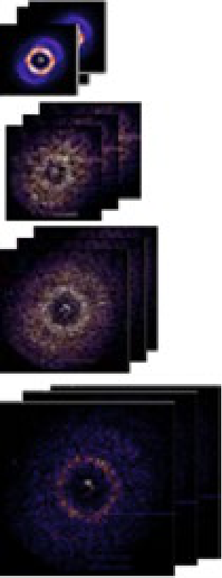
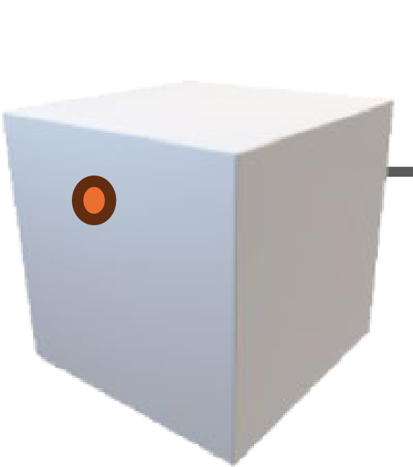
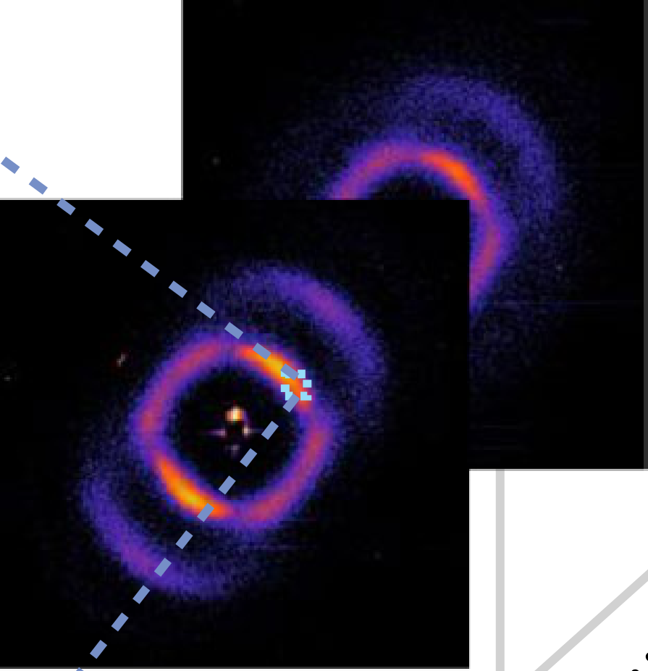
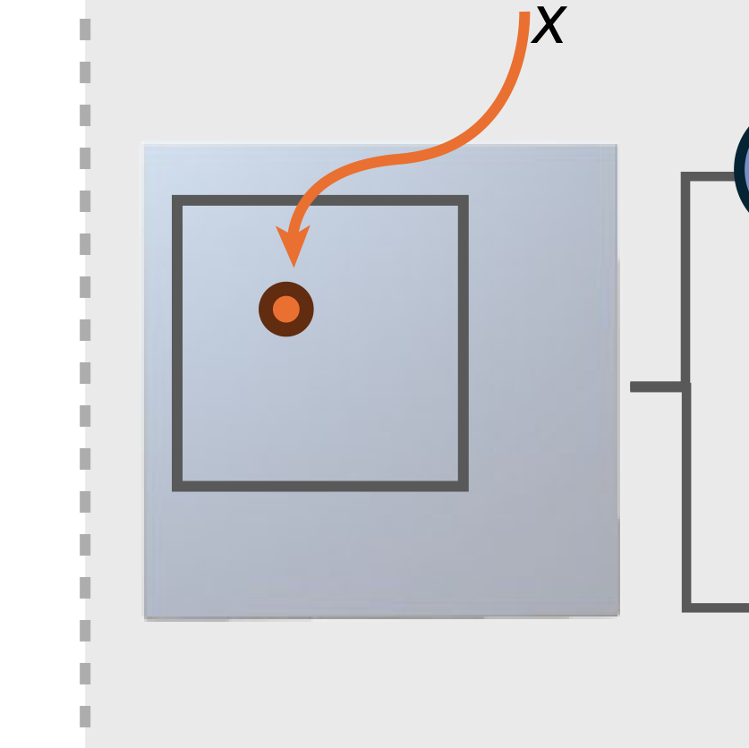
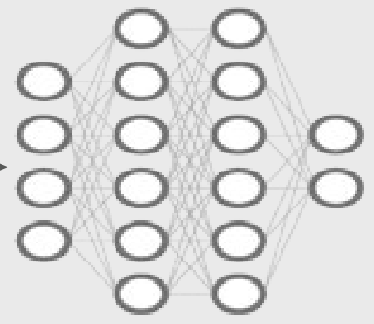
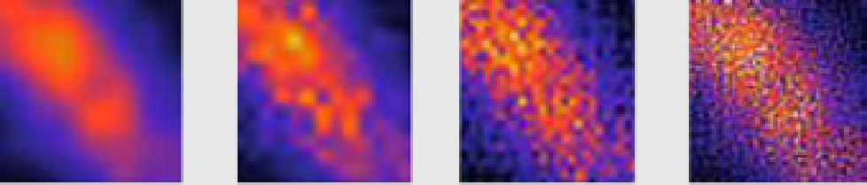

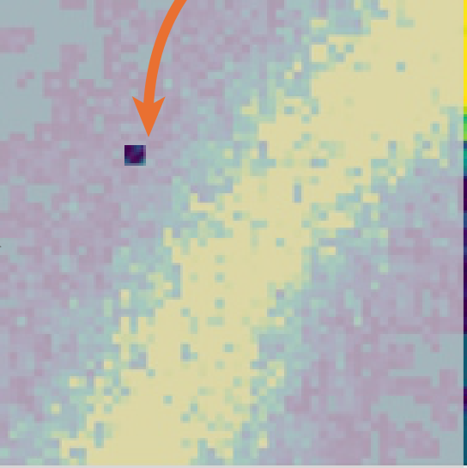
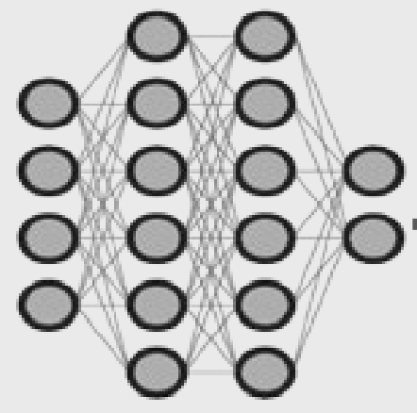
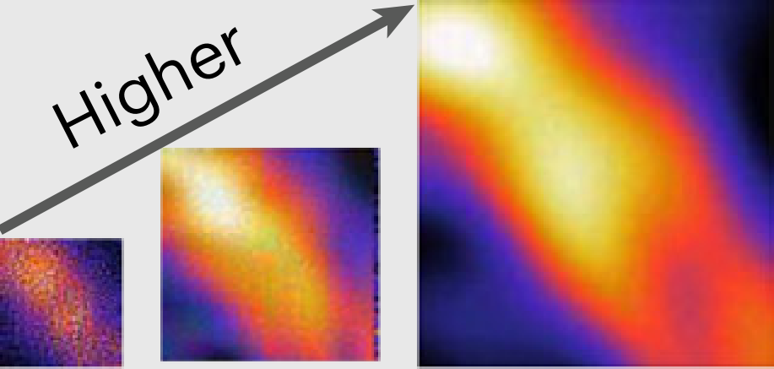
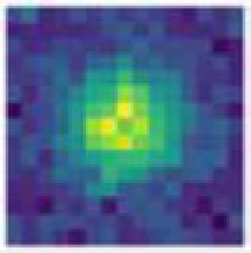
ab
c
/
MLP
/
MLP
Trainednetworks
/
MLP
/
MLP
Coarser to fine networks
Decode
Signal fittingInput coordinate
i
×
ROI
i
× … ×
0
1
i
p
x
I
x
x
Coarse
Fine Arbitrary resolutionDiﬀerent scales
**
Higher
I
N
I
Intensities
0
(1) Look-up(2) Neural networks(3)Dot product
Coordinate subsampleImage upsample
Dot product
/
x

