Slide 1
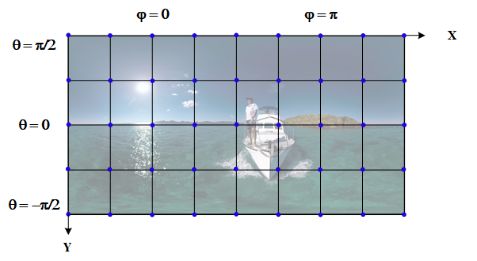
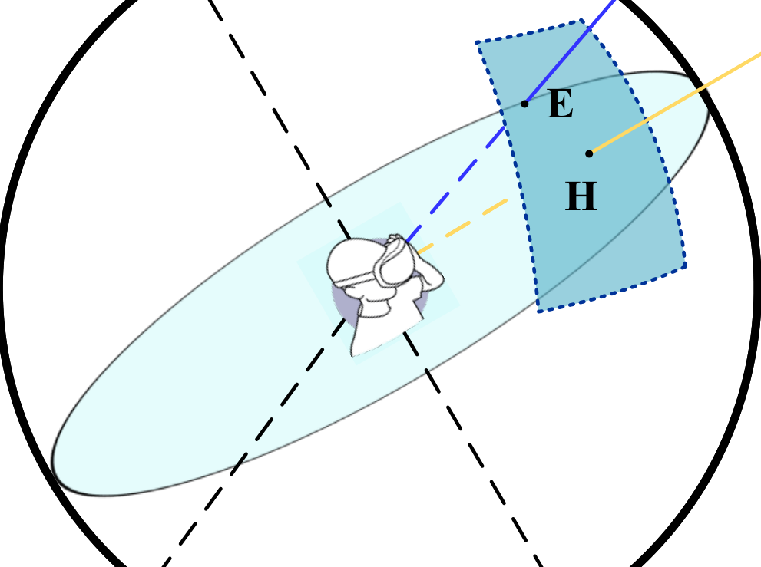
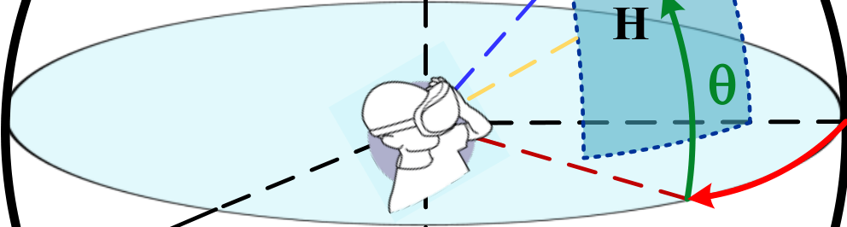


Table1:ComparisonofDifferentDataset
Dataset
Details
Sal
Head
Gaze
Content
Num.UsersNum.ContentsLength/sFreq/Hz
Wang
etal.
[10]
202273-133530
-
✓
✓
Videos
Jin
etal.
[11]
1002760100
-
✓
✓
Videos
Wu
etal.
[7]
4818164-655100
-
✓
-
Videos
Corbillon
etal.
[12]
5977030
✓
✓
-
Videos
Xu
etal.
[8]
2520820-7030
✓
✓
✓
Videos
Rai
etal.
[6]
40602560
-
✓
✓
Images
Nguyen
etal.
[9]
1572460-65530-100
✓
✓
-
Videos
Ourdataset
5015140-352120
✓
✓
✓
Videos
Y
aw
Y
Y
′
Z
′
(H)
G
E
H
q
H
Z
j
Roll
X
Pitch
X
′
(a)
(b)

