Slide 1
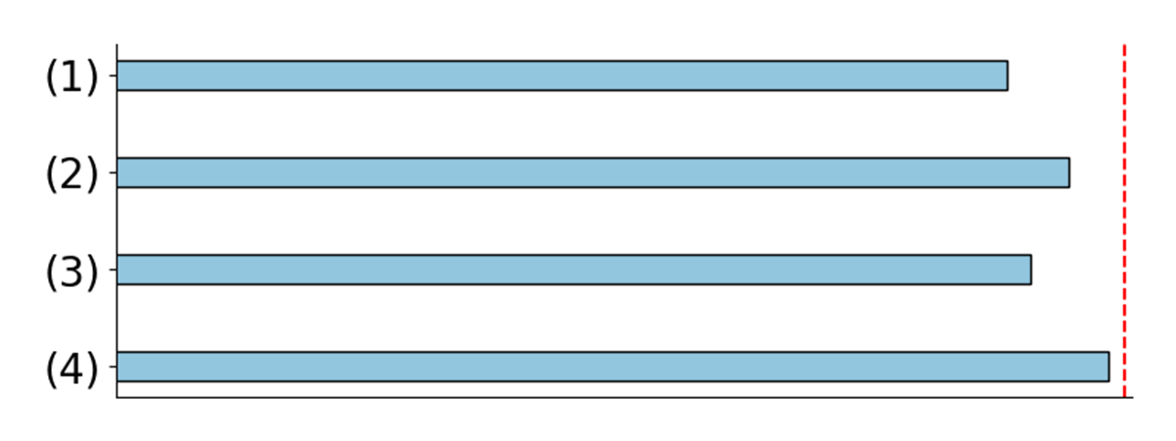
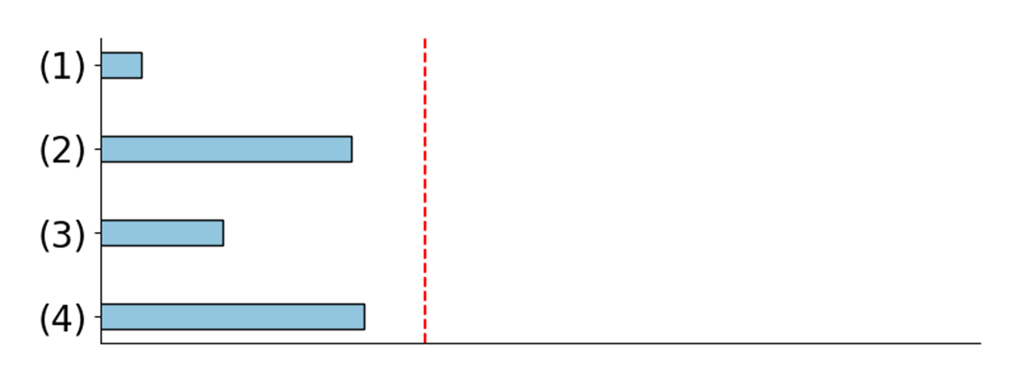
(1). All
Quantiz
ed
(2).
Quantiz
e
FC
query
key
value
(3).
Quantiz
e
A
ttention
(4).
Quantiz
e
C
onv
0.25
(0.09,3,67)
0.25
(0.22,4.60)
0.25
(0.11,3.68)
78.4
0.20
0.20
0.20
ANN
79.2
0.15
0.15
0.15
0.10
0.10
0.10
78.7
0.05
0.05
0.05
79.7
0.00
0.00
0.00
-5.0
-2.5
0.0
2.5
5.0
-5.0
-2.5
0.0
2.5
5.0
-5.0
-2.5
0.0
2.5
5.0
79.9
query
key
value
1.00
(0.31,0.22)
1.00
(0.30,0.21)
1.00
(0.23,0.18)
67.6
0.75
0.75
0.75
SNN
70.7
0.50
0.50
0.50
68.8
0.25
0.25
0.25
70.9
0.00
0.00
0.00
71.8
0.0
0.5
1.0
0.0
0.5
1.0
0.0
0.5
1.0
(a)
(b)

