Slide 1
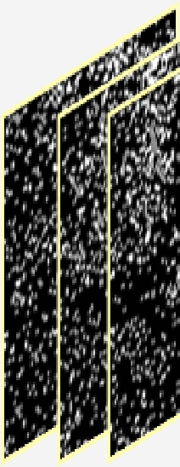
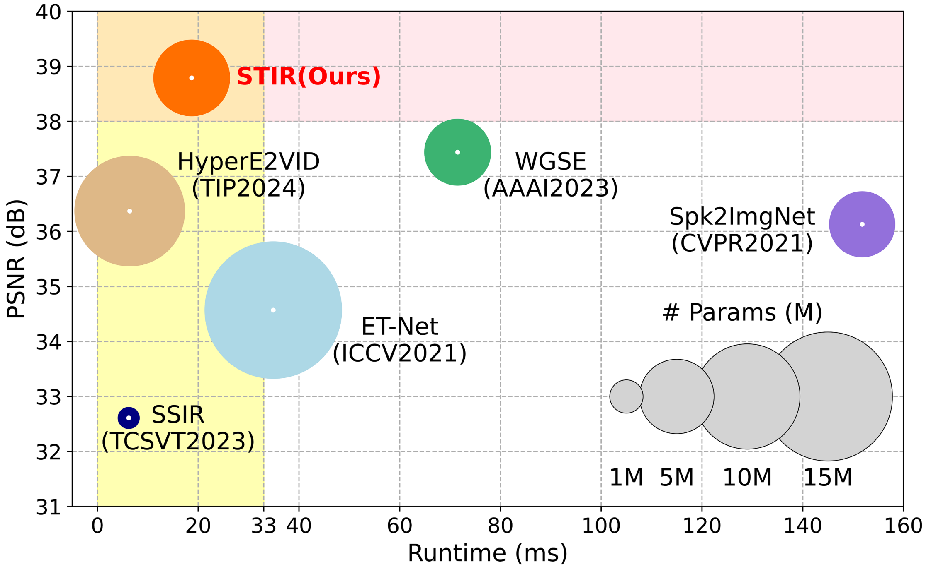
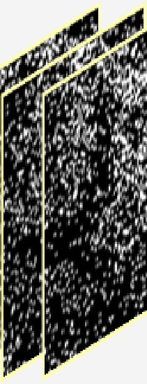
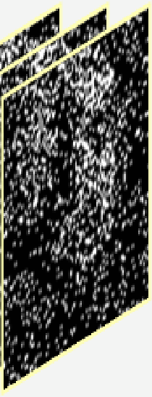

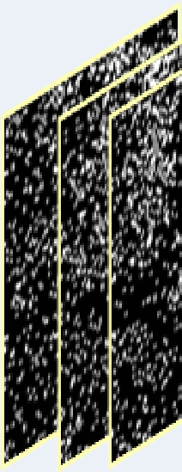
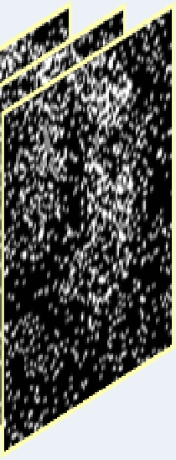
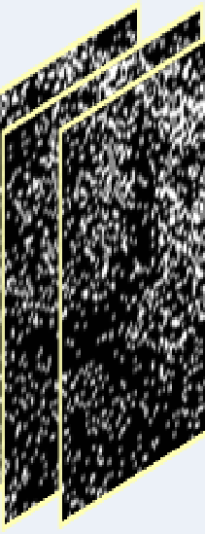

(a) Step
-
by
-
step network architecture
SER
Temporal Motion
Spatial Intensity
Spk2ImgNet
Spike Streams
Estimation
Reconstruction
(b) Joint motion
-
intensity learning
HSER
Spatio
-
Temporal
Ours
Spike Streams
Interactive Refinement

